Slide 1
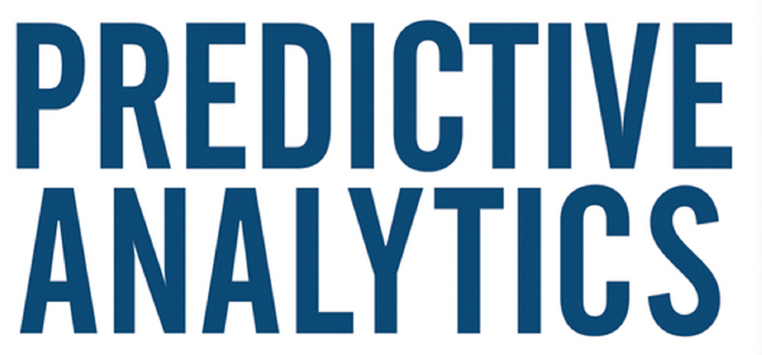


Slide 2
Data Science
Machine Learning/Deep Learning
Data Mining.
Data Analytics.
Predictive Modelling/Analytics.
Business Analytics
Artificial Intelligence
Futurology

Slide 3
Analytics
Sports Analytics
People Analytics
Banking Analytics.
Crime Analytics
Operations Analytics
Web Analytics
Text Analytics

Slide 4
About the Course
Interested in increasing your knowledge of the Big Data landscape?
This course is for those new to data science and interested in understanding why the Big Data Era has come to be.
It is for those who want to become conversant with the terminology and the core concepts behind big data problems, applications, and systems.
It is for those who want to start thinking about how Big Data might be useful in their business or career.

Slide 5
About the Course
It provides an introduction to one of the most common frameworks, Hadoop, that has made big data analysis easier and more accessible -- increasing the potential for data to transform our world!
At the end of this course, you will be able to:
Describe the Big Data landscape including examples of real world big data problems including the three key sources of Big Data: people, organizations, and sensors.
Explain the V’s of Big Data (volume, velocity, variety, veracity, valence, and value) and why each impacts data collection, monitoring, storage, analysis and reporting.

Slide 6
About the Course
Get value out of Big Data by using a 5-step process to structure your analysis.
Identify what are and what are not big data problems and be able to recast big data problems as data science questions.
Provide an explanation of the architectural components and programming models used for scalable big data analysis.
Summarize the features and value of core Hadoop stack components including the YARN resource and job management system, the HDFS file system and the MapReduce programming model.
Install and run a program using Hadoop! This course is for those new to data science.

Slide 7
About the Course
No prior programming experience is needed, although the ability to install applications and utilize a virtual machine is necessary to complete the hands-on assignments.
Hardware Requirements: (A) Quad Core Processor (VT-x or AMD-V support recommended), 64-bit; (B) 8 GB RAM; (C) 20 GB disk free.
How to find your hardware information: (Windows): Open System by clicking the Start button, right-clicking Computer, and then clicking Properties; Most computers with 8 GB RAM purchased in the last 3 years will meet the minimum requirements.

Slide 8
About the Course
You will need a high speed internet connection because you will be downloading files up to 4 Gb in size. Software Requirements: This course relies on several open-source software tools, including Apache Hadoop. All required software can be downloaded and installed free of charge. Software requirements include: Windows 7+, Mac OS X 10.10+, Ubuntu 14.04+ or CentOS 6+ VirtualBox 5+.

Slide 9
Data Scientist At Party….
I’m a business consultant in technology.
I make computers predict what people will do.
I make computers learn from data to predict individual human behaviour.
I analyze data to find patterns.
I help marketers target which customers will buy or cancel.
I predict customer behavior, like when Target famously predicted whether you are pregnant.

Slide 10
Data Science-Big Data
“Data science is like porn—you know it when you see it.”
“Big data is like teenage sex; everyone talks about it, nobody really knows how to do it, everyone thinks everyone else is doing it, so everyone claims they are doing it”.
Dan Ariely, Duke University

Slide 11
Data Science
Predictions are better than guessing.
I have good news: a little prediction goes a long way. The Prediction Effect.
Predictive technology is commonplace and affects everyone, every day.
It impacts your experiences in undetectable ways as you drive, shop, study, vote, see the doctor, communicate, watchTV, earn, borrow, or even steal.

Slide 12
The Field of Dreams
People . . . operate with beliefs and biases. To the extent you can eliminate both and replace them with data, you gain a clear advantage.
Predictive analytics (PA)—Technology that learns from experience (data) to predict the future behaviour of individuals in order to drive better decisions.

Slide 13
Predictions
Will the patient’s outcome from surgery be positive?
Will the credit applicant turn out to be a fraudster?
Will the homeowner face a bad mortgage?
Will the customer respond if mailed a brochure?
By predicting these things, it is possible to fortify
healthcare, decrease risk, conquer spam, toughen crime fighting, and cut costs.

Slide 14
Predictions…
Making such predictions poses a tough challenge.
Each prediction depends on multiple factors:
The various characteristics known about each patient.
each homeowner,
and each e-mail that may be spam.
How shall we attack the intricate problem
of putting all these pieces together for each prediction?

Slide 15
Solution…
The solution is machine learning—computers automatically developing new knowledge and capabilities by furiously feeding on modern society’s greatest and most potent unnatural resource: data.

Slide 16
“Feed Me!”—Food for Thought for the Machine
Data is the new oil.
The only source of knowledge is experience.
In God we trust. All others must bring data.

Slide 17
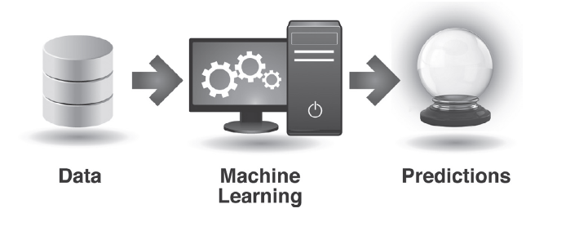
Learning From Data

Slide 18
Learning Process
Discovers insightful gems such as:
Early retirement decreases your life expectancy.
Online daters more consistently rated as attractive receive less interest.
Rihanna fans are mostly political Democrats.
Vegetarians miss fewer flights.
Local crime increases after public sporting events.

Slide 19
Machine Learning
Machine learning builds upon insights such as these in order to develop predictive capabilities, following a number-crunching, trial-and-error process that has its roots in statistics and computer science

Slide 20
I Knew You Were Going to Do That
With this power at hand, what do we want to predict?
Every important thing a person does is valuable to predict, namely:
consume, think, work, quit, vote, love, procreate, divorce, mess up, lie, cheat, steal, kill, and die.

Slide 21
Predictions in detail
Hollywood studios predict the success of a screenplay if produced.
Netflix awarded $1 million to a team of scientists who best improved their recommendation system’s ability to predict which movies you will like.
Australian energy company Energex predicts electricity demand in order to decide where to build out its power grid, and Con Edison predicts system failure in the face of high levels of consumption.

Slide 22
Examples
Wall Street predicts stock prices by observing how demand drives them up and down. The firms AlphaGenius and Derwent Capital drive hedge fund trading by following trends across the general public’s activities on Twitter.
Predicting mouse clicks pays off massively. Since websites are often paid per click for the advertisements they display, they predict which ad you’re mostly likely to click in order to instantly choose which one to show you. This, inffect, selects more relevant ads and drives millions in newly found revenue.

Slide 23
PEOPLE LOVE, WORK, PROCREATE, AND DIVORCE
The leading career-focused social network, LinkedIn, predicts your job skills.
Online dating leaders Match.com, OkCupid, and eHarmony predict which hottie on your screen would be the best bet at your side.
Target predicts customer pregnancy in order to market relevant products accordingly. Nothing foretells consumer need like predicting the birth of a new consumer.

Slide 24
Predictions…
Clinical researchers predict infidelity and divorce. There’s even a self-help website
tool to put odds on your marriage’s long-term success (www.divorce360.com), and public rumors have suggested credit card companies do the same.

Slide 25
Predictions…
There’s a machine that can participate in the same capacity as humans in the United States’ most popular broadcast celebration of human knowledge and cultural literacy. On the TV quiz show Jeopardy!, IBM’s Watson computer
triumphed.
This machine learned to work proficiently enough with English to predict the answer to free-form inquiries across an open range of topics
and defeat the two all-time human champs.

Slide 26
Predictions…
Researchers at Harvard Medical School predict that if your friends stop smoking, you’re more likely to do so yourself as well. Quitting Smoking is contagious.
Ford is learning from data so its cars can detect when the driver is not alert due to distraction, fatigue, or intoxication and take action such as sounding an alarm.

Slide 27
Predictions…
At Stanford University, a machine learned to diagnose breast cancer better than human doctors by discovering an innovative method that considers a greater number of factors in a tissue sample.
Researchers at Brigham Young University and the University of Utah correctly predict about 80 percent of premature births (and about 80 percent of full-term births), based on peptide biomarkers, as found in a blood exam as
early as week 24 of pregnancy.
University researchers derived a method to detect patient schizophrenia from transcripts of their spoken words alone.

Slide 28
The Limits and Potential of Prediction
An Data scientist is an expert who will know tomorrow why the things he predicted yesterday didn’t happen.
Good news! Predictions need not be accurate to score big value.
For instance, one of the most straightforward commercial applications of predictive technology is deciding whom to target when a company sends direct mail.

Slide 29
Learning…
If the learning process identifies a carefully defined group of customers who are predicted to be, say, three times more likely than average to respond positively to the mail, the company profits big time by preemptively removing likely non responders from the mailing list. And those non responders in turn benefit, contending with less junk mail.

Slide 30
Going Live
Learning from data is virtually universally useful. Master it and you’ll be welcomed nearly everywhere.
The first step toward predicting the future is admitting you can’t.
The “prediction paradox”: The more humility we have about our ability to make predictions, the more successful we can be in planning for the future. —Nate Silver, The Signal and the Noise: Why So Many Predictions Fail—but Some Don’t

Slide 31
EACH APPLICATION OF PA IS DEFINED BY:
1. What’s predicted: The kind of behavior (i.e., action, event, or happening) to predict for each individual, stock, or other kind of element.
2. What’s done about it: The decisions driven by prediction; the action taken by the organization in response to or informed by each prediction

Slide 32
List goes on….
stock prices, risk, delinquencies, accidents, sales, donations, clicks, cancellations, health problems, hospital admissions, fraud, tax evasion, crime, malfunctions, oil flow, electricity outages, approvals for government benefits, thoughts, intention, answers, opinions, lies, grades, dropouts, friendship, romance, pregnancy, divorce, jobs, quitting, wins, votes, and more….

Slide 33
PA APPLICATION: TARGETING DIRECT MARKETING
1. What’s predicted: Which customers will respond to marketing contact.
2. What’s done about it: Contact customers more likely to respond.

Slide 34
PA APPLICATION: PREDICTIVE ADVERTISEMENT TARGETING
1. What’s predicted: Which ad each customer is most likely to click.
2. What’s done about it: Display the best ad (based on the likelihood of a click as well as the bounty paid by its sponsor).

Slide 35
Predictive model
A mechanism that predicts a behaviour of an individual, such as click, buy, lie, or die. It takes characteristics of the individual as input, and provides a predictive score as output.
The higher the score, the more likely it is that the individual will exhibit the predicted behaviour.

Slide 36
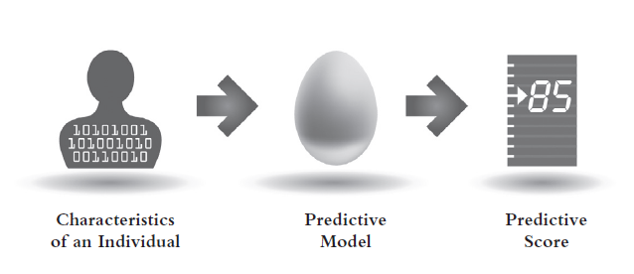
Predictive Model

