Slide 1
EEG Data Analysis
Ozioma Okonicha

Slide 2
Problem Statement: Analyzing attention levels during coding tasks.
Background: Using EEG signals to detect cognitive states.
Goal: Employ deep learning to extract features and patterns indicating attention levels.

Slide 3
Data & Preprocessing

Slide 4
Data & Preprocessing
Modeling & Analysis
Band Filtering: Extracted specific frequency bands (e.g., Alpha, Beta) using bandpass filters.
Feature Engineering: Calculated ERD (Event-Related Desynchronization) and ABratio (Alpha/Beta ratio) as features.
Data Splitting: Divided the dataset into training, validation, and test sets for model evaluation.
Initial Approach: Started with manual analysis, identifying patterns and correlations then attempted SVM with constant y labels; limited success. Then used mean X values as y labels; faced challenges in interpretability.
Deep Learning with CNN:
Architecture: Designed a Convolutional Neural Network with Conv1D, MaxPooling, Flatten, and Dense layers.
Training: Trained the model with a batch size of 32 and 10 epochs.
Choice of CNN: CNNs are well-suited for pattern recognition in time-series data like EEG.

Slide 5
Results

Slide 6
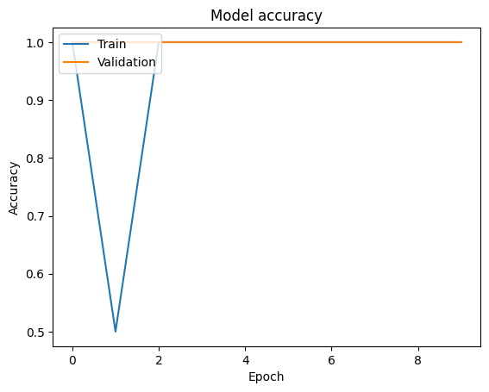
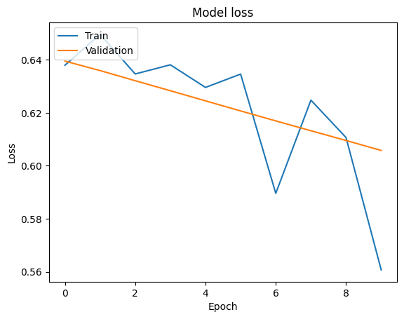
Plots

Slide 7
Future work
The model can be optimized better, for example
experiment with different deep learning architectures, such as LSTM or Transformer models.
fine-tune hyperparameters to improve model performance.

Slide 8
Contact
Email: o.okonicha@innopolis.university
GitHub repo: https://github.com/Ozziekins/EEG_Internship
Overleaf report: https://www.overleaf.com/project/64d64d8ed0480293d6df76aa

