Slide 1




NLP for GDPR Compliance Checking
Ozioma Okonicha

Slide 2
Table of contents
01
05
02
06
03
07
04
08
Introduction
Tasks for NLP in GDPR
Compliance and GDPR Audit
Key Insights
Relevance of GDPR
Trends and Patterns
Background
Lessons Learned

Slide 3
Table of contents
09
12
10
13
11
14
Feedback
Model Selection
Research Questions
Experiment Strategy
Proposed Method
Evaluation Questions

Slide 4
Introduction
Natural Language Processing (NLP)
is a field of artificial intelligence that focuses on the interaction between computers and humans using natural language.
General Data Protection Regulation (GDPR)
is a comprehensive data protection law in the European Union, governing the processing of personal data.

Slide 5
Introduction
33
20
Log
Read
From searching primary sources like Google scholar
out of the 33 papers added to the log

Slide 6
Compliance and GDPR Audit
Compliance
Compliance refers to the adherence of an organization's practices, policies, and processes to relevant laws and regulations.
GDPR Compliance Audit
A GDPR compliance audit involves assessing and verifying that an organization follows the principles and requirements outlined in the GDPR.

Slide 7


Relevance of GDPR
01
02
03
GDPR addresses issues like:
Data protection
Consent
User rights
requiring organizations to adopt transparent and lawful practices.

Slide 8
Background
01
Context
Importance of personal data and aligning processing agreements with GDPR regulations.
Complexity of GDPR requirements and the need for compliance audits.

Slide 9
Background
02
Problem
Resource-intensive manual auditing of Data Processing Agreements (DPAs) and Privacy Policy Statements.
Manual audits are resource-consuming and prone to errors.
Attempts to automate compliance checking face limitations in accuracy and coverage.

Slide 10
Background
03
Motivation
GDPR enforcement includes heavy fines for non-compliance.
Automated compliance checking with NLP can mitigate legal risks and fines.

Slide 11
Background
04
Challenges
Complexity of GDPR regulations, requiring in-depth understanding.
Ambiguity and verbosity in legal texts, often necessitating human expertise.
Papers in the literature focus on specific aspects of GDPR, not comprehensive audits.

Slide 12
Tasks for NLP in GDPR
01
02
03
Privacy Policy Analysis:
Understanding and simplifying privacy policies. [1, 11, 12]
Compliance Checking:
Verifying if policies align with GDPR regulations. [2, 4, 7, 11, 14, 16, 17]
Semantic Annotation
Enabling semantic search over legal texts. [6, 18]

Slide 13
Tasks for NLP in GDPR
01
Privacy Policy Analysis:
Recommend policies for specific issues based on past effectiveness and relevance.
Named Entity Recognition (NER): Utilizing NER to identify and classify GDPR-related entities in privacy policies,
Text Classification

Slide 14
Tasks for NLP in GDPR
02
Compliance Checking:
Automatically identify non-compliance in contracts and legal documents.
Semantic Similarity Analysis to understand the context and meaning of text segments related to GDPR compliance.
Developing an NLP model to compare organizational privacy policies against GDPR requirements, identifying gaps or areas of non-compliance.

Slide 15
Tasks for NLP in GDPR
03
Semantic Annotation
Legal Entity Recognition: Identify and classify legal entities in text documents.
Semantic Role Labeling in Policy Documents: Analyze the semantic roles within sentences to understand policy document structures.
Relation Extraction

Slide 16
Key Insights
02
04
03
01
Models
Metrics
Various models, including Logistic Regression, SVM, and BERT, are employed for compliance checking. [2, 4, 7, 8, 11, 16, 17]
Evaluation metrics include F1 scores, precision, and recall. [2, 4, 7, 11, 16, 17]
Limitations
Datasets
Limitations often include small datasets, reliance on expert knowledge, and challenges in generalizability. [2, 4, 7, 8, 11, 16, 17]
Datasets like OPP-115, PrivaSeer, and GDPR excerpts are used for evaluation. [1, 2, 4, 6, 7, 8, 10, 11, 12, 16, 17, 18]

Slide 17
Trends and Patterns
Use of NLP Techniques
Application of Machine Learning Models
[2, 4, 6, 8, 11, 15, 20]
[2, 6, 8, 11, 12, 15, 18, 19, 20]
Automated Compliance Checking
Focus on Specific Aspects of GDPR
[2, 6, 7, 11, 16, 17
[1, 4, 7, 10, 11, 13, 17]

Slide 18
Trends and Patterns
Dataset Creation
Interdisciplinary Approaches
Several papers contribute by creating datasets specific to privacy policies.
[1, 4, 7, 12, 15, 20]
Many papers combine legal expertise with NLP techniques
[1, 6, 13, 17, 18]

Slide 19

Lessons Learned
01
02
Role
Challenges
NLP plays a crucial role in automating GDPR compliance tasks.
Challenges remain, such as the need for larger and diverse datasets.

Slide 20
Research Questions
RQ1
How can NLP models contribute to automating the process of compliance checking with data protection laws, reducing manual efforts?
RQ2
How do NLP models adapt to changes in privacy policies, especially considering the dynamic nature of legal documents that may undergo updates or amendments?

Slide 21
Research Questions
RQ?
How resource-efficient are NLP-based compliance checking systems, particularly in terms of computational requirements and processing time?

Slide 22

Proposed Method
01
02
Explore pre-trained models
Perform fine-tuning
Check the recent pre-trained models, even beyond BERT. Maybe GPT-3 and T5, how can they be applied to GDPR compliance checking?
Develop a fine-tuning strategy that will specifically target GDPR nuances. Maybe transfer learning can be used to adapt existing models to the legal language used in privacy policies.

Slide 23
Model Selection
GPT-3
T5
Option 1
Option 2
How useful is GPT-3 in understanding and generating legal language?
Can it be useful or even efficient in potential for compliance checking tasks?
Can T5 be used as a text-to-text model for handling legal text?
Can it transform privacy policies into compliance related representations?

Slide 24
Experiment Strategy
01.
Pre-training and Fine-tuning
Model Selection: Explore pre-trained models like GPT-3 and T5 alongside BERT, evaluating their performance on GDPR-specific tasks (e.g., classification, information extraction).
Dataset Preparation: Create a comprehensive dataset of privacy policies annotated with GDPR provisions and compliance flags.
Fine-tuning: Adapt chosen models to the legal domain by fine-tuning on the GDPR dataset, focusing on accuracy and interpretability.

Slide 25
Experiment Strategy
02.
Evaluation and Refinement
Metrics: Use several metrics like precision, recall, F1-score, positives/negatives to understand the numerical performance of the model.
Human evaluation: Conduct human evaluations of model outputs for accuracy and interpretability, refining the model based on feedback.
Model comparison: Compare the performance of different models, evaluate them and identify the optimal choice that answers the research questions.

Slide 26
Experiment Strategy
03.
Adaptation and Monitoring
Continuous learning: Implement periodic retraining on updated privacy policies and legal rulings to maintain model accuracy and adaptability.
Active learning: Integrate mechanisms for querying human experts on ambiguous cases or emerging legal interpretations.
Performance monitoring: Track the model's performance in real-world settings and adjust the training data or fine-tuning approach as needed.

Slide 27
Evaluation Questions
Compliance elements
Sensitivity
How accurately does the NLP model identify and extract key compliance elements from privacy policies?
How sensitive is the NLP model to updates or amendments in privacy policies, and how quickly does it adapt to these changes?
Legal details
Fine-tuning
How does the selected model handle legal language intricacies present in GDPR and other data protection laws?
What impact does fine-tuning have on model performance, and how well does it adapt to changes in privacy policies?

Slide 28
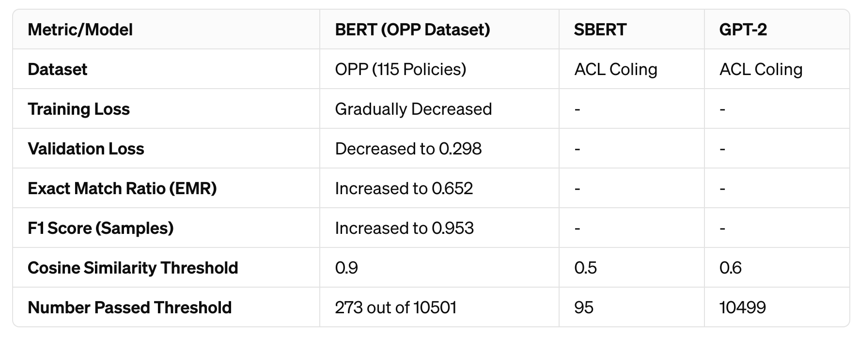
Results

Slide 29
Thanks!

