Slide 1
To Do List Application by Özkan Bulut
USED TECHNOLOGIES USED LIBRARIES
- Java Core - Lombok
- Spring Boot - Validation
- React JS - Model Mapper
- PostgreSql - Spring Data JPA
- Spring Web

Slide 2
Main purpose of this application is to create a to do list that can perform Crud(Create,Read,Update,Delete) operations on daily tasks. To-Do elements have values of: - ID - Name - Description - Created Date - Importance - Status

Slide 3
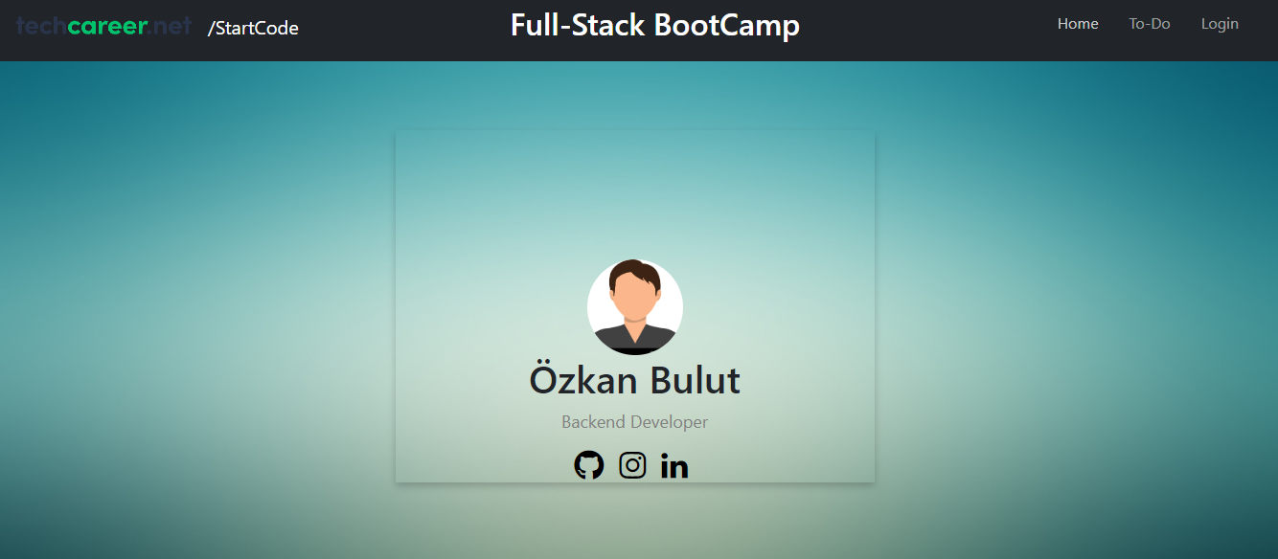
Main Page

Slide 4
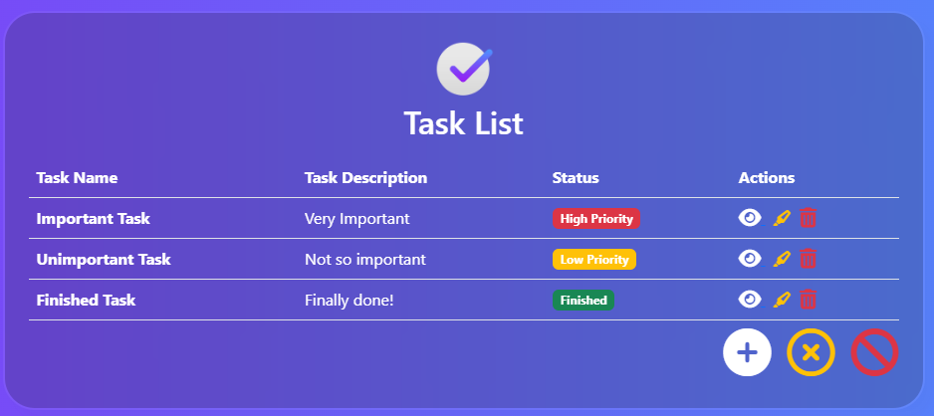
To Do List

Slide 5
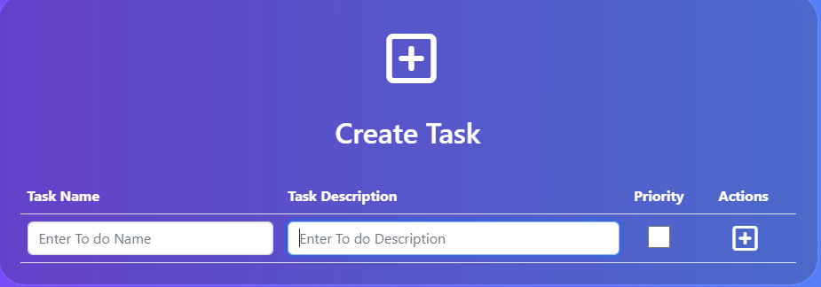
Adding a Task
When creating a task, user must provide task name and task description.
If priority is checked, it means task is high priority. If not, the task is low priority.
Task name must be unique, between 1-20 characters.
Task description does not have to be unique, but it must be between 1-60 characters.

Slide 6
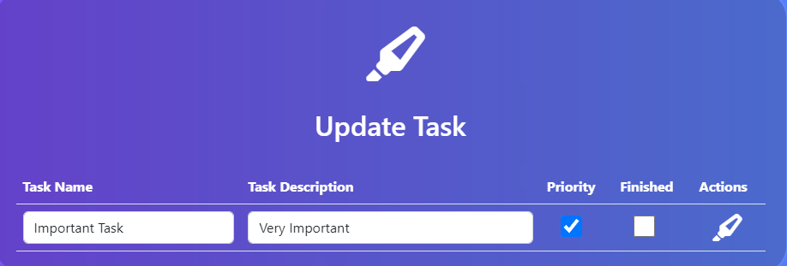
Updating a Task
When updating a task; name, description, priority and finished values are automatically rendered.
User can change any value, but task name and description can not be empty.
If finished is checked, meaning this task is finished.And it will be rendered at the bottom of the table.

Slide 7
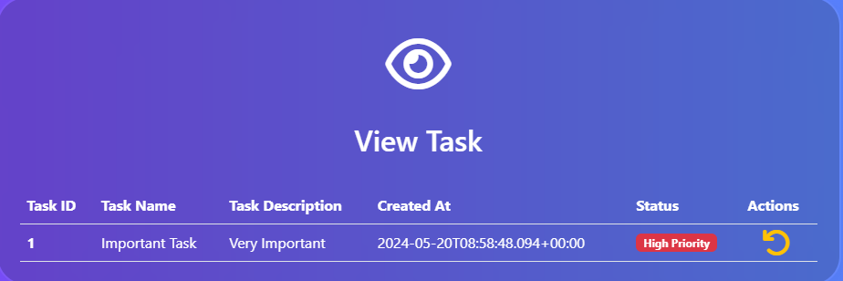
Viewing a Task
When user clicks the view button on the list, the relevant task are pulled from the backend and shown here.
To make a difference from the list, I pulled task id and created at values to show here.
If user clicks the reverse button under the actions column, he/she will redirected to the list

Slide 8
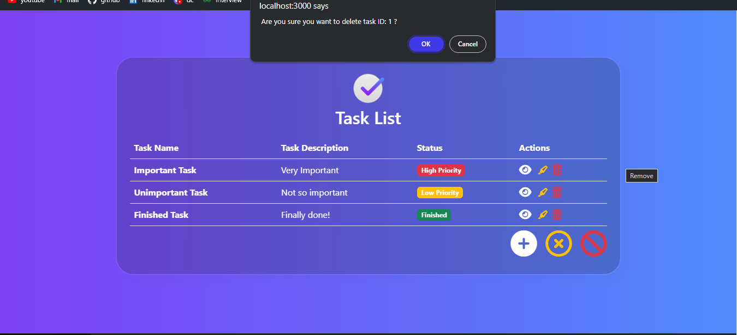
Deleting a Task
When user clicks the delete button on the list, the relevant task are deleted from the list and the database.
Before deleting, system asks user via alert system to make sure if the user is certain about deleting the task.
If user clicks OK, the task is deleted and list is refreshed

Slide 9
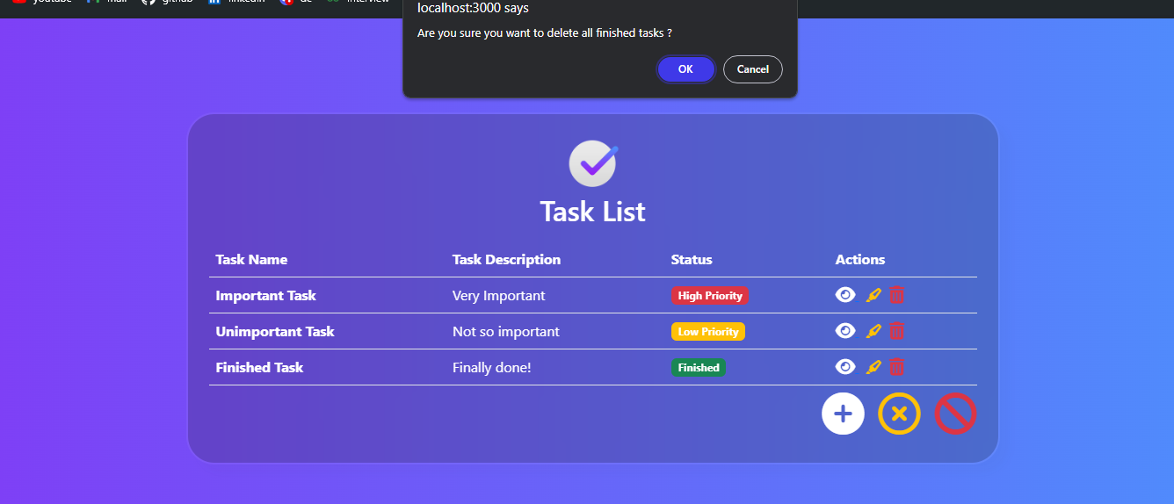
Deleting all Finished Tasks
When user clicks the yellow button under the list, all finished tasks are deleted both from the database and the list.
Before deleting, system asks user via alert system to make sure if the user is certain about deleting all finished tasks
If user clicks OK, finished tasks are deleted and list is refreshed

Slide 10
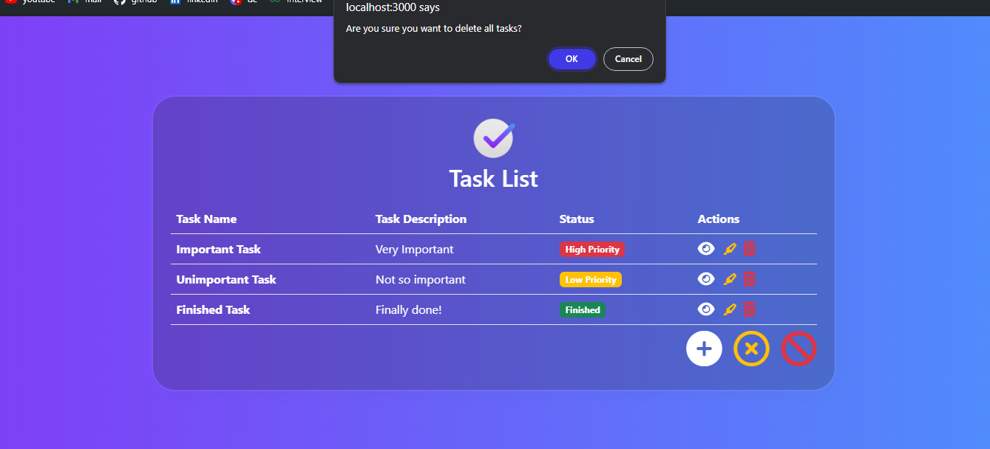
Deleting all Tasks
When user clicks the red button under the list, all tasks are deleted both from the database and the list.
Before deleting, system asks user via alert system to make sure if the user is certain about deleting all tasks
If user clicks OK, tasks are deleted and list is refreshed to empty

Slide 11
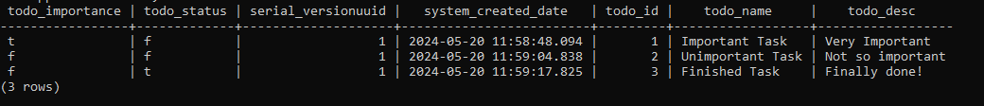
Database
Any change user makes on the front end is directly updated on the database.
For testing, I used H2Db. And for production, PostgreSql is used.

Slide 12
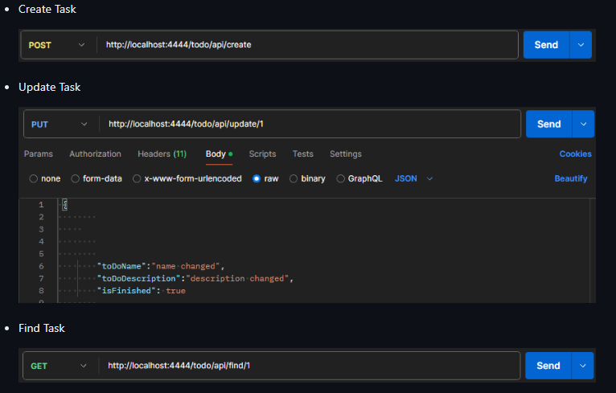
API ENDPOINTS

Slide 13
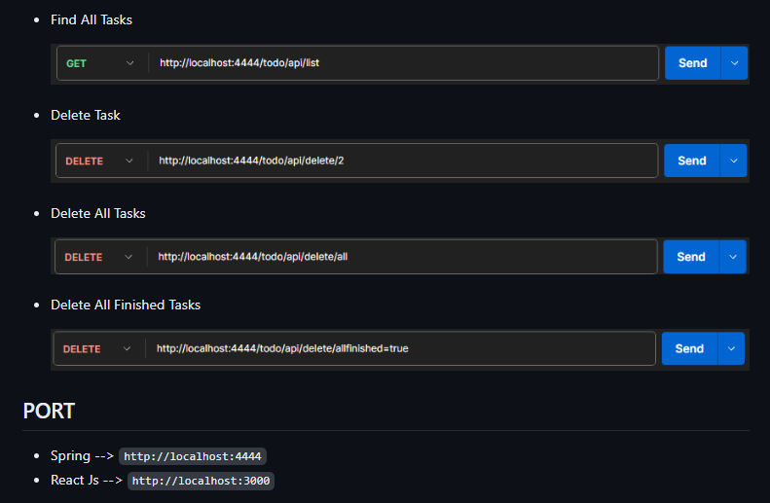
API ENDPOINTS & PORT

Slide 14
THE END
Thanks to Hamit Mızrak for all the knowledge he shared with us.
Thanks to techcareer.net for this bootcamp opportunity.
See you!

