Slide 1
DevBlog

Slide 2
Sprint 1
First thing I did was to create the script for loading of GLB objects and LUA files
I currently uses stub lua scripts that don’t have any code in
I am using test objects that were produced part of client work for mindFeast in the year 2023-2024
I might start using object that are provided with mindfeast base game
camera movement script has also been created
Middle mouse click allows for panning
Mouse wheel scrolling allows for zooming in and out
Object manipulation has also been started
Objects can be placed on the scene
Objects (currently just cubes) with hit boxes can be picked up and placed back down

Slide 3
Sprint 2
Objects
Objects can now get reloaded with button click
Objects selection display now shows what the object looks like while selecting
Instead of drop down it is a scroll
Objects now have hitboxes/hitmeshs to facilitate mouse controls on objects
Objects can be clicked and held to be move
When hovering a shader is used to show which object is being
When being held and moved, the shader turns green
More object have been added from the comp 2003 project and permission has been given

Slide 4
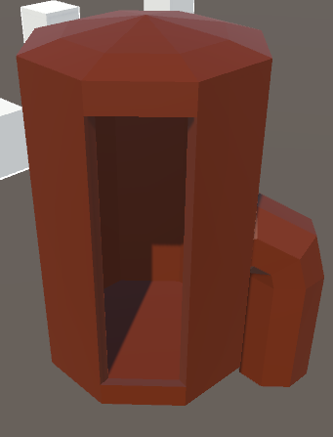
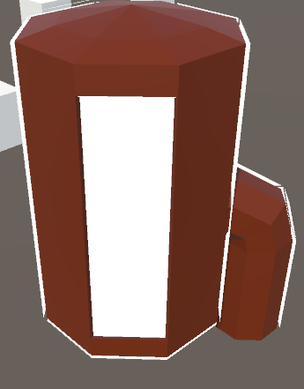
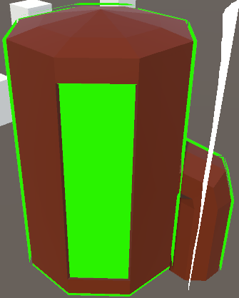

Slide 5
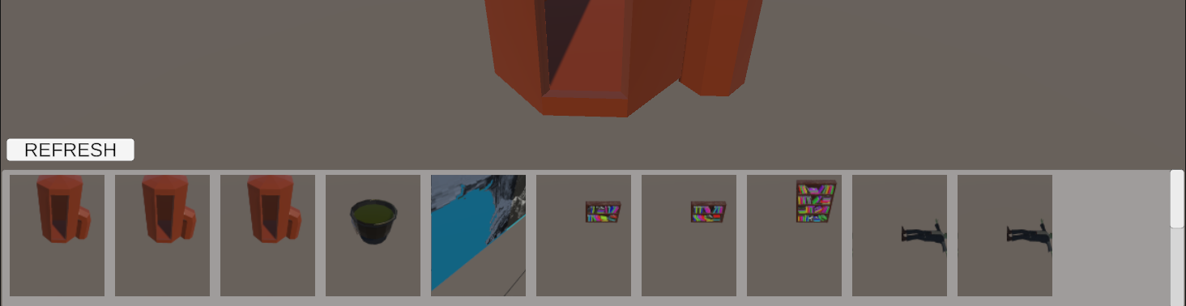
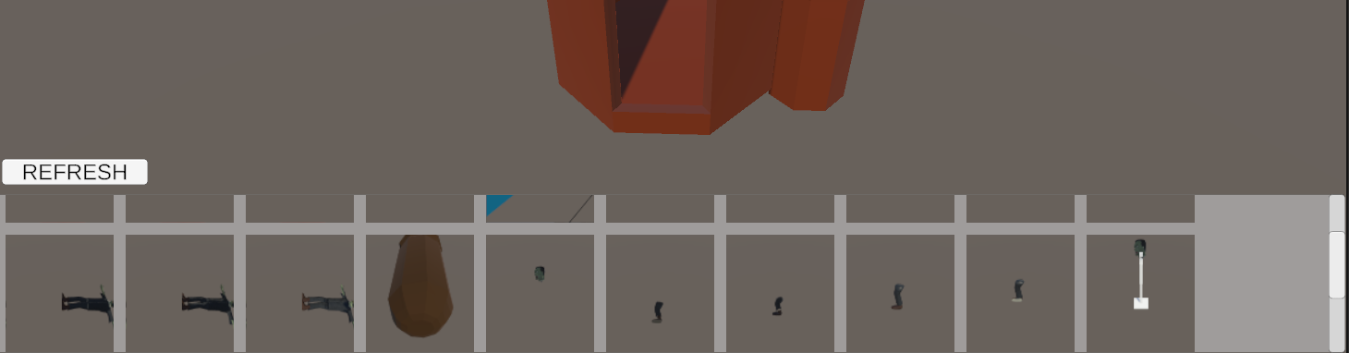

Slide 6
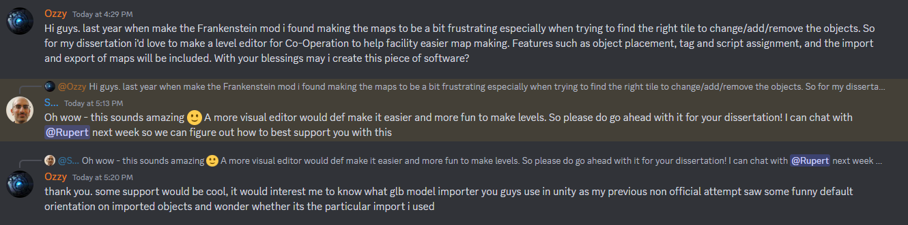
Approval form shav to allow me to make a modding tool for Co-Operation

Slide 7
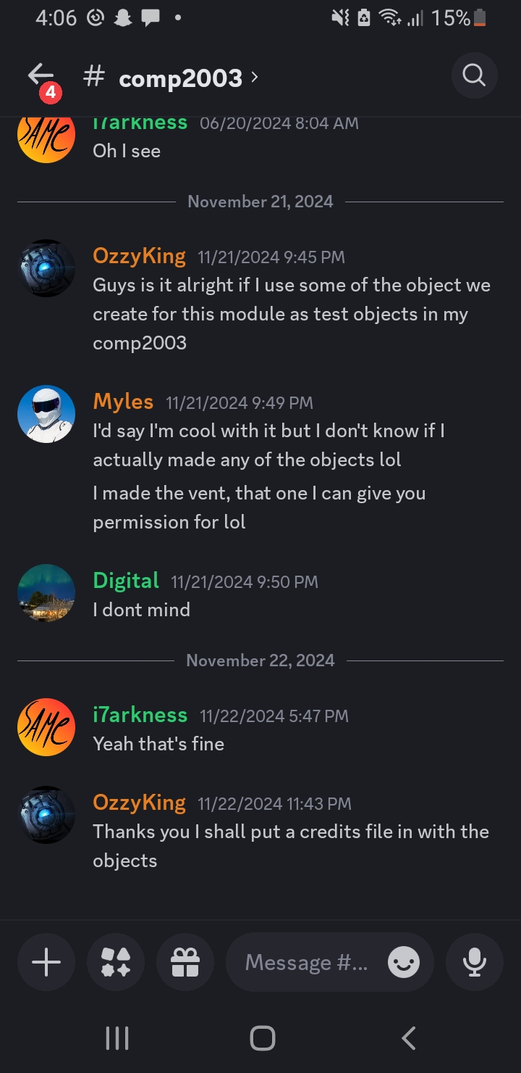
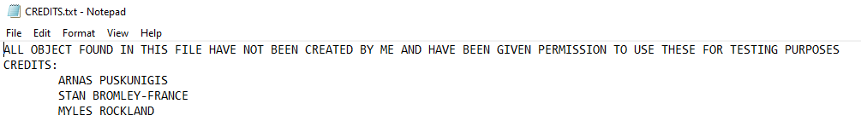
Approval of team members allowing me to use the models I’ve created

Slide 8
Look at warcraft editor
Obj and lua reloading button
Ui
Hit boxzes
Check conditions for start and end

