Slide 1
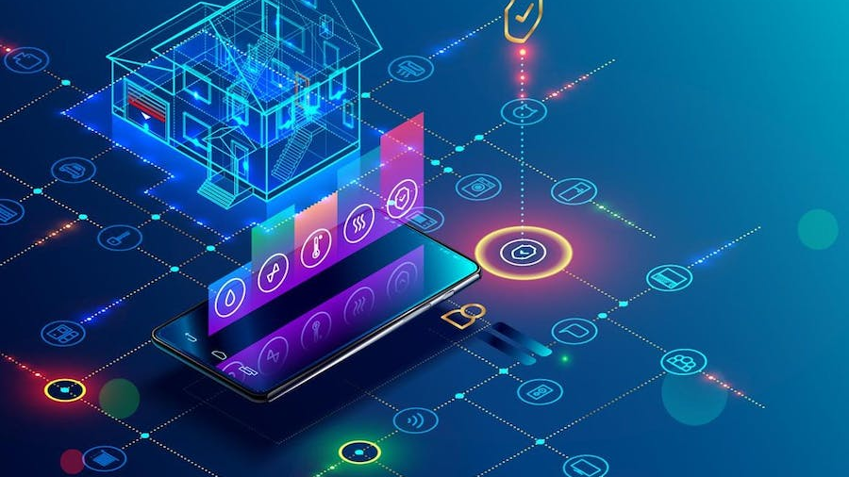
IoT Based Smart Home Automation -USING CISCO PACKET TRACER

Slide 2
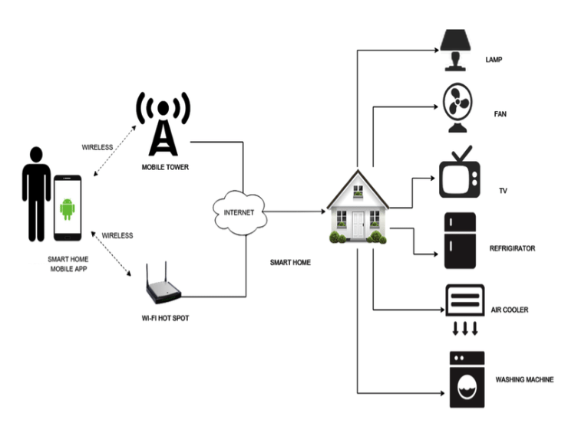
SUBMITTED BY:
Annadanam Padmasini
Enaganti Karun Kumar
Gummanur Abhishek
Kumoulica Allu
SUBMITTED TO:
Dr. B INDIRA
DEPARTMENT OF CYBER SECURITY

Slide 3

ACKNOELEDGEMENT
We would like to extend our sincere gratitude to our teacher Dr. B Indira for giving us an opportunity to present an extremely interesting and informative topic. We will also thank each other for constant support and motivation during the making of this project. We also thank all our peers for helping us whenever asked for.

Slide 4
GLOSSARY
INTRODUCTION
METHODOLOGY
DEVICES USED
IMPLEMENTATION AND OUTPUT
ADVANTAGES AND DISADVANTAGES
CONCLUSION

Slide 5

INTRODUCTION:
Smart homes may be used to automate household tasks without the need for people to constantly check the home environment using various sensors (temperature, humidity, smoke, wind, and sound).
. A smart house may be implemented using the most recent version of the simulation tool for Cisco packet tracer modelling and setup of IOE systems with traditional networking system.

Slide 6
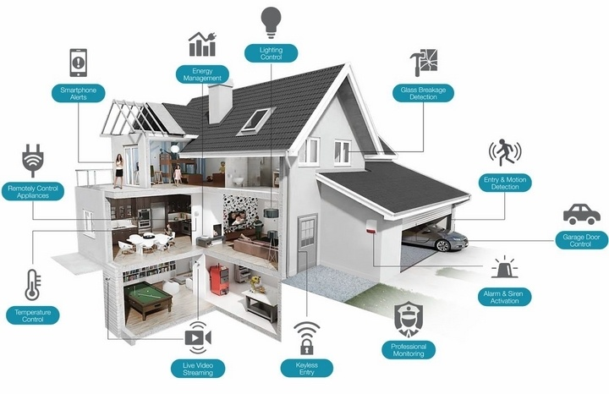
METHODOLOGY

Slide 7
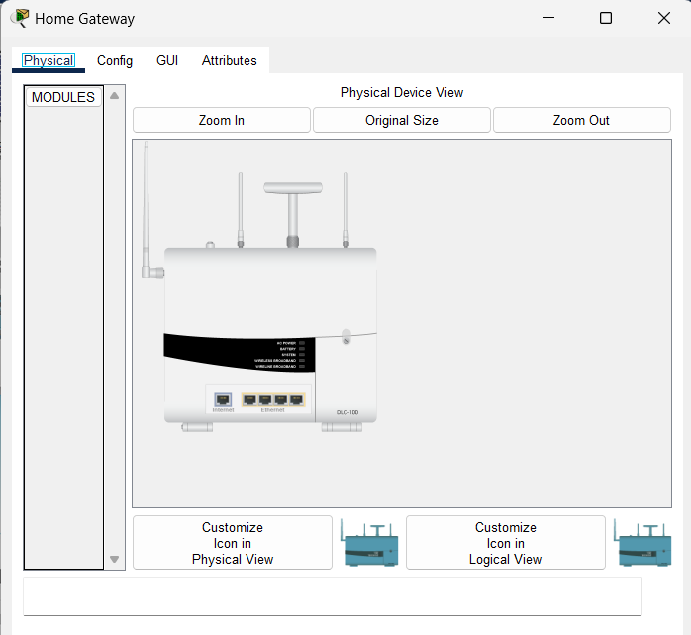
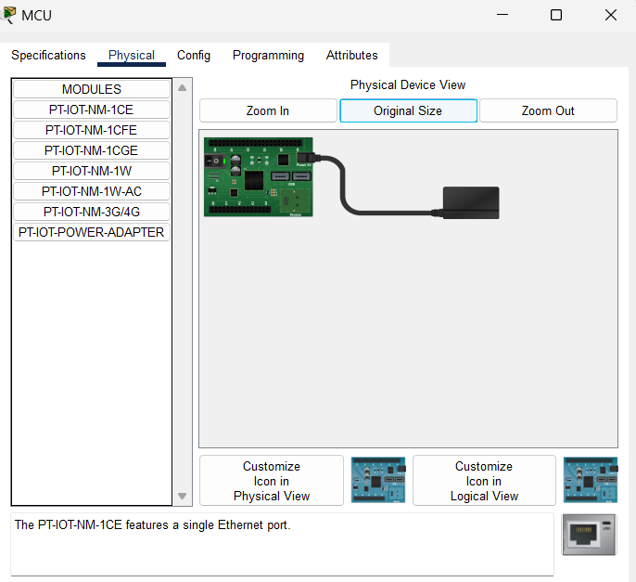
Home Gateway
Micro Controller Board

Slide 8
DEVICES USED
S. NO | DEVICES | FUNCTIONS
1 | Home Gateway | Used to assign IP addresses to smart objects and register smart things
2 | MCU | Used to connect different intelligent things
3 | Cable Modem | Use to connect to the internet at home
4 | Tablet | Used to control the home from outside
5 | Fan | Used for ventilating the home environment on the basis of certain circumstances
6 | Light | Provide light
7 | Motion Detector | Link to your home getaway and detect motion
8 | Smart Door | Link to your home getaway and provide an event based on functions
9 | Lawn Sprinkler | Used as a sprinkler based on environmental water level
10 | Smoke Sensor | Used to sense the smoke level
11 | Temperature Sensor | Used to sense the temperature of the home
12 | Older Car | Used to model various home development scenarios as it affects the amount of oil, co2 and smoke. At a level of 1 percent an hour, this absorbs carbon monoxide. At a level of 2 percent an hour, this absorbs carbon dioxide. Affects Smoke at an hourly rate of 3%.
13 | Smart light | Used to give light for home
14 | Coffee Maker | Used to make a filter coffee
15 | Solar Smart Panel | Used to generate power using solar energy
16 | Battery | Saves energy or power for usage

Slide 9
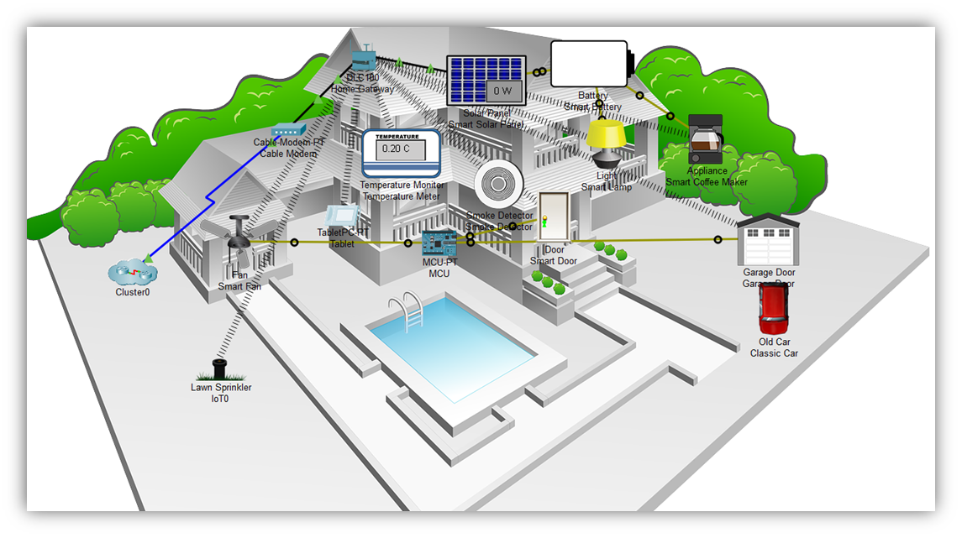
IMPLEMENTATION

Slide 10
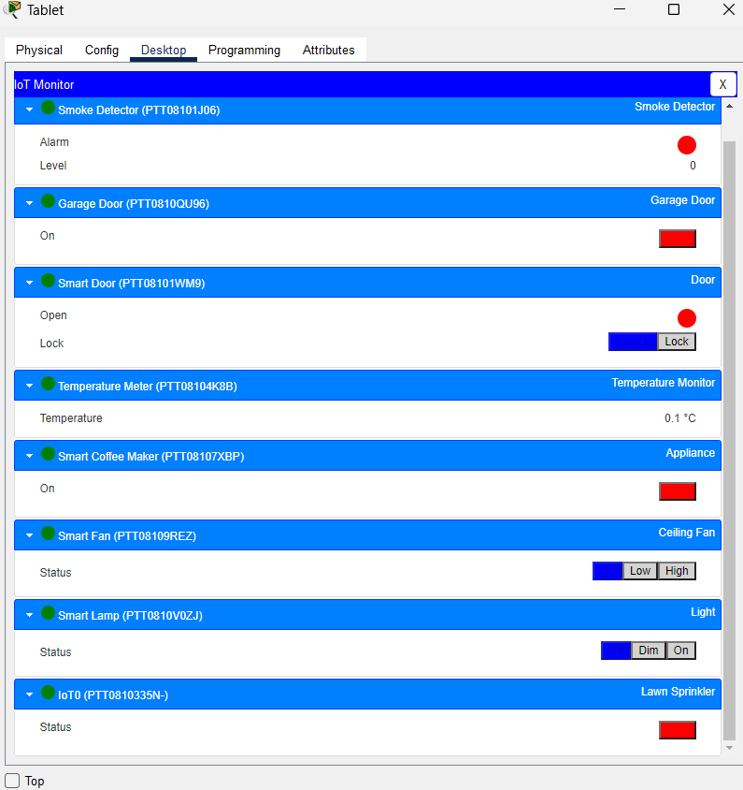
The figure depicts eight IOE devices that have been registered to a home gateway and are all legitimately operated through the internet.

Slide 11
ADVANTAGES
Controlling all of your home technology from a single location
Increasing comfort at home
Improved appliance functionality

Slide 12
DISADVANTAGES
Do not combine your smart home devices
Your smart home system is triggered by The Wrong Moments
Your smart home system's battery discharges so fast

Slide 13

CONCLUSION
We chose the recently released Cisco kit to present smart homes in this article because it included a lot of IOE devices for home automation. We utilized a home gateway to register smart devices and a microcontroller (MCU) to link various sensors and IOE devices to monitor them.

Slide 14


