Slide 1
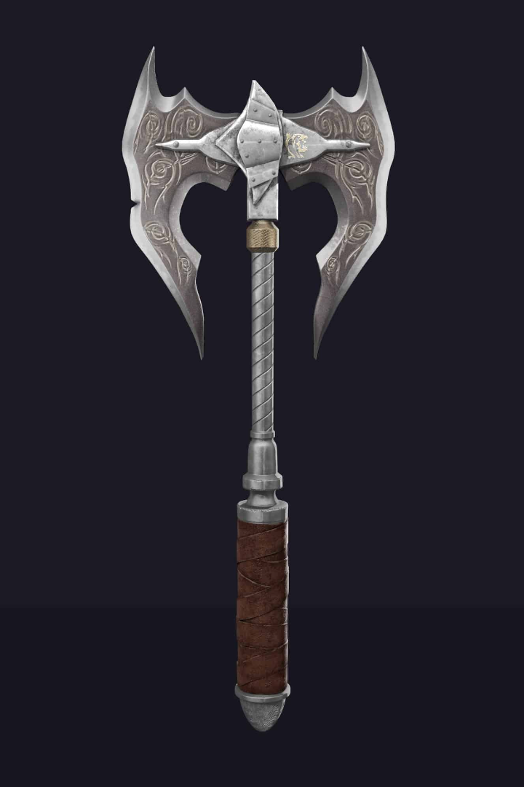
Tokenized Gaming Assets: Unlocking the Power of Blockchain
Discover the revolutionary concept of tokenized gaming assets and how blockchain technology is changing the game.
Pratyush Ranjan

Slide 2

What are Gaming Assets?
1
Digital Ownership 🎮
2
In-Game Value 💰
3
Limited Availability ⌛️
These assets can hold significant value within the gaming community, both in terms of gameplay and real-world monetary transactions.
Gaming assets are virtual items, such as skins, weapons, or characters, that players can acquire and use in video games.
Some gaming assets are rare or exclusive, making them highly sought after by collectors and enthusiasts.

Slide 3

What is Blockchain Technology?
1
Decentralized Ledger 🔗
2
Immutable Smart Contracts 📜
Blockchain technology enables the creation of a transparent and tamper-proof ledger that records transactions and asset ownership.
Smart contracts on the blockchain ensure secure and automated execution of agreements, eliminating the need for intermediaries.
3
Enhanced Security 🔒
The decentralized nature of blockchain makes it highly secure, protecting digital assets from hacking and fraud.

Slide 4
Tokenization of Gaming Assets: "Sneaker Tokens"
1
Unique Digital Representation 🔄
2
Creation and Distribution 🛠️
3
Marketplace and Value 💎
"Sneaker Tokens" are digital tokens that represent ownership of limited-edition sneakers, allowing for verifiable scarcity in the digital world.
These tokens are generated through blockchain technology, ensuring authenticity and enabling seamless trading and transfer of ownership.
By tokenizing gaming assets like limited sneakers, a digital marketplace is created, fostering a new economy based on scarcity and demand.

Slide 5

Player Assets on the Blockchain
1
Digital Ownership Rights ✅
2
Portable and Interoperable 🔄
3
Monetization Opportunities 💰
Player assets, such as achievements, character progress, and in-game currency, can be securely recorded and attributed to individual players on the blockchain.
The blockchain allows players to carry their assets across different games and platforms, enhancing portability and enabling cross-platform interactions.
With blockchain-based player assets, players have more control over buying, selling, and trading their digital possessions, opening up new possibilities for monetization.

Slide 6
Benefits of Tokenizing Gaming Assets
Liquid Market 📈
Ownership Transparency 🏢
Global Accessibility 🌍
Tokenization enables a fluid and active marketplace for gaming assets, facilitating ease of buying, selling, and trading.
The blockchain provides a transparent record of ownership, ensuring trust and preventing fraud or counterfeiting.
Tokenized gaming assets can be accessed and traded by individuals from around the world, eliminating geographic restrictions.

Slide 7
Conclusion and Future Prospects
1
Revolutionizing the Gaming Industry 🌟
2
Emerging Trends and Innovations 🚀
Tokenized gaming assets and player assets on the blockchain have the potential to transform the gaming industry, empowering players and creating new economic opportunities.
As the technology continues to evolve, we can expect to see increased adoption of blockchain-based solutions and further exploration of tokenized assets.
3
Unleashing the Full Potential 🎯
With the combination of gaming assets and blockchain technology, we are just scratching the surface of the possibilities that lie ahead.

