Slide 1
Capstone Presentation Life Insurance Sales
-by APOORVA P

Slide 2


Business Problem Understanding
The primary business problem is predicting customer churn in the life insurance sales industry.
Constraints are Data Quality, Time Constraints, Resource Limitations.
Scope is to generate insights to help the business understand key factors driving customer churn and develop retention strategies.
Objectives are to develop and evaluate different predictive models to get the best performance and provide business insights.
This Photo by Unknown Author is licensed under CC BY

Slide 3
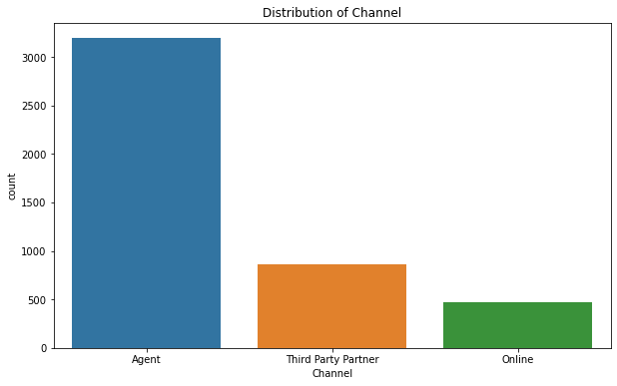
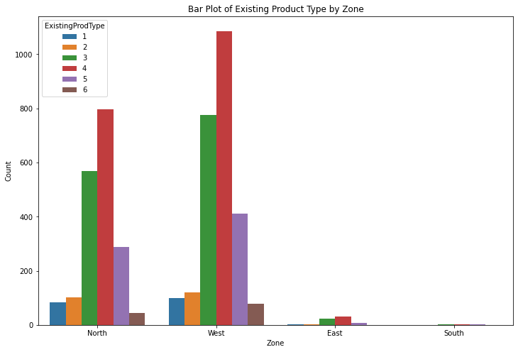
Business Problem Understanding
The data shows maximum distributers are the agents.
Majority customers are male.
Highest distribution zone is west and The existing product type is 4

Slide 4
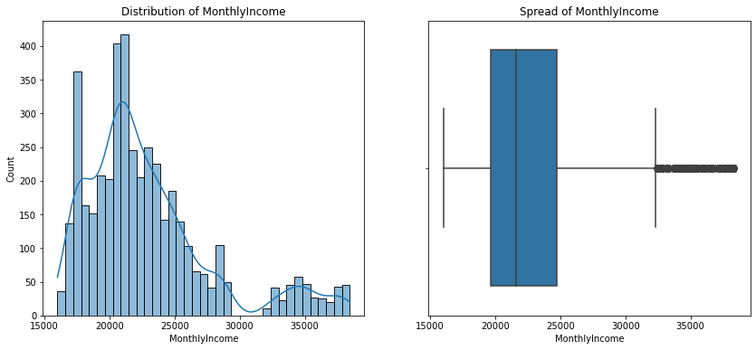
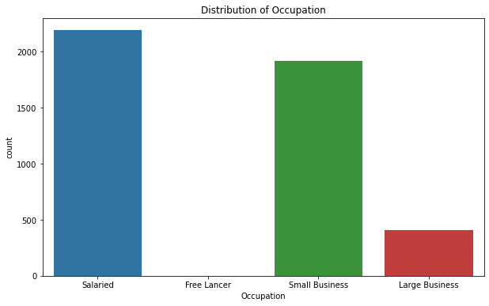
Business Problem Understanding
most of the customers salaried professionals
Segment customers based on their income levels to understand their purchasing power and preferences. The majority fall under the segment of 15000 to 25000

Slide 5
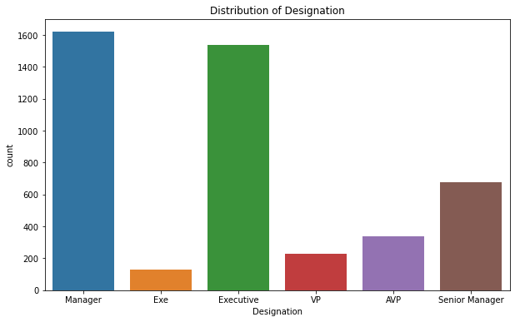
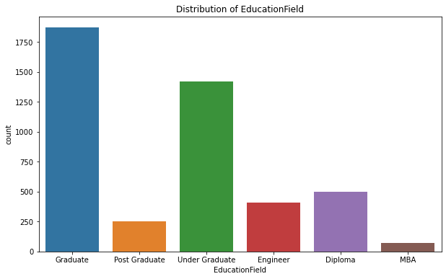
Business Problem Understanding
The most seen designation is manager.
And the maximum customers are graduates or higher

Slide 6
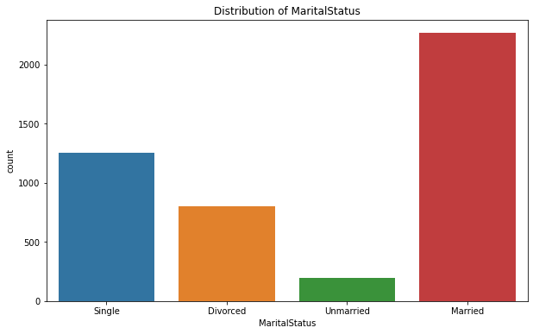
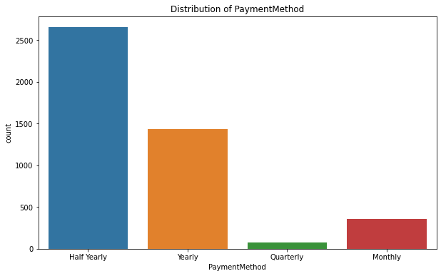
Business Problem Understanding
The most used method of payment is half yearly.
The majority customers are married

Slide 7
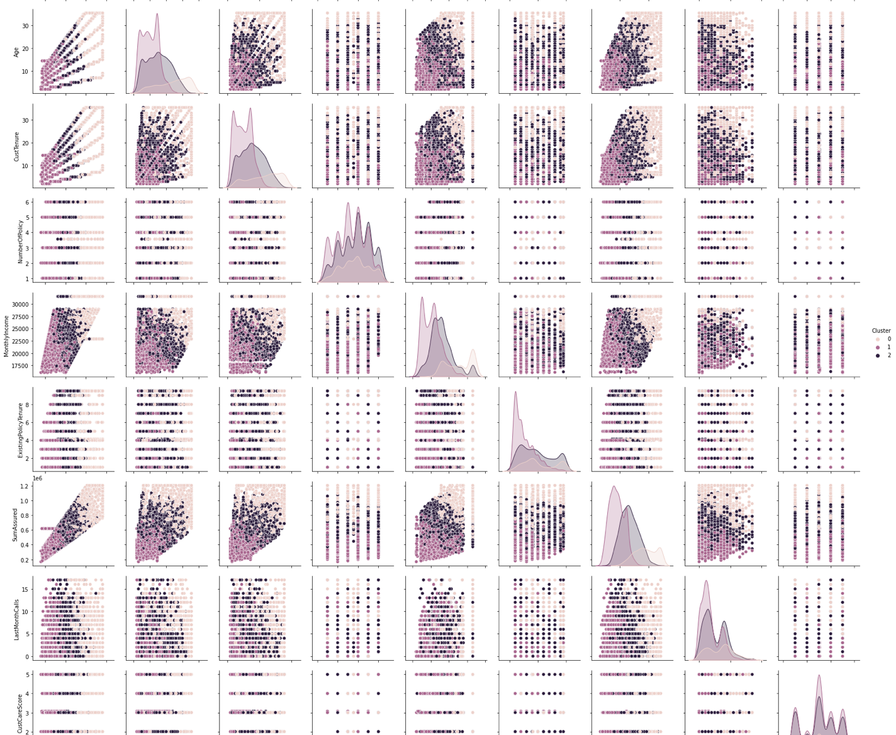
Modelling Approach Used & Why
Creating a new variable ‘Churn’ based on complaints and customer care score.
Descriptive modelling:
USING k-means clustering with 3 clusters.

Slide 8
Modelling Approach Used & Why
Model | Accuracy | Precision | Recall | F1 Score | ROC AUC
Logistic Regression | 0.841593 | 0.884754 | 0.898780 | 0.891712 | 0.922632
Decision Tree | 0.866372 | 0.903498 | 0.913415 | 0.908429 | 0.827675
Random Forest | 0.894690 | 0.980796 | 0.871951 | 0.923176 | 0.959138
Gradient Boosting | 0.879646 | 0.981690 | 0.850000 | 0.911111 | 0.942124
SVM | 0.854867 | 0.929319 | 0.865854 | 0.896465 | 0.923116
k-NN | 0.817699 | 0.859485 | 0.895122 | 0.876941 | 0.868755
Neural Network | 0.887611 | 0.931507 | 0.912195 | 0.921750 | 0.956861
Naive Bayes | 0.579646 | 0.988669 | 0.425610 | 0.595055 | 0.900555
Predictive Modelling:

Slide 9
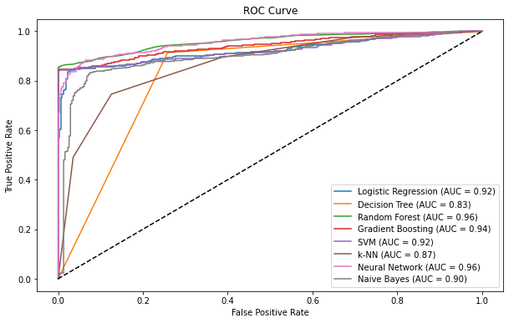
Modelling Approach Used & Why
the Random Forest and Neural Network models have the highest predictive accuracy with an AUC of 0.96, followed by Gradient Boosting with an AUC of 0.94. The Decision Tree model has the lowest performance among the models compared, with an AUC of 0.83.

Slide 10
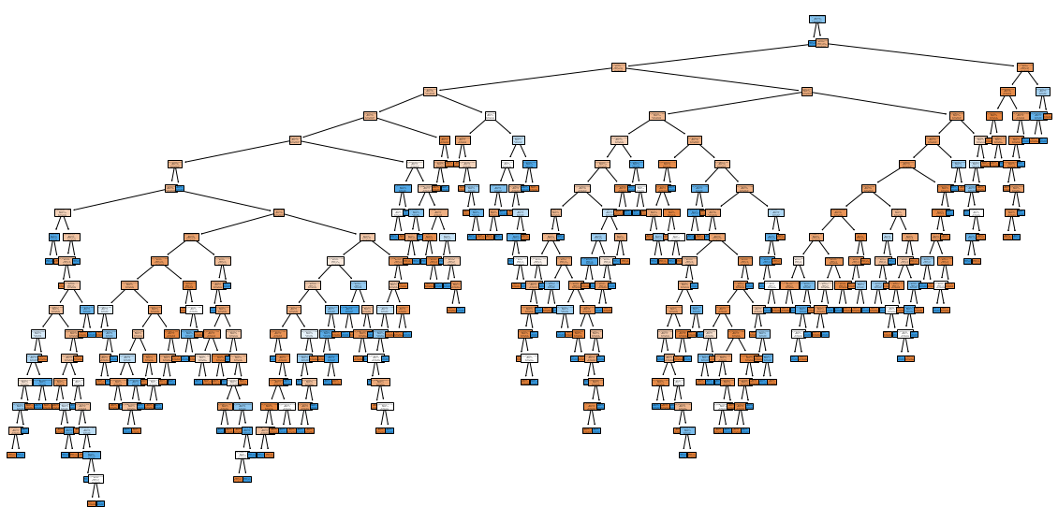
Modelling Approach Used & Why
Decision Tree

Slide 11
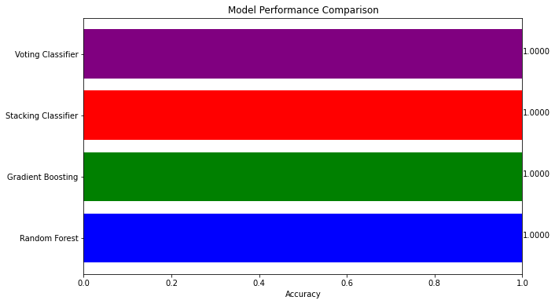
Modelling Approach Used & Why
Ensemble modelling
Hyperparameter Tuning
Feature Engineering
Regularization
Early Stopping

Slide 12

Insights from Analysis

Slide 13
Insights from Analysis
Channel Effectiveness
Occupation Preferences
Education Impact
Gender-Based Insights
Income Segmentation
Marital Status Influence
Zone-Based Strategies
Payment Method Preferences
Clustering
Predictive modelling
Ensemble modelling

Slide 14

Recommendations

Slide 15
Recommendations
Increase the customers based on the EDA
Model Validation
Explore More Data
Regularization
Model Deployment
Ensemble Methods
Feature Importance

