Slide 1
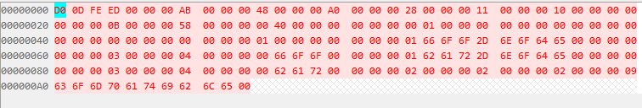
Header
Memory Reservation Block
Structure Block
Strings Block
struct fdt_header {
uint32_t magic;
uint32_t totalsize;
uint32_t off_dt_struct;
uint32_t off_dt_strings;
uint32_t off_mem_rsvmap;
uint32_t version;
uint32_t last_comp_version;
uint32_t boot_cpuid_phys;
uint32_t size_dt_strings;
uint32_t size_dt_struct;
};
struct fdt_reserve_entry {
uint64_t address;
uint64_t size;
};
FDT_BEGIN_NODE
00 00 00 01 00 00 00 00
FDT_BEGIN_NODE foo-node
00 00 00 01 66 6F 6F 2D 6E 6F 64 65 00 00 00 00
FDT_PROP compatible = "foo“
00 00 00 03 00 00 00 04 00 00 00 00 66 6F 6F 00
FDT_BEGIN_NODE bar-node
00 00 00 01 62 61 72 2D 6E 6F 64 65 00 00 00 00
FDT_PROP compatible = "bar“
00 00 00 03 00 00 00 04 00 00 00 00 62 61 72 00
FDT_END_NODE
00 00 00 02
FDT_END_NODE
00 00 00 02
FDT_END_NODE
00 00 00 02
FDT_END
00 00 00 09
字符串：
compatible
struct {
uint32_t len;
uint32_t nameoff;
}

