Slide 1
Final Project Part-I:
Optimization of Longest Overlap Substring and Distinct String operations
NCTU IEE 2019 Spring Computer Organization
TA: Aman Sinha
Email: amansinha.sw@gmail.com

Slide 2
In this project you will learning...
Basic Knowledge
C/C++ Programming
Basic Linux Usage
Algorithm Design and Code Optimization
Data Structures and Algorithm
Longest Overlap Substring

Slide 3
Schedule
05/07: Part-I announced
06/04: Part-I due day, Part-II announced
06/30: Part-II due day

Slide 4
Outline
Introduction to Longest Overlap Substring operation
Introduction to C/C++ Code optimization
Profiling using Valgrind
Base Program
Grading Policy
Useful Reference

Slide 5
What is Longest Overlap Substring?
Longest Common Substring (LCS) is a very common operation in various domains, particularly Computational Biology
Given a set of strings, for every string in the set, find all the other strings whose substrings matches with a substring of this string
Longest Overlap Substring is a particular case of LCS where the matching substrings should be at opposite ends of the corresponding strings. Default Time complexity is O(mn²)
Performing Longest Overlap Substring efficiently is critical to the applications that employee it, owing to very large size of data.

Slide 6
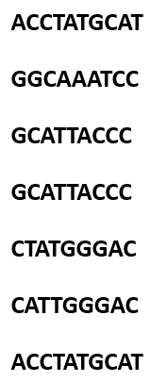
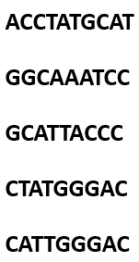
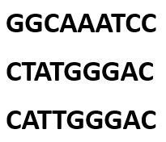
Distinct String Illustration
Remove elements that had duplicate

Slide 7
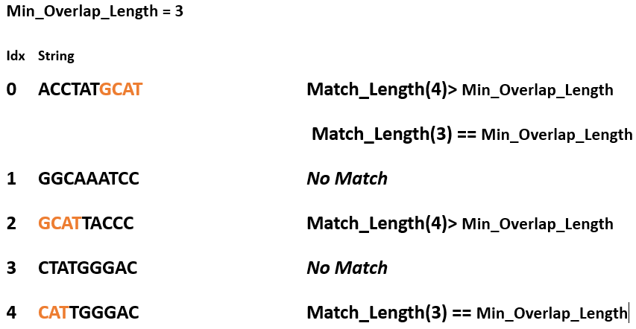
Longest Overlap Substring Illustration
outputA
2
-1
0
-1
0

Slide 8
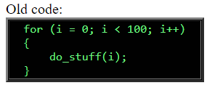
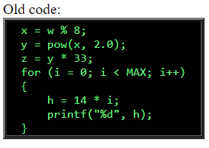
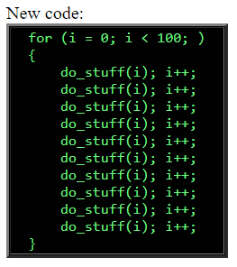
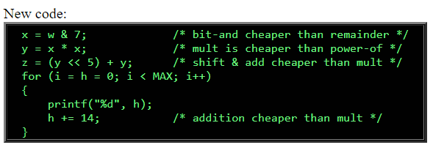
C/C++ Code optimization Techniques
Loop Unrolling
Strength Reduction

Slide 9
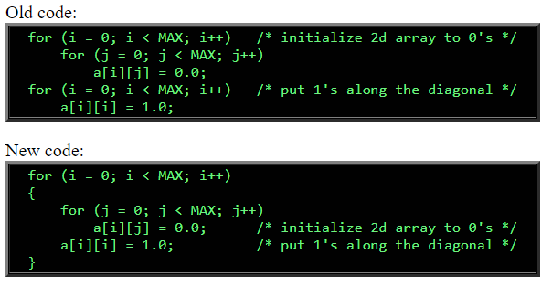
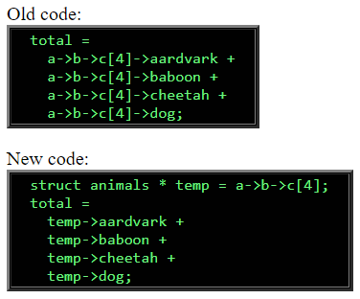
Contd.
Loop Jamming Loop Invariant Computation

Slide 10
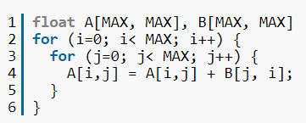
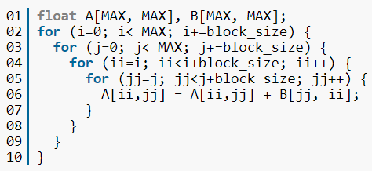
Contd.
Loop blocking
Use pointers, instead of copying large arrays
Minimize Code size
Avoid using standard libraries

Slide 11
Goal:
Optimize Longest Overlap Substring operation

Slide 12
Functions
init() - Initialize the data by reading from file
defaultCompute() – Baseline function to compute all the results
distinctStringSequential() – Find distinct strings sequentially
losSequential() – Find Longest overlap Sequences sequentially
checker() - Check the result is correct

Slide 13
Profiling using Valgrind
Memcheck : Memory usage and error check
Addrcheck : Memory leaks and bad addresses check
--db-attach : Attach debugger
Callgrind : function call-graph
Details reference: https://www.slideshare.net/aidanshribman/valgrind-29203055

Slide 14
Environment
Get base program source code with below command
git clone https://github.com/amansinha-sw/CO2019S-FP1
Compile code using make
Run code using make run

Slide 15
Task and Evaluation
Task: Implement distinctStringSequential() and losSequential(), store your result in the OutputA and use Valgrind to analyze your code
checker() will check correctness of the results by comparing with results from defaultCompute()
clock_gettime() is used to measure your preformance
Call your functions within two clock_gettime() functions
You must pass the checking to ensure your result is correct!
We will compare the execution time to rank the solutions of all the students

Slide 16
Grading Policy
FP1 (8%) and FP2 (12%)
FP1:
Completeness (40%)
All results must be correct (Pass the check) (25%)
You get speedup compared to defaultCompute() (15%)
Report (40%)
Describe your implementation algorithm and explain your results (20%)
Show how you use Valgrind profiler to help you find and solve perf. issues (5%)
Discussions on the optimizations you do (10%)
Feedback of this project (5%)
Performance Rank (20%)
We will rank your functions’ performance based on speedup
The fastest one will get 20% and the last one will get 1%
DELAY IS NOT ACCEPTABLE

Slide 17
Other Rules
Compress your code and report into one zip file and upload to E3
Name your package as: StudentID_FP1.zip
Please name your report as: StudentID_Report_FP1.pdf
Make sure TA can compile and run your code with “make” and “make run” on the provided server
Strict plagiarism check will be done to ensure integrity

Slide 18
Questions?

