Slide 1

A Project Review Meeting on Driving Licence Application Portal
By
Name : P. Naveen roll no : 2520030518
Name : K. Charith roll no: 2520030356
Team Number: 1
Under the guidance of
D. Pavithra
Assistant Professor
Department of Computer Science and Engineering
Koneru Lakshmaiah Education Foundation (Deemed to be University estd. u/s. 3 of the UGC Act, 1956) Off-Campus: Bachupally-Gandimaisamma Road, Bowrampet, Hyderabad, Telangana - 500 043. Phone No: 7815926816, www.klh.edu.in

Slide 2
Outline of the Presentation
Abstract
Introduction
Problem Statement
Project Flow Diagram
Objectives with Justification
Modules[Frontend web pages]
Expected Outcomes of the Proposed Work
Conclusion
References

Slide 3
Abstract
The Driving Licence Application Portal is a web-based system designed to simplify and digitize the process of applying for a driving licence. The portal allows users to register, apply for learner and permanent licences, schedule driving tests, upload documents, and track application status online. This system reduces paperwork, minimizes waiting time, and improves transparency between applicants and transport authorities.

Slide 4
Introduction
The traditional driving licence process involves long queues and manual paperwork. The proposed portal provides an online solution for users to complete all licence-related activities digitally. It ensures faster processing, secure data management, and better user convenience.

Slide 5
Problem Statement
Manual driving licence systems are time-consuming and inefficient. Applicants face delays in registration, test scheduling, and status tracking. The project aims to develop a centralized digital platform that simplifies the complete driving licence application process.

Slide 6
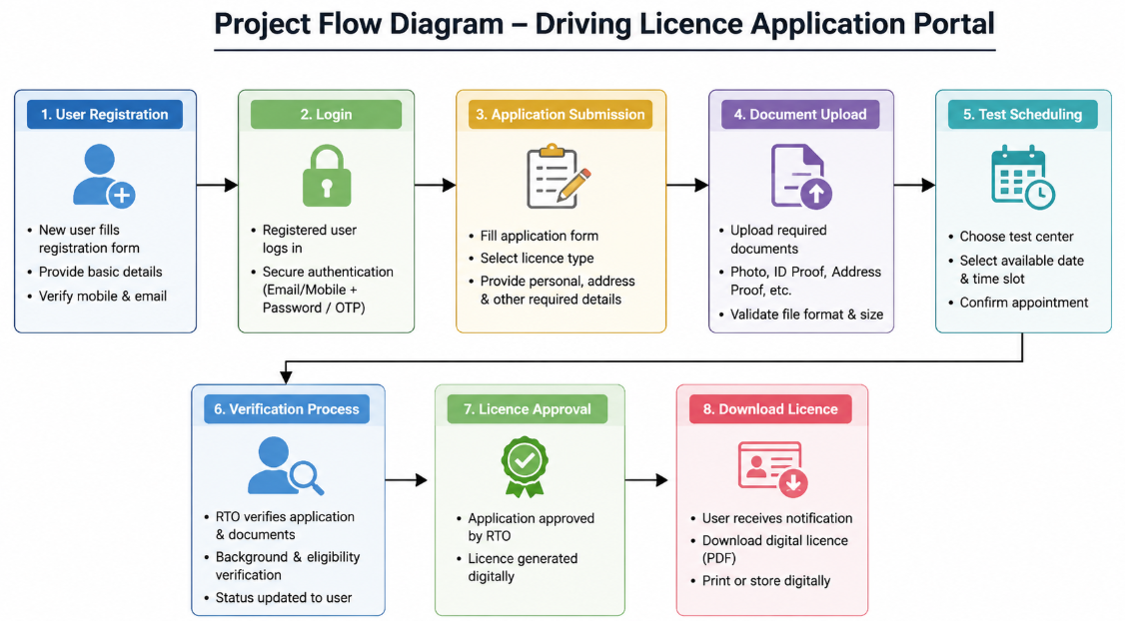
Project Flow Diagram

Slide 7
Objectives with Justification
To automate the driving licence application process.
To reduce paperwork and manual errors.
To provide online scheduling and status tracking.
To improve transparency and efficiency in licence management.

Slide 8
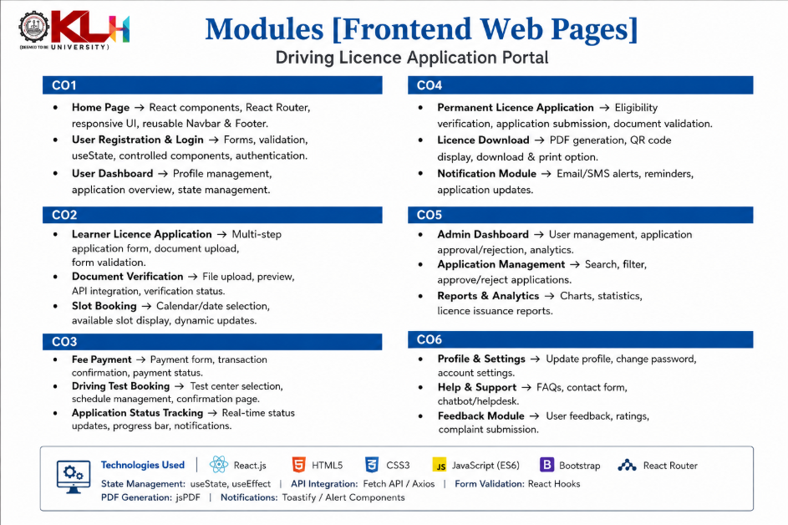

Slide 9
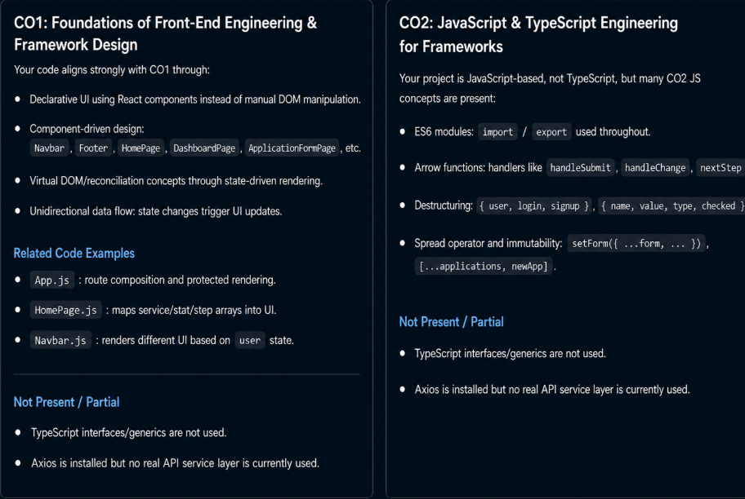
[CO Mapping]

Slide 10
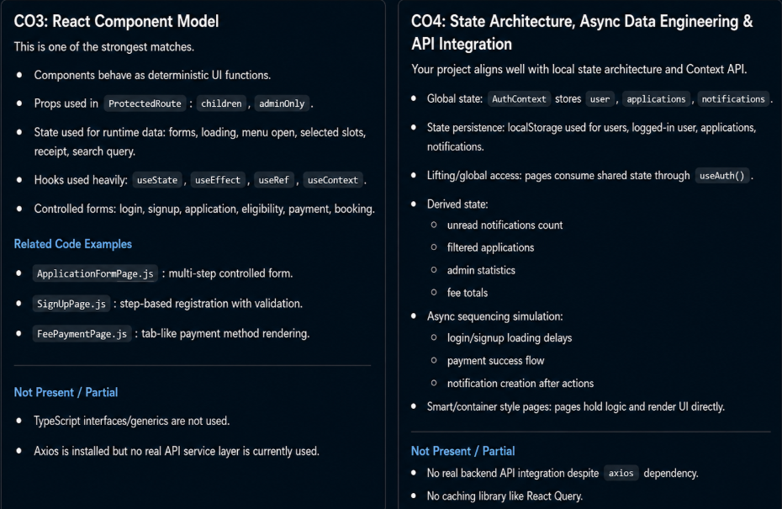
[CO Mapping]

Slide 11
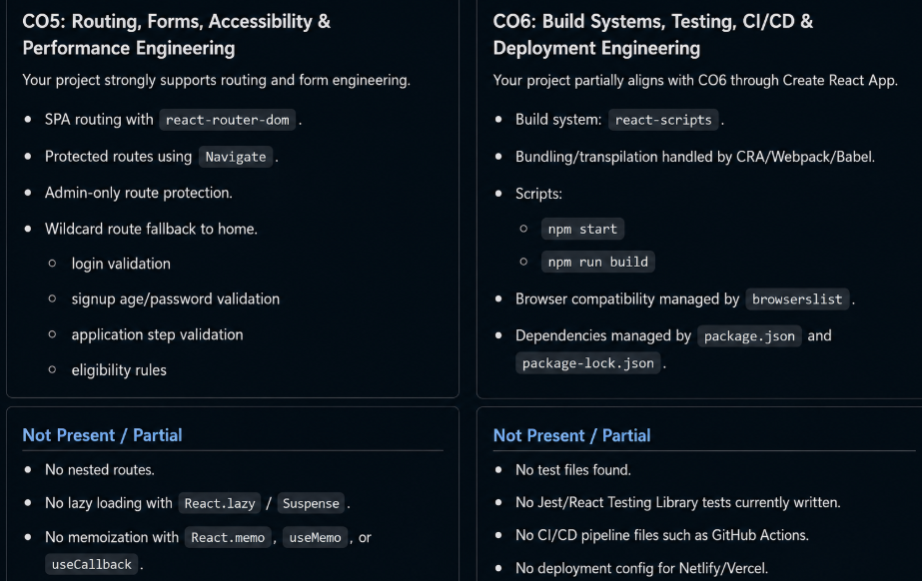
[CO Mapping]

Slide 12
Expected Outcomes of the Proposed Work
The project provides a secure and efficient online system for driving licence applications. Users can complete the process digitally, reducing delays and improving service quality. The portal enhances accessibility, transparency, and data management.
The system reduces manual paperwork, minimizes processing delays, and improves overall service efficiency. By digitizing the application process, it ensures greater transparency, accuracy, and accountability in licence management.

Slide 13
Conclusion and Future Scope
The Driving Licence Application Portal simplifies the licence process through automation and digital services. In future, the system can be integrated with AI-based verification, mobile applications, online payment gateways, and real-time notifications

Slide 14
References
Ministry of Road Transport and Highways.
Online E-Governance Portal References.
Online Transport Management System Research Papers.
HTML, CSS, JavaScript Documentation.
Research Articles on Online Licence Management Systems.

Slide 15
Thank you

