Slide 1

Title :Real-Time Ride Pooling and Matching System
Student Name: P. Naveen
Student ID: 2520030518
Cluster: 3
Section: 9
Under the Guidance
of
Supervisor Name: Dr Venkat Isampalli
Assistant Professor
Department of CSE

Slide 2
Abstract
This project presents the design and development of a Real-Time Ride Pooling and Matching System aimed at reducing transportation costs, traffic congestion, and environmental pollution. The system enables passengers traveling in similar directions to share a single vehicle by intelligently matching ride requests in real time.
The proposed system uses location-based services, GPS tracking, and efficient matching algorithms to identify nearby users with compatible routes and schedules. By analyzing factors such as distance, travel time, and user preferences, the system ensures optimal ride pairing and route planning.
A mobile and web-based interface is developed to allow users to easily request rides, view matched partners, track vehicles, and communicate with drivers. The system also includes safety features such as user authentication, trip history, and feedback mechanisms to enhance trust and reliability.
Overall, this project improves urban mobility by promoting shared transportation, lowering fuel consumption, and providing a cost-effective and eco-friendly travel solution. The Real-Time Ride Pooling and Matching System contributes to the development of smart transportation and sustainable cities.

Slide 3
Existing System
Most people travel individually using personal vehicles or taxis.
Current ride booking apps mainly focus on single passenger rides.
These systems do not efficiently match people travelling in the same direction.
This leads to higher travel cost, traffic congestion, and transportation efficiency.
Lack of real-time ride sharing reduces transportation efficiency.

Slide 4
Proposed System
The proposed system introduces a Real-Time Ride Pooling and Matching System.
It connects passengers traveling in similar routes and timings.
The system uses location data and matching algorithms to find suitable ride partners.
Users can request a ride or offer a ride.
The system reduces cost, traffic, and pollution while improving transportation efficiency.

Slide 5
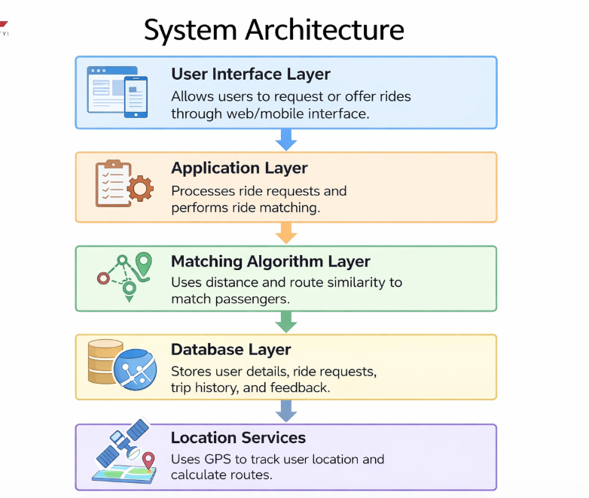
System Architecture

Slide 6
Project Modules
User Registration and Login Module Allows users to create accounts and securely log in.
Ride Request Module Users enter pickup and destination locations.
Ride Offer Module Drivers can offer available rides.
Ride Matching Module Matches passengers and drivers based on route similarity.
Ride Tracking Module Shows real-time ride updates and trip status.
Feedback Module Allows users to rate and review rides.

Slide 7
Objectives
To develop a real-time ride pooling platform.
To reduce traffic congestion and travel cost.
To promote eco-friendly transportation.
To match passengers travelling in similar routes efficiently.
To provide a safe and reliable ride-sharing system.

Slide 8
Co’s Attainments - FWD
CO1 – Apply HTML and CSS to design the front-end interface. CO2 – Implement JavaScript for dynamic web functionality. CO3 – Develop responsive web pages for user interaction. CO4 – Integrate front-end with backend services. CO5 – Design user-friendly web applications.

Slide 9
Co’s Attainments - DSA
CO1 – Understand basic data structures and algorithms. CO2 – Implement searching and matching algorithms. CO3 – Optimize route matching using algorithmic techniques. CO4 – Analyze algorithm efficiency for ride matching. CO5 – Apply DSA concepts in real-world applications.

Slide 10
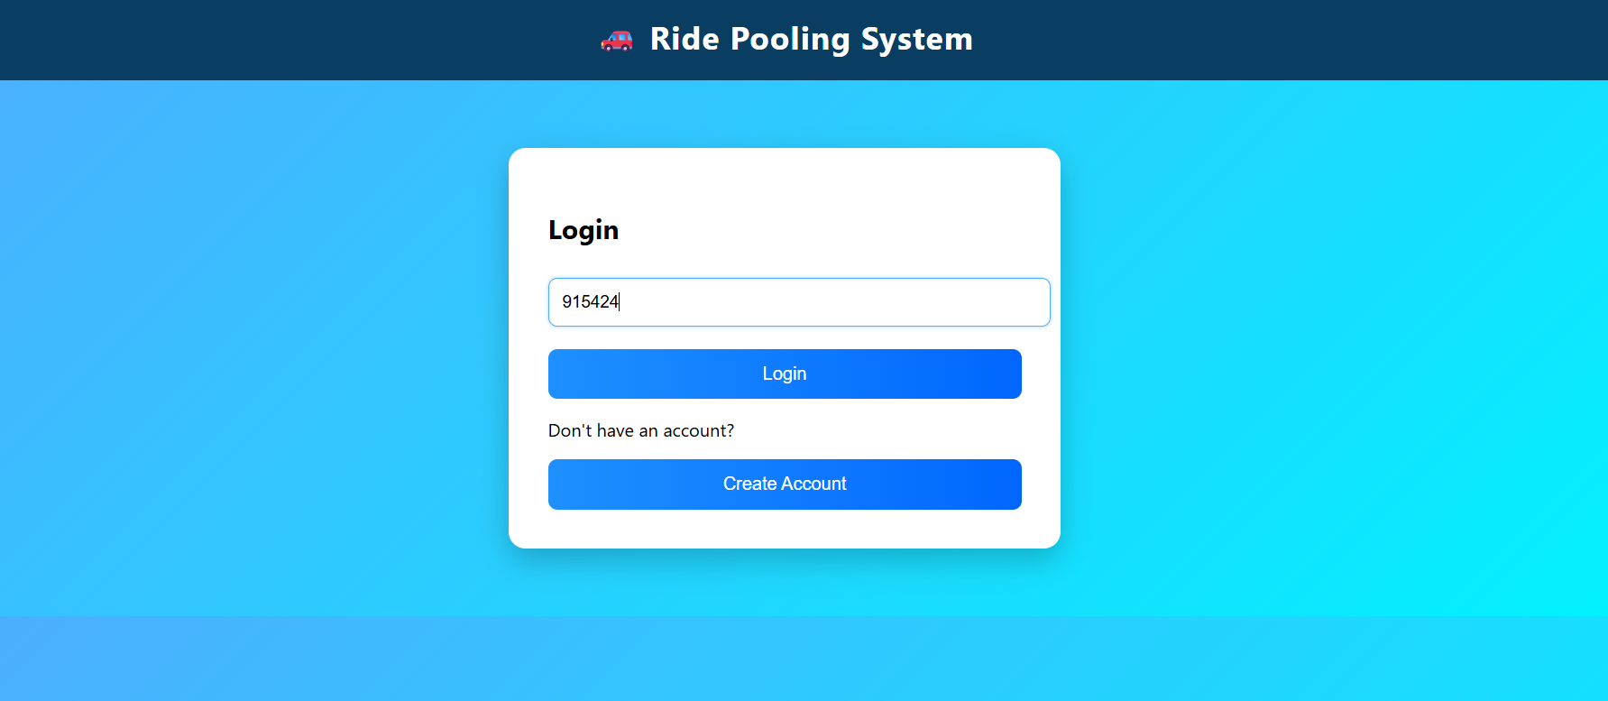
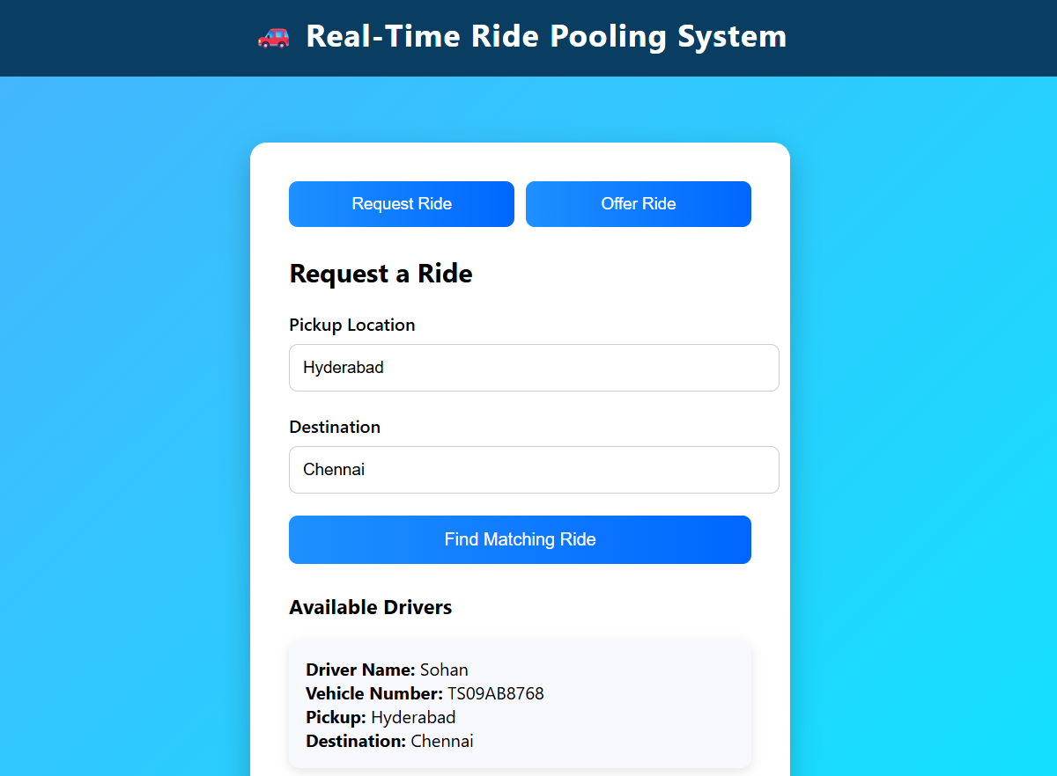
Screenshots for FWD & DSA

Slide 11
Conclusion
The Real-Time Ride Pooling and Matching System provides an efficient way to share rides.
It reduces transportation costs and traffic congestion.
The system promotes sustainable and eco-friendly travel.
Future improvements can include AI-based route optimization and mobile app integration.

Slide 12
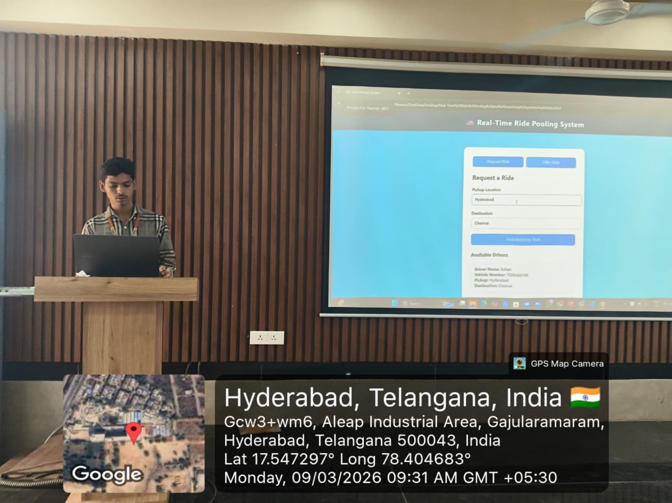
Geo- Tag Photos

Slide 13
THANK YOU

