Slide 1
PRANESH R K
Final Project
3/21/2024 Annual Review

Slide 2
ABSTRACTIVE TEXT SUMMARIZATION USING LSTM
3/21/2024 Annual Review

Slide 3


AGENDA
Problem Statement
●Introduction to the abstract text summarization using a deep learning concept.
Project Overview
●Overview of the project aims and objectives in implementing abstract text summarization using LSTM.
End Users
●A transformative leap in information extraction, offering concise yet comprehensive insights.
Our Solution
●It crafts succinct, contextually-aware summaries, heralding a paradigm shift.
The "Wow" in Our Solution
●Highlighting unique features or innovations that set our solution apart from existing methods.
Modeling
●Explanation of the neural network for input transformation and optimization techniques to enhance the model.
Results
●Presentation of the outcomes and visualizations obtained from applying our solution to sample images.
Conclusion
●a transformative leap in information extraction, offering concise yet comprehensive insights from voluminous textual data.
3/21/2024 Annual Review

Slide 4

PROBLEM STATEMENT
Developing algorithms capable of understanding the underlying meaning of the text to accurately distill key information.
Ensuring generated summaries are both coherent and concise, maintaining logical structure and flow while avoiding unnecessary redundancy.
Encouraging the generation of summaries that offer fresh insights and perspectives beyond mere rephrasing, enhancing the value and utility of the summaries.
3/21/2024 Annual Review

Slide 5

PROJECT OVERVIEW
Develop a system that reads a passage and writes a shorter, but accurate summary in its own words.
We'll use advanced algorithms to understand the main ideas of the text and rewrite them in a concise, coherent manner.
This project aims to create a tool that can help users quickly grasp the essential information from long documents, saving time and effort.
3/21/2024 Annual Review

Slide 6

WHO ARE THE END USERS?
They can use the summarization tool to quickly understand complex academic papers, extracting key points for study or research purposes.
Professionals such as journalists, analysts, and executives can benefit from summarizing lengthy reports, articles, or documents, saving time and enabling quick decision-making.
Everyday readers who encounter lengthy articles, blog posts, or news stories can utilize the summarization tool to obtain a brief overview of the content without having to read through the entire document.
3/21/2024 Annual Review

Slide 7
YOUR SOLUTION AND ITS VALUE PROPOSITION
●Our solution utilizes advanced natural language processing algorithms to understand the context and generate concise summaries that accurately capture the essence of the original text.
●By providing users with succinct summaries, our solution enables them to quickly extract relevant information from lengthy documents, saving time and effort in processing large volumes of text.
●Users can gain a comprehensive understanding of complex texts without needing to read through every detail, allowing them to make informed decisions or acquire knowledge efficiently.
3/21/2024 Annual Review

Slide 8

THE WOW IN YOUR SOLUTION
Our solution goes beyond simple keyword extraction by comprehensively understanding the context of the text.
We provide multilingual support, enabling users to summarize texts in various languages.
Our solution offers personalization options, allowing users to customize the level of brevity or detail in the summaries according to their preferences.
3/21/2024 Annual Review

Slide 9
MODELLING
Implement a neural network architecture where the input sequence is transformed into an output sequence.
Utilize transformer-based models like BERT or GPT to capture complex relationships and semantics within the text for better summarization accuracy.
Employ optimization techniques such as gradient descent and regularization methods like dropout to enhance model training and prevent overfitting.
Fine-tune pre-trained models on domain-specific data to adapt them for specific summarization tasks, leveraging transfer learning to improve performance.
3/21/2024 Annual Review

Slide 10
RESULTS
Input:
Back in the 1950s, the fathers of the field, Minsky and McCarthy, described artificial intelligence as any task performed by a machine that would have previously been considered to require human intelligence.That's obviously a fairly broad definition, which is why you will sometimes see arguments over whether something is truly AI or not.Modern definitions of what it means to create intelligence are more specific. Francois Chollet, an AI researcher at Google and creator of the machine-learning software library Keras, has said intelligence is tied to a system's ability to adapt and improvise in a new environment, to generalise its knowledge and apply it to unfamiliar scenarios."Intelligence is the efficiency with which you acquire new skills at tasks you didn't previously prepare for," he said."Intelligence is not skill itself; it's not what you can do; it's how well and how efficiently you can learn new things."It's a definition under which modern AI-powered systems, such as virtual assistants, would be characterised as having demonstrated 'narrow AI', the ability to generalise their training when carrying out a limited set of tasks, such as speech recognition or computer vision.Typically, AI systems demonstrate at least some of the following behaviours associated with human intelligence: planning, learning, reasoning, problem-solving, knowledge representation, perception, motion, and manipulation and, to a lesser extent, social intelligence and creativity.AlexNet's performance demonstrated the power of learning systems based on neural networks, a model for machine learning that had existed for decades but that was finally realising its potential due to refinements to architecture and leaps in parallel processing power made possible by Moore's Law. The prowess of machine-learning systems at carrying out computer vision also hit the headlines that year, with Google training a system to recognise an internet favorite: pictures of cats.The next demonstration of the efficacy of machine-learning systems that caught the public's attention was the 2016 triumph of the Google DeepMind AlphaGo AI over a human grandmaster in Go, an ancient Chinese game whose complexity stumped computers for decades. Go has about possible 200 moves per turn compared to about 20 in Chess. Over the course of a game of Go, there are so many possible moves that are searching through each of them in advance to identify the best play is too costly from a computational point of view. Instead, AlphaGo was trained how to play the game by taking moves played by human experts in 30 million Go games and feeding them into deep-learning neural networks.

Slide 11
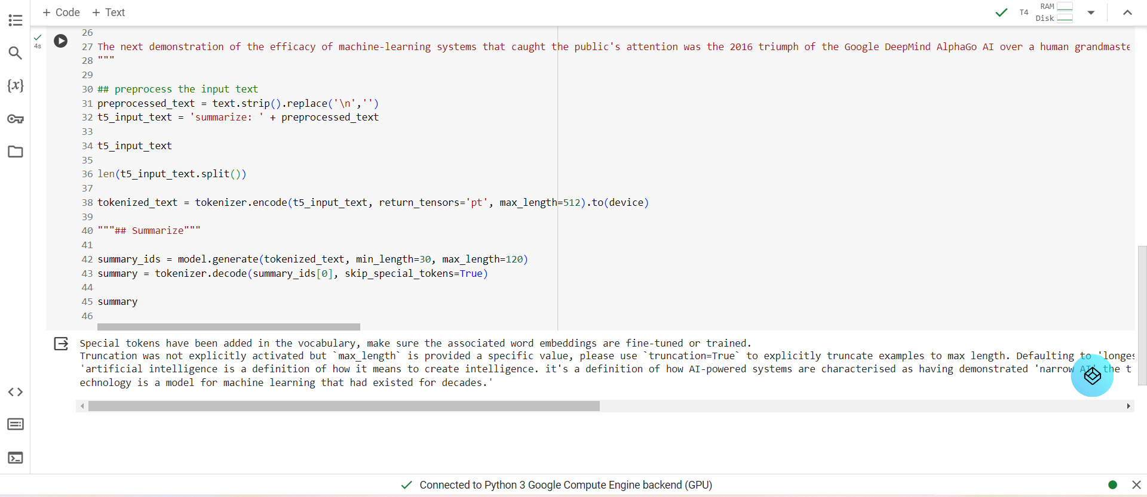
RESULTS
OUTPUT

