Slide 1




GANDHI INSTITUTE OF ENGINEERING AND TECHNOLOGY (GIET) UNIVERSITY GUNUPUR, ODISHA
LEARNATHON 4.0
Hospital Readmission Risk Prediction
TEAM ID : TEAM(MB6)3_4
TEAM: P. SAMEER TANAYA PATRO(23CSE410)
DEBASISH PANDA(23CSE460)
UDIT KUMAR BHOI(23CSE315)

Slide 2
Problem Statement :
Predict Hospital Readmission Risk for Patients with Chronic Conditions
Hospital readmissions among patients with chronic conditions like diabetes, heart disease, and hypertension are a major healthcare concern. Early prediction of readmission risk can help reduce unnecessary hospital stays and improve patient outcomes. This project aims to build a machine learning model to identify high-risk patients based on their medical and demographic data.

Slide 3
OBJECTIVES:
To find out what factors lead to patients being readmitted to the hospital.
To collect and clean patient data like age, disease type, and hospital visits.
To build a machine learning model that can predict if a patient will be readmitted.
To check how well the model is working using different performance measures.
To help doctors take early action by giving useful insights from the model.

Slide 4
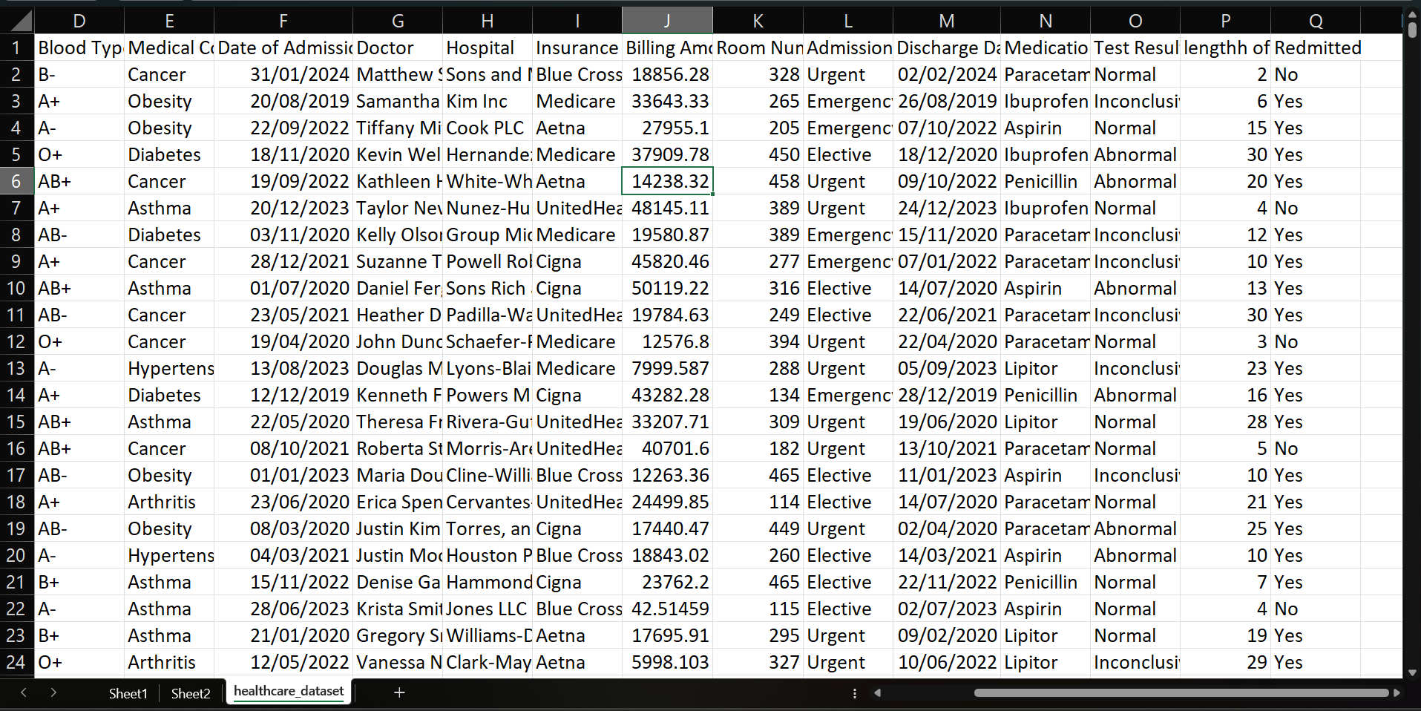
PATIENT DATA:

Slide 5
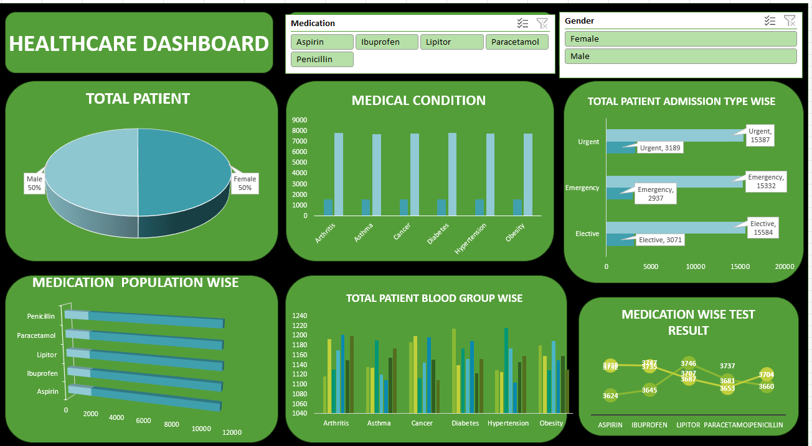
HEALTHCARE DASHBOARD:

Slide 6

PROPOSED SOLUTION :
To address the issue of frequent hospital readmissions among patients with chronic conditions, we propose developing a machine learning-based solution that can accurately predict which patients are at high risk of being readmitted. The system will use historical patient data such as age, diagnosis, treatment history, length of stay, and previous readmissions to identify key patterns and risk factors.

Slide 7

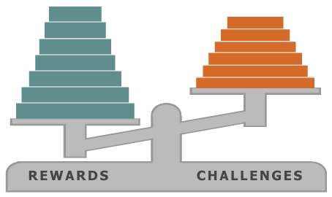
CHALLENGES FACED:
Data Quality and Missing Values: Medical datasets often have missing, incomplete, or inconsistent information, which can affect model accuracy.
Imbalanced Dataset: Readmitted patients are usually fewer than non-readmitted ones, which can lead to biased models favoring the majority class.
Feature Selection: Identifying which patient features (like age, diagnosis, treatment) are most relevant for predicting readmission is difficult and critical

Slide 8


