Slide 1
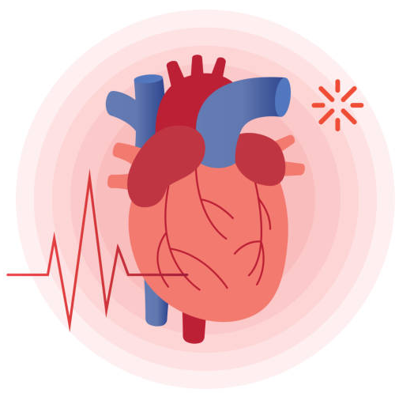
Datathon 2: Early Prediction of Heart Failure
Team 14: Abdulaziz Sherif, Priyonto Saha, Rohini Datta
Objectives:
Explore the factors associated with the occurrence of a cardiovascular event (heart disease, stroke, and/or hypertension). (Dataset: Cardiovascular Event (CED))
Explore the health factors and lifestyle factors associated with mortality among patients with heart failure. (Dataset: Mortality (MD))
Machine Learning Technique:
Logistic regression (LR)
Verify assumptions for logistic regression
Train model on training dataset (80%)
Evaluate model performance using test dataset (20%)

Slide 2

Exploratory Data Analysis:
Missing data analysis
Summary statistics
Pairwise contingency matrices for categorical predictors
Correlation matrix for continuous predictors
Histograms for distribution
Preprocessing:
Dataset: Cardiovascular Event
Data clean-up
Variable ‘id’ removed
Low frequency categories removed or collapsed
Variable ‘smoking_status’ removed due to high missingness
Mean imputation for ‘bmi’ missing data
Outcome ‘event’ created combining hypertension, heart disease, and/or stroke
0 = no cardiovascular event, 1= one or more cardiovascular event
Logistic Regression:
Most clinically relevant variable selected out of variables with high multicollinearity
Observations identified as outliers removed

Slide 3
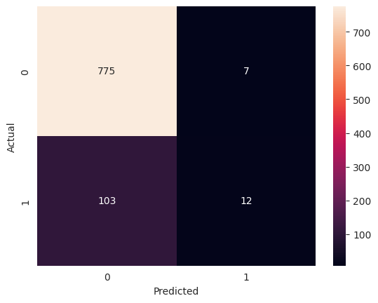
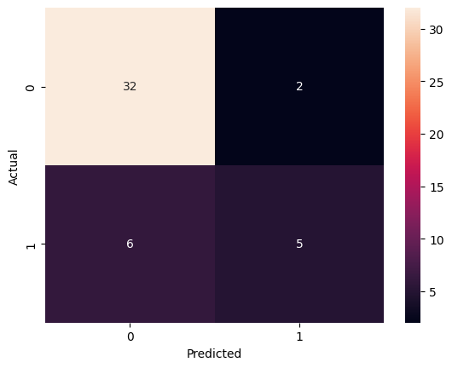
Findings:
Table 1. Summary of LR for CED
 | Coefficient | Standard Error | p-value | 95% CI
Constant | -5.7219 | 0.232 | 0.000 | (-6.177, -5.266)
Gender | 0.4082 | 0.096 | 0.000 | (0.220, 0.596)
Age | 0.0657 | 0.003 | 0.000 | (0.060, 0.072)
Marital status | -0.0054 | 0.147 | 0.971 | (-0.293, 0.283)
Residence type | -0.0679 | 0.095 | 0.476 | (-0.255, 0.119)
Average glucose level | 0.0038 | 0.001 | 0.002 | (0.001, 0.006)
Table 2. Summary of LR for MD
 | Coefficient | Standard Error | p-value | 95% CI
Constant | 3.4922 | 8.673 | 0.687 | (-13.507, 20.492)
Age | 0.0499 | 0.020 | 0.012 | (0.011, 0.089)
Anaemia | 0.3694 | 0.447 | 0.409 | (-0.507, 1.246)
Creatinine Phosphokinase | 0.0007 | 0.001 | 0.336 | (-0.001, 0.002)
Diabetes | 0.0981 | 0.436 | 0.822 | (-0.756, 0.952)
Ejection fraction | -0.0713 | 0.020 | 0.000 | (-0.110, - 0.033)
High blood pressure | -0.2434 | 0.455 | 0.592 | (-1.135, 0.648)
Platelets | -1.115e-06 | 3.28e-06 | 0.734 | (-7.55e-06, 5.32e-06)
Serum Creatinine | 2.2455 | 0.739 | 0.002 | (0.796, 3.695)
Serum Sodium | -0.0378 | 0.060 | 0.0530 | (-0.158, 0.080)
Sex | -0.5191 | 0.541 | 0.337 | (-1.580, 0.541)
Smoking | 0.6158 | 0.532 | 0.247 | (-0.427, 1.658)
Time | -0.0220 | 0.004 | 0.000 | (-0.029, -0.015)
Figure 1. Confusion matrix for LR for CED
Figure 2. Confusion matrix for LR for MD

