Slide 1
17BD1A054D
17BD1A054H
17BD1A055C
17BD1A055K

Slide 2
INTRODUCTION
In current trend many social networking sites are created and providing services of communications, multi-media services, e-commerce etc immensely.A thousand millions of users throughout the globe are using one or more social networking sites.
According to research survey many more than 30% of dummy or duplicate or fake accounts are present in all social media services like twitter, facebook etc.
Cyberbullying includes mean text messages, blackmails that can be very embarrassing to the concerned person.
However, this social networking sites has lead to the growth of cyber criminal acts such as cyberbullying which has become a worldwide epidemic.

Slide 3
In this system, social network sites focuses on the user blogs and captures the user behavior whether he/she cyberbullies or not.
This system even tracks the attackers using profile matching techniques and network based techniques etc.
Crawling the user information from the user blogs is less practical and the cyberbullies can easily manipulate the public profile information.

Slide 4
Based on existing surveys attacker easily morph the data.
It is very less practical to find the attacker using small tiny blogs
Based on the network based models we should effort heavy data for detecting.

Slide 5
In our proposed system we are implementing the web based application which will find the cyberbullies according to their behavior.
We calculate the user behavior according to the chat statements of the user which he/she do with others.
By using Machine Learning algorithm we classify the cyberbullies users and we block the accounts. Here we are using Naive Bayes algorithm to perform the classification of the users.

Slide 6
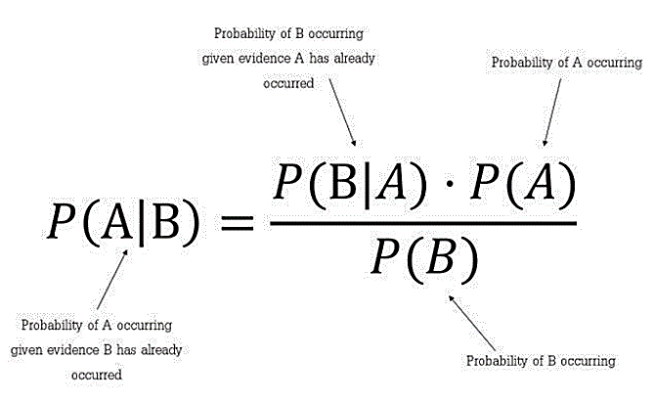
Naive Bayes Algorithm
Naive Bayes is a simple supervised machine learning algorithm that uses the Bayes’ theorem with strong independence assumptions between the features to procure results. That means that the algorithm just assumes that each input variable is independent. It really is a naive assumption to make about real-world data.

Slide 7
We are depending on the chat history instead of the profile attributes or any other media attributes so we can conclude with minimum amount of the computation.
Due to machine learning classifications we can get accurate results.
As we are relying on chat messages we get high accuracy as anonymous users can easily manipulate the profile information.

Slide 8
HARDWARE REQUIREMENTS
Hardware : Pentium
Speed : 1.1 GHz
RAM : 4 GB
Hard Disk : 20 GB
SOFTWARE REQUIREMENTS
Operating System : Windows Family
Technology : Java, J2EE and Python 3.7
Web Technologies : Html, JavaScript, CSS
Web Server : Apache Tomcat 8.0
Database : My SQL 5.5 or Higher
UML's : StarUml

Slide 9
Using Psychological Perspective : Feinberg and Robey worked on the psychological aspects of cyberbullying by preventing them using careful observation, monitoring.Psychological perspective has given rise to the study of cyber profiling.
Using Semantic Analysis : Two classes of data are used, one with the positive tone and other with the negative tone. These are then converted into vector form. The test data is classified into positive or negative based on the data that the supervised algorithm was trained with.
Using a Static dictionary of bad words : A computer software known as Bully Tracer was designed to detect cyberbullying in a chat room conversation. This software has a dictionary of bad words like swear words and it matches the post to these bad words to detect offensive text.

Slide 10
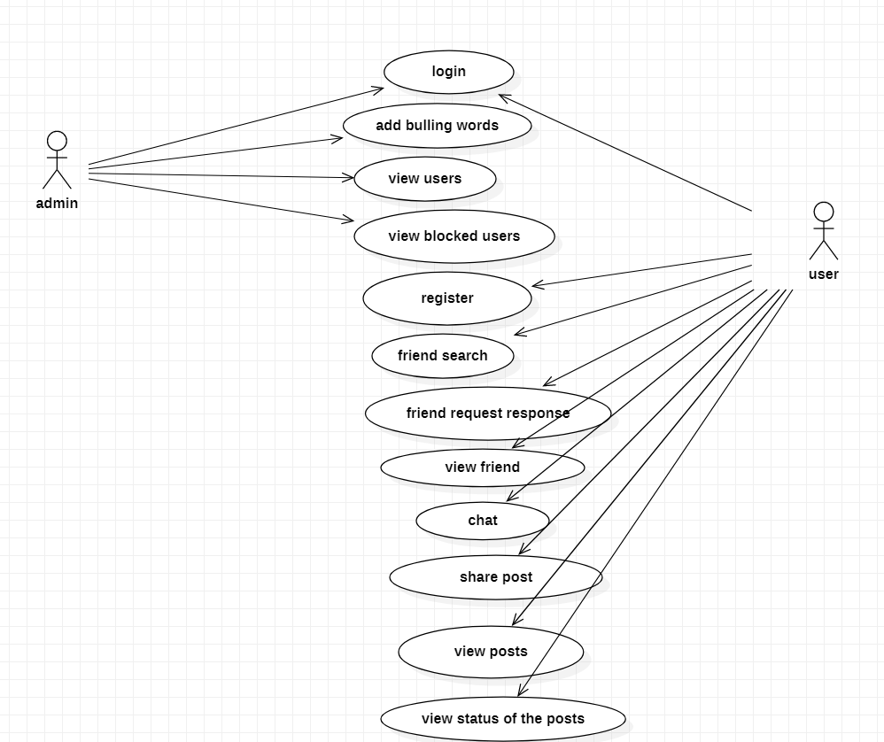
USECASE DIAGRAM:

Slide 11
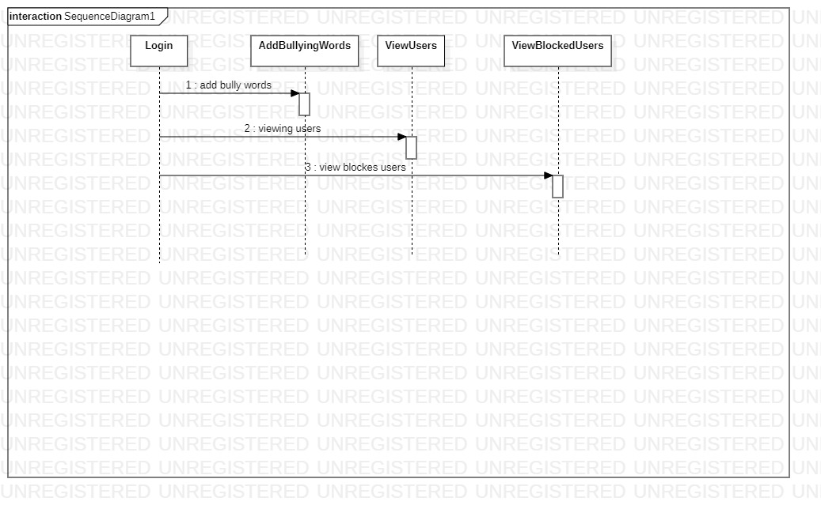
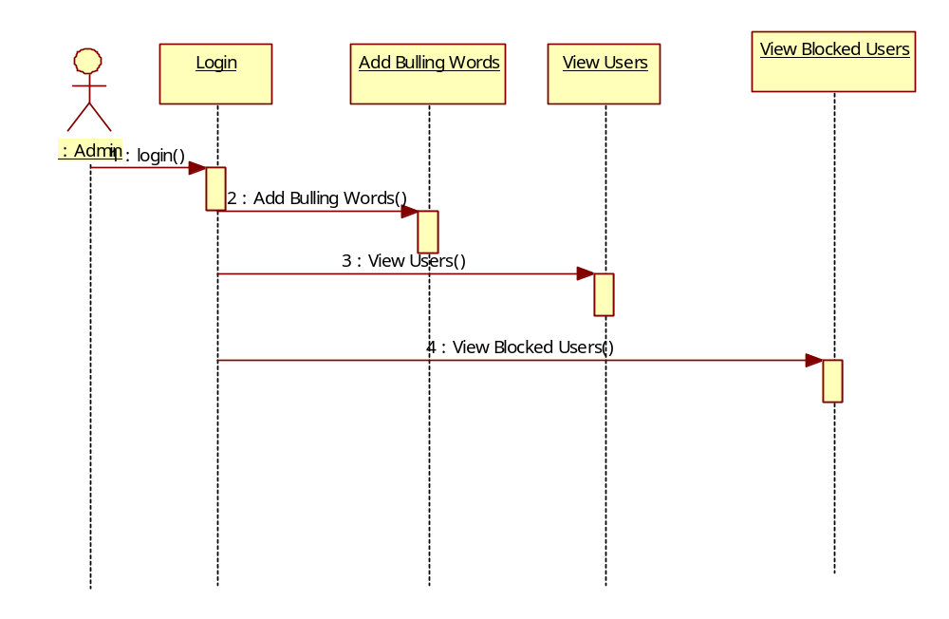
ADMIN SEQUENCE DIAGRAM:

Slide 12
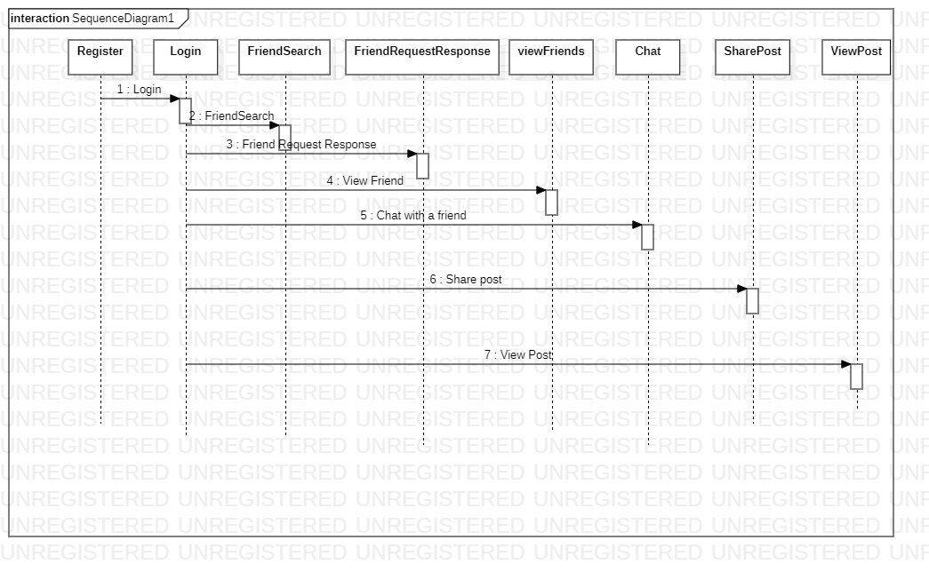
USER SEQUENCE DIAGRAM:

Slide 13
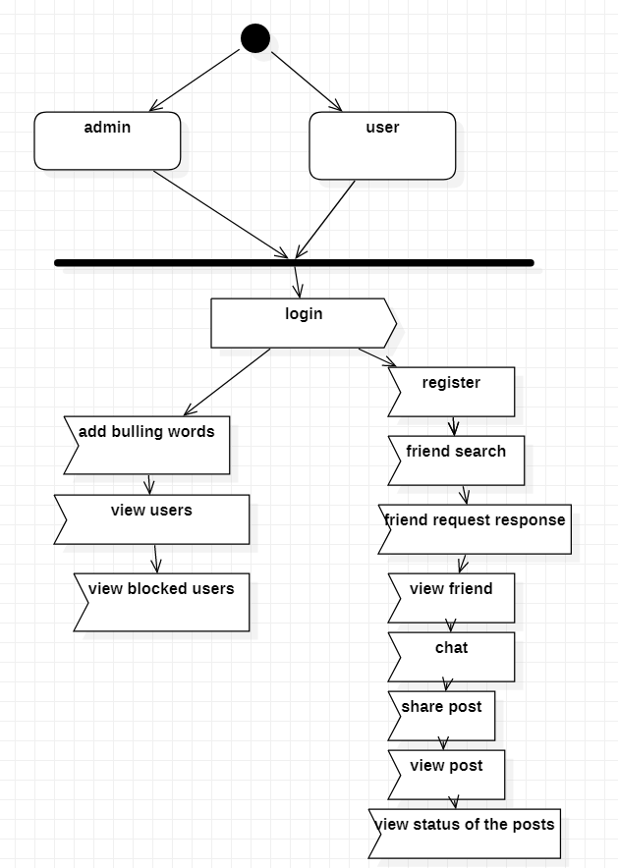
ACTIVITY DIAGRAM

Slide 14
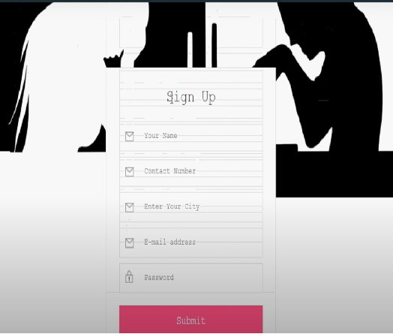
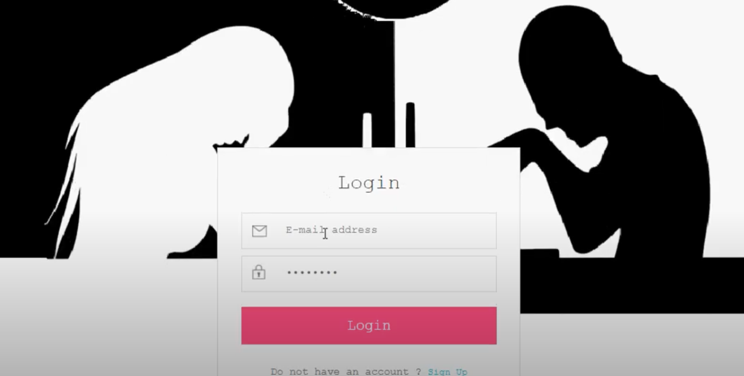
LOGIN WEB-PAGE

Slide 15
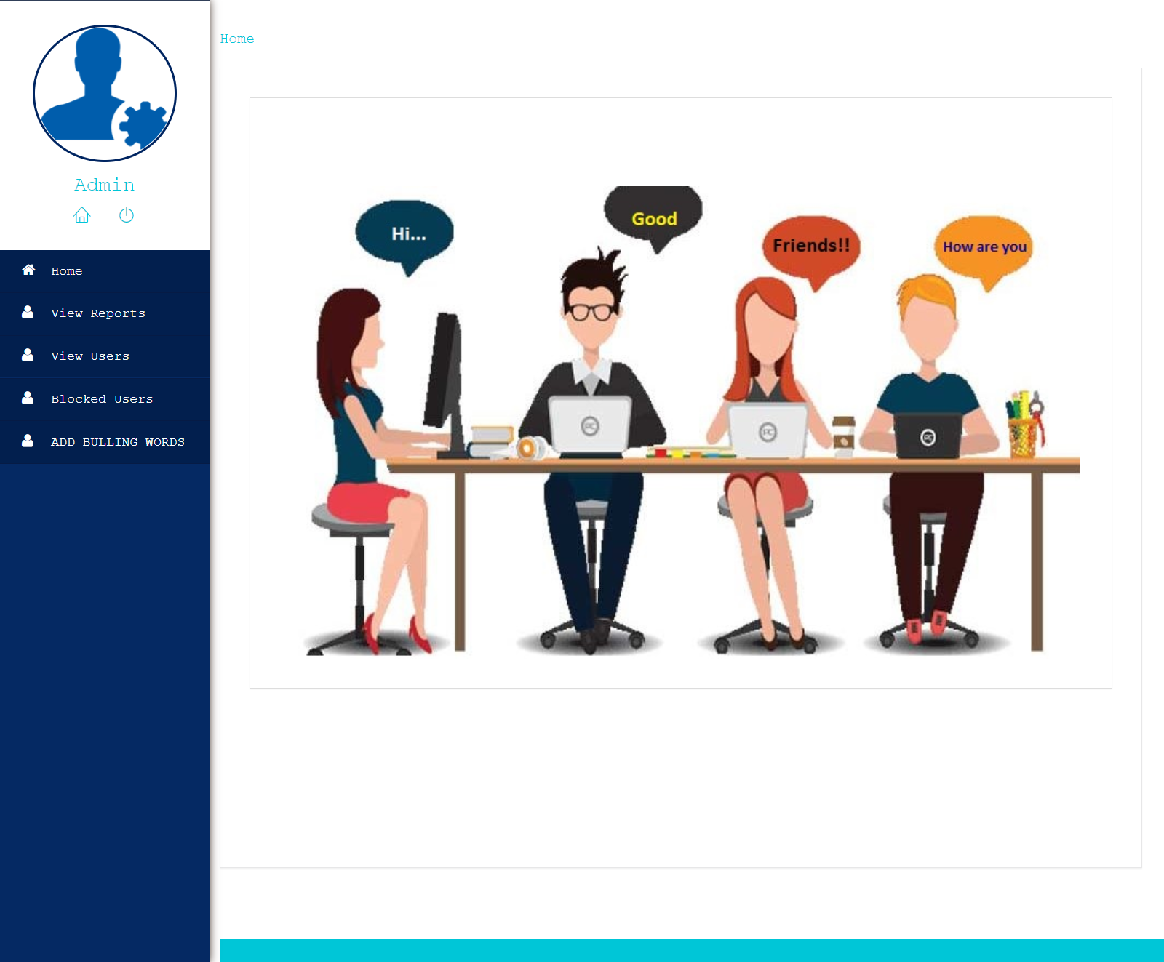
ADMIN HOME PAGE

Slide 16
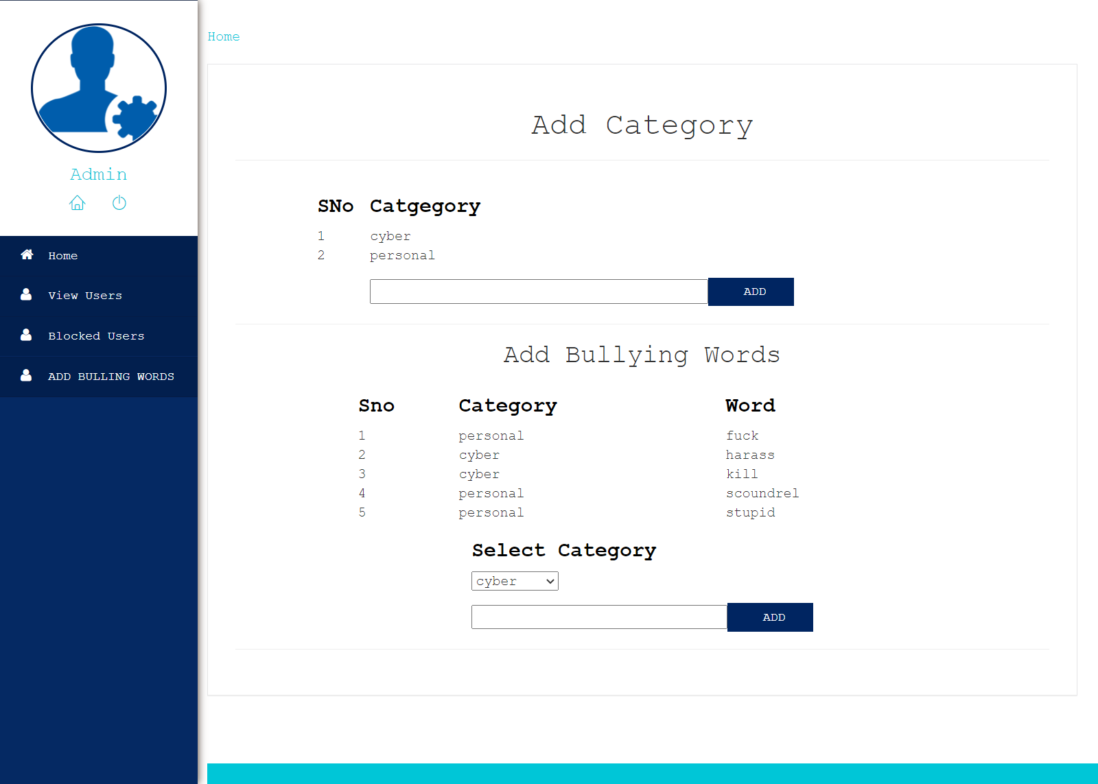
Adding Bully Words

Slide 17
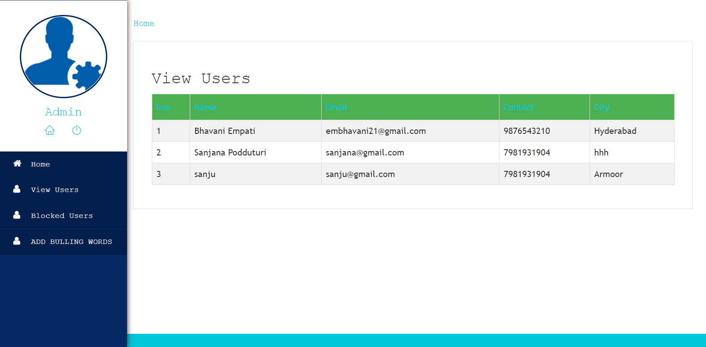
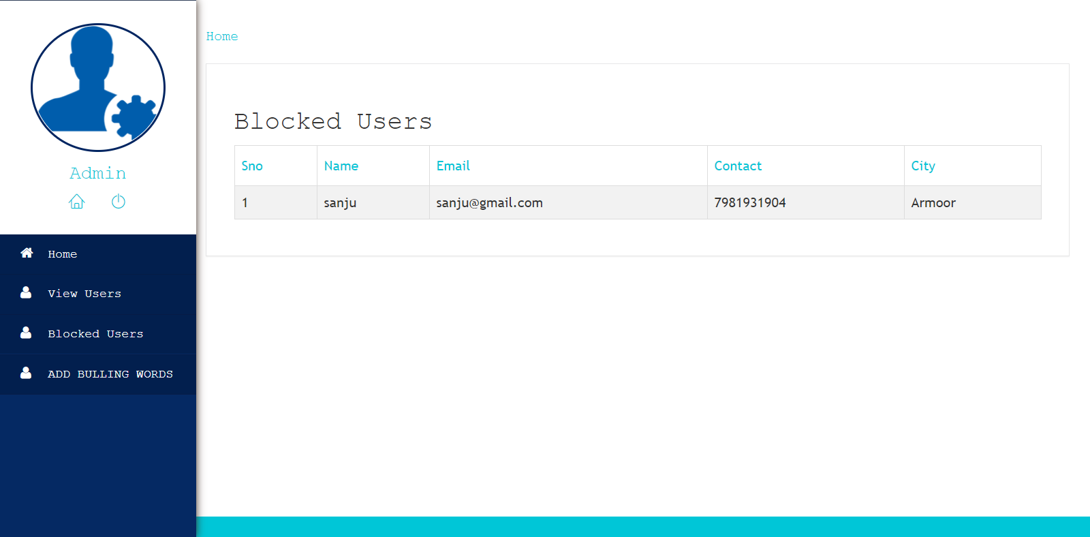
View Users and View Blocked Users

Slide 18
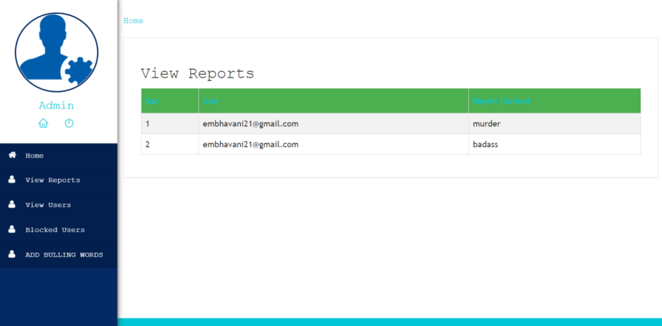
Viewing the bully words reported by users

Slide 19
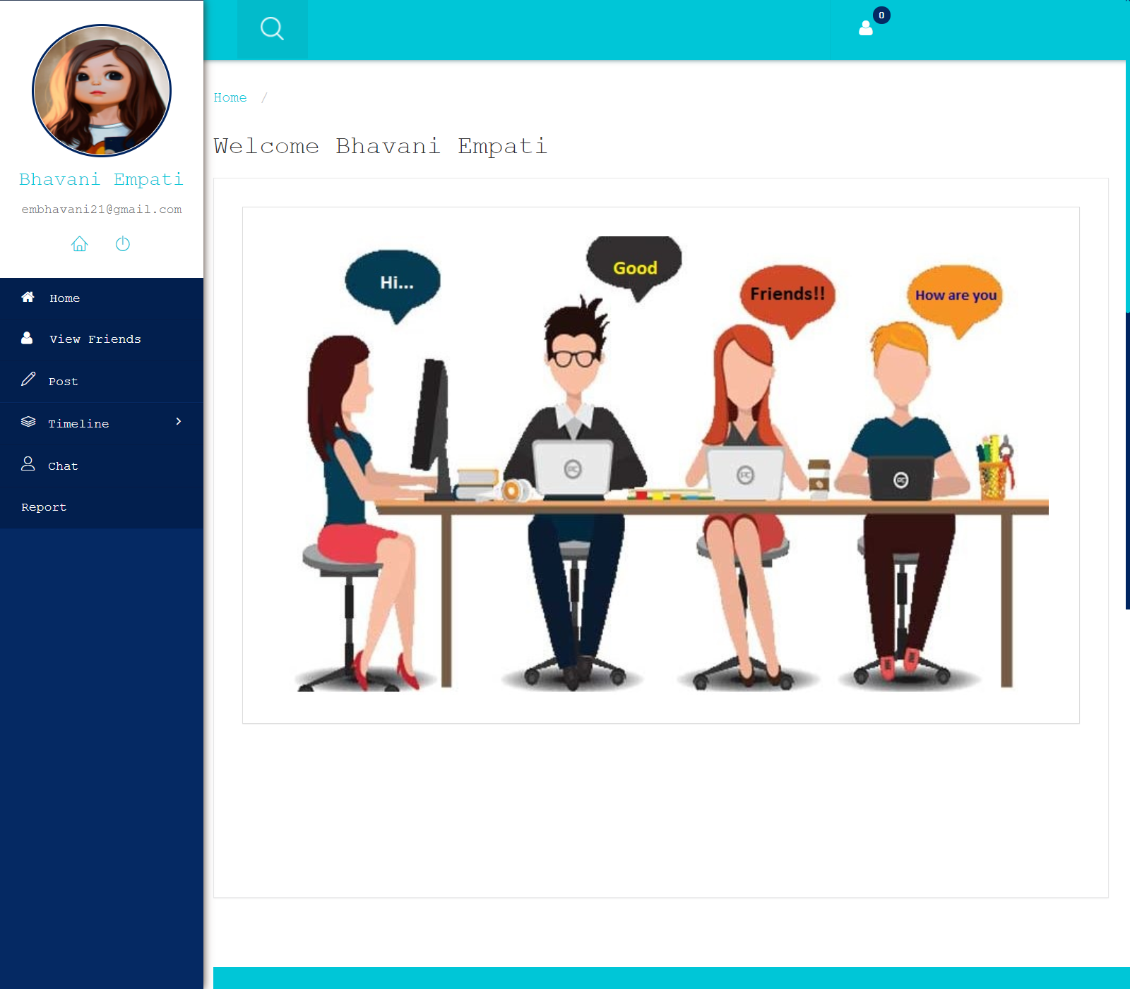
User Profile

Slide 20
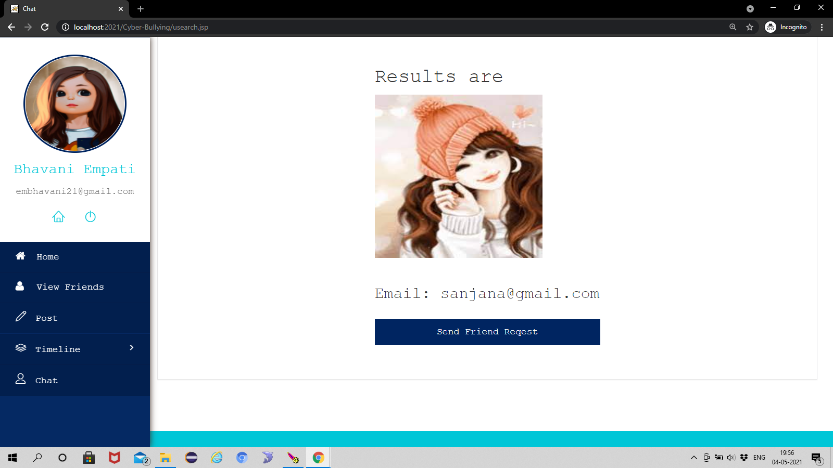
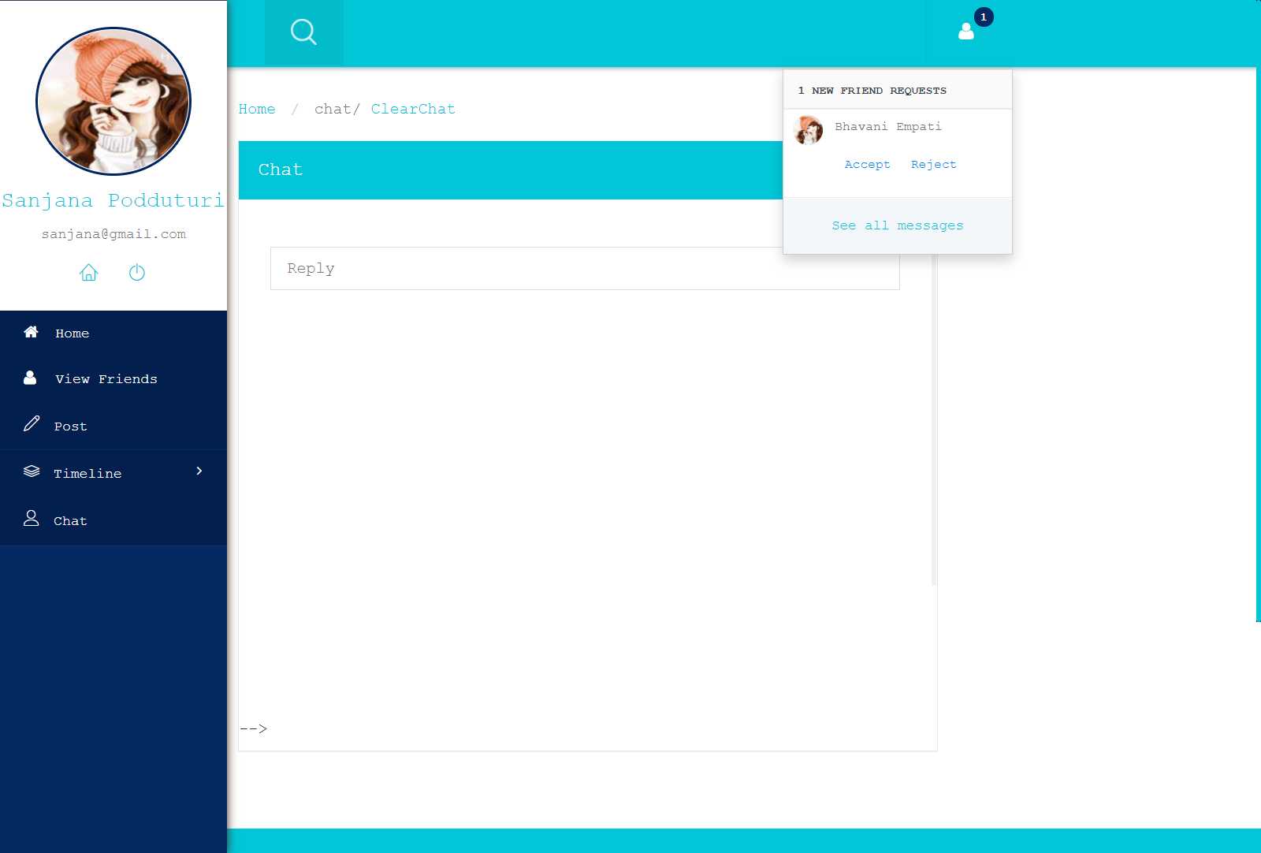
Sending Friend Requests and Accepting Friend Requests

Slide 21
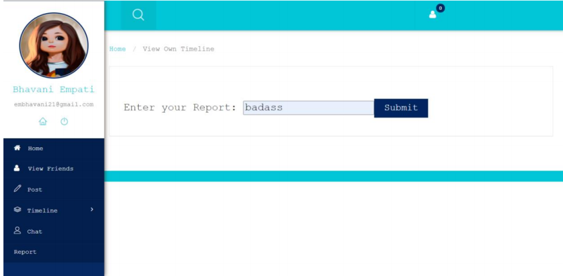
Sending reports to admin

Slide 22
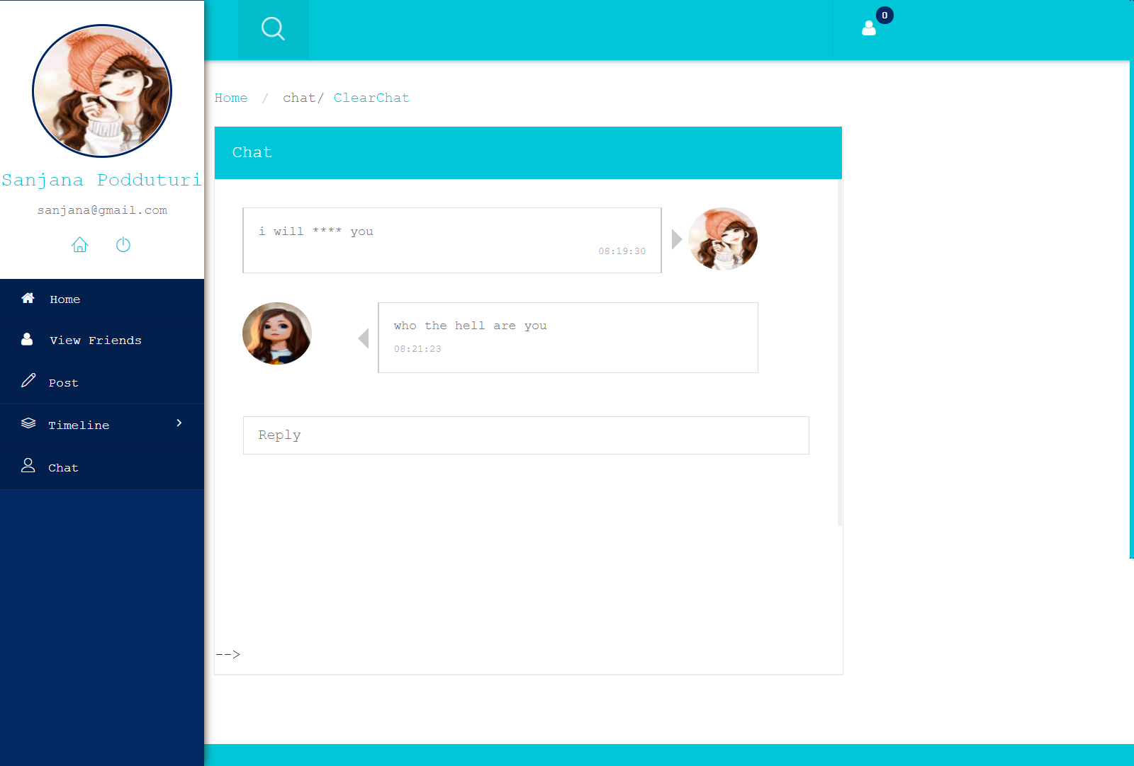
Chat Between Users

Slide 23
TEST CASES

Slide 24
1.REGISTRATION TEST CASE
Test Case ID #1 |  | Test Case Description - Validations in Registration Form
S# | Prerequisites |  | S# | Test Data Requirement
1 | User should be Registered |  | 1 | Data should be valid
Test Condition
Entering data in registration form
Step # | Step Details | Expected Results |  | Actual Results | Pass/Fail/Not Executed/Suspended
1 | User gives Name | Pop showing phone number verification message |  | Enter valid phone number | Fail
2 | Submitting the form without entering any details | Pop showing name verification message |  | Enter name | Fail
3 | User enters invalid format of email id | Pop showing email verification message |  | Enter valid email id | Fail
4 | User enters a phone number with < 10 digits | Pop showing phone number verification message |  | Enter valid phone number | Fail
5 | Entering valid username and password | - |  | Redirecting to profile upload page | Pass

Slide 25
2.LOGIN TEST CASE
Test Case ID #2 |  | Test Case Description - Validations in Login Form
S# | Prerequisites |  | S# | Test Data Requirement
1 | User should have an email id |  | 1 | Data should be valid
Test Condition
Entering data in login form
Step # | Step Details | Expected Results |  | Actual Results | Pass/Fail/Not Executed/Suspended
1 | User gives an email or password | User logged in |  | Redirecting to home page | Pass
2 | Submitting the form without entering any details | Login fail |  | Enter email /password | Fail
3 | User enters wrong Email and (or) password | Login fail |  | Enter correct email /password | Fail

Slide 26
