Slide 1


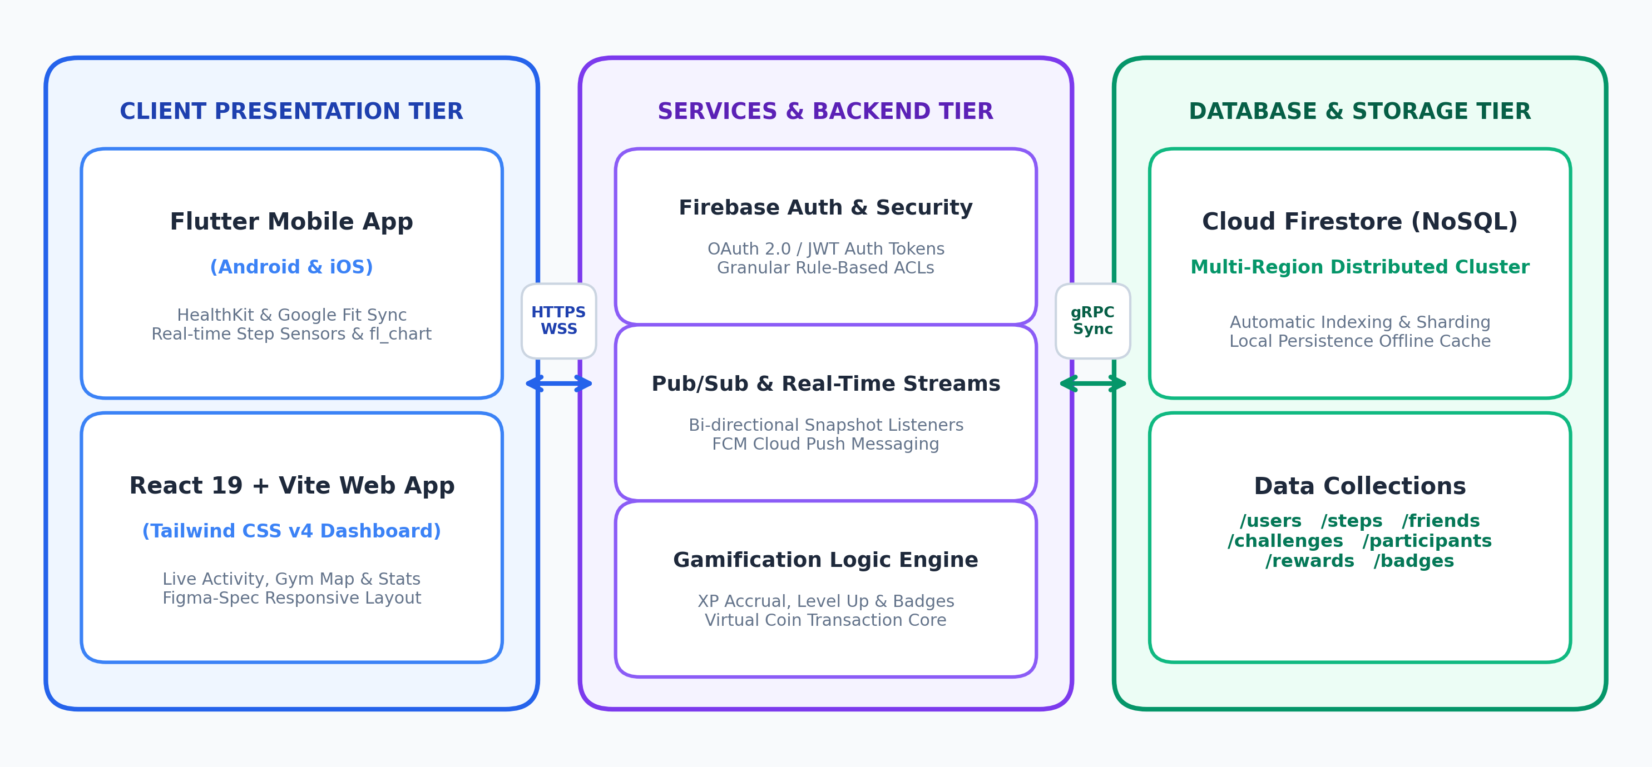
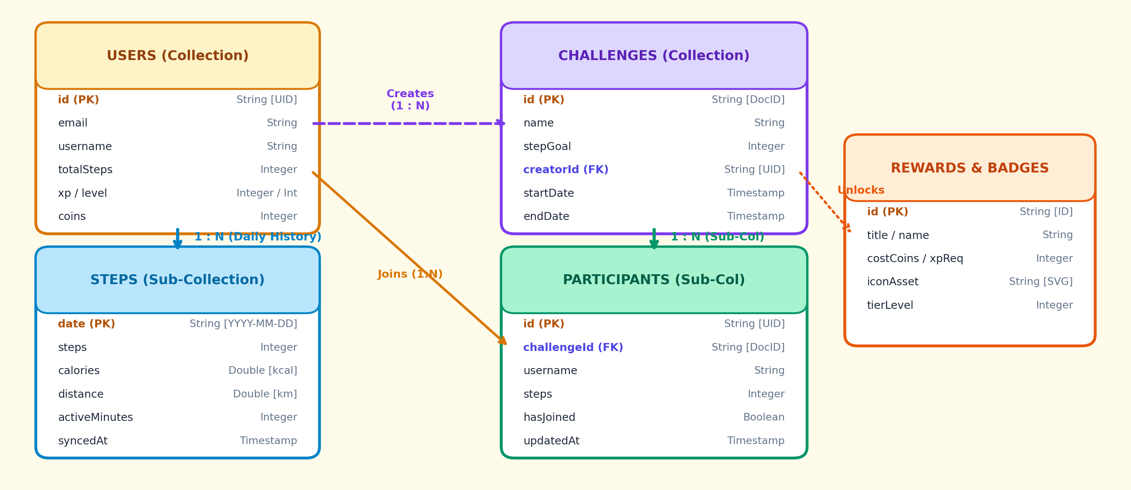
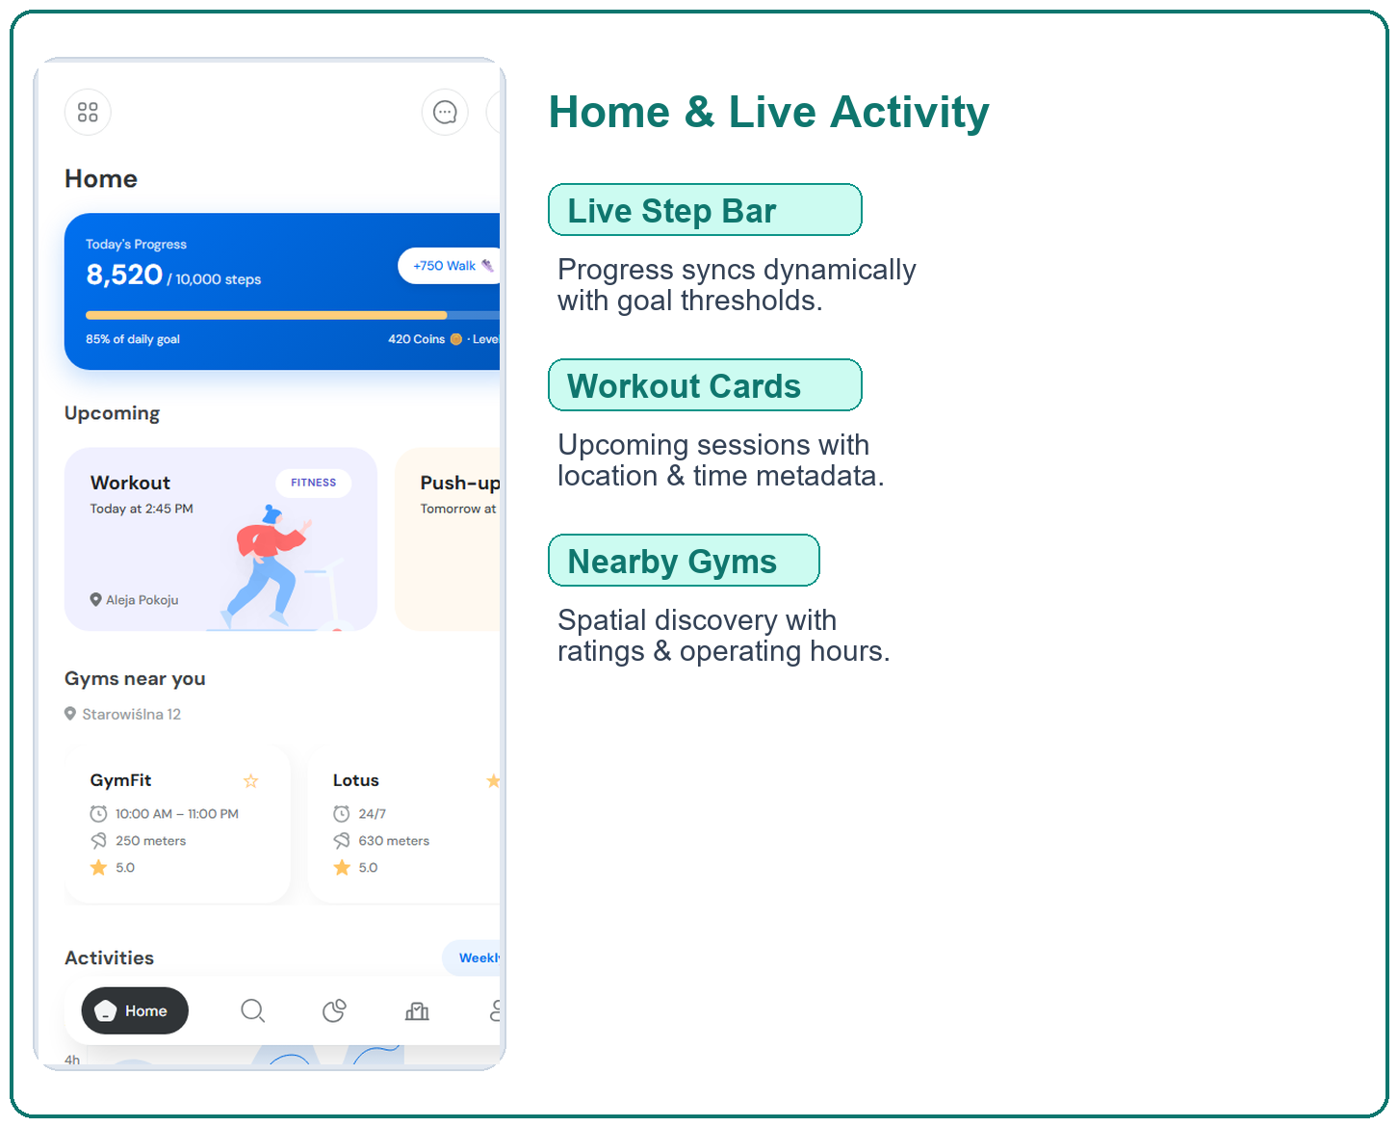
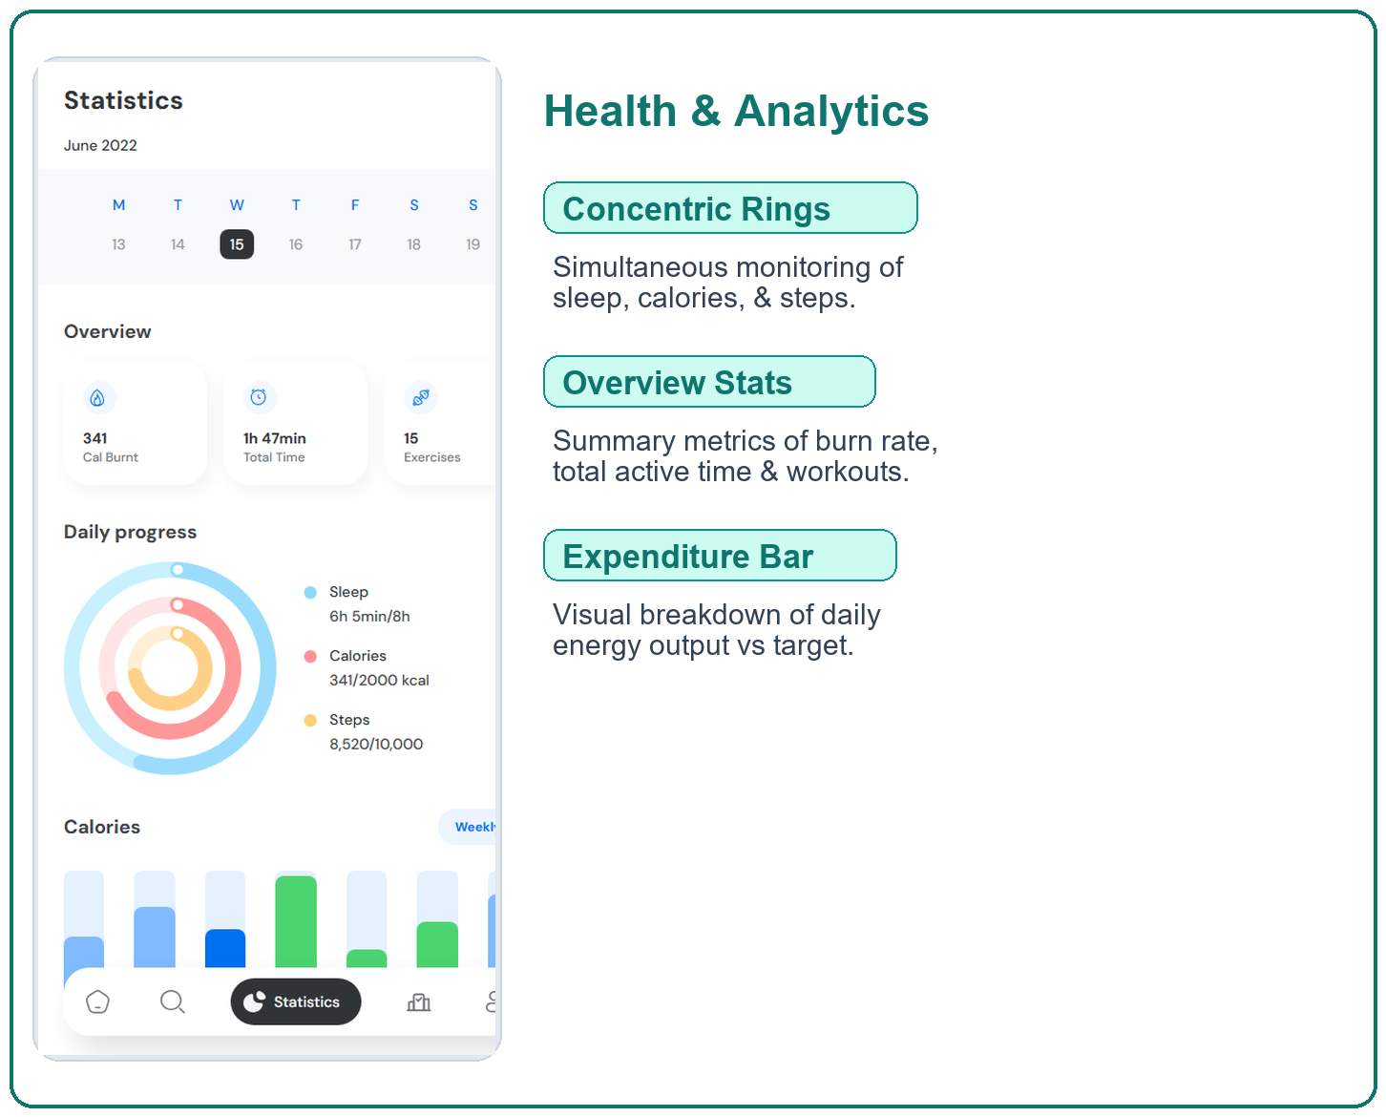

STEPPY: DISTRIBUTED FITNESS GAMIFICATION & REAL-TIME ACTIVITY PLATFORM
Team ID: 25CS1302E-PBL-042 | Section: S14 | Student Lead: P. Shashe Preetham (2300030001) | Faculty Guide: Dr. K. Venkata Rao
Database Systems Engineering and Distributed Backend Development (25CS1302E) | KLH Bachupally Campus, CSE | PBL 2026-27
Abstract
Tools & Technologies
Steppy is a cross-platform distributed fitness gamification ecosystem built with Flutter, React 19, and Google Cloud Firestore. It converts physical movement into an engaging social experience via real-time step streaming, peer-to-peer challenges, tiered XP level progression, and virtual token rewards.
Main Outcome: Outcome: Delivers low-latency (<110ms) state replication across mobile and web with robust offline persistence, boosting long-term fitness habit retention through social accountability.
Front-End Mobile: Flutter 3.x (Dart), Provider state management, fl_chart, flutter_svg, Health SDK.
Front-End Web: React 19, Vite 8, TypeScript 5.7, Tailwind CSS v4, Figma Make Design System.
Back-End & APIs: Google Firebase, Firebase Auth (OAuth 2.0 / JWT), Cloud Functions, FCM Push.
Database & Storage: Cloud Firestore (Distributed NoSQL Document Store), Local SQLite/Hive Cache.
DevOps & Tools: Git & GitHub, Postman, Android Studio, VS Code, Node.js, Chrome DevTools.
Problem Statement & Objectives
Problem: Conventional fitness trackers function as passive, siloed logs with 65%+ 30-day user drop-off due to missing real-time peer engagement and fragile sync on intermittent networks.
Objective 1: Engineer real-time step streaming bridging device sensors (HealthKit/Google Fit) with a distributed NoSQL backend.
Objective 2: Build a gamified challenge and live leaderboard module with sub-120ms real-time event updates.
Objective 3: Implement responsive cross-platform interfaces (Flutter mobile & React/Tailwind web) with offline-first persistence.
Scope: End-to-end user auth, sensor ingestion, challenge lifecycle, live leaderboards, and virtual coin store.
System Architecture
Existing vs Proposed System
Feature | Existing Fitness Systems | Steppy (Proposed System)
Data Architecture | Siloed local DB or polling RDBMS | Distributed NoSQL (Firestore) multi-region cluster
State Replication | Manual refresh / high latency (>2s) | Bi-directional real-time snapshot streams (<110ms)
Platform Coverage | Single mobile OS / fragmented web | Unified cross-platform (Flutter mobile + React 19 web)
Social Dynamics | Static post-workout summaries | Live head-to-head challenges & dynamic XP leveling
Offline Resilience | Sync errors on network drops | Dual-tier local cache with automatic reconciliation
ER Diagram & Database Design
Feasibility Study
Technical: Built with production-grade open tooling (Flutter 3.x, React 19, TypeScript, Cloud Firestore). Sensor SDKs (HealthKit & Health Connect) provide standardized platform telemetry. 100% serverless cloud backend guarantees 99.9% availability.
Economic: Entirely zero-cost infrastructure leveraging open-source toolchains. Firebase Spark tier grants 50k reads, 20k writes/day, and 1GB storage for free, perfectly covering academic demonstration and seamless pay-as-you-scale adoption.
Operational: Consumer-grade mobile UX based on Figma specifications. Concentric progress rings, workout cards, and weekly calendar views ensure zero user learning curve and high habit retention across mobile and web.
Schedule: Executed in 12-week semester sprint: W1-3 (SRS & Schema Design), W4-7 (Mobile & Web UI), W8-10 (Real-Time Streams & Gamification), W11-12 (Testing, Security Auditing & Release).
Implementation Screenshots
Results & Testing
Conclusion
Future Scope
Latency Testing: Firestore document read/write latency clocked <110ms with sub-120ms multi-client peer update propagation.
Security & ACLs: 100% test pass on Firestore security rules. Unauthorized step injection and unauthorized challenge edits blocked.
Offline Resilience: Smooth local cache fallback with zero data corruption upon automatic reconnect.
Outcome: Successfully architected and deployed Steppy, a complete distributed fitness gamification platform fulfilling all PBL course deliverables.
Impact: Proved that reactive NoSQL document streaming coupled with game psychology (XP, badges, store items) substantially increases user engagement and fitness routine adherence.
1. Wearable BLE Sync: Direct Bluetooth Low Energy integration with WearOS and Apple Watch sensors.
2. On-Device Edge ML: TensorFlow Lite model for adaptive goal calibration and fatigue risk detection.
3. Social Guilds: Campus-wide guild tournament system with group step multipliers and NFT rewards.
References: [1] Google Cloud Firestore, Distributed NoSQL Database Architecture & Real-Time Streams, 2026. [2] Flutter Foundation, Building Reactive Cross-Platform Client Applications, 2026. [3] J. Hamari et al., "Does Gamification Work? A Literature Review on Motivating Health Behaviors," Computers in Human Behavior.

