Slide 1
Machine Learning (CC2008)
Ana Rocha, 202208946
Pedro Silva, 202205150
Utsav Acharya, 202204009

Slide 2
Project Goals and Approach
The main goal of this project is to enhance the performance of the Random Forest Classifier, when dealing with imbalanced class distributions.
Specifically, we aim to address the class imbalance issue using the SMOTE (Synthetic Minority Over-sampling Technique) method.
Overall, the application of SMOTE in our Random Forest model led to improvements in handling class imbalance, but the gains were not substantial. While we observed better performance metrics, particularly in balanced accuracy, the improvements were moderate.

Slide 3
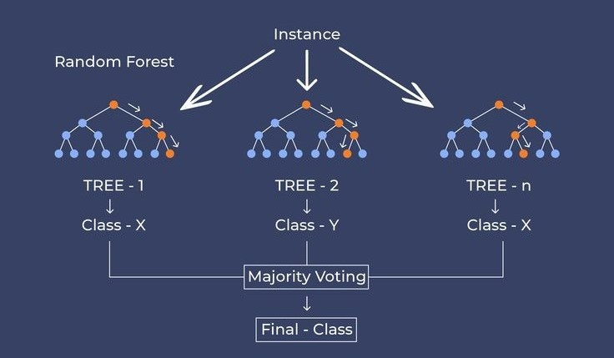
Random Forest
The Random Forest algorithm is a machine learning technique that constructs multiple decision trees during the training process. Each tree is built using a random subset of the dataset and a random subset of features for each split. This randomness introduces diversity among individual trees, which helps to reduce the risk of overfitting and enhances the overall predictive performance of the model.
When applied to datasets with class imbalance the Random Forest algorithm exhibits specific behaviours.

Slide 4

Random Forest
Due to the bootstrap sampling method, if a class is underrepresented in the original dataset, it will likely remain underrepresented in the bootstrapped samples used to train each tree. This can lead to a bias towards the majority class, as the trees may not have enough examples of the minority class to learn effectively.
Additionally, the algorithm tends to identify and prioritize features that distinguish the majority class, which can hinder the correct classification of the minority class.

Slide 5
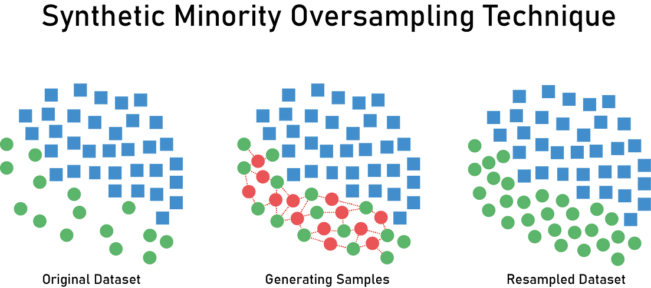
SMOTE
To solve the problem of class imbalance in Random Forest models, we propose using the Synthetic Minority Over-sampling Technique (SMOTE). This technique is a type of oversampling method that generates synthetic examples in the feature space to balance the minority class, thereby improving the performance of predictive models.
We developed two hypotheses.

Slide 6
SMOTE hypotheses
“Binary SMOTE”
Our Binary SMOTE approach is designed to strategically apply the SMOTE technique to only a subset of the decision trees. For instance, if the Random Forest algorithm is set to generate 10 trees, it ensures that 5 of these trees are built using a dataset where the minority class has been synthetically oversampled to match the size of the majority class (100% SMOTE), while the remaining 5 trees are built without any SMOTE applied (0% SMOTE).
This approach allows us to observe if the appliance of SMOTE affect the model's performance.
“Gradient SMOTE”
This approach involves gradually increasing the application of SMOTE across the trees in the Random Forest. The first tree is built without any SMOTE (0% SMOTE), the second tree with a small amount (20% SMOTE), the third with more (40% SMOTE), and so on. This gradient approach allows us to observe how varying levels of synthetic oversampling affect the model's performance.

Slide 7
Hypotheses study

Slide 8
Selected datasets and their characteristics
For our empirical study, we selected datasets that are entirely numeric. This decision was driven by the requirements of the SMOTE technique, which relies on numerical calculations to generate synthetic samples. By choosing numeric datasets, we ensured that SMOTE could be applied effectively and efficiently. Of course, we could have chosen other datasets, but we would have to transform the categorical variables into numerical ones, which would be computationally intensive. Additionally, all selected datasets exhibit class imbalance, making them ideal candidates for evaluating the performance of our proposed approaches

Slide 9
pc4 id: 1049 | False 0.877915 True 0.122085
wall-robot-navigation id: 1497 | 1 0.404142 2 0.384348 4 0.151393 3 0.060117
kc2 id: 1063 | no 0.795019 yes 0.204981
balance-scale id: 11 | L 0.4608 R 0.4608 B 0.0784
banknote-authentication id: 1462 | 1 0.555394 2 0.444606
phoneme id: 1489 | 1 0.706514 2 0.293486
steel-plates-fault id: 40982 | Other_Faults 0.346728 Bumps 0.207110 K_Scratch 0.201443 Z_Scratch 0.097888 Pastry 0.081401 Stains 0.037094 Dirtiness 0.028336
spambase id: 44 | 0 0.605955 1 0.394045
kc1 id: 1067 | False 0.845424 True 0.154576
first-order-theorem-proving id: 1475 | 6 0.417457 1 0.177999 3 0.122262 5 0.101994 4 0.100850 2 0.079438

Slide 10
Hyperparameters and Metrics
Hyperparameters
We set n_estimators to 10, meaning the forest comprises 10 decision trees. This balance allows for sufficient variability without excessive computation time. The min_samples_split parameter was set to 10, ensuring that a node only splits if it contains at least 10 samples, which helps prevent overfitting by avoiding splits with too few samples.
Metrics
We set n_estimators to 10, meaning the forest comprises 10 decision trees. This balance allows sufficient variability, without excessive computation time. The min_samples_split parameter was set to 10, ensuring that a node only splits if it contains at least 10 samples, which helps preventing overfitting, by avoiding splits with too few samples.

Slide 11
Analysis of results
Notes:
discussion, in light of hypothesized effect

Slide 12
In conclusion, the goals o this project were successfully achieved, as both the Binary SMOTE and Gradient SMOTE hypotheses led to improvements in the performance metrics of the Random Forest model when dealing with class imbalance. However, the enhancements were not substantial, the higher the imbalance, the better the results, especially in balanced accuracy.
This suggests that while SMOTE can aid in addressing class imbalance, additional strategies or further optimization (SMOTE optimization) may be necessary to achieve significant performance improvements.

Slide 13
Thanks!
Do you have any questions?
Please keep this slide for attribution

