Slide 1
TELECOM CHURN PREDICTION
Enabling Targeted Retention Offers using Machine Learning
CAPSTONE PROJECT
GROUP - 1

Slide 2
INTRODUCTION
Welcome to our presentation on Customer Churn Prediction in the Telecommunication Industry.
The objective is to leverage Machine Learning to predict customer churn and enable targeted retention offers.
This will lead to increased customer satisfaction and reduced churn rates, benefiting both the company and society.
CHURN PREDICTION is one of the most popular Big Data use cases in business. It consists of detecting customers who are likely to cancel a subscription to a service.
CHURN is a problem for telecom companies because it is more expensive to acquire a new customer than to keep your existing one from leaving.

Slide 3
Dataset Description
The Source dataset is in csv format
Dataset contains 2 lakhs rows and 30 columns
There are some missing values for the provided input dataset
The variable known as churn indicates whether a specific consumer gets churned or not, and we will be creating models to forecast it.
Challenge of Churn in Telecom
High customer churn rates are a significant challenge for telecommunication companies.
Losing customers leads to increased costs for acquiring new ones and impacts overall revenue.
Machine Learning offers a promising solution to tackle this issue.

Slide 4
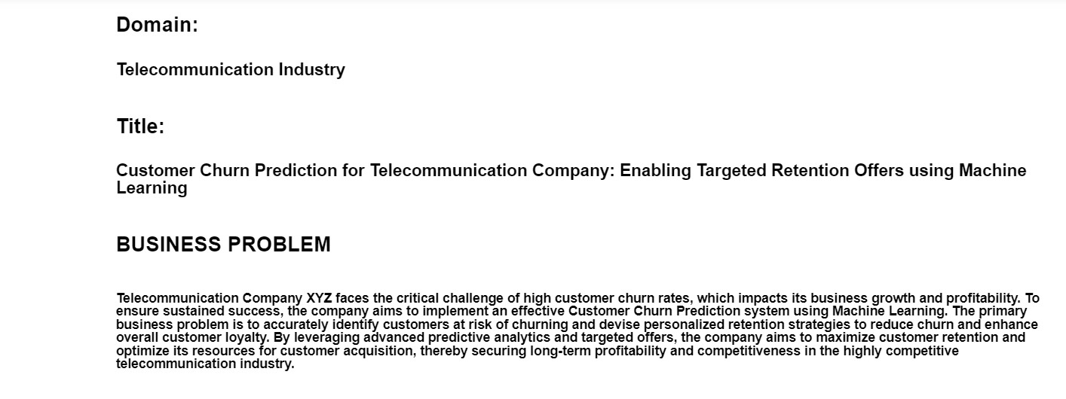
BUSINESS PROBLEM

Slide 5
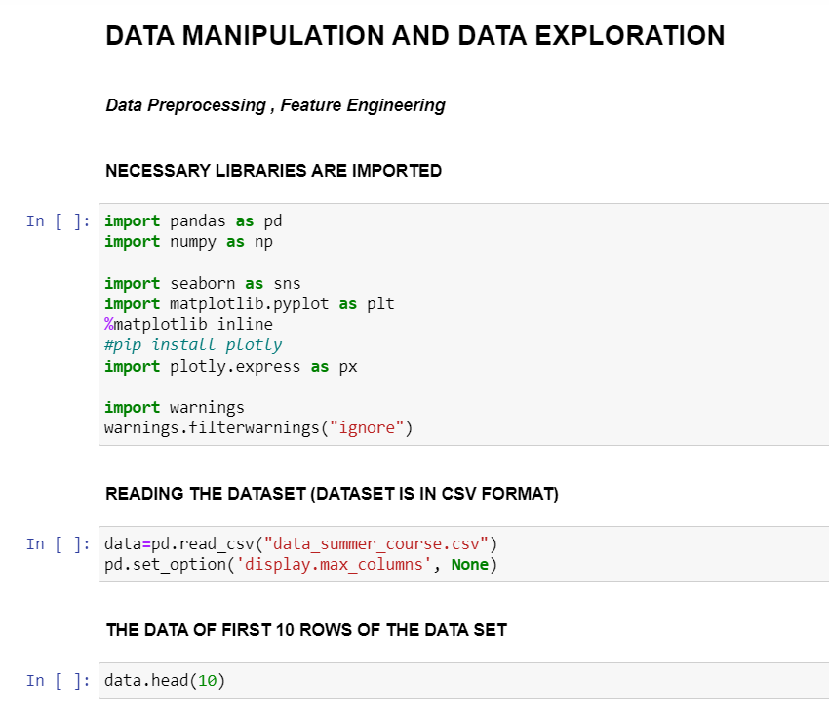
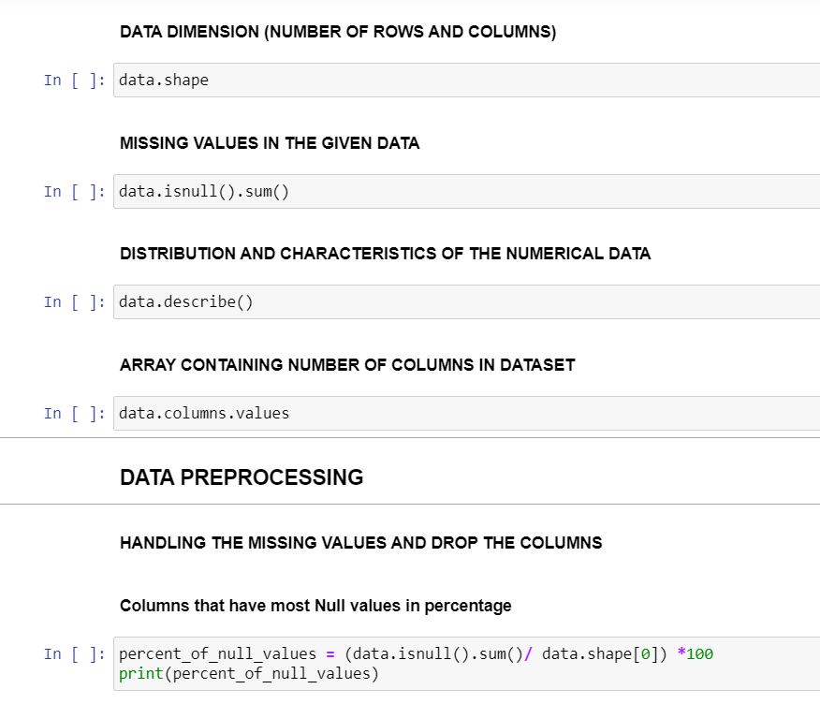
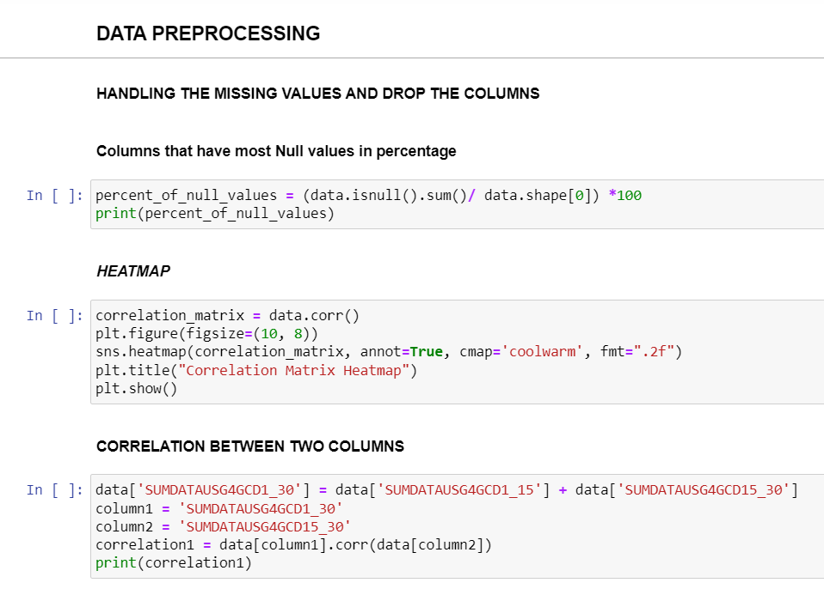
DATA EXPLORATION AND data MANIPULATION

Slide 6
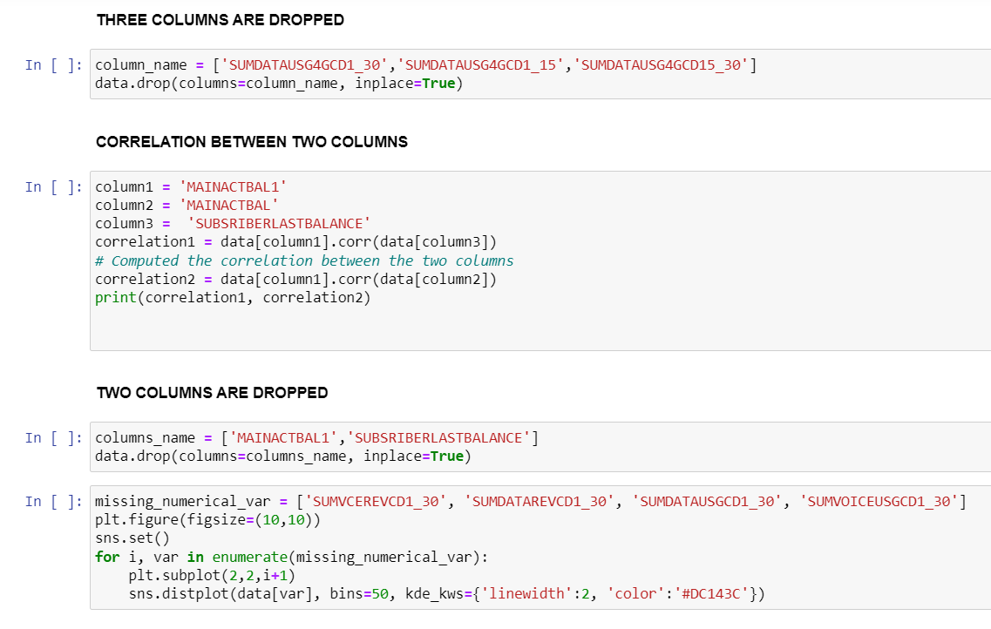
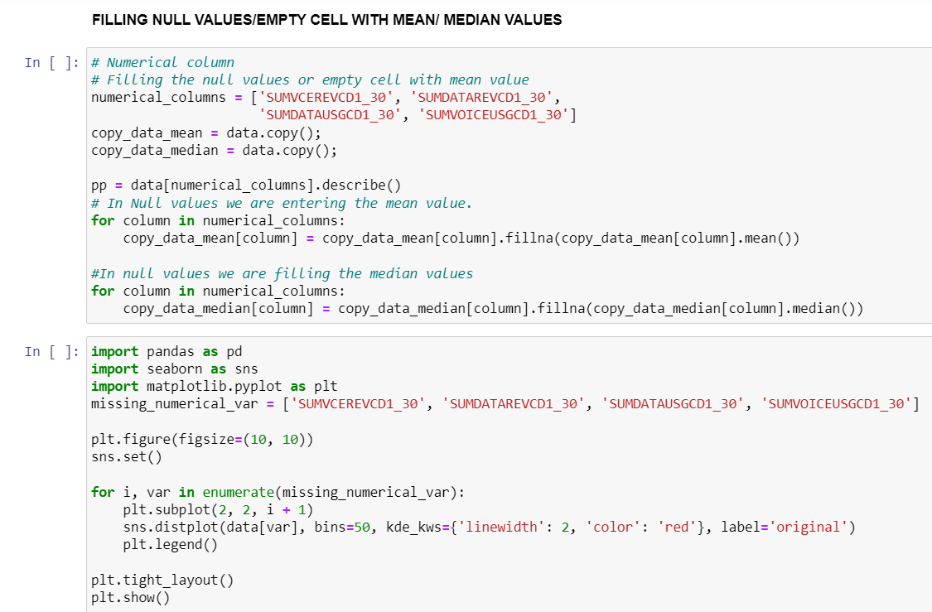
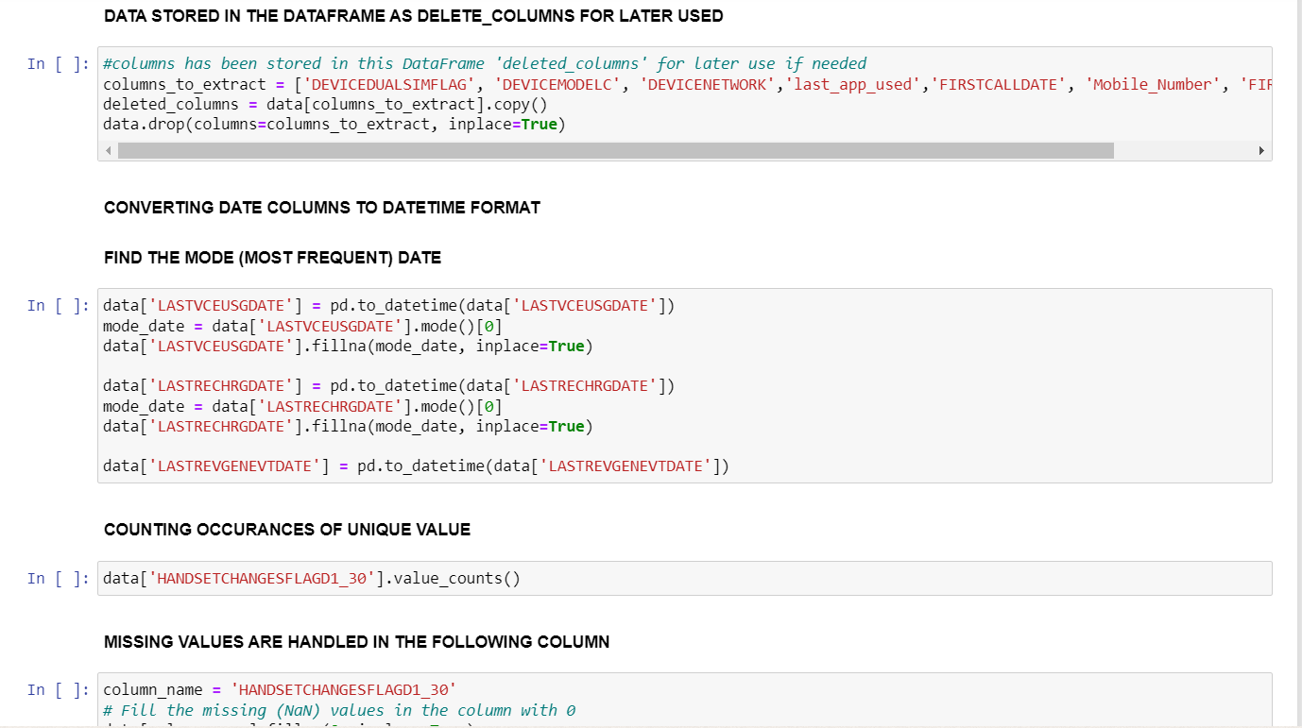
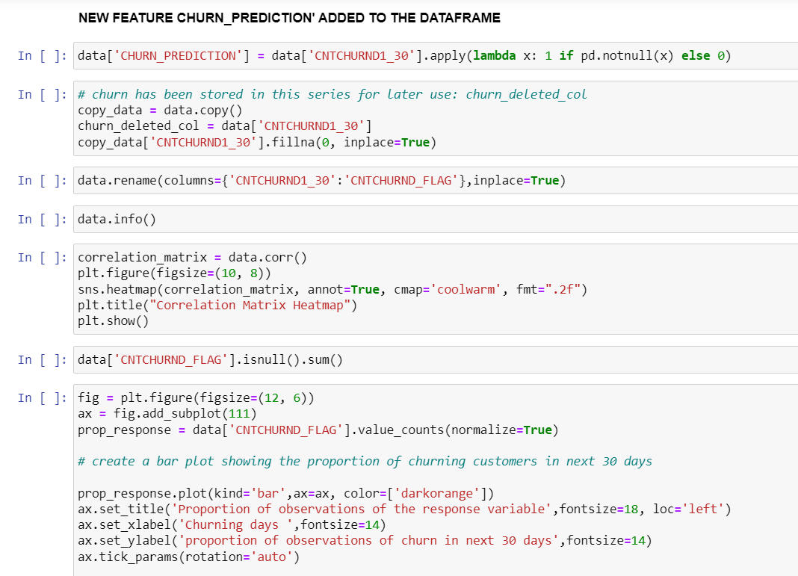
DATA EXPLORATION AND data MANIPULATION

Slide 7
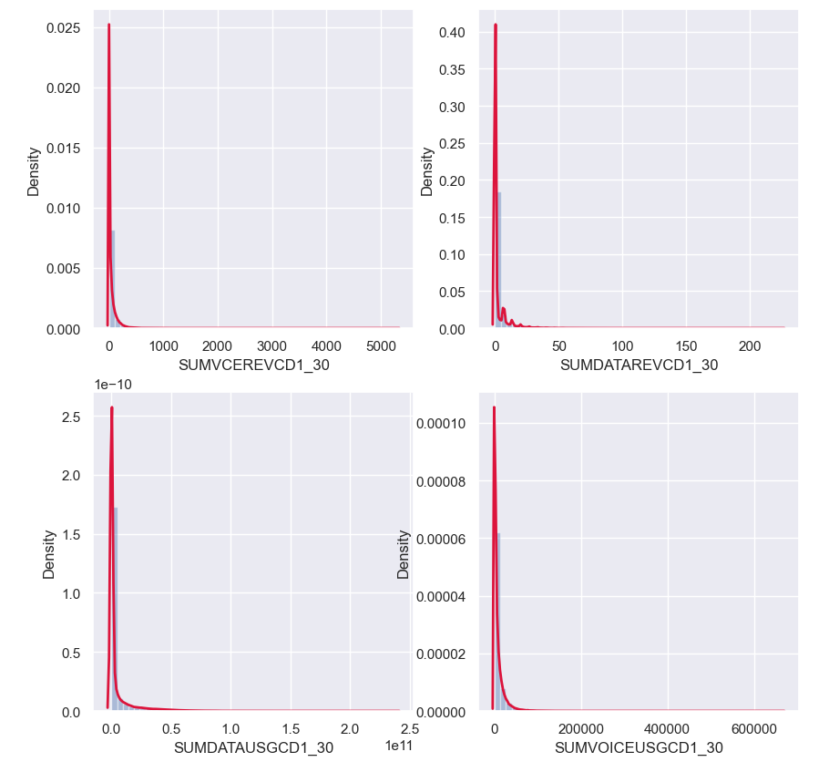
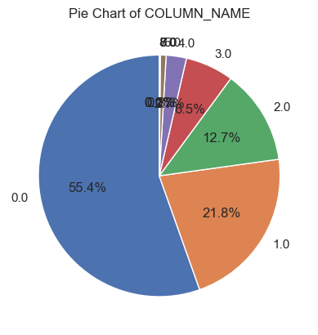
DATA PREPROCESSING
MISSING VALUES
DISTRIBUTION OF CNTCHURN_FLAG COLUMN IN PIECHART

Slide 8
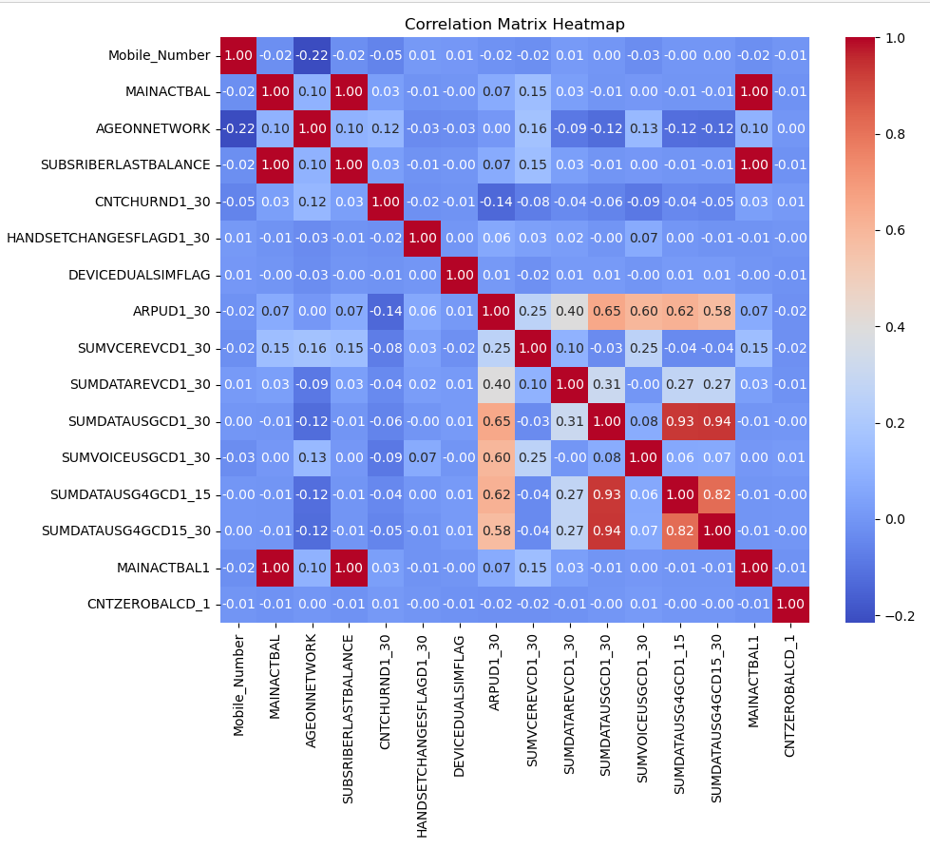
DATA PREPROCESSING
The correlation matrix heatmap is a powerful visualization that allows you to identify patterns and relationships between different numeric variables in the dataset. High positive values (close to 1) indicate strong positive correlations, meaning when one variable increases, the other tends to increase as well. High negative values (close to -1) indicate strong negative correlations, meaning when one variable increases, the other tends to decrease. A correlation coefficient close to 0 suggests little to no linear relationship between the variables.

Slide 9
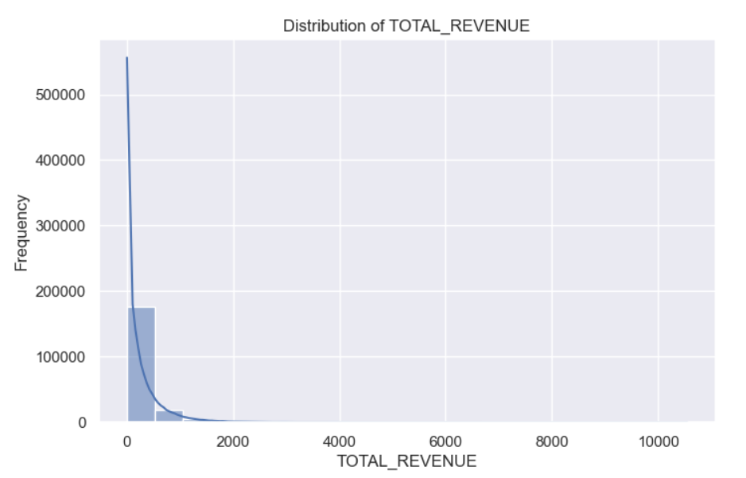
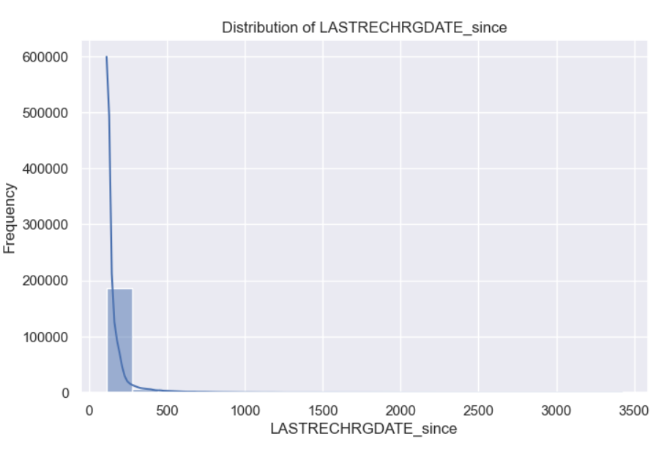
EXPLORATORY DATA ANALYSIS
UNIVARIATE ANALYSIS
NUMERIC FEATURES
The univariate histogram gives us an idea of how the data in each numeric column is distributed. It helps us understand the central tendency, the spread of data, and any potential outliers in the dataset. By visualizing the data in this way we can quickly identify patterns or irregularities, make comparisons between different columns, and gain insights into the characteristics of each variable individually.

Slide 10
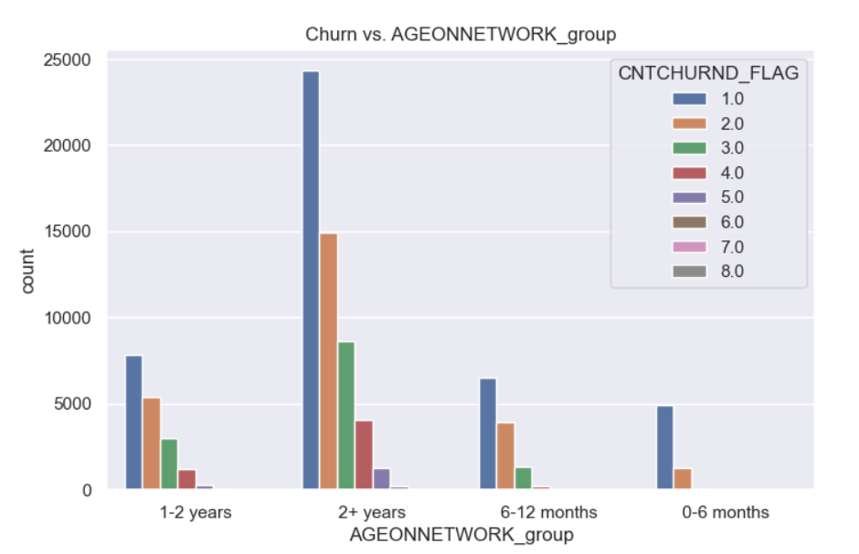
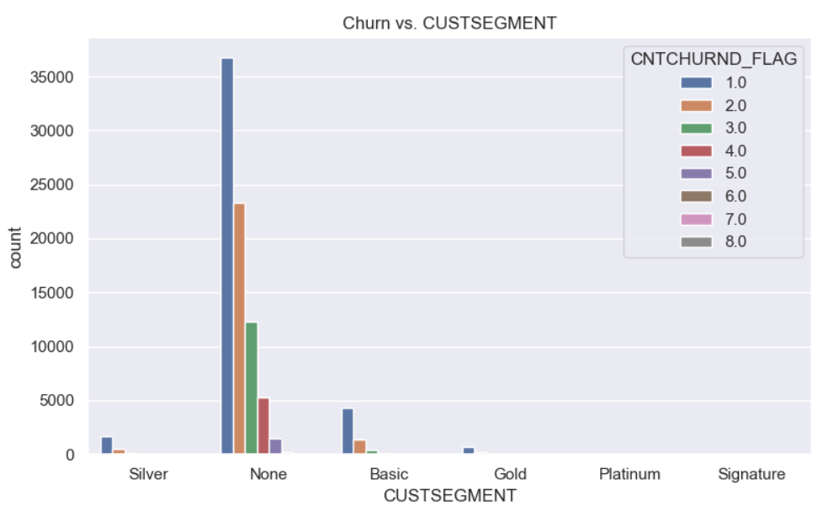
EXPLORATORY DATA ANALYSIS
bivariate ANALYSIS
CATEGORIAL FEATURES
Bivariate Analysis between the "Churn" variable and each of the categorical features in the dataset. Bivariate Analysis involves exploring the relationship between two variables to understand how they interact or influence each other. The goal of this Bivariate Analysis is to understand how the categorical features are related to the "Churn" variable and to identify any patterns or trends that may be useful for further analysis or predictive modeling related to customer churn.

Slide 11
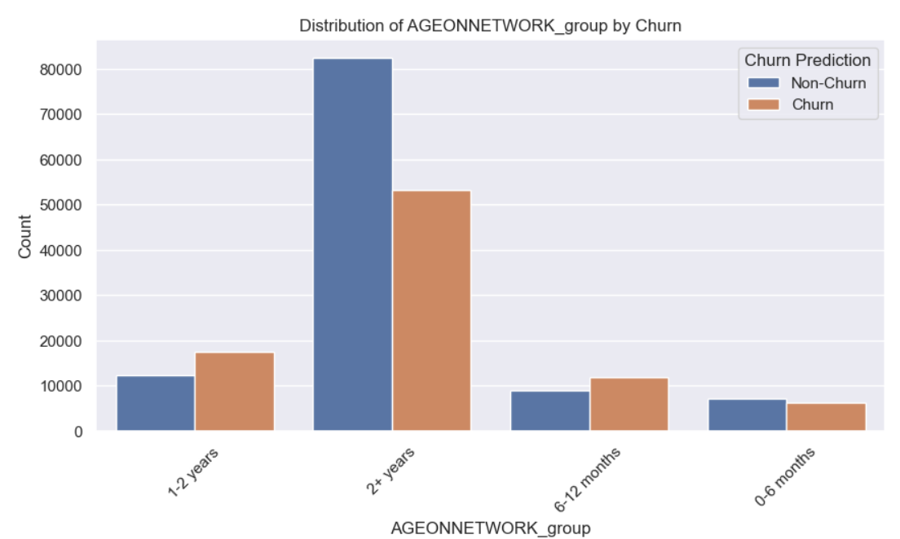
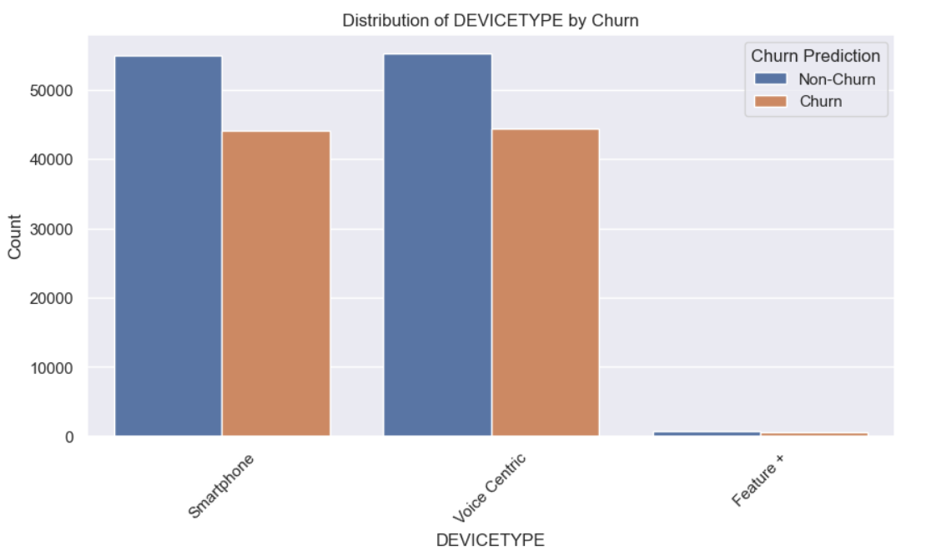
BIVARIATE ANALYSIS (COUNTPLOT)
Visualizing the distribution of each categorical feature (column) in the dataset with respect to the "Churn" prediction. This helps us understand how each categorical feature is related to the predicted churn outcome.
This analysis helps in understanding which categorical features may have significant differences in their distributions between customers who are predicted to churn and those who are not predicted to churn. Such insights are valuable for identifying important predictors of churn and making data-driven decisions to reduce customer churn rates.

Slide 12
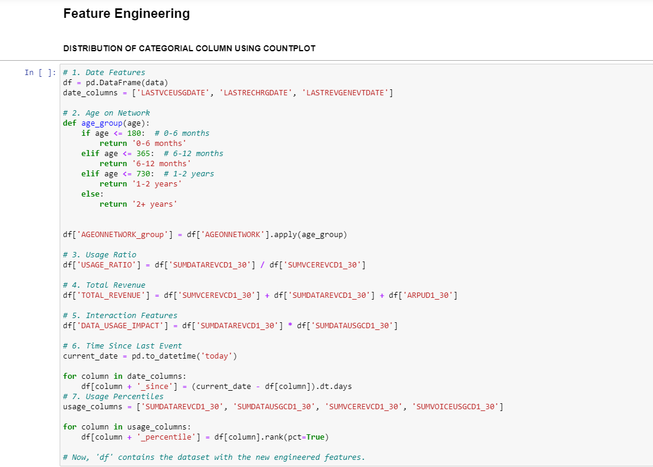
FEATURE ENGINEERING

Slide 13
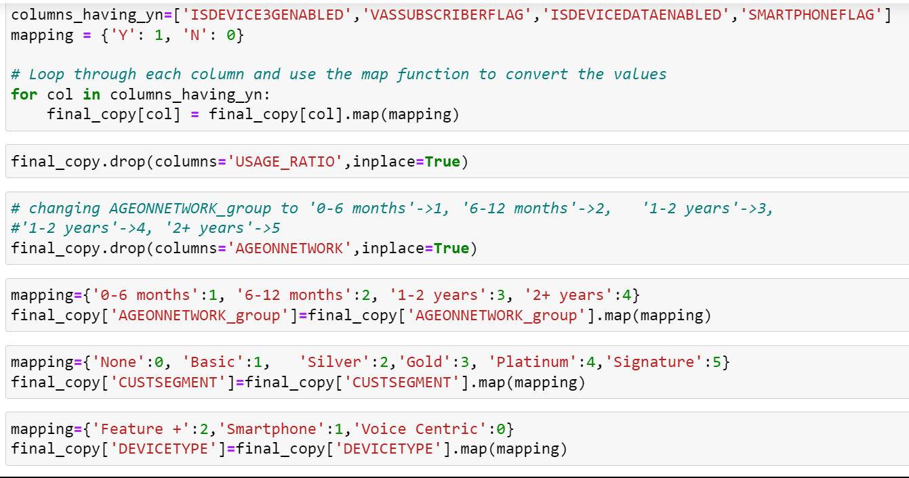
Transforming Existing Features to numerical

Slide 14
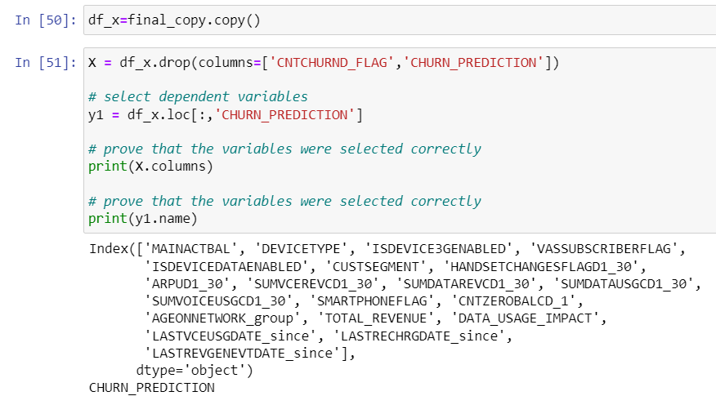
FINAL DATASET
(AFTER DATA PREPROCESSING ,EDA,FEATURE ENGINEERING , etc.)

Slide 15
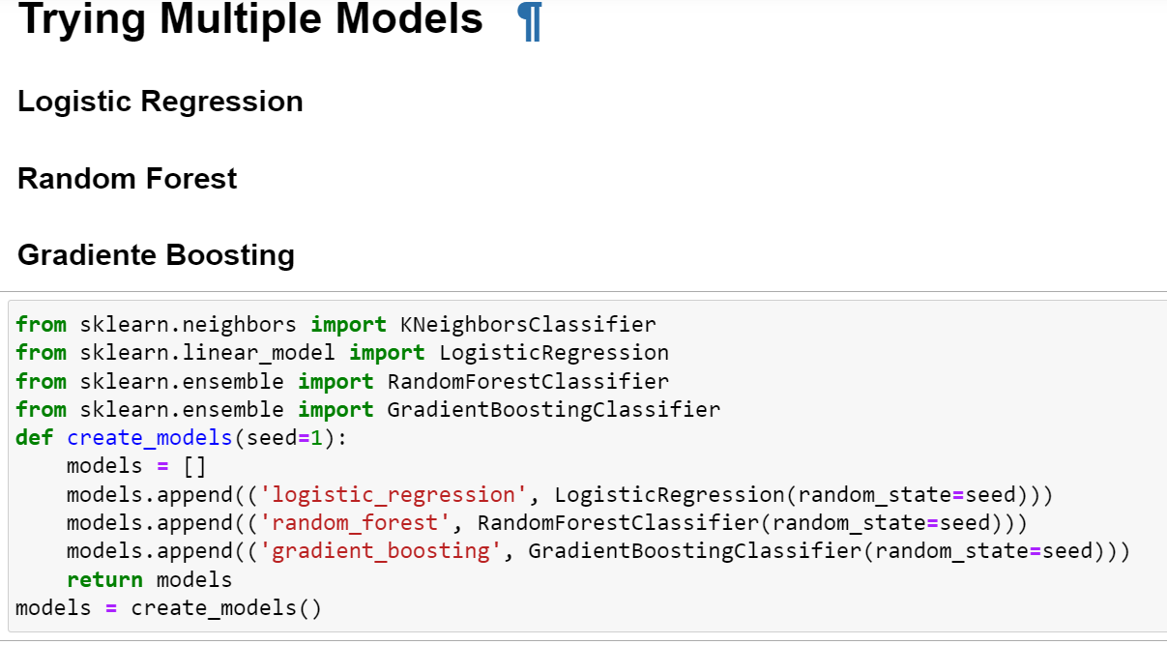
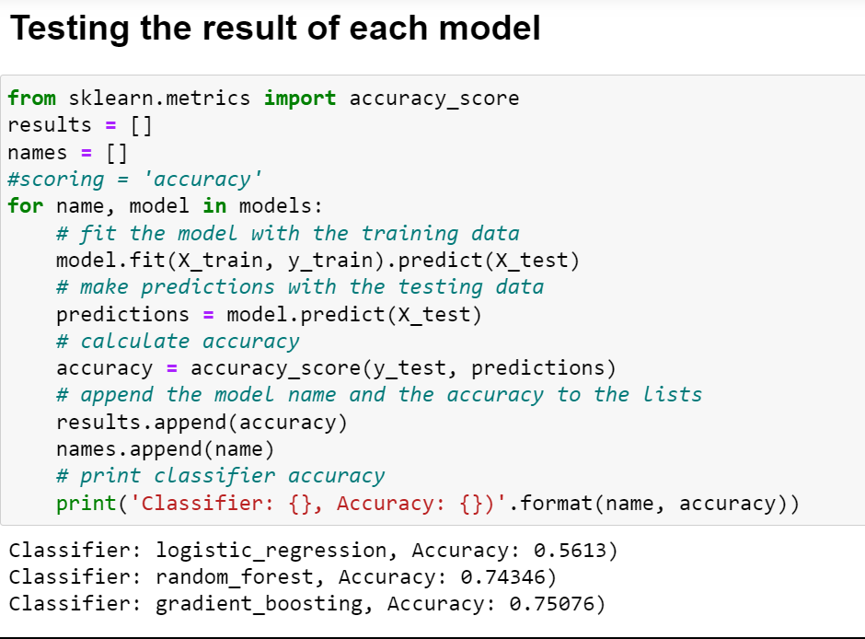
IMPLEMENTATION OF MODEL USING MACHINE LEARNING
PREDICTING WHICH MODEL GIVES US THE BEST ACCURACY
Gradient boosting with accuracy – 0.75076

Slide 16
CONCLUSION
Customer Churn Prediction using Machine Learning enables telecommunication companies to retain valuable customers and reduce churn rates.
Targeted retention offers benefit both the company and society by fostering a sustainable and customer-centric approach.

Slide 17






TEAM MEMBERS
CH. RABI NARAYAN PATRA
MANISH KUMAR PRASHAN
SOURAV PAL
PRANAB NAYAK
PRAVIVEEK RAY
SAMRIDHI PATTANAYAK

Slide 18
THANK YOU

