Slide 1
Test Review & Reteach
[ 5.00 ] [ Today’s Date ] [ Instructor Name ]

Slide 2
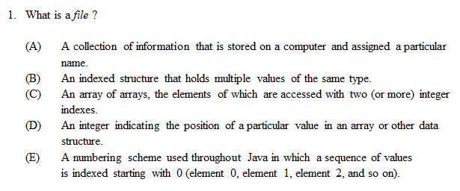

Slide 3
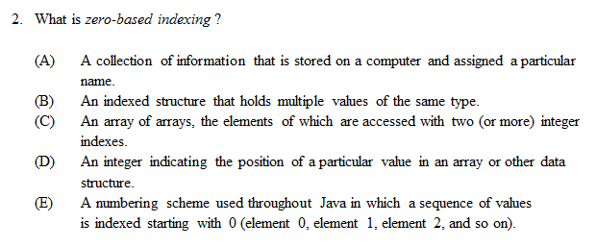

Slide 4
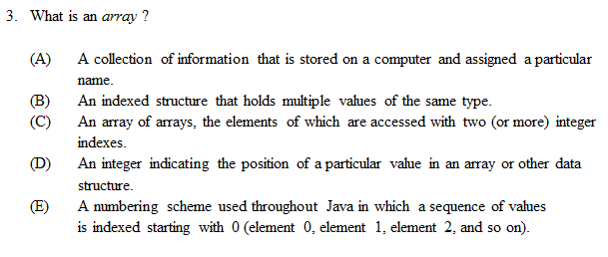

Slide 5
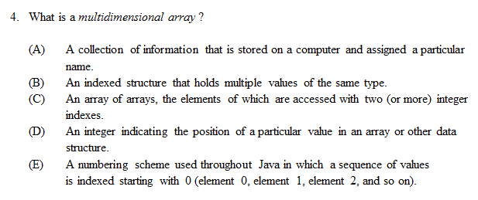

Slide 6
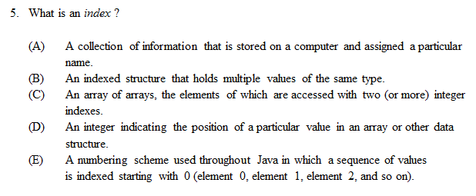

Slide 7
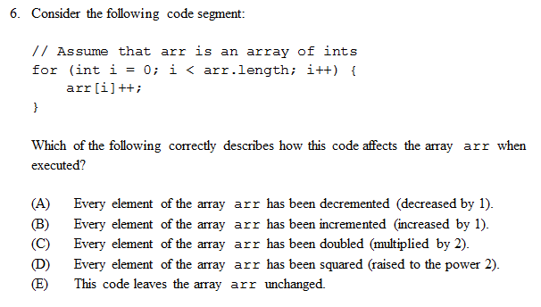

Slide 8
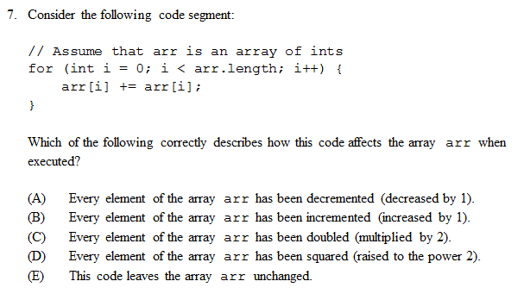

Slide 9
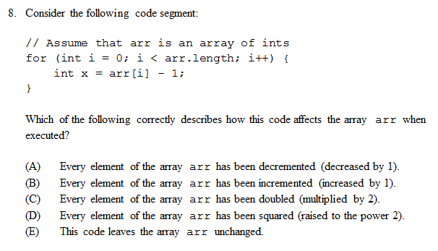

Slide 10
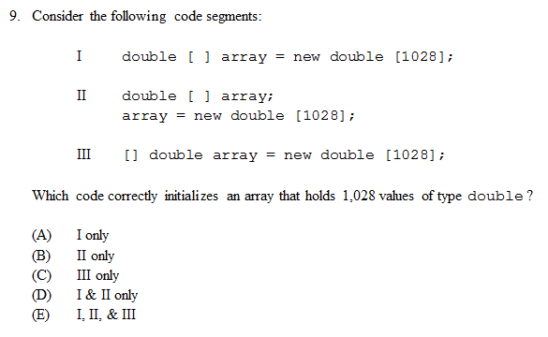

Slide 11
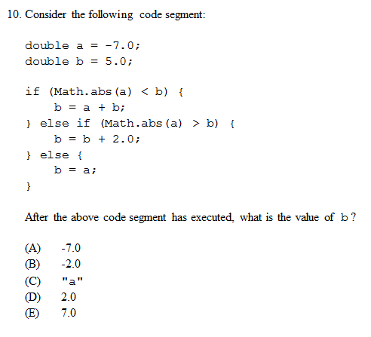

Slide 12
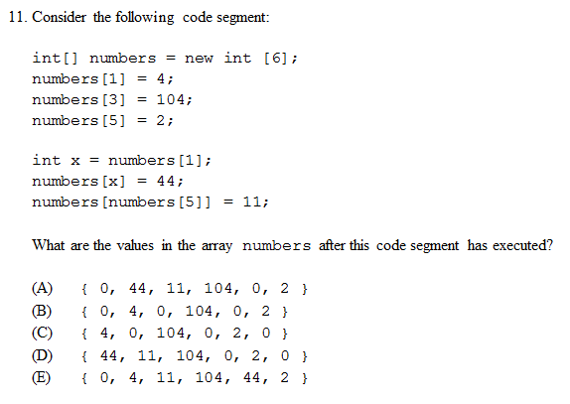

Slide 13
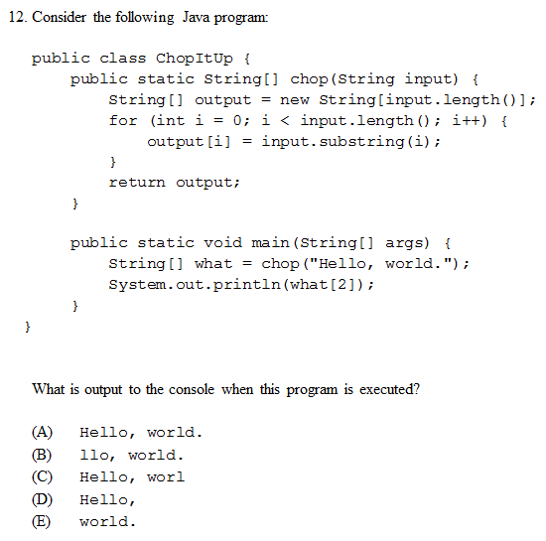

Slide 14
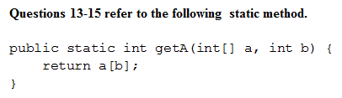
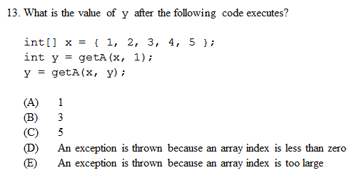

Slide 15
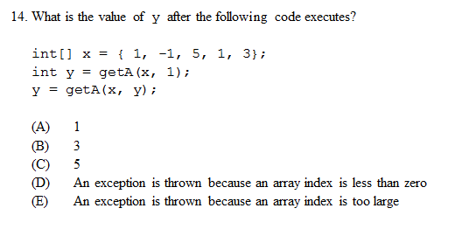

Slide 16
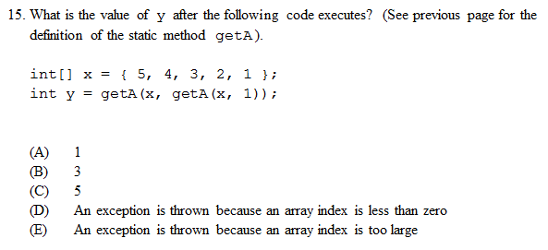

Slide 17
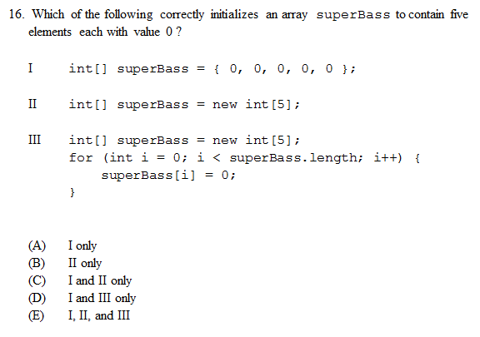

Slide 18
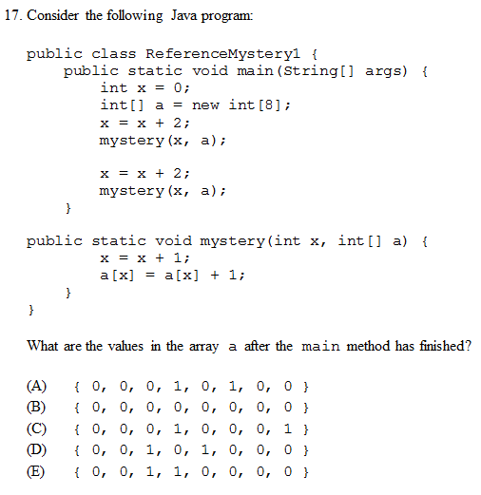

Slide 19
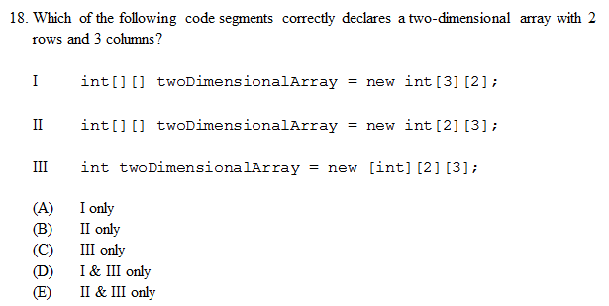

Slide 20
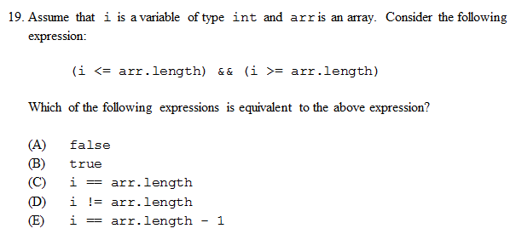

Slide 21
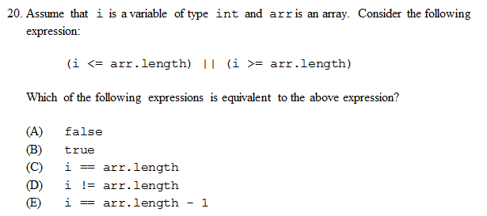

Slide 22
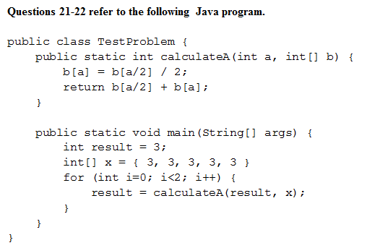
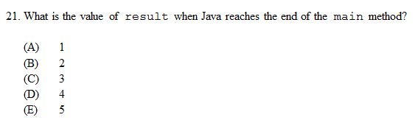

Slide 23
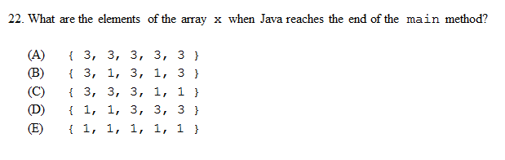

Slide 24
Homework
Correct any incorrect test answers by re-answering on a separate sheet of paper:
To get back credit, you must justify your new answers.
Staple new answer sheet to the old test and return it tomorrow.

Slide 25
Object-Oriented Programming
[ 5.01 ] [ Today’s Date ] [ Instructor Name ]

Slide 26
Modeling and Design in Object-Oriented Programming
Notes:
What do we mean by making “design decisions?”To model something in a program, you need to make decisions about what data and actions are important to your model.
Ask students to offer some design decisions for the following classes (each on its own slide):
a forecast, student, or dog

Slide 27



What if you were to design a Forecast class?
forecastOK
forecastAZ
forecastAK
Notes:
Discussion points to bring up/guide students to:
If you’re interested in forecasting a tornado, you might choose to model the weather with finer granularity than you might opt for if predicting rainfall or cloud cover.
Different model components will be appropriate in different situations.
Does a forecast written by a student in Arizona need the same inputs and methods as a forecast in Oklahoma? What might be different? The same?

Slide 28

Design the Student class
What might be an application of a Student class?
What behaviors (methods) and data (states) does a student have?
Notes:
Schools often use Learning Management Systems that keep track of attendance, grades, student information, etc. How could this information be stored? What methods would you design to manipulate this data?
If students are suggesting overly-complex models of student1 or myDog, use it as an opportunity to discuss complexity. Is it always a good idea to add states and behaviors (data and methods)? When is it appropriate to make a model more complex? When do you want to keep it simple?
The rule of thumb is to only include the complexity you need. If this language works for your class, tell them to always design around principles of completeness, robustness, and simplicity.
Completeness: Does this model do everything I need it to do? Does it contain all the data I need it to contain?
Robustness: Is this model sufficiently flexible for everything I need it to do? Can I use it in different contexts (this isn’t important in this unit, but will become important later.)
Simplicity: Can my model be simpler? Extra complexity can lead to coding mistakes or errors down the road. I want my code to be easy for other programmers to read/interpret.

Slide 29
Considerations for effective modeling
Completeness
Robustness
Simplicity
Notes:
Completeness: Does this model do everything I need it to do? Does it contain all the data I need it to contain?
Robustness: Is this model sufficiently flexible for everything I need it to do? Can I use it in different contexts (this isn’t important in this unit, but will become important later.)
Simplicity: Can my model be simpler? Extra complexity can lead to coding mistakes or errors down the road. I want my code to be easy for other programmers to read/interpret.

Slide 30



Design the Dog class
What behaviors (methods) and data (states) does a common dog have?
myDog
sistersDog
teachersDog
Notes:
Completeness, Robustness, and Simplicity

Slide 31
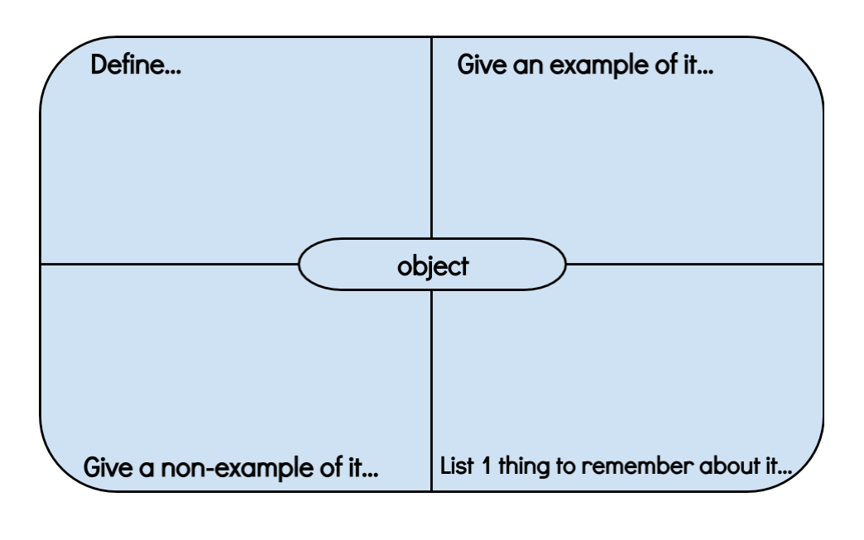
Graphic Organizer

Slide 32
Objects = State (Data) + Behavior (Methods)
// Data is stored in an array.
int[] digits = {1, 2, 3, 4, 5, 6, 7, 8 , 9, 10};
// Method dictates actions.
System.out.println(Arrays.toString(digits));

Slide 33
Why isn’t this an object or model?
while (guess != number) {
System.out.println(“Incorrect.”);
System.out.println(“Your guess? “);
guess = console.nextInt();
numGuesses++;
}

Slide 34


Client Code
Code that uses the object.
What program (client code) might need to access the data and methods stored in:
student1
myDog

Slide 35

Think-Pair-Share
Create these objects:
1. myDog, teachersDog, sistersDog
2. student1, student2, student3
3. forecastNY, forecastAZ, forecastOK

Slide 36
A class
A blueprint or outline for a particular set of objects.
Class: Instances:
Dog myDog, sistersDog, teachersDog, …
What are some other examples?

Slide 37
Key Components of a Class
Fields: outline what data (state) the object will hold.
Methods: outlines the behavior of each object.
Constructor: code that initializes the object being constructed.

Slide 38
Read through the Point Class and complete the following Practice problems:
Self-Check 8.1: whatIsOOP
Self-Check 8.2: whatIsAnObject
Self-Check 8.3: StringObject
Self-Check 8.4: ReferenceMystery3
Self-Check 8.5: CalculatorObject

Slide 39

Encapsulation
A class uses encapsulation to protect the object’s data from outside access (by the client code). You do this by making each field private.

Slide 40
Research a Custom Pokemon Class:
i. http://www.pokemon.com/us/parents-guide/
(Basic overview of the game)
ii. https://youtu.be/DlEbXH8eUTk?t=1m26s
(this is a 30 minute YouTube video of gameplay)
iii. http://www.pokemon.com/us/pokedex/ (types of Pokemon)
iv. http://tinyurl.com/no4mzic (Pokemon with stats)
v. http://en.wikipedia.org/wiki/Gameplay_of_Pokémon
(Wikipedia entry)

Slide 41
Homework
Read HW 8.1

Slide 42
Object State & Behavior
[ 5.02 ] [ Today’s Date ] [ Instructor Name ]

Slide 43
Recap
What is a field?
What is an instance method?
What were the two ways that we write a translate instance method?
public void translate(int dx, int dy) {
x += dx;
y += dy;
}
public void translate(int dx, int dy) {
this.x += dx;
this.y += dy;
}
Compiler
Notes:
Field: A variable inside an object that makes up part of its internal state.
Instance Method: A method inside an object that operates on that object.
One used the implicit parameter, this; the other did not. Neither is more correct.

Slide 44
Mutators
The translate method is an example of a mutator
Generally, a mutator assigns a new value to one of the object’s fields
In a radio, the mutators would be things like:
On/off switch
Volume knob
Tuning dial
Preset station selection switches
Mutator: An method that modifies the object’s internal state.
Notes:
Reminder:
Instance Method: A method inside an object that operates on that object.

Slide 45
Mutator conventions
It is common for a mutator method’s name to begin with “set”, e.g.
setVolume
setStation
What was the return type of our translate instance method?
Usually mutators methods have a void return type; they change the state of the object but have nothing to return
What were the formal parameters of our translate instance method?
Mutator methods often accept parameters that specify the new state of the object, or how to modify the object’s current state
Notes:
void
Formal parameter: A variable that appears inside parentheses in the header of a method that is used to generalize the method’s behavior.

Slide 46
Accessors
Accessors form a second important category of instance methods
Generally, an accessor returns the value of one of the objects fields
In a radio, the accessors might:
Tell us the current station
Tell us the current volume
Tell us whether the radio is turned on
What are some accessor methods you have used on other classes?
Accessor: An instance method that provides information about the state of an object without modifying it.
Notes:
length and substring on String
exists method on FIle

Slide 47
Accessor conventions
It is common for an accessor method’s name to begin with “get” or “is”, e.g.
getVolume
getStation
isTurnedOn
Accessor methods usually do not have a void return type
What might the return type be for each of the above three methods?
Accessor methods don’t usually have any formal parameters

Slide 48
Any questions about mutators and accessors?

Slide 49
Remind Students from yesterday’s class.
So far, we’ve created fields in our classes that state what data will be stored in all instance objects.
What would be a good method to include in all instances of the Student class?
What would be a good method for all instances of the Dog class to have?
What method should all forecasts have, no matter what area you’re forecasting for?

Slide 50
 Practice
// File: Point.java
public class Point {
int x;
int y;
public void translate(int dx, int dy) {
this.x += dx;
this.y += dy;
}
}
Add an accessor method to our existing Point class: getDistanceFromOrigin
Write client code that uses the new method
Before you start, think about:
What should its return type be?
What formal parameters should it have?
How will you compute the return value?
Annotate your code, use the words “accessor” and “mutator”

Slide 51
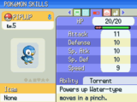
Fields
public class Pokemon {
//What are some examples of fields
//What would fields look like for
\ //a student, dog, or forecast?
}
Notes:
This begins the slides that go along with Option #2 - Pokemon

Slide 52
Methods
What would be a good method to include in all instances of Students?
What would be a good method for all instances of the Dog class?
What method should all forecasts have, no matter what forecast?

Slide 53
Accessor Methods
public class Student {
private String name;
public String getName () { // getter accessor method
return name;
}
public void setName(String newname) { // setter accessor method
name = newname;
}
}

Slide 54
Accessor Example
public class FormGroups {
public static void main (String args[]){
Student groupLeader = new Student();
groupLeader.setName(“Pat”);
System.out.println (“The group leader is “ + groupLeader.getName());
}
}
Note:
The return expression from groupLeader.getName() is a reference to an object.
A copy of that reference is returned, not a copy of the object.

Slide 55
Methods: Pokémon
Pokémon get an effort ribbon if their combined stats exceed a certain value – what’s a good way to get all of a Pokémon's stats?
What would the method sumStats look like?

Slide 56
sumStats:
public int sumStats() {
return(HP + attack + defense + specialAttack + specialDefense + speed);
}

Slide 57
Methods: Pokemon
Pokemon use vitamins to boost their stats. Here are some examples:
Vitamin Function
hpUp + points to HP
protein + points to attack
iron + points to defense
Now write a method, consumeVitamin, that actually changes the state.

Slide 58
consumeVitamin
public void consumeVitamin( int hpUp, int protein …) {
hp += hpUp;
attack += protein;
…
}

Slide 59
Constructors
We need to initialize our values of each instance of the Pokémon class.
This is done in the constructor:
public class Pokemon {
int hp;
int attack;
public Pokemon(int hitpoints, int a) {
hp = hitpoints;
attack = a;
}
}

Slide 60
Constructors
We can then call these constructors to create our instances:
Pokémon pikachu = new Pokémon(70, 120);
We can also call our methods on the object:
pikachu.sumStats(); //returns 190

Slide 61
Homework
Read BJP 8.2 up to “Mutators and Accessors”
Complete self-check questions #9 – 11, 13 – 16

Slide 62
Object Initialization: Constructors
[ 5.03 ] [ Today’s Date ] [ Instructor Name ]

Slide 63
Reminder: Objects use constructors
Start your constructor with the keyword public
Follow the class name and whatever you think you should include
Design Questions
Which parameters do you think should be auto-initialized?
When does it make sense to proscribe the initial state?

Slide 64
Student
public class Student {
public String name;
public int gradeLevel;
public double gpa;
public Student(String n, int gl, double g) {
name = n;
gradelevel = gl;
gpa = g;
}
}
// It’s a good idea to use a single
// letter from the fields you are
// initializing in the constructor.
// It keeps things simple.
What would you add to this constructor?
Can you think of some situations where you would want to leave out some of the fields?

Slide 65
Dog
public class Student {
public String breed;
???; //What else could be made fields?
public Dog(???) { //How do we add these as parameters?
???; //How do we assign values passed through?
}
}
What would you add to this constructor?
Can you think of some situations where you would want to leave out some of the fields?

Slide 66
Forecast
public class Forecast {
public boolean tornadoWarning; //Does it make sense to have
???; //a tornado warning? This is
//a design choice!!!
Constructor(???)
}
What would you add to this constructor?
Can you think of some situations where you would want to leave out some of the fields?

Slide 67
Static Method
Static method in Java is a method which belongs to the class and not to the object.
A static method can call only other static methods and can not call a non-static method from it.
A static method can be accessed directly by the class name and doesn’t need any object
A static method cannot refer to "this" or "super" keywords in anyway
Syntax
<class-name>.<method-name>

Slide 68
Example of a Static Method
Output
>>Value of a = 0 >>Value of b = 1 >>Value of a = 0
>>Value of b = 2
public class Demo{
public static void main(String args[]){
Student s1 = new Student();
s1.showData();
Student s2 = new Student();
s2.showData();
}
}
class Student {
int a; //initialized to zero
static int b; //initialized to zero only when class is loaded not for each object created.
Student(){
//Constructor incrementing static variable b
b++;
}
public void showData(){
System.out.println("Value of a = "+a);
System.out.println("Value of b = "+b);
}
}

Slide 69
Exit Ticket:
Write your name and the name of another group’s class.
How would you declare an object according to that group’s constructor?

Slide 70
Homework
Read HW 8.3 up to “The Keyword this”
Take notes, since you will have to teach a mini-lesson later.

Slide 71
Encapsulation
[ 5.04 ] [ Today’s Date ] [ Instructor Name ]

Slide 72
Mini Lessons on chapter 8 section 4
Encapsulation and Abstraction
Private Fields
Class Invariants
Changing Internal Implementations
Notes:
Remind your students to also give you quiz questions for the next lesson!

Slide 73
Encapsulation and Abstraction
Why can’t we just ignore code, or promise not to modify it instead of encapsulating it?
Notes:
Remind your students to also give you quiz questions for the next lesson!

Slide 74
Private Fields
What is the scope of private fields?
But what if we still want client code to have to read some of the fields?
Notes:
Remind your students to also give you quiz questions for the next lesson!

Slide 75
Class Invariants
How is enforcing a class invariant different from using a class constant?
Can you use a mutator method to change the class invariants?
Notes:
Remind your students to also give you quiz questions for the next lesson!

Slide 76
Changing Internal Implementations
How come changing the internal design does affect client code?
Notes:
Remind your students to also give you quiz questions for the next lesson!

Slide 77
Mini Lesson Guidelines
Each group has 7 minutes to present and 2 minutes for questions.
Each group must submit 3 questions related to your topic for an in-class quiz tomorrow.
You have 15 minutes to prepare your presentations and questions.

Slide 78
Rubric
3 pts. | 2 pts. | 1 pts. | 0 pts.
Presentation includes definitions and an example with proper syntax. | Presentation includes definitions or an example with proper syntax. | Presentation includes definitions or an example with proper syntax with few mistakes. | Presentation includes definitions or an example with proper syntax with many mistakes.
Presentation includes a non-example as helpful contrast. | Presentation includes a non-example that is marginally helpful. | Presentation includes a non-example that does not add to comprehension. | Presentation includes a non-example that adds confusion, or presentation does not include a non-example.
Presentation includes a helpful tip that is clearly explained and concisely stated. | Presentation includes a helpful tip that is clearly explained or concisely stated. | Presentation includes a helpful tip that is not clearly explained and may include a small error. | Presentation does not include a helpful tip or hint.

Slide 79
Homework
Read HW 8.4
Complete chapter 8 self-check questions #17 – 21.

Slide 80
Finding and Fixing Errors
[ 5.05 ] [ Today’s Date ] [ Instructor Name ]
Notes:
This unit is mostly do on the board. Feel free to edit this slide deck as you see fit!

Slide 81
Today’s plan:
Error check and resubmit all chapter 8 assignments.
Study for the test by:
Reviewing all of the blue, self-check pages at the end of Chapter 8.
Re-reading sections as needed to complete the self-check problems.

Slide 82
Homework Regrade/Resubmit
You all have the opportunity to get full credit on your homework grades by correcting them now, in class.
Use your error checking algorithm, and if you need help just ask!

Slide 83
Homework
Begin reviewing chapter 8 for the Unit Test.

Slide 84
Picture Lab
[ 5.06 ] [ Today’s Date ] [ Instructor Name ]
Notes:
This unit is mostly done on the board. Feel free to edit this slide deck as you see fit!

Slide 85
Picture Lab Placeholder
Edit and use this slide deck to go over questions your class has.
Follow the Teacher Guide for the Picture Lab found on github.
Come prepared with the Student Guide for your students, and make sure that they download the appropriate files.

Slide 86
Picture Lab
Pacing Guide: Day 1
Section | Total Time
Student Activity 1 & 2 | Full class
Homework: Summarize your notes in your notebooks. Notebook checks in class tomorrow! | TONIGHT
Notes:
Pacing slide for each day of the project please adjust for your class as needed.

Slide 87
Picture Lab
Pacing Guide: Day 2
Section | Total Time
Student Activity 3 & 4 | Full class
Notebook Checks | During class
Homework: Outline Chapter 8 | TONIGHT

Slide 88
Picture Lab
Pacing Guide: Day 3
Section | Total Time
Student Activity 5 | Full class
Notebook Checks | During class
Homework: Read and highlight Chapter 2 of Barron’s review book. Skip “The this Keyword”. | TONIGHT

Slide 89
Picture Lab
Pacing Guide: Day 4
Section | Total Time
Student Activity 5 & 6 | Full class
Notebook Checks | During class
Homework: Take the Chapter 2 exam in Barron’s review book, skipping #20. Grade your answers. | TONIGHT

Slide 90
Picture Lab
Pacing Guide: Day 5
Section | Total Time
Student Activity 6, continued | Full class
Check Barron’s review books for highlighting note-taking, and practice test completion and correction | During class
Homework: Read and highlight Chapter 5 of Barron’s review book. | TONIGHT

Slide 91
Picture Lab
Pacing Guide: Day 6
Section | Total Time
Student Activity 7 | Full class
Homework: Read BJP 8.5 and answer self-check questions 29–30 | TONIGHT

Slide 92
Picture Lab
Pacing Guide: Day 7
Section | Total Time
Student Activity 8 | Full class
Creating a collage | During class
Homework: Finish up creating a collage Pacing Guide: Day 8 | TONIGHT

Slide 93
Picture Lab
Pacing Guide: Day 8
Section | Total Time
Student Activity 9 | Full class
Simple edge detection algorithm and implementation | During class
Homework: Continue working on Simple edge detection. | TONIGHT

Slide 94
Picture Lab
Pacing Guide: Day 9
Section | Total Time
Student Activity 9, continued | Full class
Finish Simple edge detection | During class
Homework: Submit 5 review questions on the electronic survey. | TONIGHT

Slide 95
Review
[ 5.07 ] [ Today’s Date ] [ Instructor Name ]

Slide 96
What’s on the test?

Slide 97
Practice Test

Slide 98
Review Practice test questions
Which of the following are correct replacements for /* method body */?
Date d = new Date(m, d, y);
System.out.println(d);
System.out.println(d.myMonth + “:” + d.myDay + “:” + d.myYear);
System.out.println(d);
I only
II only
III only
II and III only
I, II, and III
A client class has a display method that writes the date represented as its parameter. "Assume that the Date class's toString() method returns the date in the form month/day/year."
private int myMonth;
private int myDay;
private int myYear;
…
//Outputs Date d in the form month:day:year.
public void display (Date d)
{
/* method body */
}

Slide 99
Review Practice test questions
What output will be produced by this program?
public class Clownin {
public static void main (String [] args){
int a = 6, b = 3;
weird(a, b);
System.out.println(a + “ “ + b);
}
public static void weird (int x, int y) {
x += y;
y *= x;
System.out.println(x + “ “ + y);
}
}

Slide 100
Review Practice test questions
If the following code is in a method in the Picture class, what will the value of count be after the following code executes?
int count = 0;
for (int row = 5; row < 12; row++){
for (int col = 8; col < 13; col++){
count++;
}
}

Slide 101
Review Practice test questions
Write two unrelated methods for the Picture class.
Write a method int getCountRedOverValue (int value) that returns a count of the number of piexels in the current picture that have a red value more than the parameter value.
Write a method setRedToHalfValueInTopHalf() that sets the red value for all piexels in the top half of the picture to half the current red value.

Slide 102
Review Practice test questions
Write two unrelated methods for the Picture class.
Write a method clearBlueOverValue(int value) that sets the blue value to 0 for every pixel that has a current blue value greater than the parameter value.
Write a method int[] getAverageForColumn(int col) that creates and returns an array of integers the size of the number of elements in the column with index col. Each item in the array should contain the average of the red, green, and blue values for each pixel in the column.

Slide 103
Review Topics
Make a list of review topics that you feel you need to go over for the test tomorrow.
For each topic, follow up by reviewing the textbook, self-check problems, and the appropriate Practice problems.

Slide 104
Good Luck!

