Slide 1
Test Review & Reteach
[ 7.00 ] [ Today’s Date ] [ Instructor Name ]

Slide 2
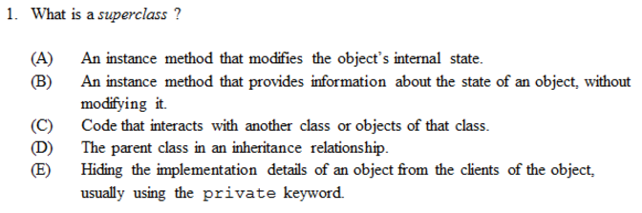

Slide 3
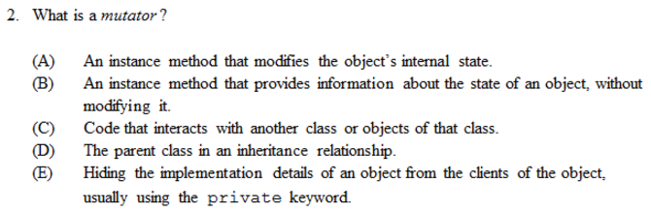

Slide 4
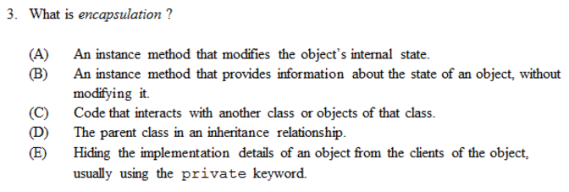

Slide 5
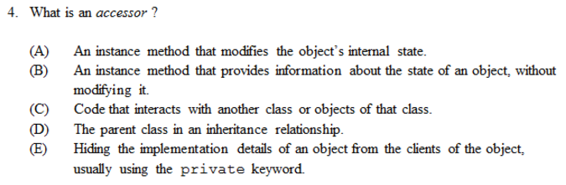

Slide 6
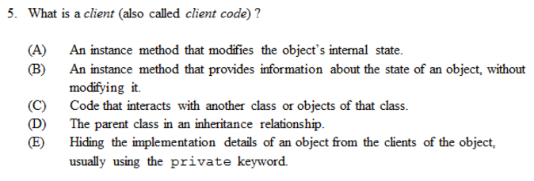

Slide 7
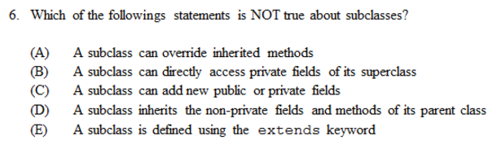

Slide 8
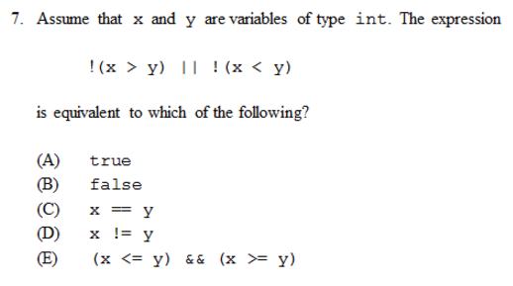

Slide 9
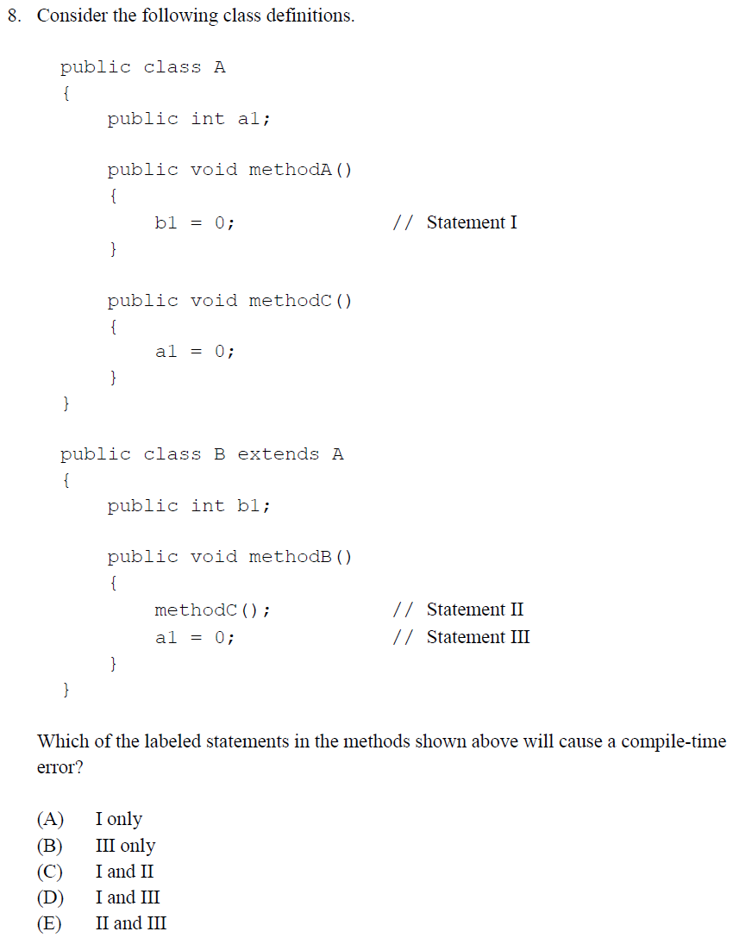

Slide 10
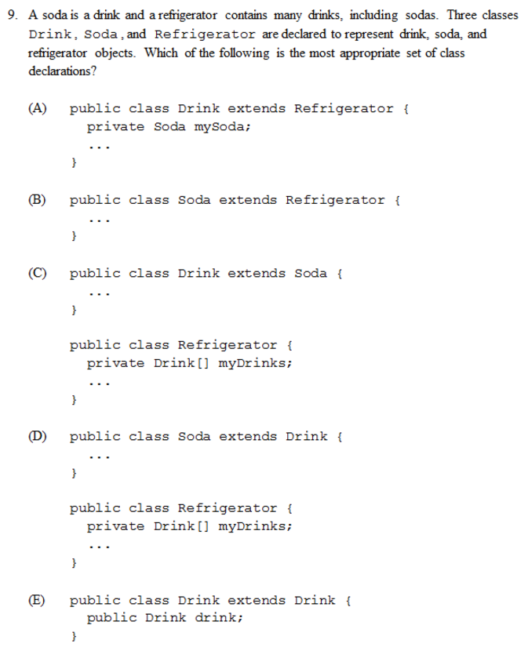

Slide 11
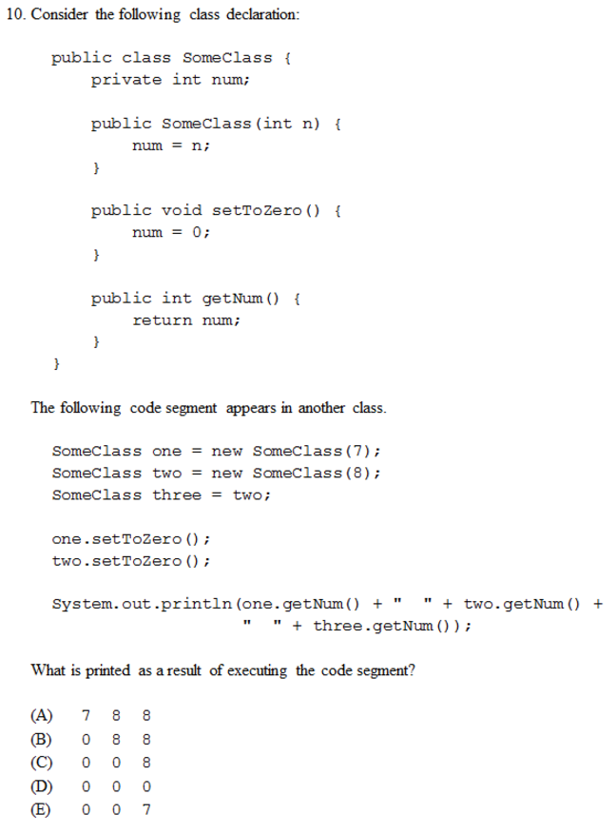

Slide 12
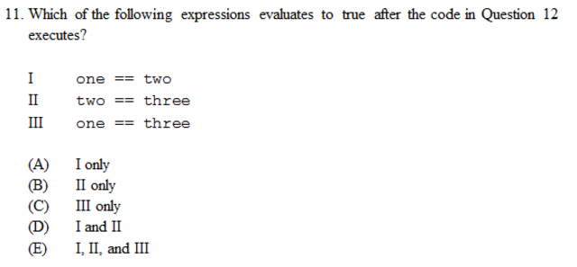

Slide 13
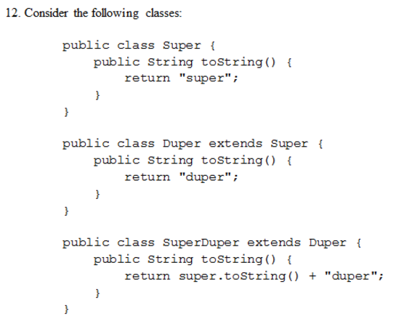
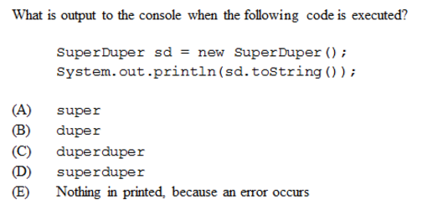

Slide 14
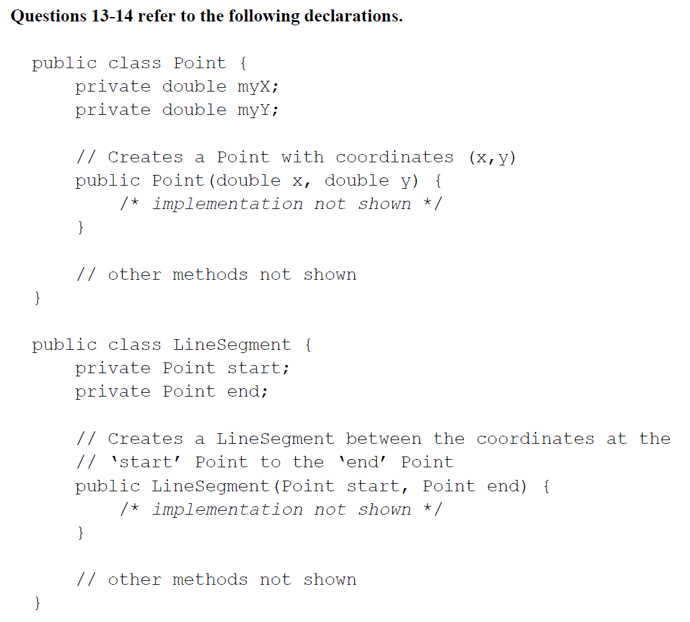
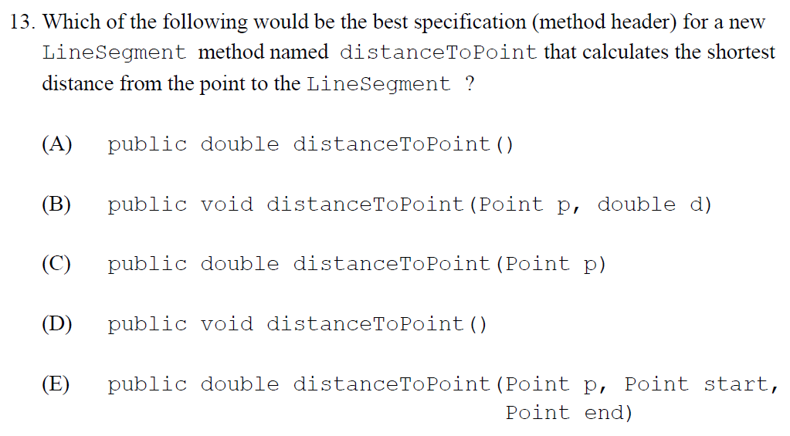

Slide 15
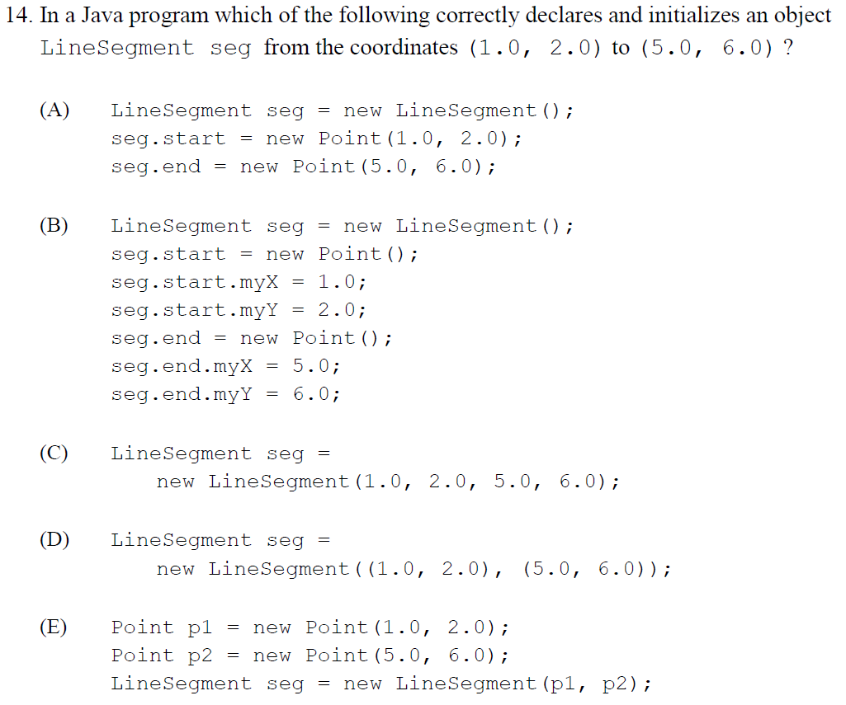

Slide 16
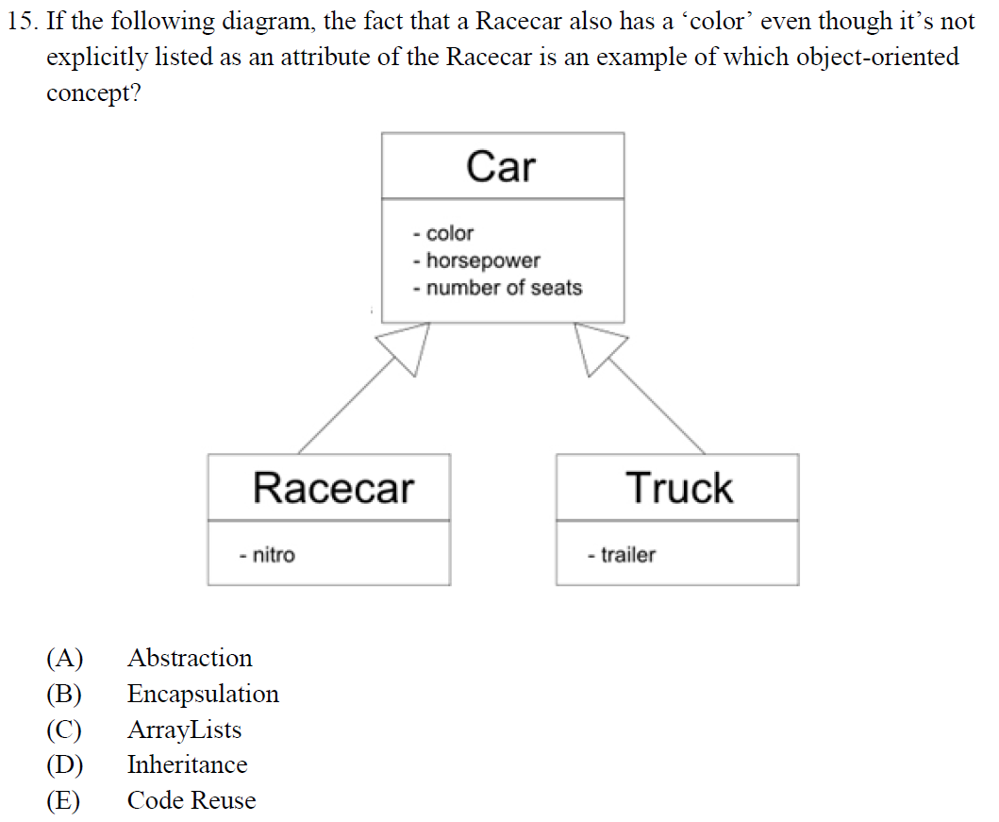

Slide 17
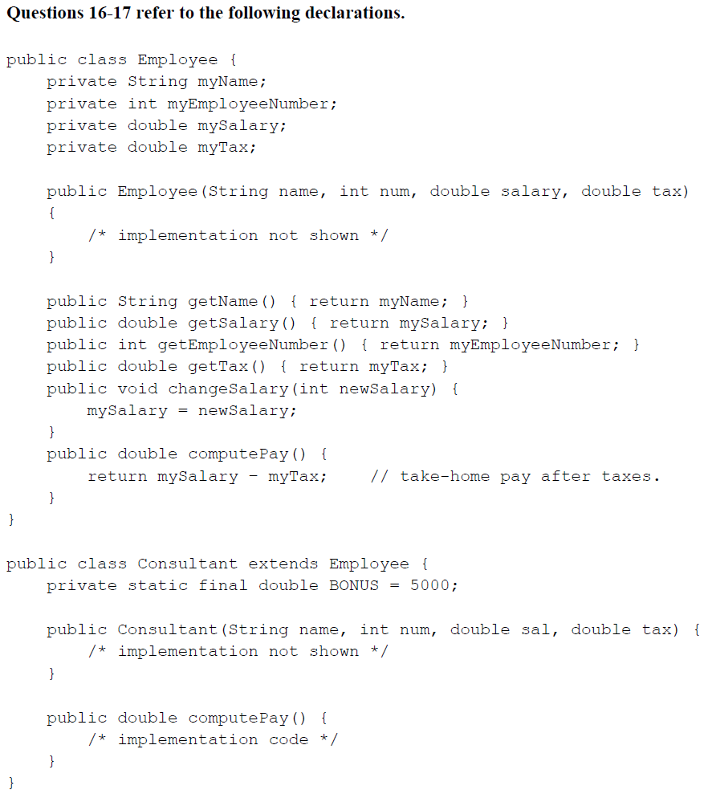
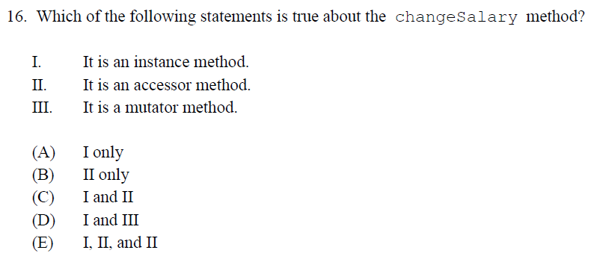

Slide 18
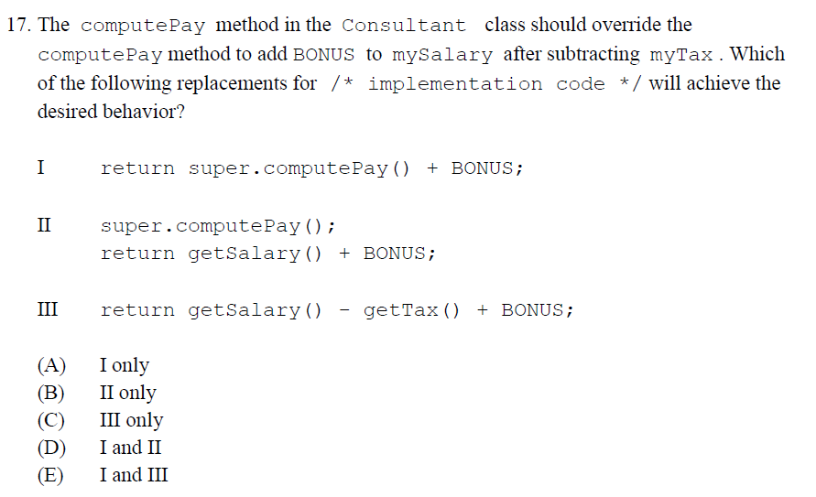

Slide 19
Homework
Read BJP 13.1 up to “Sorting”
Correct any incorrect test answers by re-answering on a separate sheet of paper:
To earn credit, you must justify your new answers.
Staple new answer sheet to the old test and return it tomorrow.

Slide 20
Searching Algorithm
[ 7.01 ] [ Today’s Date ] [ Instructor Name ]

Slide 21
GAME DAY
Searching Algorithms using Battleship

Slide 22
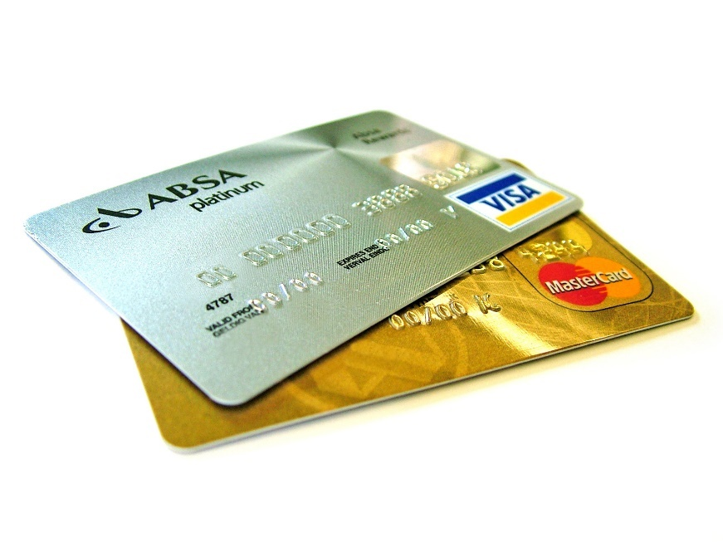
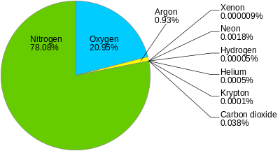

Computers are good at managing large collections of data quickly and easily:

Slide 23
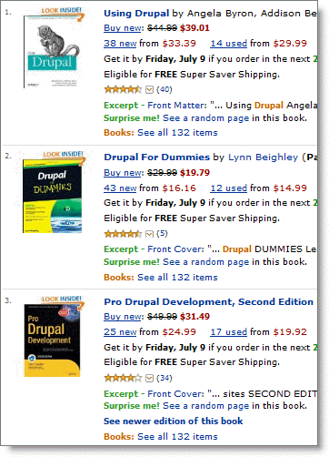

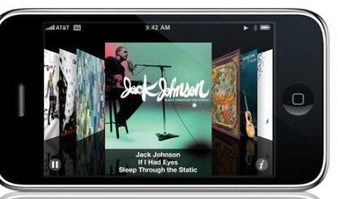
We use searching all the time:
Finding the right pants on Amazon
Researching a topic on Wikipedia
Finding that picture you took two years ago
Selecting a song to exercise to

Slide 24
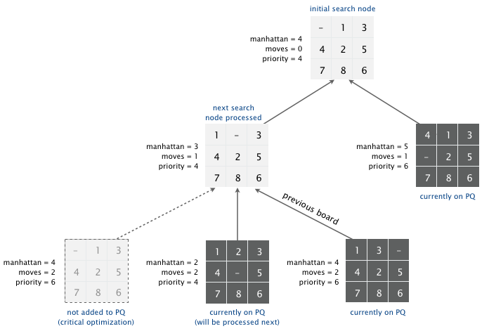
Puzzle Solving AI
Notes:
Example diagrams

Slide 25
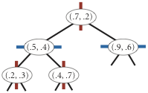
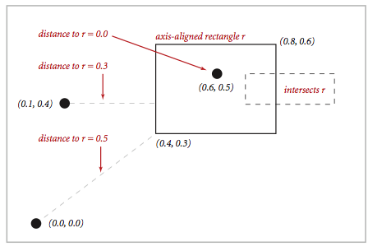
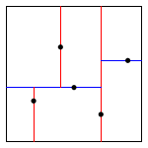
Collision Detection
Notes:
Example diagrams

Slide 26
We need to search for a specific data point:
Example:
When you search the internet, you’re looking for a single keyword (“or phrase”) called a “search key” within a webpage
When you input your student number, it searches through a database of accounts for one associated with your number

Slide 27
Using algorithms:
We need to use algorithms to quickly search our datasets
Imagine if each web search took 3 seconds long
Imagine if each item scanned at a grocery store took 10 seconds to find

Slide 28
When we decide as program designers which searching or sorting to use,
We factor in:
The size of the data array
The space efficiency of the algorithm (memory)
Run-time efficiency (how fast it executes)

Slide 29
CSUnplugged: Battleship Activity
Notes:
Edit this slide to include instructions as you see fit ; the explanation in the battleship instructions is pretty good.
Here is the direct link to the instructions
http://csunplugged.org/searching-algorithms

Slide 30
Search method:
Take an array of integers arr
And an integer n,
And returns a Boolean indicating if n appears somewhere in arr.
Notes:
Extra practice if needed!

Slide 31
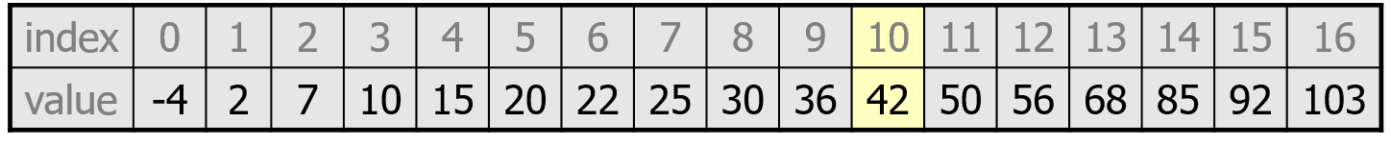
Sequential (Linear) Search
Locates a target value in an array/list by examining each element from start to finish.
How many elements will it need to examine?
Searching the array below for the value 42:
i

Slide 32
Binary Search
Locates the target value in a sorted array/list by successively eliminating half of the array from consideration.
How many elements will it need to examine?
Example: Searching the array below for the value 42:
Binary needs to be sorted!
min
mid
max

Slide 33
Sequential Search Walkthough
public static boolean search(int[] arr, int n) {
for (int i=0; i < arr.length; i++) {
if (arr[i] == n)
return true;
}
return false;
}

Slide 34
Sequential Search Walkthough
public static int search(int[] arr, int n) {
for (int i=0; i < arr.length; i++) {
if (arr[i] == n)
return i;
}
return -1;
}

Slide 35
Binary Search Walkthrough
public static int binarySearch(int[] a, int target){
int min = 0;
int max = a.length - 1;
while (???) {
int mid = (min + max) / 2;
if (a[mid] < target) {
???
} else if (a[mid] > target) {
???
} else {
???
}
}
}

Slide 36
Binary Search Walkthrough
public static int binarySearch(int[] a, int target) {
int min = 0;
int max = a.length - 1;
while (???) {
int mid = (min + max) / 2;
if (a[mid] < target) {
min = mid + 1;
} else if (a[mid] > target) {
max = mid - 1;
} else {
return mid; // target found
}
}

Slide 37
Binary Search Walkthrough
public static int binarySearch(int[] a, int target)
{
int min = 0;
int max = a.length - 1;
while (min <= max) {
int mid = (min + max) / 2;
if (a[mid] < target) {
min = mid + 1;
} else if (a[mid] > target) {
max = mid - 1;
} else {
return mid; // target found
}
}
return -(min + 1); // target not found
}

Slide 38
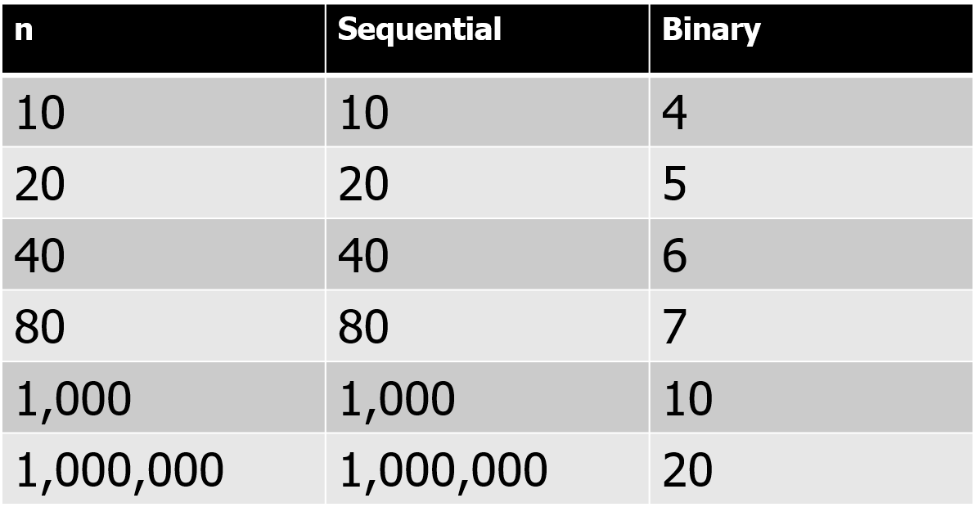
Worst-case scenarios: Binary vs Sequential

Slide 39
Homework
Read HW 13.1 “Sorting”
Complete self-check questions #4-6 and exercises #1-3

Slide 40
Sorting Algorithm
[ 7.02 ] [ Today’s Date ] [ Instructor Name ]

Slide 41
Sorting
Which searching method was faster? (what are those methods)
What was a prerequisite for that search?
What are examples where it might be important to store data?

Slide 42
As you arrive…
Think of 3 examples where your phone, tablet, or computer needs to sort things in order.

Slide 43

Sorting algorithms
There are many sorting algorithms.
Some take more time.
Some use more memory.
Some are simple and some are complex.
Initially, we’ll learn about 2 simple ones:
-selection sort
-insertion sort

Slide 44
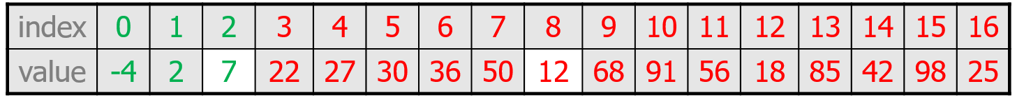
Selection Sort
Think of the array as having two parts:
Sorted part at the left
Unsorted part at the right
Repeatedly put the smallest unsorted value into its final position (at the end of the sorted section)

Slide 45
Selection Sort
The algorithm:
Look through the list and find the smallest value.
Swap it so that it’s at index 0.
Look through the list and find the second smallest value.
Swap it so that it is at index 1.
…
Repeat until all values are in their proper places.

Slide 46
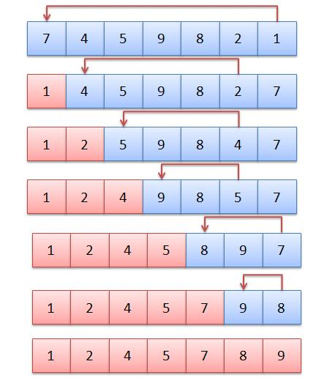
Selection Sort
public static void selectionSort(int[] a)
{
for (int i = 0; i < a.length - 1; i++) {
// find index of smallest remaining value
int min = i;
for (int j = i + 1; j < a.length; j++) {
if (a[j] < a[min])
min = j;
}
// swap smallest value into its proper place, a[i]
int temp = a[i];
a[i] = a[min];
a[min] = temp;
}
}

Slide 47
Insertion Sort
For insertion sort, we used arrays.
Arrays don’t let you insert in the middle.
So how did we insert the next unsorted element where it belongs?
We slide it into place!

Slide 48
Insertion Sort: Array
public static void insertionSort(int[] a) {
for (int i = 1; i < a.length; i++) {
for (int j = i; j > 0 && a[j] < a[j-1]; j--) {
int temp = a[j];
a[j] = a[j-1];
a[j-1] = temp;
}
}
}

Slide 49
Insertion Sort: ArrayList
public static void insertionSort(ArrayList<Integer> a) {
for (int i = 1; i < a.size(); i++) {
for (int j = i; j > 0 && a.get(j) < a.get(j-1); j--) {
int temp = a.get(j);
a.set(j, a.get(j-1));
a.set(j-1, temp);
}
}
}
Remove i^{th} element
Find where it belongs
Insert it into place

Slide 50
Insertion Sort: ArrayList
public static void insertionSort(ArrayList<Integer> a) {
for (int i = 1; i < a.size(); i++) {
1. How do we remove the i^{th} element?
}
}

Slide 51
Insertion Sort: ArrayList
public static void insertionSort(ArrayList<Integer> a) {
for (int i = 1; i < a.size(); i++) {
int value = a.remove(i);
2. Where does the value belong?
3. How do we insert the value at that place?
}
}

Slide 52
Insertion Sort: ArrayList
public static void insertionSort(ArrayList<Integer> a) {
for (int i = 1; i < a.size(); i++) {
int value = a.remove(i);
int j = i;
while (j > 0 && value < a.get(j-1)) {
j--;
}
a.add(j, value);
}
}

Slide 53
Comparison: ArrayList vs Array Insertion Sort
Our ArrayList implementation is…
More intuitive (no sliding necessary)
More like how we’d sort a hand of cards IRL
Maybe easier to read
Is it faster?
The ArrayList still has to do the same number of exchanges
The code is merely hidden from us, but it’s still there
So no, not faster

Slide 54
Homework
Read HW 13.1 “Shuffling”

Slide 55
Elevens Lab
[ 7.03 ] [ Today’s Date ] [ Instructor Name ]

Slide 56
[Slides reserved for Elevens Lab review]
Use these slides to discuss questions that arise during the Elevens Lab or to post homework that you assign throughout the lab.

Slide 57
Review
[ 7.04 ] [ Today’s Date ] [ Instructor Name ]

Slide 58
What’s on the test?

Slide 59
Practice Test

Slide 60
Review Topics
Make a list of review topics that you feel you need to go over for the test tomorrow.
For each topic, follow up by reviewing the textbook, self-check problems, and the appropriate Practice problems.

Slide 61
Good Luck!

