Slide 1
Test Review & Reteach
[ 8.00 ] [ Today’s Date ] [ Instructor Name ]

Slide 2
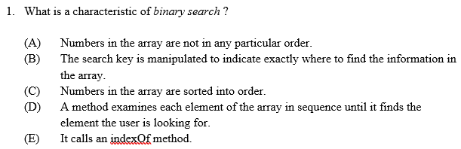

Slide 3
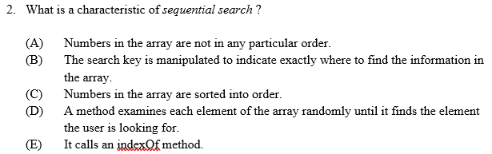

Slide 4
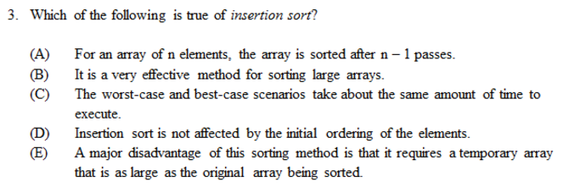

Slide 5
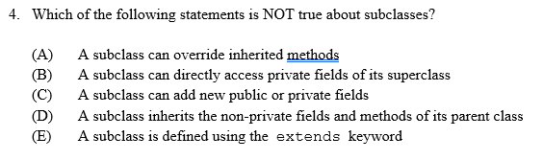

Slide 6
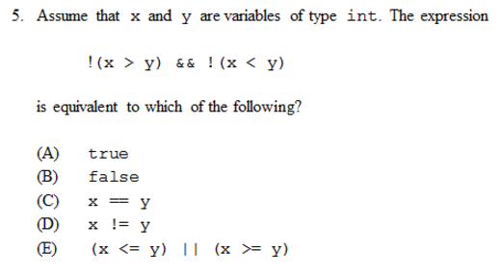

Slide 7
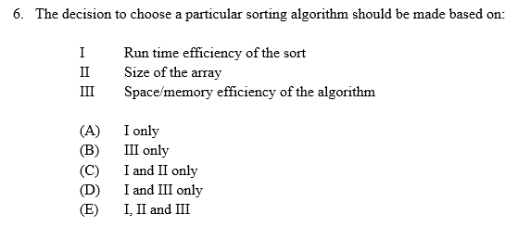

Slide 8
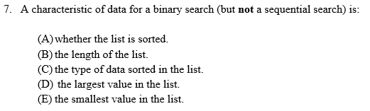

Slide 9
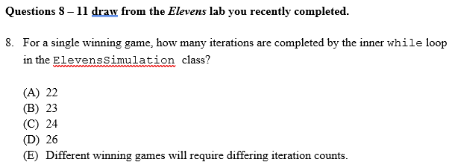

Slide 10
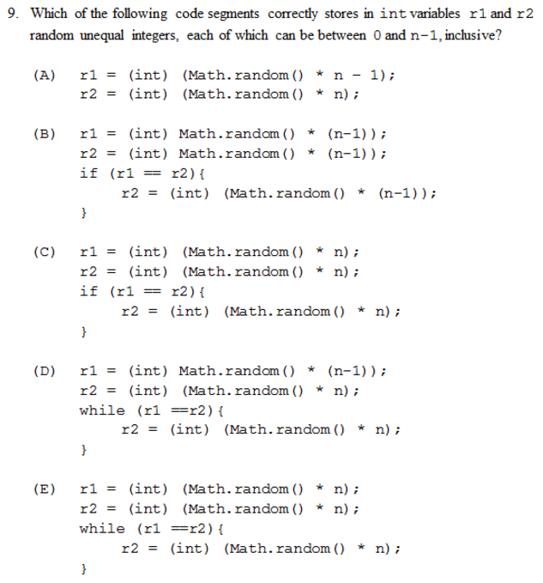

Slide 11
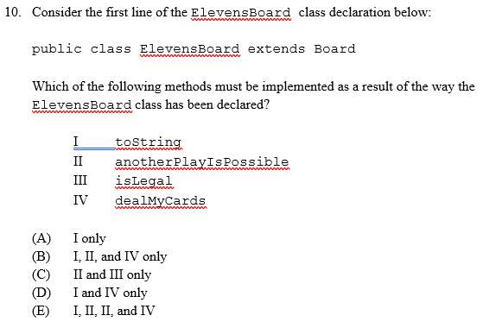

Slide 12
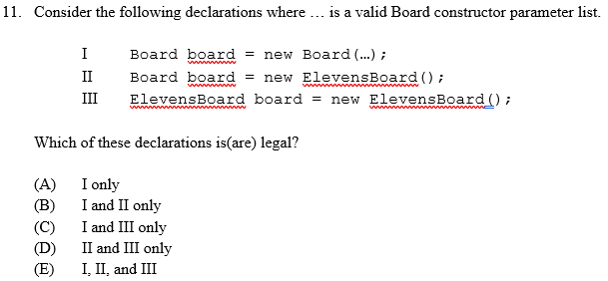

Slide 13
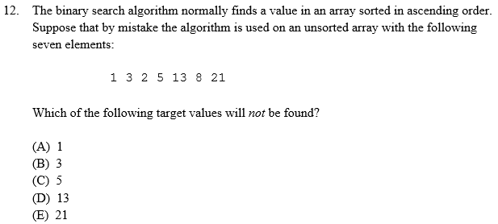

Slide 14
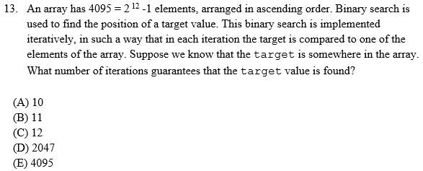

Slide 15
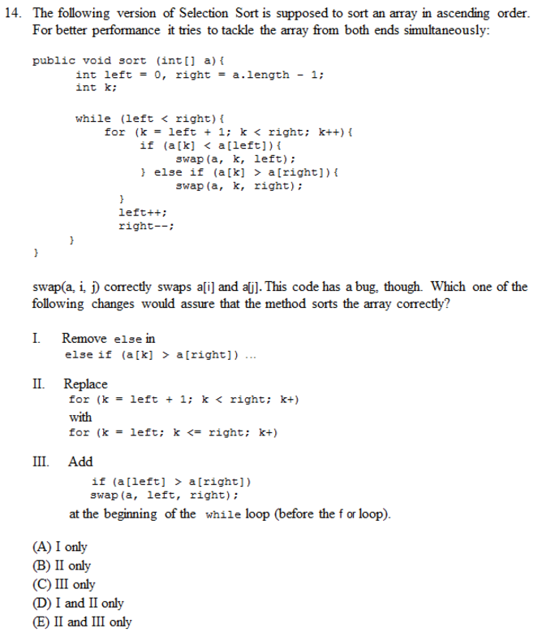

Slide 16
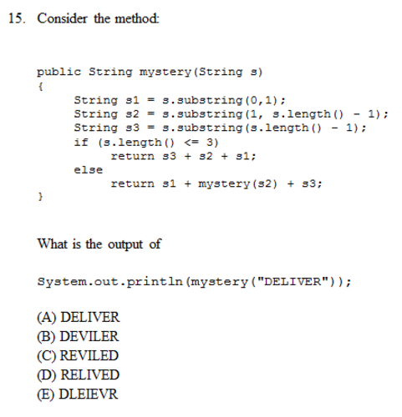

Slide 17
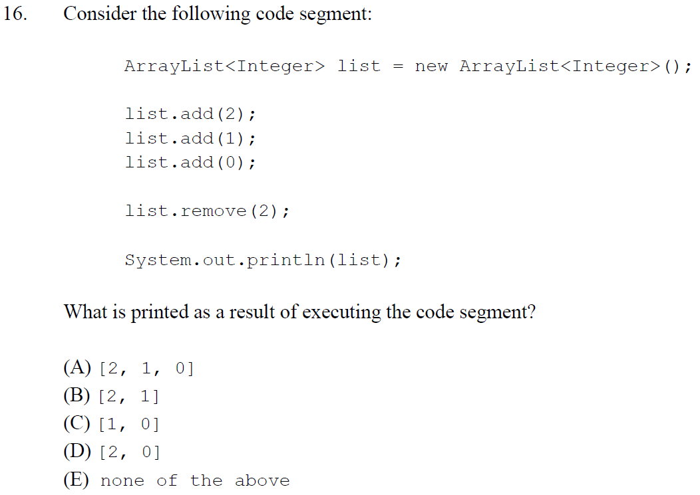

Slide 18
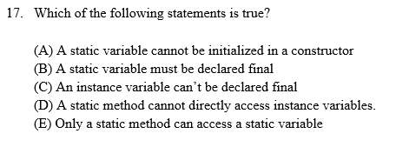

Slide 19
Homework
Read BJP 12.1 up to “Structure of Recursive Solutions”
Correct any incorrect test answers by re-answering on a separate sheet of paper:
To get back credit, you must explain your new answers.
Staple the new answer sheet to the old test and submit.

Slide 20
Thinking Recursively
[ 8.01 ] [ Today’s Date ] [ Instructor Name ]

Slide 21
Tower of Hanoi

Slide 22
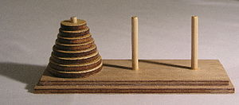

Slide 23
Rules:
Move all the rings to the right-most post.
You can only take one ring at a time.
A ring cannot be put on a smaller ring.

Slide 24
Discussion

Slide 25
Iteration vs Recursion
Iteration: A programming technique in which you describe actions to be repeated typically using a loop.
Recursion: A programming technique in which you describe actions to be repeated using a method that calls itself.

Slide 26
By Trixx - I designed this using http://thewalnut.io/, CC BY-SA 3.0, https://commons.wikimedia.org/w/index.php?curid=43282866

Slide 27
Homework
Read the rest of HW 12.1

Slide 28
Writing Recursive Solutions
[ 8.02 ] [ Today’s Date ] [ Instructor Name ]

Slide 29
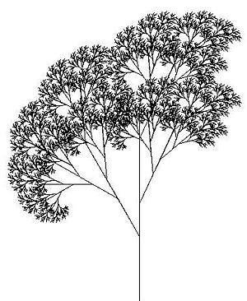
What makes a method recursive?
A method that calls itself
How would you write a recursive method?
Here is an example:
public static void writeStars (int x) { writeStars(x - 1); // Prints a star. }
Notes:
Don’t worry if students don’t include a base case! Congratulate your students on remembering that the method calls itself, then ask students how this method is supposed to stop. (It won’t! This is called infinite recursion.)

Slide 30
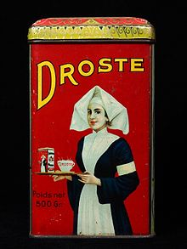
What makes a method recursive?
Base case:
A case within a recursive solution that is
so simple, it can solved without needing
to call the method again.
Recursive case:
A case within a recursive solution that
involves reducing the overall problem to a
simpler problem of the same kind that
can be solved with a recursive call.
Notes:
To make sure that you write recursive methods that work, you need to remember 2 key ingredients:

Slide 31
A recursive method:
public static void writeStars (int x) {
if (x == 0) {
System.out.println();
} else {
System.out.println(“*”);
writeStars(x – 1);
}
}

Slide 32
Wrong recursion:
public static void writeStars(int x) {
System.out.print(“*”);
writeStars(n - 1);
}
What is the output of this recursive call?

Slide 33
Grudgeball

Slide 34
Slides reserved for your own or chosen Grudgeball questions.

Slide 35
Homework
Read the rest of HW 12.2
Complete self-check questions %5, 7 – 9 and exercise #1

Slide 36
Mechanics of Recursion
[ 8.03 ] [ Today’s Date ] [ Instructor Name ]

Slide 38
Slide reserved for teacher demo, scratch MIT dragon curve, etc. Any way you think would best model recursion for your respective class. The Lesson Plan has great examples and activities to choose from.

Slide 39
Iterative to Recursive and Vice Versa
Recursive Iteration
int factorial(int n){ int factorial(int n){
if (n == 1){ int product = 1;
return 1; for (int i = 2; i <= n; i++){
}else{ product *= i;
return n*factorial(n-1); }
} return product;
} }

Slide 40
Iterative vs Recursive
Recursion can be used to traverse String, array, and ArrayList objects, much like a loop
Any recursive solution could be written with iteration (loops) instead
Some algorithms are easier to solve recursively, like traversing trees
In general recursive solutions are more resource intensive than iteration

Slide 41
Koch Curve
Divide the line segment into three segments of equal length
Draw an equilateral triangle that has the middle segment from step 1 as its base and points outward
Remove the line segment that is the base of the triangle from step 2
Recur

Slide 42
Koch Visuals
Koch Curve Zoom: https://www.youtube.com/watch?v=PKbwrzkupaU
Mandelbrot Zoom: https://www.youtube.com/watch?v=0jGaio87u3A

Slide 43
Homework
Complete self-check #6, 10, and exercise #3

Slide 44
Merge Sort
[ 8.04 ] [ Today’s Date ] [ Instructor Name ]

Slide 45
Recursive Application
Now that we know recursion, we can do merge sort.
Like selection and insertion sort, merge sort works on arrays.

Slide 46
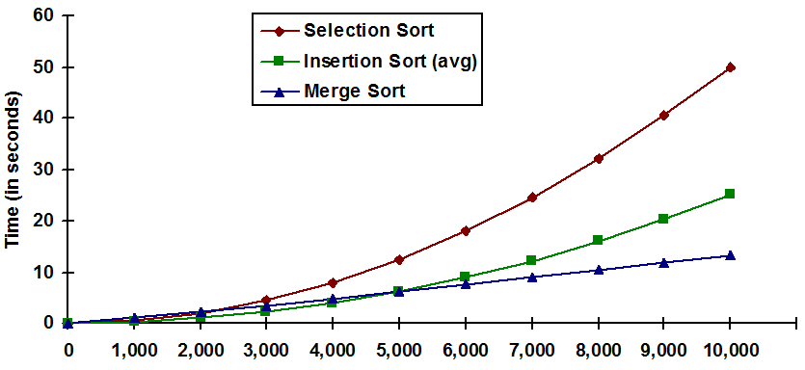
Merge sort worst case performance is O(n log n)

Slide 47
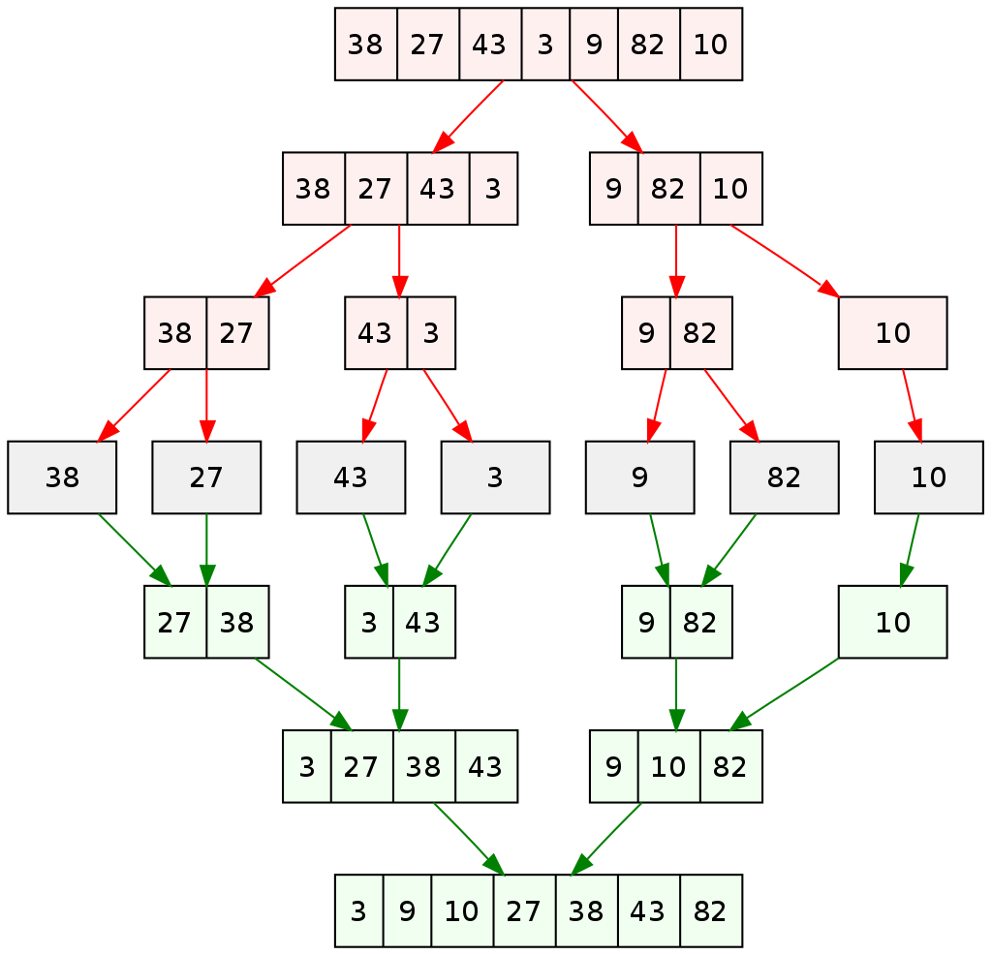
Merge sort in action: On paper, plan out all of the steps to merge sort.

Slide 48
Steps to merge sort:
Split the array into two halves down to
one element.
Sort the left half.
Sort the right half
Merge the two halves together. Recursion
Notes:
We’ll work on merge first.

Slide 49
The merge:
Maintain a current index for each list starting at 0.
Create an empty list to hold the result.
When we haven’t exhausted our two lists,
insert the smallest element at the point and advance the index.
14 | 32 | 67 | 76
23 | 41 | 58 | 85
14
23
32
41
58
67
76
85

Slide 50
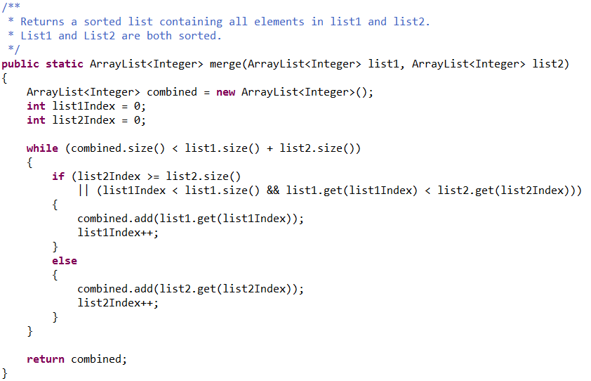

Slide 51
MergeSort
The algorithm:
If the list’s size is 0 or 1, just return the original list (as it is stored).
Split the list parameter into two lists, of (roughly) equal size.
Sort both split lists, list 1 and list 2.
Merge the two sorted lists (list 1 and list 2), and return the result.

Slide 52
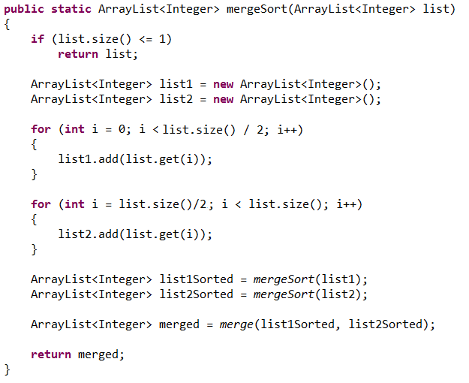

Slide 53
Homework
Summarize notes for notebook check tomorrow.

Slide 54
Finding and Fixing Errors
[ 8.05 ] [ Today’s Date ] [ Instructor Name ]
Notes:
This unit is mostly done either on practice it or the board. Feel free to edit this slide deck as you see fit!

Slide 55
Today’s plan:
Error check and resubmit all chapter 12 assignments.
Study for the test by:
Reviewing all of the blue, self-check pages at the end of Chapter 9.
Re-reading sections as needed to complete the self-check problems.

Slide 56
Homework Regrade/Resubmit
You all have the opportunity to get full credit on your homework grades by correcting them now, in class.
Use your error checking algorithm, and if you need help just ask!

Slide 57
Homework
Begin reviewing chapter 12 for the quiz.

Slide 58
Review and Quiz
[ 8.06/7 ] [ Today’s Date ] [ Instructor Name ]

Slide 59
What’s on the test?

Slide 60
Review Topics
Make a list of review topics that you feel you need to go over for the test tomorrow.
For each topic, follow up by reviewing the textbook, self-check problems, and the appropriate Practice problems.

Slide 61
Quiz

Slide 62
Good Luck!

