Slide 1
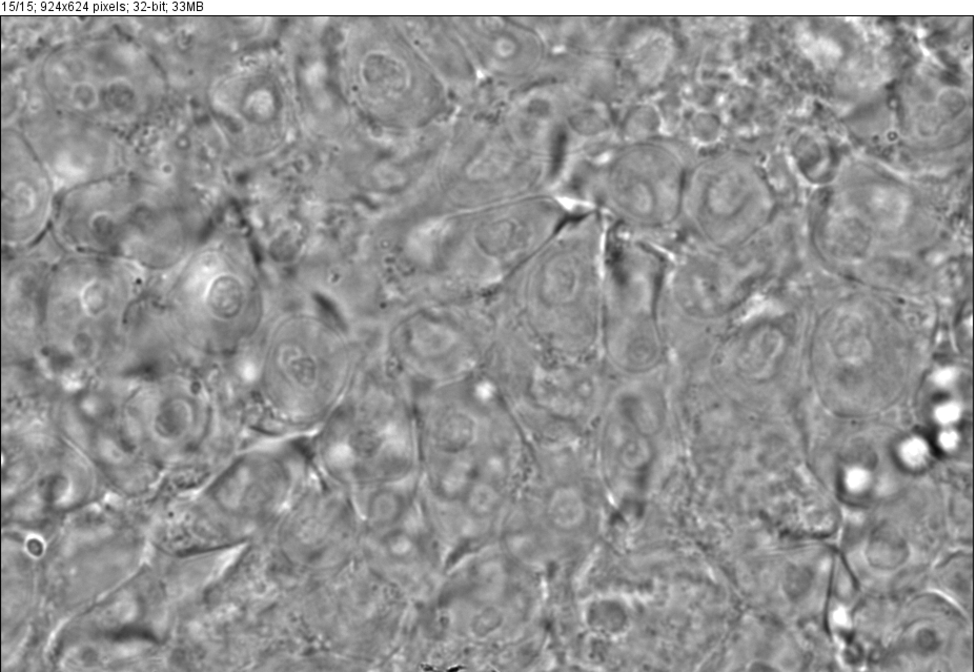
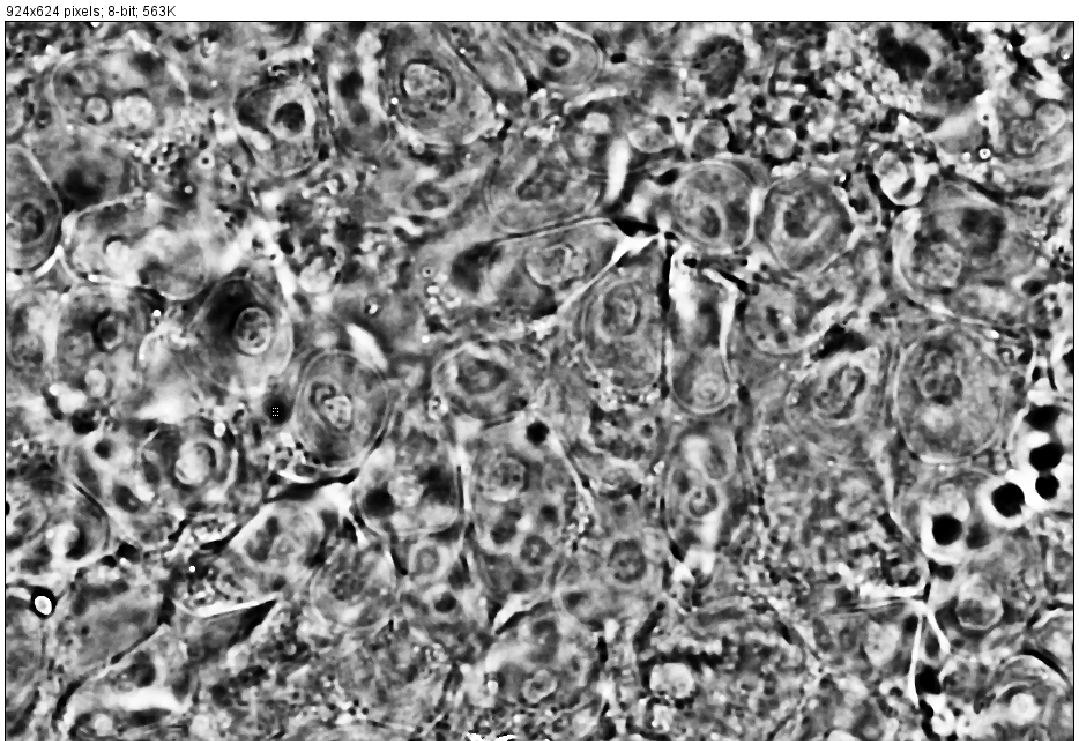
Working with FIJI

Slide 2
Segmented Image
1.Invert
2.B/W adjust
3.Contrast Enhanced
4.smooth,sharpe
5.Binary mask
6. Watershed
7.Image calculator [add original and mask image]
Target image
(0_prediction image from Moffitt dataset )

Slide 3
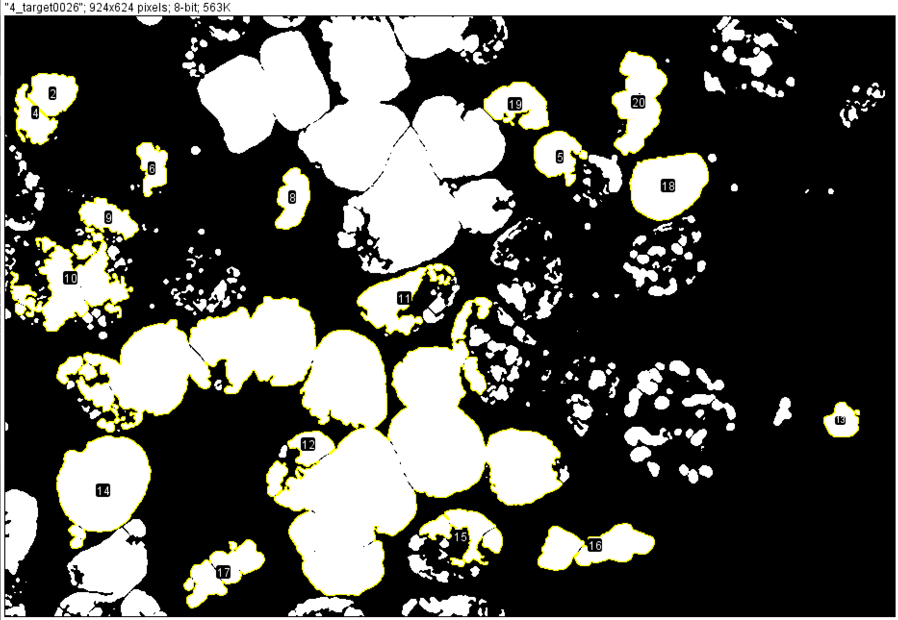
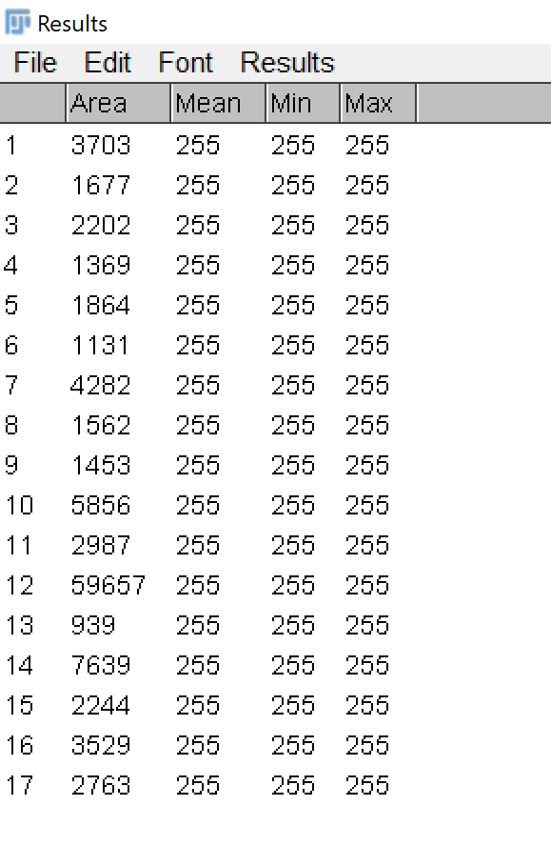
Segmented Image
1.Invert
2.B/W adjust
3.Contrast Enhanced
4.smooth,sharpe
5.Binary mask
6. Watershed
7.Image calculator [add original and mask image]
8.Particle analysis
9. Each particle intensity, area and count

Slide 4
Use the last Segmented Image
Select ROI (cell )
Perform Cell dilution
Fig:3

Slide 6
Fig:3, erode, make binary , add with original image
Look up table :16 color

Slide 7
Topics:
How to automate a sequence of commands that would normally be performed manually on an image .
Solution: ImageJ Macros [programming language used by ImageJ to perform same tasks over in multiple images]
How to do a batch processing in macro
Solution: Using function process batch macro :it uses again ImageJ macro with additional instruction that can be tweaked to do a batch processing
How to get coordinates of the cell in the image with intensity
Solution: Analyze particle, set measurement: centroid will give (X,Y coordinates of the cell )

Slide 8
Testfdast

Slide 9
Testfdast

Slide 10
Testfdast

