Slide 1
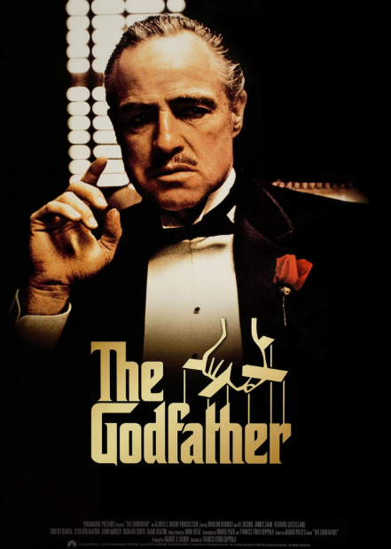











IMDB MOVIES Analysis Using SQL & BI
Project Team Id: PTID-CDA-FEB-26-1269
Project Id: PRSQ-02-IMDB Movies
Team members: P. Chowdesh, Darshan M
Course Name: Certified Data Analytic
Project Name: IMDB MOVIES Data Analysis
Email Id:pchowdesh8618@gmail.com ,darshandichi82@gmail.com
Institute Name: Datamites(kudligate branch)

Slide 2

Project Objective
The objective of this project is to analyze movie performance using key factors such as budget, revenue, ratings, and director contributions. The analysis aims to identify patterns and trends that influence the success of movies, evaluate financial performance, and understand the impact of directors and production strategies. The insights derived from this project will help support data-driven decision-making and improve future investment and planning in the movie industry
To Analysis:-
Analyze overall movie performance using key KPIs
Identify factors driving revenue and success
Evaluate the impact of directors on movie performance
Understand trends in movie production over time
Provide insights for better investment decisions

Slide 3

Dataset Overview
About Dataset :-
The dataset used in this project consists of two main tables: Movies and Directors. The Movies table includes key attributes such as movie title, budget, revenue, popularity, release date, vote average (rating), and vote count. The Directors table contains information about director name, gender, and department. These two tables are connected using a common director ID to enable combined analysis.
The dataset contains a total of 47 movies with a total budget of 10 billion and total revenue of 39 billion. This structured dataset allows analysis of movie performance, director impact, and overall industry trends.

Slide 4
Attribute Information:
Table Directors:
Name: Name of the Director
ID: Unique ID of the Directors
Gender: Gender of the Director→ 0/2=Male, 1=Female
Department: Department of the Directors.
Table Movies:
ID: Unique Id for Movies
Original title: Movie name
Budget: Budget of the movie
Popularity: Popularity of the Movie
Release Date: Release date for the movies
Revenue: Revenue collected movie
Title: Initial title of the movie
Vote Average: Average IMDB rating
Vote Count: Number of Vote the movie got
Overview: Description of the movie
Tagline: Tagline of the Movie
UID: Unique ID for Movie
Director ID: Director ID

Slide 5
Taskes sql
Can you get all data about movies?
How do you get all data about directors?
Check how many movies are present in IMDB.
Find these 3 directors: James Cameron ; Luc Besson ; John Woo
Find all directors with name starting with S.
Count female directors.
Find the name of the 10th first women directors?
What are the 3 most popular movies?
What are the 3 most bankable movies?
What is the most awarded average vote since the January 1st, 2000?
Which movie(s) were directed by Brenda Chapman?
Which director made the most movies?
Which director is the most bankable?

Slide 6
DataCleaning
Mention:-
Checked NULL values using IS NULL
Checked duplicates using GROUP BY + HAVING COUNT(*) ! Found replaced with “not available”
Verified data consistency
Validated date formats
During the data cleaning process, I verified the dataset for null values is replaced with "string like not available in tagline column in movies table” and duplicate records using SQL queries. I also validated the data types and created age group categories using CASE statements for segmentation analysis. The dataset was clean and ready for analysis.

Slide 7
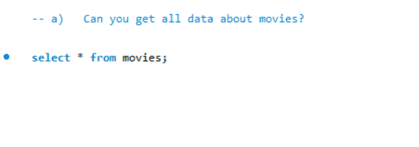
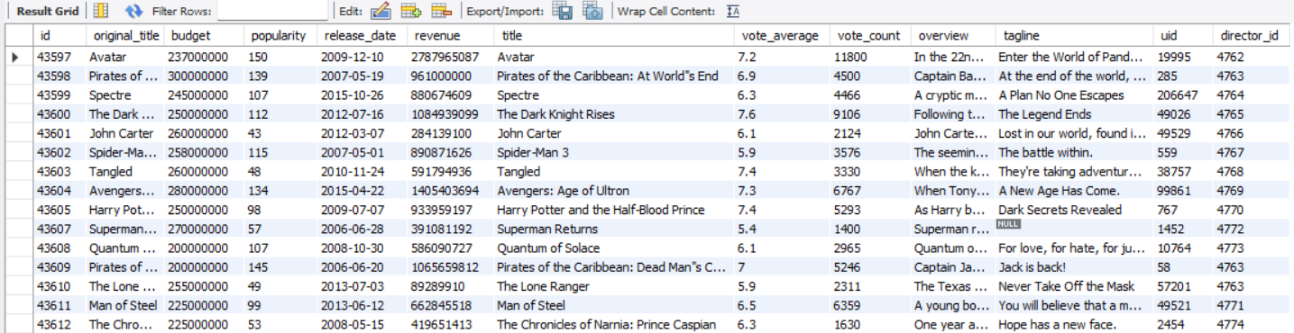
1. How do you get all data about Movies?
Insights:-
The dataset contains attributes such as budget, revenue, ratings, popularity, and release date, which allow both financial and performance analysis. These attributes help in understanding profitability, audience engagement, and trends over time, enabling comprehensive movie performance evaluation.”

Slide 8
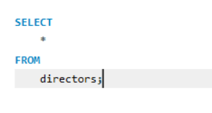
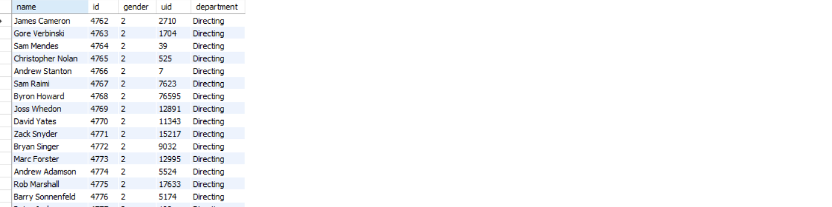
Sql queshions:-
2. How do you get all data about directors?
Insights:-
The directors table contains key attributes like ID, name, gender, and department, which help in identifying directors, analyzing their performance, and understanding diversity in the dataset. This enables evaluation of director impact on movie success and supports better decision-making.

Slide 9
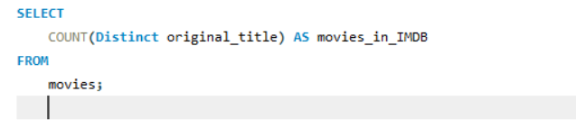
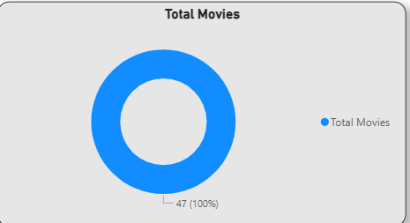

3. Check how many movies are present in IMDB
The dataset consists of 47 movies, representing a focused movie portfolio that allows detailed performance analysis and comparison across key factors such as revenue, budget, and ratings.
More Business Meaning:-
A portfolio of 47 movies is:
Manageable for analysis
Suitable for identifying trends

Slide 10
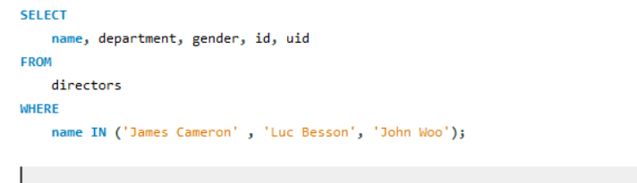
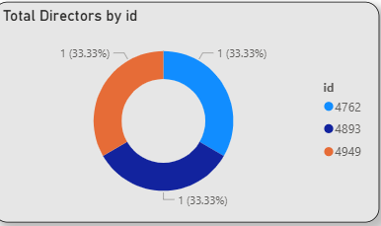

4. Find these 3 directors: James Cameron ; Luc Besson ; John Woo
Insights:-
Performance Comparison
“Among the selected directors, there is a noticeable difference in performance in terms of revenue and movie output.”
Business Insight:
Not all directors contribute equally
Helps identify top-performing talent
“By filtering specific directors, I compared their performance and observed that revenue contribution is uneven, with one director significantly outperforming others. This highlights the importance of director selection in driving movie success and revenue

Slide 11
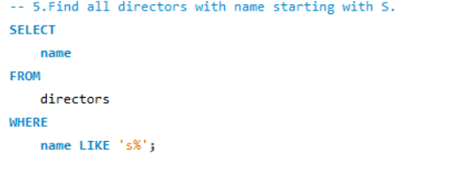
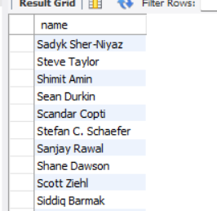
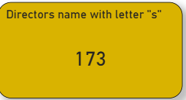
5. Find all directors with name starting with S.
Small Subset of Directors
“Directors whose names start with ‘S’ represent only a small portion of the total director base.”
Meaning:-
Not a dominant group
Just a segment of overall dat
Insights:-
The analysis shows that directors whose names start with ‘S’ form a small subset of the dataset. While this segmentation does not directly impact business decisions, it is useful for organizing and filtering large datasets for more focused analysis.”

Slide 12

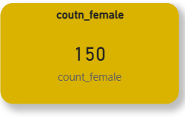

6. Count female directors
Insights:-
The analysis shows that only 150 out of over 2000 directors are female, highlighting a significant gender imbalance. This indicates an opportunity for the industry to improve diversity and better utilize untapped talent.”
Female Representation Exists but Limited
“The dataset contains 150 female directors, indicating presence but limited representation.”
Meaning:
Female directors are not dominant

Slide 13
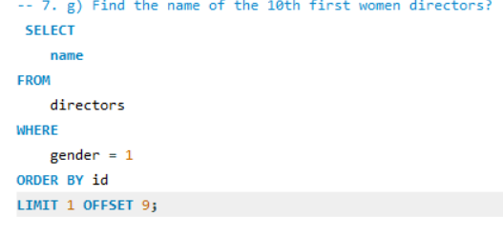
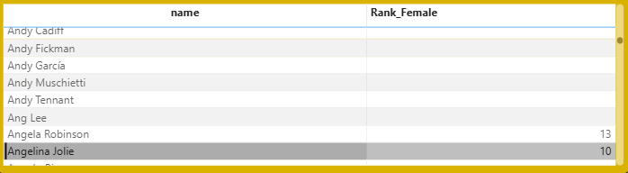

7. Find the name of the 10th first women directors?
Insights:-
Ordered Identification
“The 10th female director identified based on ID ordering is Angelina Jolie.”
👉 Meaning:
Data is being analyzed in a structured sequence
ID represents entry/order in dataset
By filtering female directors and applying ranking based on ID, I identified the 10th director as Angelina Jolie. This demonstrates how ordered data can be used to extract specific records, although it does not directly represent performance

Slide 14
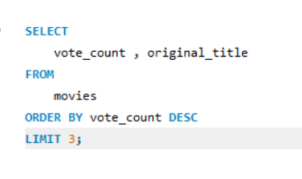
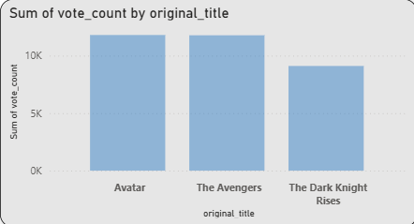
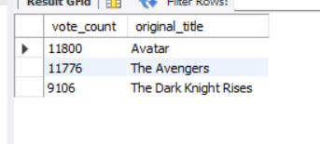
8. What are the 3 most popular movies?
Insights:-
Audience Engagement Indicator
“Total vote count represents overall audience engagement across all movies.”
Meaning:-
More votes → more audience interaction
Shows popularity and reach
The vote count analysis shows audience engagement across movies. It highlights that a few movies attract a large portion of audience interaction, indicating a hit-driven engagement pattern. This helps in identifying popular content and understanding audience preferences.”

Slide 15
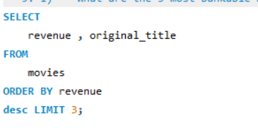
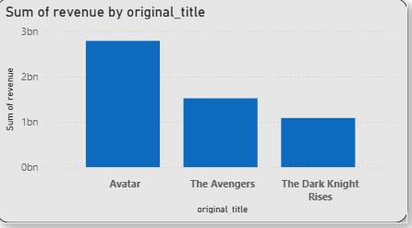
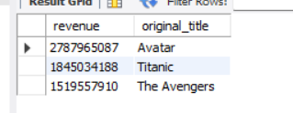
9. What are the 3 most bankable movies?
Avatar is the Clear Leader
~2.8B revenue
“Avatar significantly outperforms all other movies in terms of revenue.”
Business Insight:-
Major revenue driver
Benchmark for success
Large Gap Between Top Movies
Avatar (~2.8B) vs Avengers (~1.5B)
“There is a huge revenue gap between the top movie and the rest.”
Business Insight:-
Revenue is highly concentrated
Few movies dominate earnings
Mid-Level Performance Cluster
Avengers (~1.5B) Dark Knight Rises (~1.1B)
“Other movies perform within a closer revenue range.”
Business Insight:-
Stable but not exceptional performance
Competitive market

Slide 16
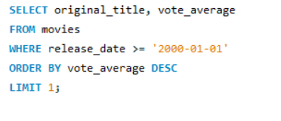
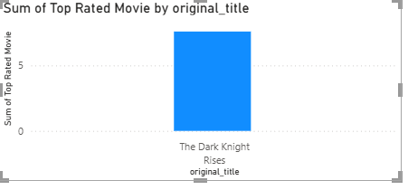
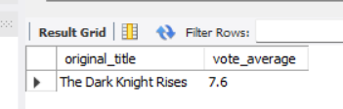
10. What is the most awarded average vote since the January 1st, 2000?
Insights:-
Top Rated Movie Identified
“The Dark Knight Rises is the highest-rated movie in the dataset after 2000.”
💡 Meaning:
Strong audience appreciation
High satisfaction level
This chart shows that The Dark Knight Rises is the highest-rated movie after 2000, indicating strong audience satisfaction. However, high ratings do not always translate into the highest revenue, highlighting the difference between quality and commercial performance

Slide 17
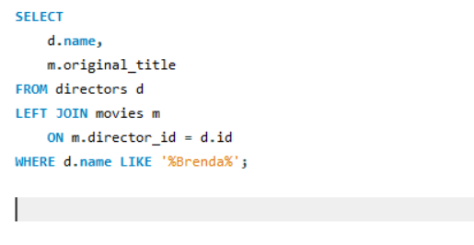

11. Which movie(s) were directed by Brenda Chapman?
Insights:-
Director: Brenda Chapman Result: 0 movies in your dataset
his can happen due to:
1. No matching records in Movies table
Director exists
But no movie linked via director_id
The result shows that Brenda Chapman has no associated movies in the dataset. This could be due to data limitations or missing relationships. It highlights the importance of validating data completeness before making business decisions.”

Slide 18
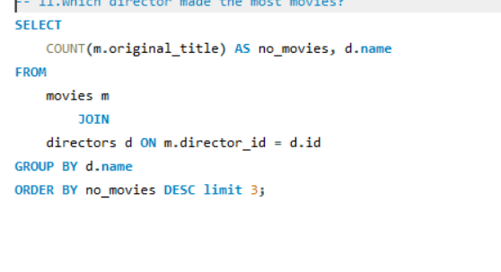
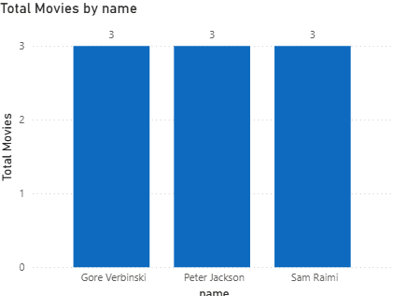
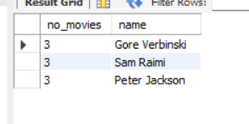
12. Which director made the most movies?
Insights:-
Top directors by number of movies” Result: 3 directors have same highest count
Balanced Contribution
“The workload is distributed across multiple directors rather than relying on a single individual.”
Business Benefit:-
Reduced dependency
Better risk management
“The analysis shows that multiple directors share the top position in terms of movie count, indicating a balanced distribution of work. Since there is no clear leader, further evaluation based on revenue and ratings is required to identify the most effective director.

Slide 19
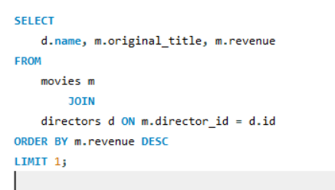
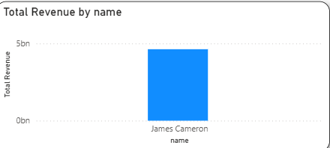
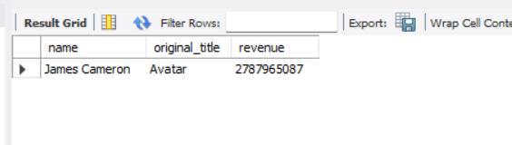
13. Which director is the most bankable?
Insights:-
Dominant Director
“James Cameron is the highest revenue-generating director in the dataset.”
Meaning:
Clear top performer
Strong track record
The chart shows that James Cameron is the top revenue-generating director, significantly outperforming others. This highlights revenue concentration and the importance of director selection in driving movie success.

Slide 20
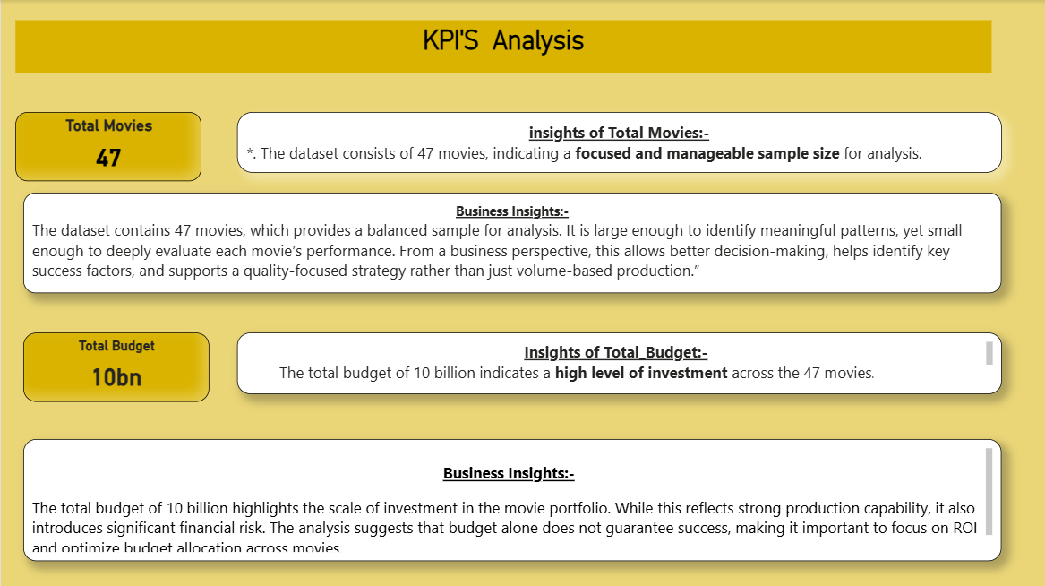

Slide 21
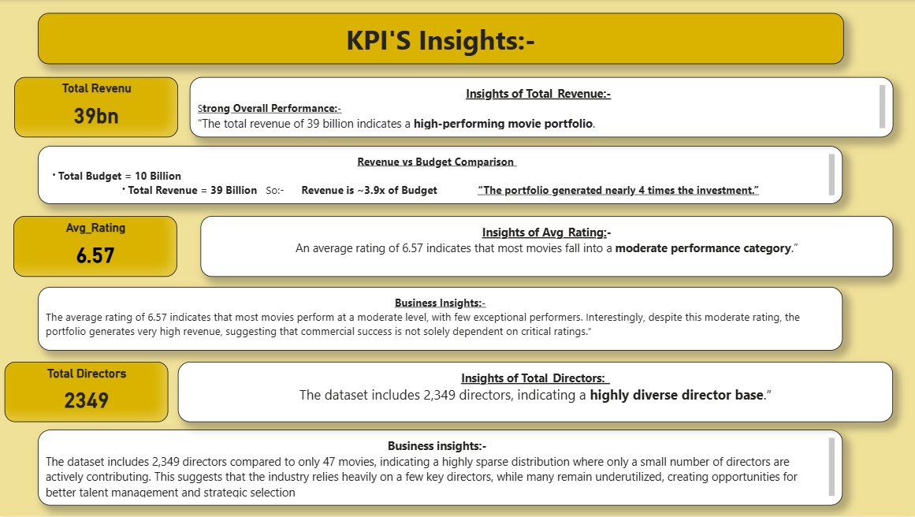

Slide 22
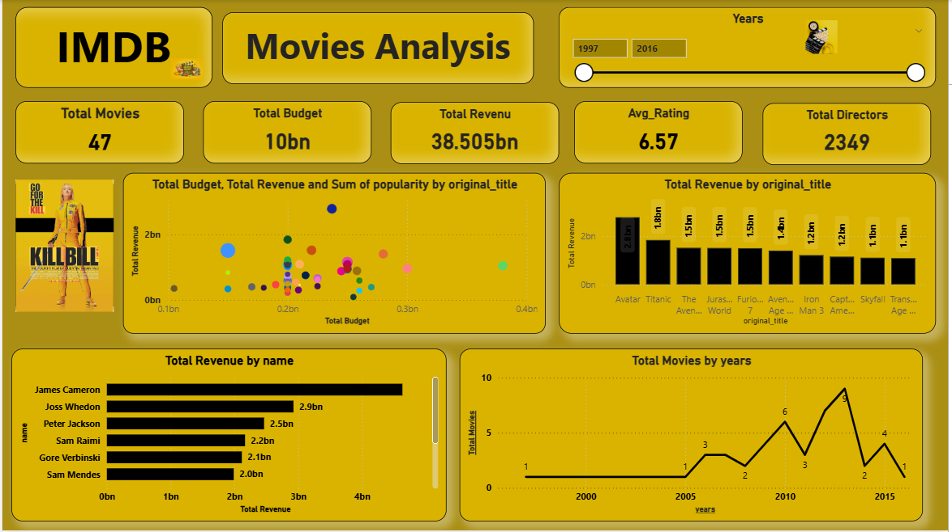

Slide 23
OverAll Insights:-
Insights:-
Hit-Driven Industry
“The movie industry is highly hit-driven, where a small number of movies generate the majority of total revenue.”
From:
Avatar dominating revenue
Few top movies
. 2. Strong Financial Performance
“With a total revenue of 39B against a 10B budget, the portfolio shows high profitability.”
Meaning:
~4x return
Successful investmen
3.Budget ≠ Success
“Higher budget does not guarantee higher revenue.”
From:
Scatter plot analysis
4.Director Impact is Critical
“A few directors, especially top performers, contribute significantly to overall revenue.”
Example:
James Cameron dominance
5.Gender Imbalance Exists
“Female directors are significantly underrepresented in the dataset.”
Insight:

Slide 24
Over All Insights:-
Suggessions:-
Focus on High ROI Movies
“Identify and invest in movies that generate high revenue with relatively lower budgets.”
Why:
Maximizes profit
Reduces financial risk
Leverage Top Directors
“Collaborate more with high-performing directors who consistently deliver strong revenue.”
Example:
Directors like top performers in your dataset
Reduce Over-Dependence
“Avoid relying on a small number of directors or blockbuster movies.”
Why:
High risk if they fail
Improve Content Quality
“Focus on increasing average ratings by investing in better storytelling and production quality.”
Why:
Builds long-term audience trust
over all insights:-
Based on the analysis, I recommend focusing on high ROI projects, leveraging top-performing directors, improving content quality, and using data-driven strategies to optimize future decisions while also addressing diversity and data quality gaps.”

Slide 25
Over All Insights:-
Conclusion Insights:-
In conclusion, the analysis of the IMDB movies dataset provides valuable insights into the key factors that drive success in the movie industry. The findings reveal that the industry is highly hit-driven, where a small number of blockbuster movies and top-performing directors contribute significantly to total revenue.
Despite a high overall return on investment, the analysis highlights that a larger budget does not always guarantee success, and some low-budget movies achieve exceptional performance, indicating the importance of efficient resource utilization. Additionally, there is a noticeable gap between critical success and commercial performance, as highly rated movies do not always generate the highest revenue.
The study also identifies important areas for improvement, such as the need for better content quality, reduced dependency on a few directors, and increased diversity among filmmakers. Overall, this analysis emphasizes the importance of data-driven decision-making, strategic investment, and balanced risk management to achieve sustainable growth and long-term success in the movie industry.

