Slide 1

Customer Segmentation Analysis Using SQL & BI
Project Team Id: PTID-CDA-FEB-26-1269
Project Id: PRDA-04(Customer Data Analysis)
Team members: P. Chowdesh, Darshan M
Course Name: Certified Data Analytic
Project Name: customer_Segmentation_project
Email Id:pchowdesh8618@gmail.com ,darshandichi82@gmail.com
Institute Name: Datamites(kudligate branch)

Slide 2
Project Objective
The objective of this project is to analyze customer purchasing behavior using SQL and Power BI, in order to identify key customer segments, revenue patterns, and business insights that support data-driven decision making.
To Analysis:-
To analyze customer purchase data using SQL
To calculate key performance indicators (KPIs)
To segment customers based on age, gender, and category
To identify revenue trends and top-performing segments
To provide business insights for better decision-making
Aim:-
This project aims to analyze customer transaction data to understand purchasing patterns, calculate key KPIs like revenue and AOV, and identify important customer segments that contribute most to the business.

Slide 3

Dataset Overview
About Dataset :-
This dataset contains shopping information from 10 different shopping malls between 2021 and 2023. We have gathered data from various age groups and genders to provide a comprehensive view of shopping habits in Istanbul. The dataset includes essential information such as invoice numbers, customer IDs, age, gender, payment methods, product categories, quantity, price, order dates, and shopping mall locations.
The dataset consists of customer transaction records including demographic information, product category, purchase quantity, and payment details. It helps in analyzing revenue patterns, customer segments, and overall business performance.

Slide 4
Attribute Information:
invoice_no: A combination of the letter 'I' and a 6-digit integer uniquely assigned to each operation.
customer_id: A combination of the letter 'C' and a 6-digit integer uniquely assigned to each operation.
gender: String variable of the customer's gender.
age: Positive Integer variable of the customers age.
category: String variable of the category of the purchased product.
quantity: The quantities of each product (item) per transaction.
price: Product price per unit in Turkish Liras (TL).
payment_method: String variable of the payment method (cash, credit card or debit card) used for the transaction.
invoice_date: The day when a transaction was generated.
shopping_mall: String variable of the name of the shopping mall where the transaction was made.
The dataset contains transactional and demographic attributes such as invoice number, customer ID, age, gender, category, quantity, price, and payment method. These attributes help in calculating KPIs and performing customer segmentation analysis.

Slide 5
Taskes sql
1.How is the shopping distribution according to gender?
2.Which gender did we sell more products to?
3.Which gender generated more revenue?
4.Distribution of purchase categories relative to other columns?
5.How is the shopping distribution according to age?
6.Which age cat did we sell more products to?
7.Which age cat generated more revenue?
8.Distribution of purchase categories relative to other columns?
9.Does the payment method have a relation with other columns?
10.How is the distribution of the payment method?

Slide 6
DataCleaning
Mention:-
Checked NULL values using IS NULL
Checked duplicates using GROUP BY + HAVING COUNT(*)
Verified data consistency
Validated date formats
During the data cleaning process, I verified the dataset for null values and duplicate records using SQL queries. I also validated the data types and created age group categories using CASE statements for segmentation analysis. The dataset was clean and ready for analysis.

Slide 7
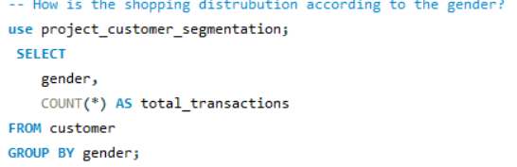
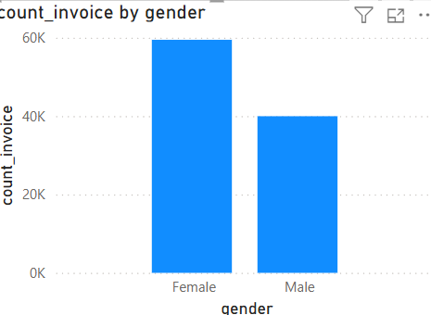

Sql queshions:-
1. How is the shopping distribution according to gender?
Insights:-
The gender-based analysis shows that female customers contribute approximately 60% of total transactions, while male customers contribute around 40%. This indicates higher purchase frequency and stronger engagement among female shoppers.

Slide 8
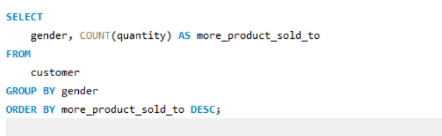
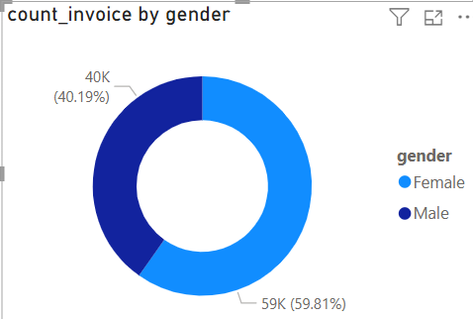

2. Which gender did we sale more product to?
Insights:-
The gender-based analysis shows that female customers contribute approximately 60% of total transactions, while male customers contribute around 40%. This indicates higher purchase frequency and stronger engagement among female shoppers.

Slide 9
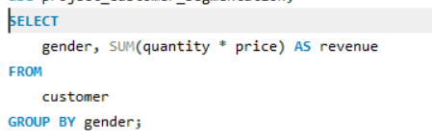
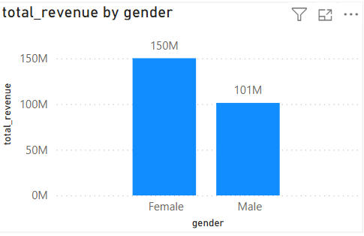

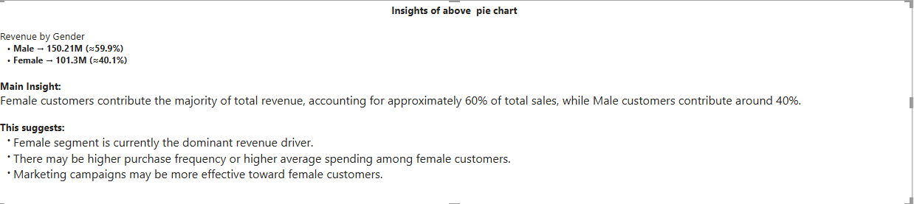
3. Which gender generates more revenue?

Slide 10
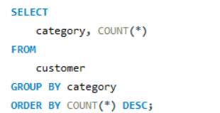
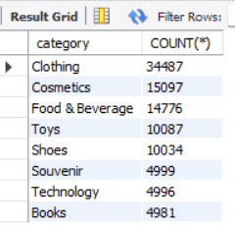
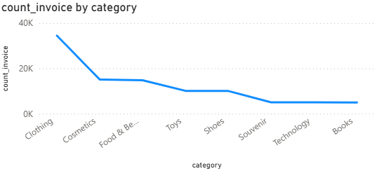
4. Distribution of purchase categories relative to other columns?
Insights:-
Shopping Distribution by Category
Clothing dominates with 34,487 transactions, indicating highest demand.
Cosmetics and Food & Beverage show strong mid-level performance.
Toys and Shoes have moderate transaction volume.
Books, Technology, and Souvenir record the lowest transaction counts.

Slide 11
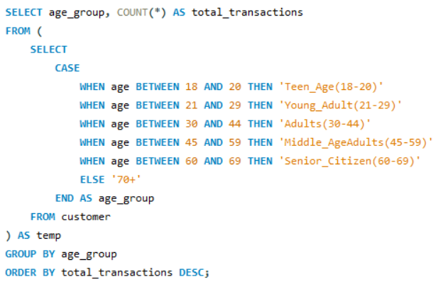
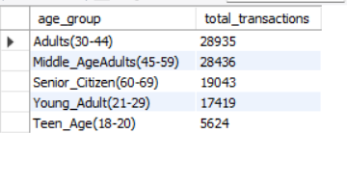
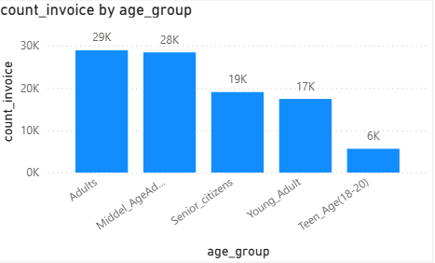
5.How is the shopping distribution according to age?
Business Interpretation
If Adults (30–44) are highest:
Strong purchasing power
Financially stable customers
Ideal segment for premium products
If Young Adults (21–29) are highest:
Trend-driven buying behavior
Opportunity for digital marketing campaigns
If Middle Age (45–59) is high:
Stable and consistent purchase pattern
Insights:-
The transaction distribution varies across different age segments.
Working-age customers contribute the highest number of transactions.
Younger and senior segments show comparatively lower purchase frequency.
This indicates that economically active age groups drive business performance.

Slide 12
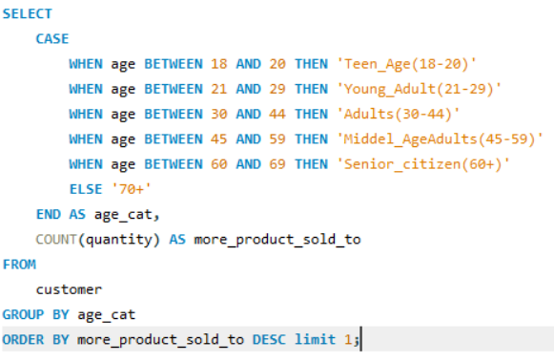
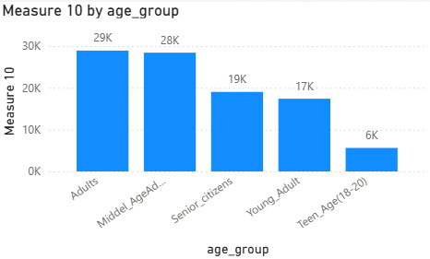

6.Which age category we sell mor products?
Business Interpretation
If Adults (30–44) are highest:
Strong purchasing power
Financially stable customers
Ideal segment for premium products
If Young Adults (21–29) are highest:
Trend-driven buying behavior
Opportunity for digital marketing campaigns
If Middle Age (45–59) is high:
Stable and consistent purchase pattern
Insights:-
The age-group analysis shows that the majority of transactions are generated by working-age customers, particularly adults and middle-aged segments. This indicates that customers within economically active age groups demonstrate higher purchasing behavior.

Slide 13
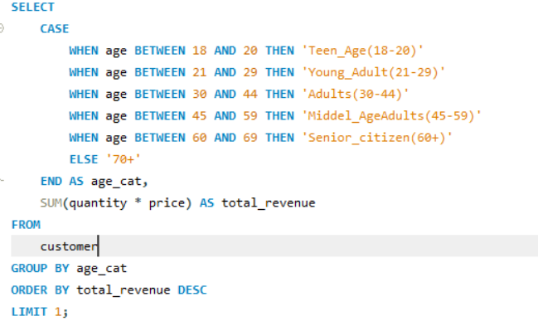
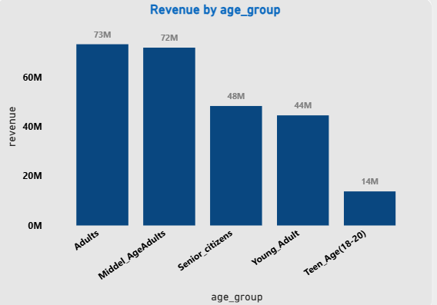

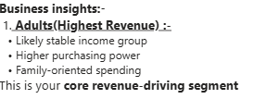

7.Which age category generates more revenue?

Slide 14
8. Distribution of purchase categories relative to other columns?
Insights:-
Shopping Distribution by Category
Clothing dominates with 34,487 transactions, indicating highest demand.
Cosmetics and Food & Beverage show strong mid-level performance.
Toys and Shoes have moderate transaction volume.
Books, Technology, and Souvenir record the lowest transaction counts.
What This Means:-
Fashion-related products drive customer engagement Repeat purchase behavior is strong in Clothing
Technology may have lower transactions but possibly higher price per unit Low-performing categories may require promotional strategies

Slide 15
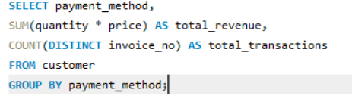
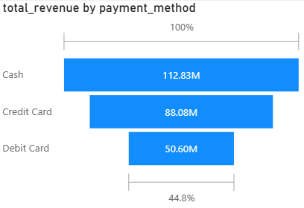
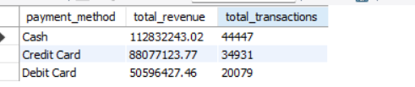
9.Dose payment method have relation betw other col?
Credit Card is highest:-
Indicates strong purchasing power
Customers are comfortable with higher-value transactions
Potential for premium product targeting
Digital Wallets are strong:-
Younger demographic dominance
Tech adoption is high
Opportunity for app-based promotions
Cash is highest:-
Reflects traditional buying behavior
Wide customer accessibility
May indicate smaller transaction sizes

Slide 16
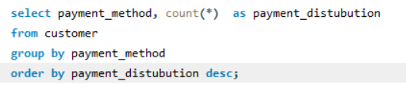
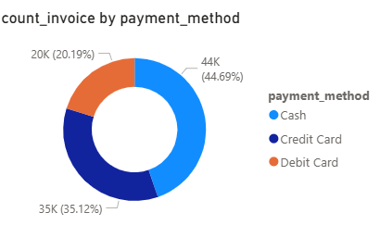
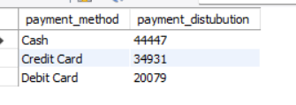
10.How is the distribution of the payment method?
Insights:-
Cash is the most preferred payment method, accounting for approximately 45% of total transactions.
Credit Card transactions represent around 35% of purchases.
Debit Card usage is comparatively lower at approximately 20%.
Traditional cash payments still dominate customer transactions.
Digital payments (Credit + Debit) together account for more than 50% of transactions, indicating growing digital adoption.
What This Means:-
Cash is still dominant → traditional buying behavior Strong credit card usage → customers comfortable with higher spending
Debit card moderate → regular daily purchases Digital adoption is significant (55%)

Slide 17
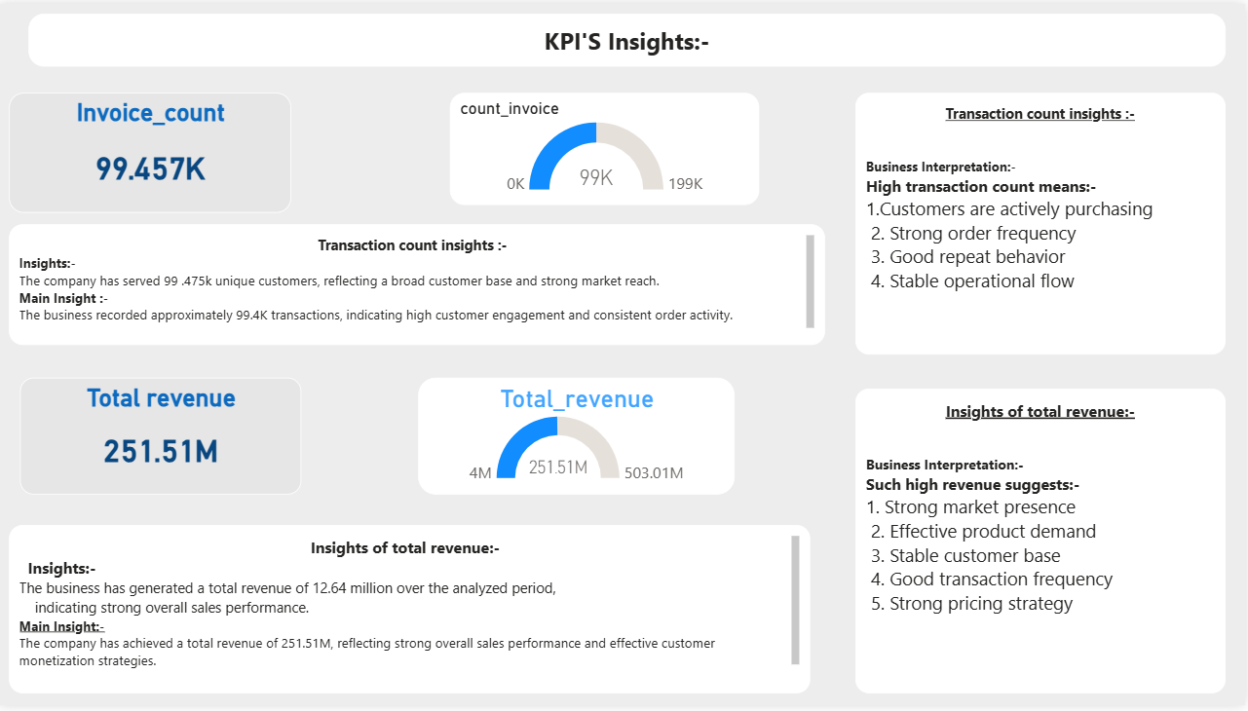

Slide 18
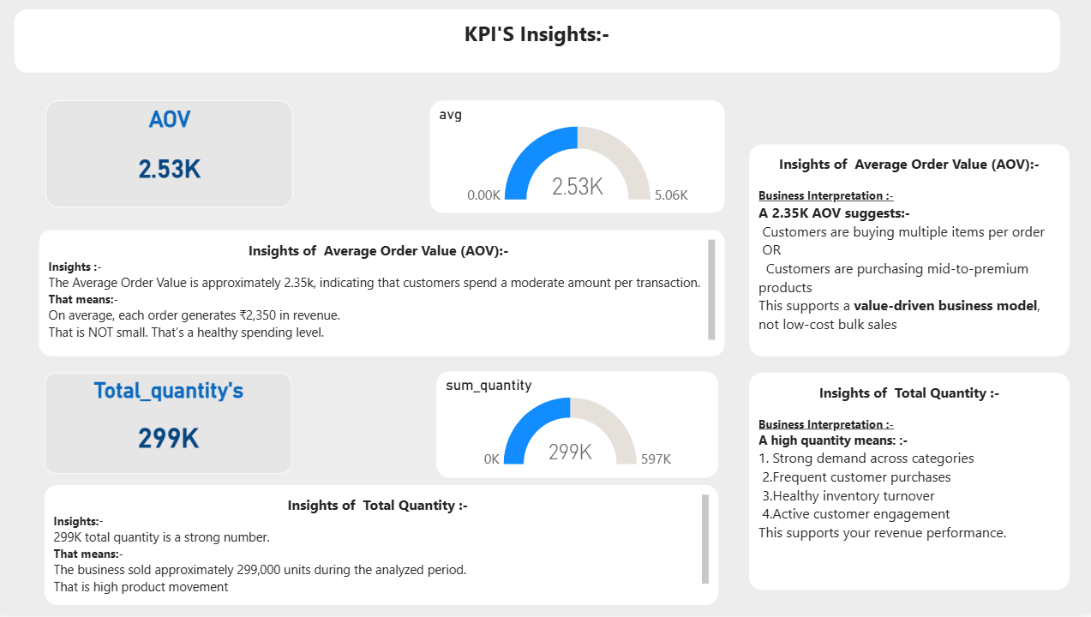

Slide 19
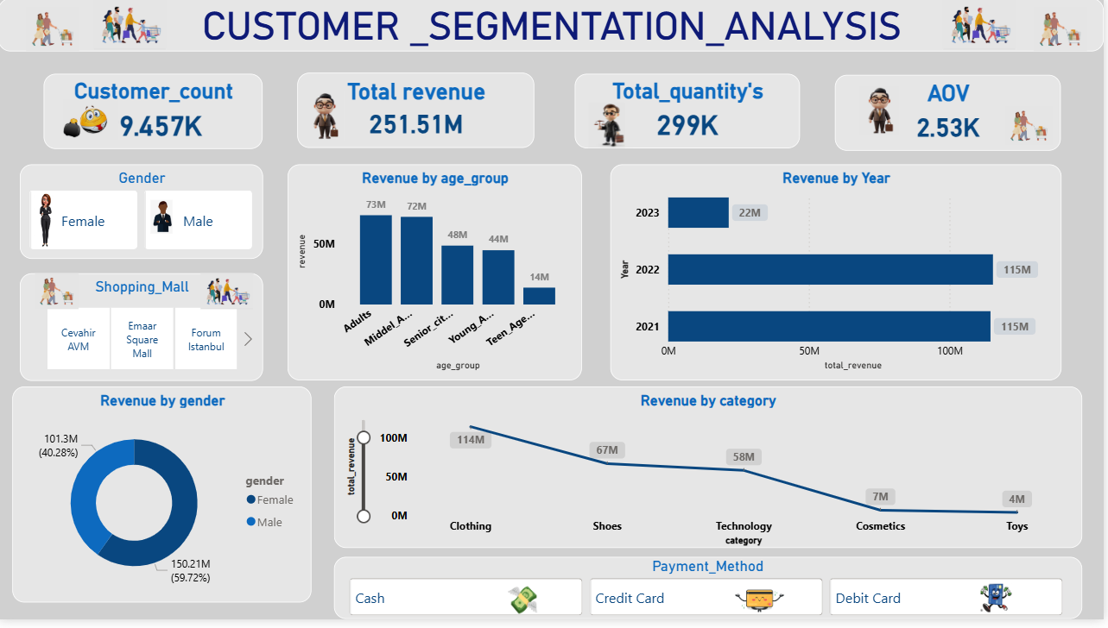

Slide 20
Over All Insights:-
Insights:-
Revenue Performance
The business generated 251.51M in total revenue.
Strong revenue supported by ~99K transactions.
Average Order Value (AOV) is 2.35K, indicating healthy spending per order.
Customer Segmentation Insights
Female customers contribute approximately 60% of total transactions, making them the dominant segment.
Working-age customers (21–44 years) generate the highest purchase activity.
Adults and middle-aged customers drive overall business performance.
Category Insights
Clothing is the highest-performing category in transaction volume.
Cosmetics and Food & Beverage show strong mid-level demand.
Books and Technology have lower transaction frequency.
Customer demand is concentrated in fashion and lifestyle segments.
Payment Method Insights
Cash (45%) is the most preferred payment method.
Credit Card usage is strong (35%), showing purchasing power.
Digital payments (Credit + Debit) exceed 50%, indicating growing digital adoption.

Slide 21
Over All Insights:-
Business Recommendations (suggestions):-
Focus on High-Value Segments:-
Target female and working-age customers with personalized campaigns.
Strengthen Top Categories:-
Expand Clothing inventory and introduce bundle offers.
Improve Low-Performing Categories:-
Promote Books and Technology through discounts or combo deals.
Encourage Digital Payments:-
Offer cashback or rewards for card payments.
Reduce cash handling operational cost.
Increase AOV:-
Introduce product bundling and cross-selling strategies.
Conclusion:-
In conclusion, the analysis reveals strong revenue performance driven primarily by female and working-age customers. Clothing emerges as the dominant category, and although cash remains the most preferred payment method, digital adoption is significant. By focusing on high-performing segments and optimizing underperforming categories, the business can further enhance profitability and customer engagement.

