Slide 1
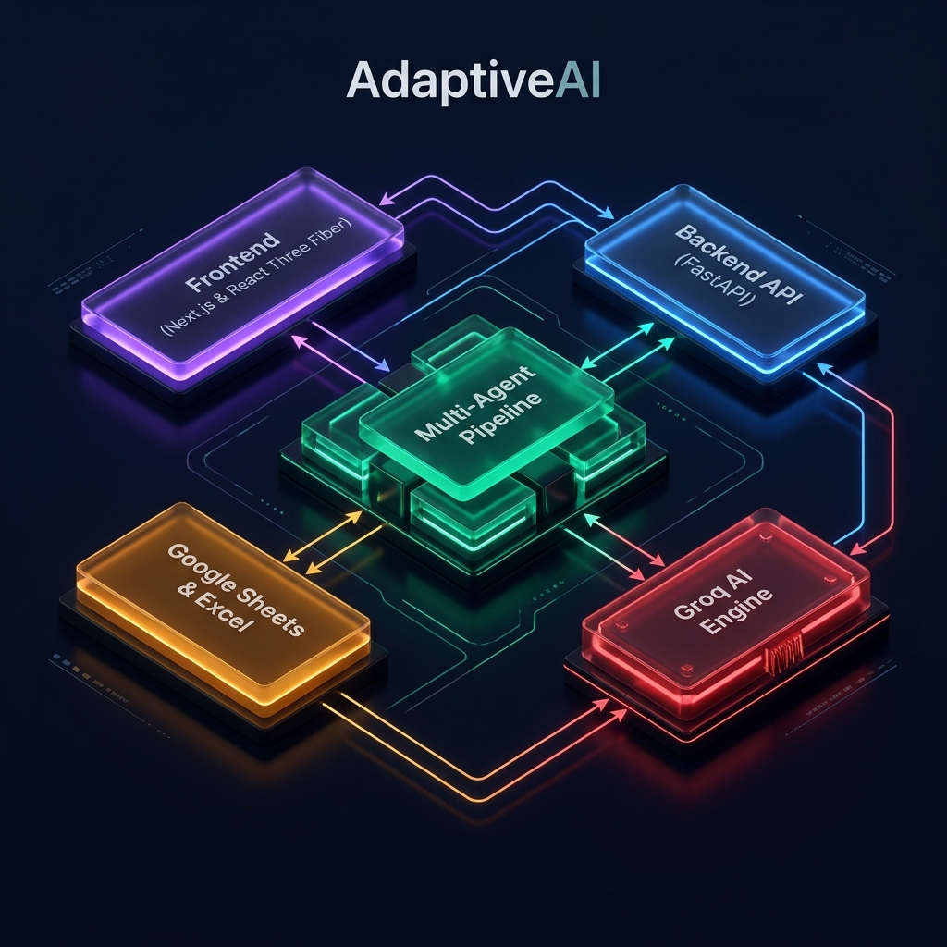
🧠
AdaptiveAI
AI-Native Operational Intelligence Platform for Startups
A multi-agent reasoning system that helps startups discover, evaluate, and adopt the right AI tools — powered by 6 specialized agents.
ByteHearts × Ranovex AI Product Hackathon 2026 | Built by Pagadala Mohith | v1.0.0

Slide 2
THE PROBLEM
Startups Are Drowning in AI Chaos
Every day, thousands of new AI tools are launched, promising to revolutionize how we work.
For founders, CTOs, and small business leaders, this explosion has turned into a massive headache.
They suffer from severe "AI FOMO" and "Tool Fatigue" — wasting thousands of dollars on overlapping AI subscriptions.
💸
⚙️
🛡️
Financial Waste
Operational Bottlenecks
Security & Obsolescence
Paying for overlapping SaaS tools with zero understanding of actual ROI
Teams spend hours on repetitive tasks because they can't orchestrate autonomous workflows
Blindly integrating AI models that are insecure or about to be deprecated

Slide 3
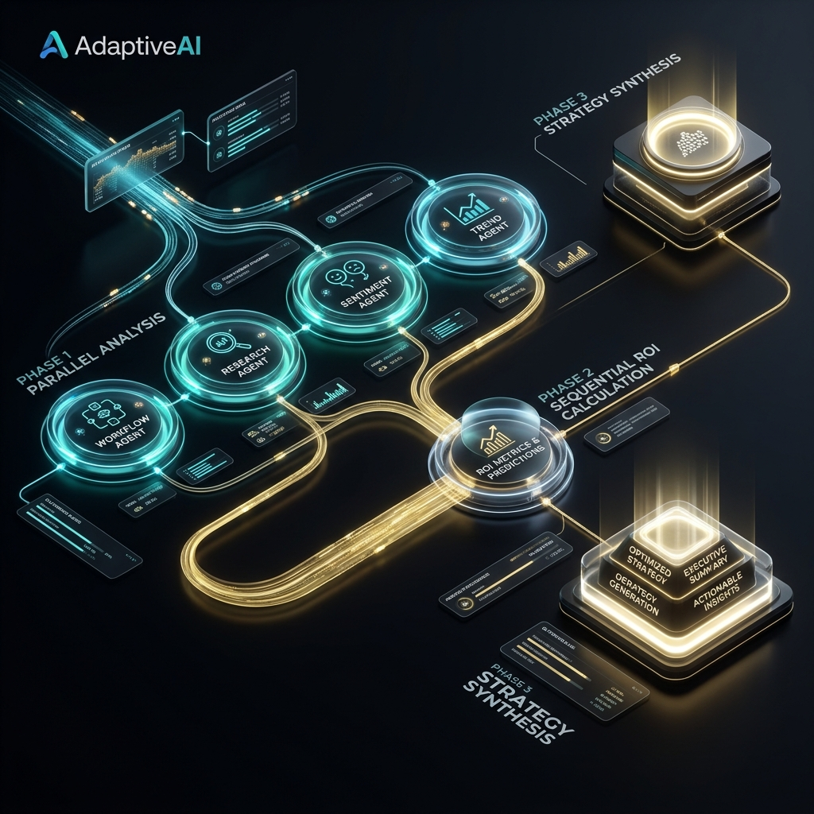
OUR SOLUTION
Your AI-Powered Fractional CTO
AdaptiveAI is an intelligent stack optimizer and digital twin simulator.
It guides companies from ad-hoc tool adoption to systematic, AI-native automation.
✦ Scans your actual business parameters
✦ Models your workflows & tests tool compatibilities
✦ Audits security feeds & simulates efficiency gains
✦ Creates a virtual sandbox before you spend a dollar
All powered by a collaborative pipeline of 6 specialized reasoning agents.

Slide 4
DIFFERENTIATOR
What Makes AdaptiveAI Unique?
Unlike static AI directories or single-prompt wrappers, AdaptiveAI is a living, breathing operational cockpit.
🧠
🏗️
📡
Multi-Model Bagger Engine
Departmental Digital Twin
Real-Time Synchronization
We orchestrate 6 specialized agents in parallel — Workflow, Research, Sentiment, Trend, ROI, and Strategy — routing each task to the exact model optimized for it.
We don't just recommend tools — we simulate them. We build a virtual, interactive model of your departments to test workflows and bottlenecks before any real-world migration.
Every piece of advice is backed by live ecosystem feeds (GitHub, News API, Product Hunt) and physically committed to your secure spreadsheet database — zero hallucinations.

Slide 5
CORE FEATURES
Four Pillars of Intelligent Automation
💡
Multi-Agent Stack Optimization
📊
Interactive ROI Recalculation Engine
Orchestrates 6 reasoning agents in parallel to audit workflow pain points and compile a fully compatible, high-ROI AI tool stack tailored to your goals.
Input custom parameters (Team Size, Hourly Rates, Manual Hours, AI Budgets) to instantly trigger a multi-agent financial audit — computes savings in under 25 seconds.
🎭
Departmental Digital Twin Sandbox
🛡️
Operational Obsolescence & Alert Center
Generates a virtual blueprint of your company's departments. Isolates manual friction points and simulates post-automation productivity gains.
Real-time threat monitor scanning GitHub metrics, developer logs, and NVD CVE feeds. Warns of deprecation, licensing, or security risks while suggesting alternatives.

Slide 6
ARCHITECTURE
System Architecture

Slide 7
AI PIPELINE
Multi-Agent Orchestration Flow
3-Phase Execution Pipeline
Phase 1 — Parallel Analysis
Workflow, Research, Sentiment, and Trend agents execute simultaneously for maximum speed.
Phase 2 — Sequential ROI
ROI agent runs after Research, using its tool recommendations as financial modeling input.
Phase 3 — Strategic Synthesis
Strategy agent combines all outputs into a unified, actionable roadmap.
Automatic Fallback Chain
Primary Model → Llama 3.3 → Llama 4 Scout → OpenRouter → Mock Response

Slide 8
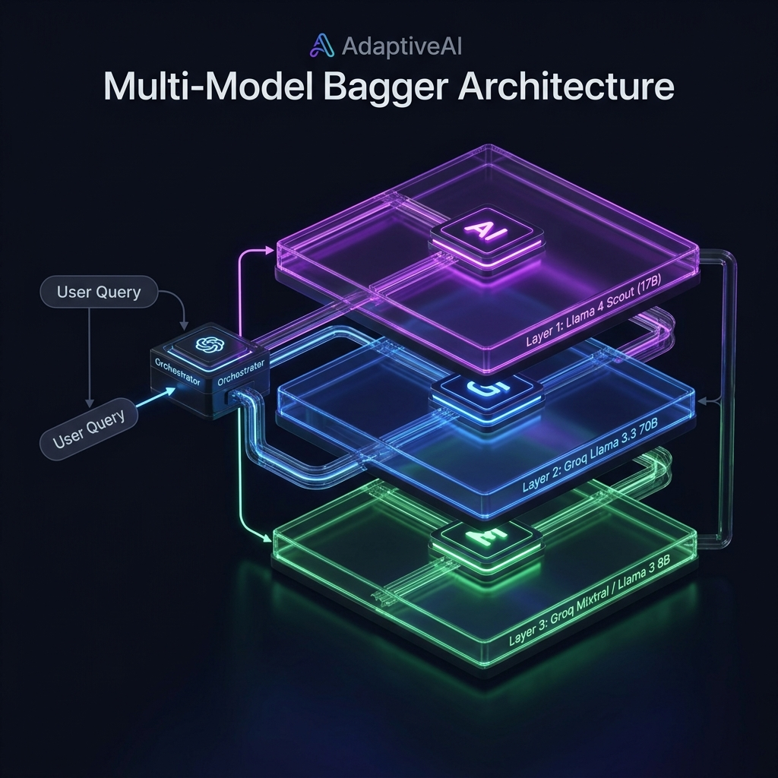
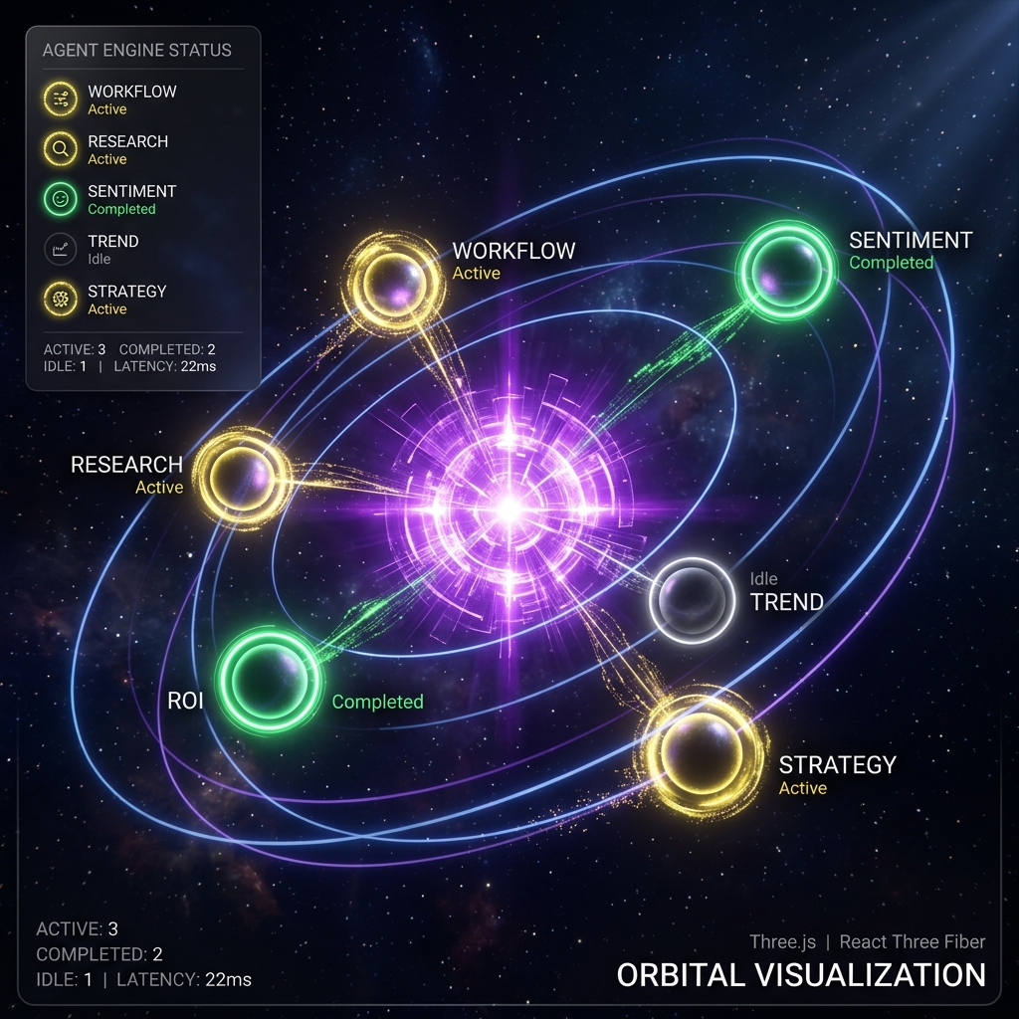
AI ENGINE
Multi-Model Bagger & 3D Orbital Visualization

Slide 9
AI INTEGRATION
Proprietary Multi-Agent Collaborative Pipeline
🧠
🌐
📡
Multi-Model Bagger (Groq API)
Live Web Ingestion & Crawling
Grounding & Retrieval Integration
Operations distributed across a specialized cluster: • GPT-OSS-120B for Strategy Agent (strategic roadmaps) • Qwen 3 32B for Workflow, Research, Sentiment, Trend & ROI Agents (structured JSON, math, classification)
Custom HTML/BeautifulSoup4 parser scrapes target startup landing pages, preserving brand context to construct onboarding profiles automatically.
Agents grounded on live external APIs: • GitHub Search API (starred momentum) • News API (emerging SaaS releases) • Product Hunt GraphQL V2 (upvotes) Preventing hallucinations with real-time ecosystem data.

Slide 10
TECH STACK
Built With Modern, Battle-Tested Technologies
🖥️
⚙️
💾
🔗
Frontend
Backend
Database
External APIs
Next.js 16 (React 19), TypeScript Three.js, React Three Fiber, Drei Framer Motion, GSAP, Zustand v5 Vanilla CSS + CSS Variables
FastAPI (Python) + Uvicorn Pydantic v2 Validation JWT Auth (python-jose + bcrypt) httpx + BeautifulSoup4
Google Sheets (gspread) 8 Master Worksheets Local Excel Fallback (openpyxl) Dual-Write Architecture
Groq API (High-Speed LLMs) GitHub Search REST API News API (Market Intelligence) Product Hunt GraphQL V2

Slide 11
AGENT ROSTER
6 Specialized Reasoning Agents
🔧
Workflow Intelligence
🔍
Tool Research
💬
Sentiment Intelligence
Qwen 3 32B
Qwen 3 32B
Qwen 3 32B
Bottleneck analysis & automation opportunities
SaaS matching & compatibility scoring
Community trust & social reputation
📈
Trend Tracking
💰
ROI Estimation
🧠
Strategy Synthesis
Qwen 3 32B
Qwen 3 32B
GPT-OSS-120B
Technology forecasting & obsolescence detection
Financial modeling & payback calculations
Unified roadmap generation

Slide 12
ROADMAP
Product Roadmap & Vision
v1.0 — CURRENT
v1.1 — NEXT
v1.2 — GROWTH
v2.0 — VISION
✅ Multi-agent AI consultant (Live) ✅ Google Sheets database (Live) ✅ 3D orbital visualization (Live) ✅ JWT authentication (Live) ✅ Market intelligence scraping (Live)
🔜 PostgreSQL migration option 🔜 Real-time WebSocket chat 🔜 Enhanced analytics dashboard
🔜 Team collaboration features 🔜 Custom agent creation 🔜 Multi-tenant deployment
🔮 Self-improving agent loop 🔮 Multi-tenant SaaS deployment 🔮 Enterprise API marketplace

Slide 13
🧠
Thank You
AdaptiveAI — AI-Native Operational Intelligence for Startups
Built with ❤️ by Pagadala Mohith | ByteHearts × Ranovex AI Product Hackathon 2026
6
3
150+
8
<25s
Specialized Agents
LLM Models
AI Tools Indexed
Master Worksheets
Full Pipeline Execution

