Slide 1
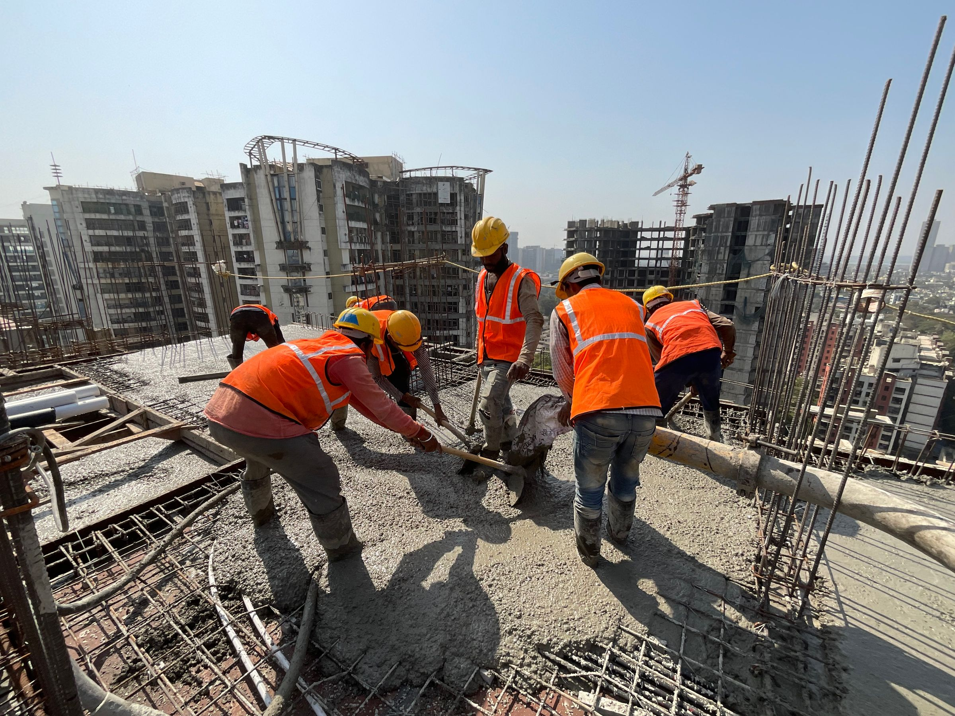

POINT BREAK
SMART INDIA HACKATHON 2026
PRAHARI
THE COUNTDOWN BAND
The hazard outside. The strain inside.
One warning on your wrist.
PROBLEM STATEMENT ID 26181
PROBLEM STATEMENT TITLE
A secure, AI-powered Personal Health Companion that delivers real-time, privacy-preserving health monitoring and early warning capabilities, helping individuals recognize health risks before they become emergencies. The solution should improve resilience during heat waves, floods, pollution events, and other disasters common in India while enabling continuous health support through on-device intelligence.
Built for people
working beyond the last signal.
THEME
PS CATEGORY
TEAM ID
Photo: yajna S R / Pexels · Mumbai, India
MedTech / BioTech / HealthTech
Hardware
To be provided
PRAHARI / POINT BREAK
@SIH Idea submission- Template
01 / 06
Notes:
Opening: PRAHARI aims to bring two early warnings to one wrist: official hazard alerts and personal heat-strain trends. Team name and PS ID/title are taken from PRAHARI_SIH2026_Idea_3.pdf. Team ID was absent from the supplied materials and must be filled before submission. The photograph is a real contextual photograph, not the team or a prototype trial. Photo: yajna S R, https://www.pexels.com/photo/construction-workers-working-on-top-of-a-building-20591230/ (Pexels License).

Slide 2
POINT BREAK
IDEA TITLE
Two threats. One personal warning system.
Proposed Solution / PRAHARI — The Countdown Band
01
THE HAZARD OUTSIDE
02
THE STRAIN INSIDE
Warnings must travel past a network outage.
A regional forecast cannot see your body.
Official CAP alerts → phone + gateway band
→ LoRa peer relay → vibration at the wrist
Heart rate + skin temperature + ambient heat
→ on-device trend → early rest / cooling prompt
THE BAND
THE COMPANION APP
ONE CONNECTED ENTRY POINT
SHARES WARNINGS LOCALLY
Senses • decides • warns
Fetches alerts • keeps offline history
INNOVATION & UNIQUENESS
*Proposed features; personal forecasts and recovery tracking require validation.
Body + hazard in one device
Time to heat-risk threshold*
Recovery across shifts*
PRAHARI / POINT BREAK
@SIH Idea submission- Template
02 / 06
Notes:
Detailed solution: A connected phone downloads official CAP alerts and sends relevant alerts over BLE to a gateway band. That LoRa-equipped band can relay them to nearby bands. Phones alone have no LoRa radio. New external alerts need at least one connected entry point; local body monitoring is intended to continue offline. Proposed originality is the combination of official multi-hazard warning, local relaying, individualized heat-strain forecasting, and a thermal-debt/recovery ledger. Forecast-to-threshold is a research feature, not a validated countdown to collapse. Do not present this as implemented mesh or proven prediction. SACHET confirms CAP-based multi-hazard dissemination and RSS: https://sachet.ndma.gov.in/.

Slide 3
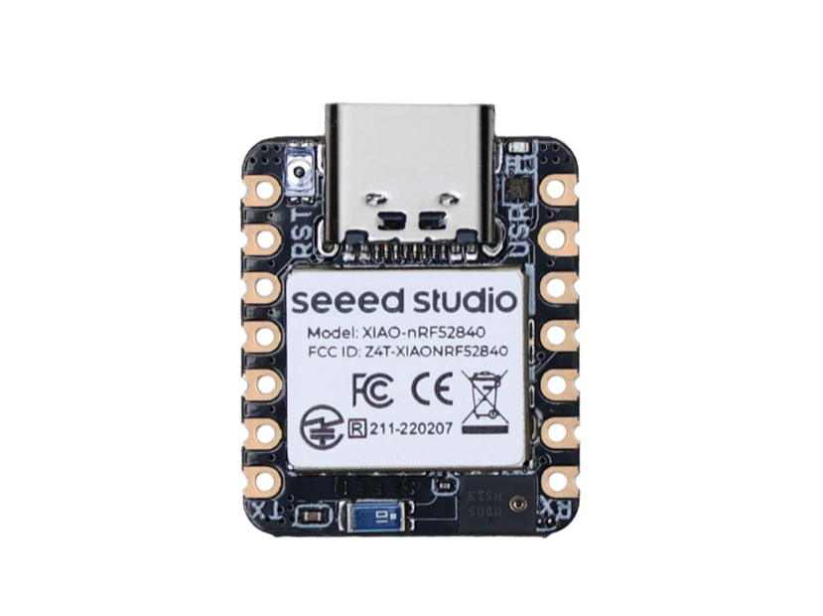
POINT BREAK
TECHNICAL APPROACH
Sense locally. Decide on-device. Relay the warning.
Proposed rev B architecture · hardware + embedded intelligence + offline companion
1
SENSE
2
DECIDE
3
WARN
MAX30102 · heart rate / PPG
MAX30208 · contact skin temp
AHT20 · air temp + humidity
Onboard IMU · motion context
Signal-quality + motion gate
Kalman estimate + personal baseline
Trend-to-threshold forecast*
Recovery / thermal-debt ledger*
Distinct haptics + OLED status
SX1262 LoRa · local peer relay*
BLE · Android companion*
Local records + protected keys*
XIAO nRF52840 Sense
Privacy by design
C/C++ · Arduino | TinyML planned
Flutter / Dart · local storage planned
Keep raw physiology on-device;
share only necessary alert data.*
CAP → connected phone → BLE gateway band → LoRa peers → haptic warning
Board image: Seeed Studio · *Planned / requires validation; air temperature + humidity alone are not full WBGT.
PRAHARI / POINT BREAK
@SIH Idea submission- Template
03 / 06
Notes:
Methodology: sample sensors on the shared I2C bus; use motion and signal quality to decide whether the physiological estimate is usable; build individual baselines; evaluate trend prediction before presenting a time estimate. Low-quality input must show an unavailable estimate, not reassuring status. Rev B uses MAX30102, MAX30208 and SX1262/Ra-01SH from pcb/README.md and the project report; older breadboard firmware uses SX1278 and an earlier sensor breakout. LoRa relay, TinyML, app, security integration and forecasting are proposed, not demonstrated by the checked-in sensor test firmware. AHT20 measures air temperature and humidity, not solar radiant load; do not call this full measured WBGT. Sources: https://wiki.seeedstudio.com/XIAO_BLE/ ; https://ojs.aaai.org/index.php/AAAI/article/view/18809 ; https://sachet.ndma.gov.in/ . Manufacturer image shows an actual XIAO module, not a completed PRAHARI band.

Slide 4
POINT BREAK
FEASIBILITY AND VIABILITY
A working sensing core. A focused path to a field pilot.
CHALLENGE
STRATEGY TO OVERCOME IT
FEASIBILITY TODAY
Motion & sensor uncertainty
Quality gate; reference-device validation;
show “estimate unavailable” on poor signal.
Verified on the bench
Live heart-rate sensing + OLED
I²C discovery and sensor diagnostics
Radio loss & stale alerts
Time stamps, expiry, deduplication, hop limits;
measure delivery and battery life in the field.
Engineering in progress
Rev B PCB + BOM available
Radio bring-up / PCB checks open
App + forecasting + relay to integrate
Fit, power & deployment cost
Modular parts; duty cycling; enclosure trials;
quote the complete rev B assembly before pilot.
Pilot readiness gates
01
Close hardware issues
02
Validate sensing + relay
03
Supervised worker pilot
Economic viability: off-the-shelf modules + a two-layer PCB; final cost awaits rev B BOM, battery, enclosure and assembly quotes.
PRAHARI / POINT BREAK
@SIH Idea submission- Template
04 / 06
Notes:
Evidence: README.md and Obsidian Projects/PRAHARI.md document live finger heart-rate testing and successful OLED integration. These are bench demonstrations, not clinical or field validation. The latest dated root notes record unresolved SX1278 SPI bring-up and PCB DRC issues (3 errors + 4 unconnected); the older pcb README contains a cleaner historical result. Do not claim the current board is fabrication-ready. A 70 x 40 mm rev B carrier design and BOM exist. The older ₹3,468 number covers selected rev A modules only and is not a finished rev B device price; it was omitted as a headline. The old ~2 km/hop and clinical accuracy values are unverified for this implementation. The next gates are hardware integrity, safe sensor/reference testing, radio delivery and power measurements, then supervised wearability and usability work. Applicable radio settings and permissions must be checked for the chosen region before field operation; no categorical regulatory approval is claimed.

Slide 5
POINT BREAK
IMPACT AND BENEFITS
Earlier awareness. A clearer next action.
57%
of Indian districts face high
to very high heat risk.
CEEW, 2025 · district-level heat-risk assessment [1]
SOCIAL / Reach the person
Simple haptics; no personal smartphone needed
for local warning reception.
Start with outdoor work crews.
ECONOMIC / Support timely action
Construction · agriculture · municipal work
Earlier rest and cooling prompts aim to reduce
disruption; pilot outcomes will test the benefit.
Photo: yajna S R / Pexels
MEASURE IN THE PILOT Alert delivery time • Missed / false alerts • Time to action • Shift-long wearability
PRAHARI / POINT BREAK
@SIH Idea submission- Template
05 / 06
Notes:
Potential impact, not demonstrated outcomes. Intended initial audience is outdoor work crews, followed by field responders and remote communities. Simple haptics and icon/status displays can reduce dependence on text literacy and individual phone ownership; validate distinct patterns and comprehension in the user pilot. Crew response still requires training and a local escalation protocol. Economic savings and reduced health harm are not quantified until evaluated. Modular repair and rechargeable power are design intentions; no environmental benefit is quantified. CEEW reports 57% of Indian districts at high to very high heat risk in its 2025 study: https://www.ceew.in/publications/mapping-climate-risks-and-impacts-of-extreme-heatwave-disaster-in-indian-districts . Photo is contextual, not an endorsement or completed trial: https://www.pexels.com/photo/construction-workers-working-on-top-of-a-building-20591230/ .

Slide 6
POINT BREAK
RESEARCH AND REFERENCES
Grounded in research. Built to be tested.
Reference & research work · clickable source titles
01
THE NEED
CEEW · How Extreme Heat is Impacting India (2025)
PROJECT EVIDENCE
District-level heat risk; basis for the 57% figure.
PRAHARI repository
02
OFFICIAL WARNING SOURCE
NDMA · SACHET National Disaster Alert Portal
Sensor + OLED firmware
KiCad design + BOM
Bring-up and verification notes
CAP-based multi-hazard alerts and RSS dissemination.
03
ALGORITHM FOUNDATION
Buller et al. · Wearable physiological estimation
Kalman-filter research; PRAHARI still needs its own validation.
Obsidian project brain
PRAHARI reference deck + report
04
HARDWARE PLATFORM
Seeed Studio · XIAO nRF52840 Series
Repository access may be restricted.
MCU, BLE and Sense IMU documentation; module image source.
PHOTOGRAPHY yajna S R / Pexels · Mumbai construction workers · Pexels License
PRAHARI / POINT BREAK
@SIH Idea submission- Template
06 / 06
Notes:
Local reference materials: /home/per/Downloads/SIH2026-IDEA-Presentation-Format.pptx; /home/per/Downloads/PRAHARI_SIH2026_Idea_3.pdf; /home/per/Downloads/PRAHARI_Project_Report.pdf; /home/per/Documents/Obsidian/Projects/PRAHARI.md and linked XIAO, LoRa and MAX30102 notes; /home/per/PRAHARI/README.md; /home/per/PRAHARI/pcb/README.md. The supplied template is the base package; all six idea-detail sections are retained and the instruction slide is removed. Research supports motivation and architecture, not achieved PRAHARI performance. No mortality guarantee, regulatory approval, clinical accuracy, competitor claim, field range, or manufactured device cost is asserted. Real stock photography only; the board image is from its manufacturer. No AI image generation used. Photo license: https://www.pexels.com/license/.

