Slide 1

SMART INDIA HACKATHON 2026
PRAHARI — The Countdown Band
Warns before the emergency — the flood, cyclone or heatwave coming at you,
and the heat strain building inside you — and reaches workers no tower reaches.
• Problem Statement ID – 26181
•
Problem Statement Title – A secure, AI-powered Personal Health Companion that delivers real-time, privacy-preserving health monitoring and early warning capabilities, helping individuals recognize health risks before they become emergencies. The solution should improve resilience during heat waves, floods, pollution events, and other disasters common in India while enabling continuous health support through on-device intelligence.
• Theme – MedTech / BioTech / HealthTech
• PS Category – Hardware
• Team ID – <your team id>
• Team Name – Point Break
Notes:
Title slide follows PRAHARI_SIH2026_Idea_3.pdf: original SIH artwork, title and tagline, then PS ID, full PS title, theme, hardware category, Team ID and Point Break. Team ID is still absent from supplied materials. The tagline describes intended coverage, not a demonstrated radio range. New official alerts need at least one connected entry point.

Slide 2
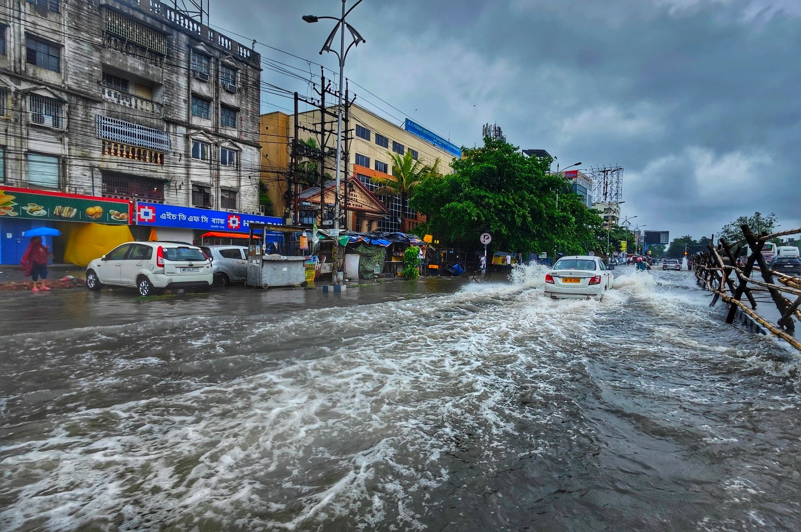

POINT BREAK
IDEA TITLE
PRAHARI: two warnings, one system.
Proposed solution / Personal heat-strain awareness + official multi-hazard early warning
THE HAZARD OUTSIDE
THE STRAIN INSIDE
Flood, cyclone, heatwave and lightning alerts can fail to reach the last mile.
Heat exposure and incomplete recovery differ from one worker to the next.
01 THE BAND
02 THE COMPANION APP
• Heart rate, skin temperature, ambient heat and motion
• Local risk trend, OLED status and distinct haptic patterns
• LoRa peer relaying extends alerts beyond the gateway
• Fetches official NDMA SACHET CAP alerts when online
• Sends relevant alerts by BLE to a LoRa gateway band
• Keeps offline history and recovery records on the phone
INNOVATION & UNIQUENESS
Personal countdown*
Thermal debt ledger*
Two warnings, one wrist
Estimate time to a heat-risk threshold
only when signal quality permits.
Carry cumulative strain and recovery
across shifts and overnight.
Separate hazard and strain patterns;
local reception needs no personal phone.
*Proposed, to validate. Photos: Dibakar Roy (Kolkata flood); Abhishek Gupta (Indian farmer) / Pexels. Context images, not trials.
PRAHARI / POINT BREAK
@SIH Idea submission- Template
02 / 06
Notes:
The personal countdown is a research feature: estimate time to a chosen risk threshold, not guaranteed minutes until collapse. Thermal debt means tracking accumulated strain and recovery rather than resetting the story each shift. A phone is not a LoRa radio: it uses BLE to a gateway band. Body monitoring is intended to work offline; new CAP alerts need connected ingress. Photos: https://www.pexels.com/photo/flood-on-street-in-city-in-india-25189241/ by Dibakar Roy; https://www.pexels.com/photo/indian-farmer-working-in-a-field-during-summer-29912210/ by Abhishek Gupta. Pexels License. Architecture and features are proposed except documented sensor/OLED bench work.

Slide 3
POINT BREAK
TECHNICAL APPROACH
System architecture / two inputs, one wrist.
Proposed end-to-end flow · body processing stays local; official alerts enter through a connected gateway
A / PERSONAL HEAT-STRAIN PATH
SENSOR INPUTS
XIAO nRF52840
ESTIMATE + FORECAST
LOCAL WARNING
MAX30102 · heart rate
MAX30208 · skin temp
AHT20 · air temp / RH
IMU · motion
Filter + sample signals
Calculate signal quality
C/C++ on the band
Usable
signal?
YES
Kalman + personal baseline
Trend to threshold*
Recovery ledger*
OLED risk / time*
Strain vibration
Prompt to take action
NO
B / OFFICIAL HAZARD-ALERT PATH
Estimate unavailable · refit / resample
NDMA SACHET
PHONE APP
GATEWAY BAND
PEER BANDS
HAZARD WARNING
Official CAP / RSS alerts
Fetch · location · expiry
BLE in → SX1262 LoRa
Deduplicate · hop limit
Distinct wrist vibration
PLANNED STACK C/C++ · Kalman / TinyML evaluation · Flutter + local storage · protected keys · raw physiology kept local
*Validation required. Low-quality data must not imply safety. New CAP alerts need connected ingress. Air temp + RH alone are not full WBGT.
PRAHARI / POINT BREAK
@SIH Idea submission- Template
03 / 06
Notes:
Architecture is an editable flowchart. The body branch routes unusable signals to estimate-unavailable / refit / resample; that is not a safe classification. A valid estimate drives a local strain alert. The external branch preserves issuer, location, timestamp and expiry checks, then sends via BLE to a LoRa-equipped gateway and peers. Payload deduplication and hop limits are proposed to reduce repeated flooding. Official alerts do not depend on physiological signal quality. Full radio protocol, forecasting, app and secure-key integration are not yet demonstrated. References and evidence are on slide 6.

Slide 4
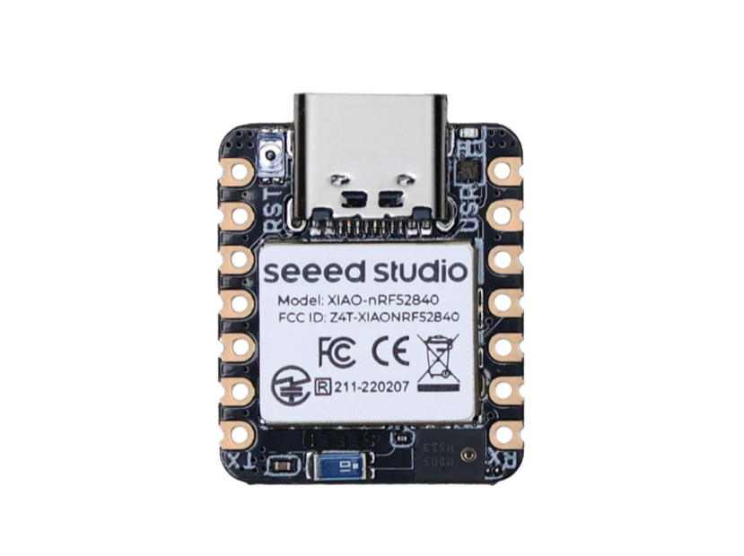
POINT BREAK
FEASIBILITY AND VIABILITY
From a working sensing core to a supervised pilot.
COMPACT, MODULAR HARDWARE
CHALLENGES → MITIGATION
XIAO + sensor modules
Two-layer rev B carrier PCB
LiPo protection + haptic output
Motion / uncertainty
Quality gating + reference-device testing; no false reassurance.
Radio outages / old alerts
Expiry, deduplication and hop limits; measure delivery and range.
VERIFIED
Battery / fit / robustness
Duty-cycle sensing and radio; test comfort, sweat and shift use.
Live PPG / heart rate, OLED and I²C diagnostics.
IN PROGRESS
Radio bring-up; PCB checks; app + forecast integration.
Data protection
Keep physiology local; validate access control and key handling.
ECONOMIC & OPERATIONAL VIABILITY
IMPLEMENTATION GATES
Off-the-shelf parts simplify repair and sourcing. Quote the full rev B assembly, enclosure and battery before setting a device price.
01
Close hardware
and radio issues
02
Validate sensing,
relay and power
03
Supervised pilot
and user feedback
Photo: Seeed Studio, actual XIAO module. Bench results do not establish clinical accuracy or field readiness; full-device cost remains to be quoted.
PRAHARI / POINT BREAK
@SIH Idea submission- Template
04 / 06
Notes:
Documented bench evidence is sensor/OLED operation, not a completed countdown or radio mesh. Latest project notes identify unresolved SPI radio bring-up and PCB check failures; older PCB README clean results refer to another state. Rev B carrier is 70 x 40 mm. Its specified protection circuit and haptic driver are design choices, not validated enclosure safety. The older ₹3,468 estimate only covers selected rev A modules. The implementation sequence is proposed; no unsupported 12-week guarantee. Manufacturer component image from https://wiki.seeedstudio.com/XIAO_BLE/.

Slide 5
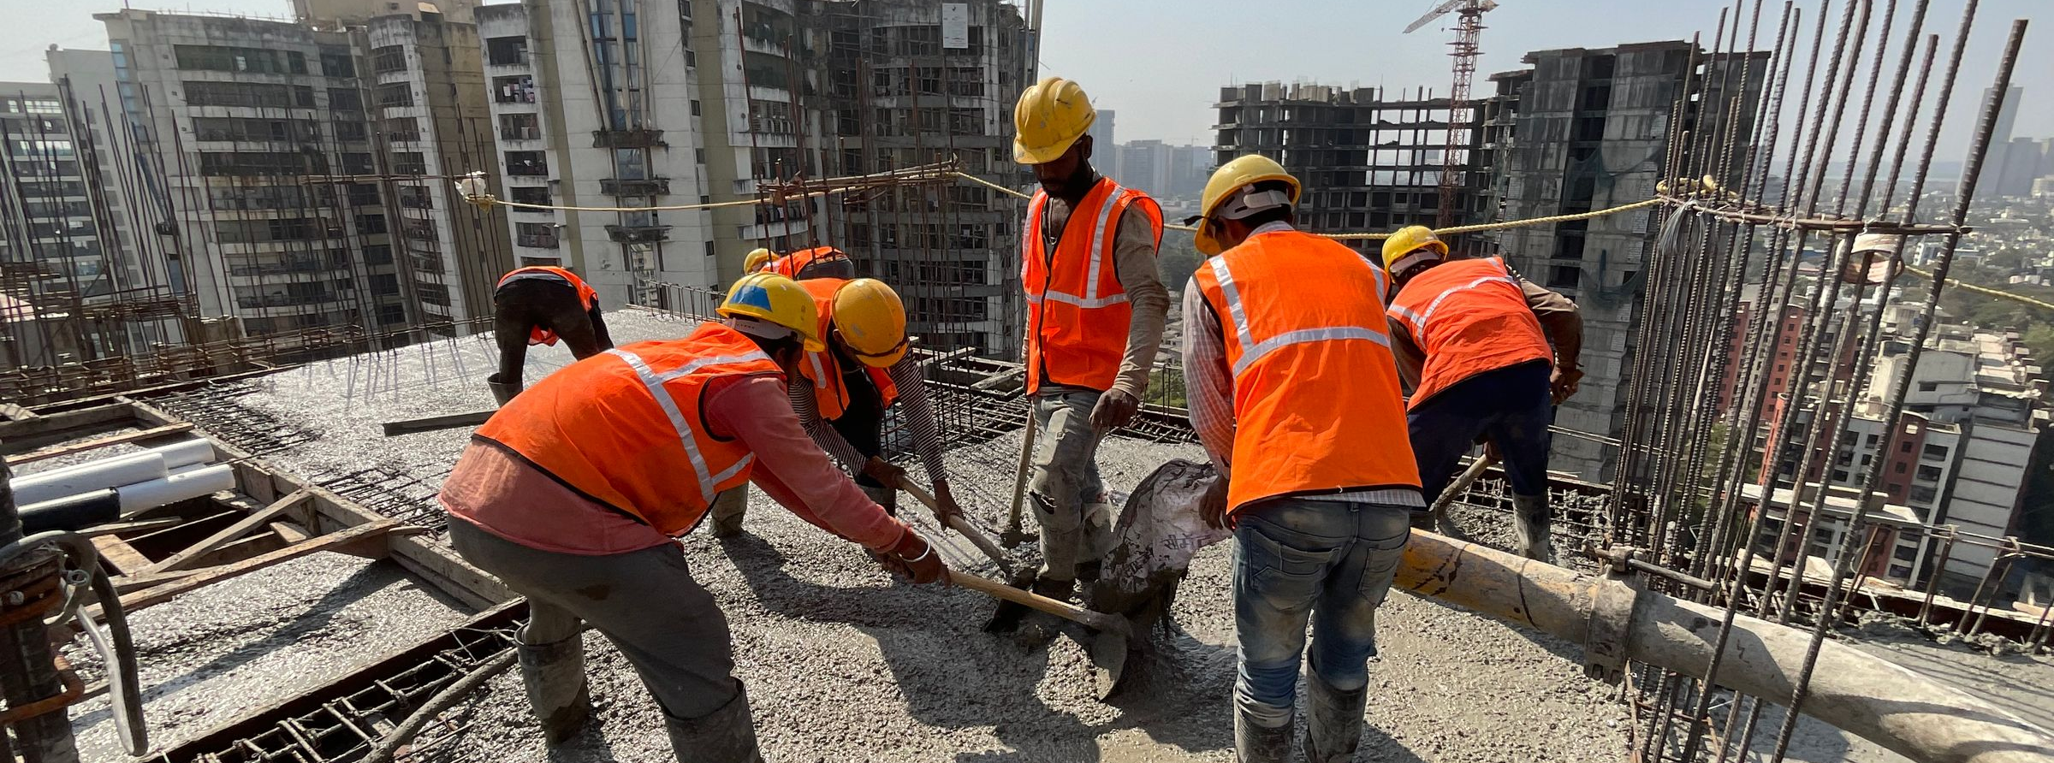
POINT BREAK
IMPACT AND BENEFITS
Put the warning where action can start.
OUTDOOR WORK CREWS
FARMING COMMUNITIES
DISASTER-EXPOSED AREAS
57%
of Indian districts at high to very high heat risk
CEEW, 2025 [1]
SOCIAL
ECONOMIC
SYSTEMIC & ENVIRONMENTAL
Distinct haptics support simple warnings.
No personal phone needed for reception.
Local crews can act on shared alerts.
Timely rest prompts aim to reduce disruption.
Crew deployment can share gateway access.
Measure time to action before claiming savings.
Extend official alerts into local peer networks.
Rechargeable, modular design aims for repair.
Validate durability and lifetime in the pilot.
PILOT METRICS Delivery time • Missed / false alerts • Time to action • Battery per shift • Comfort and comprehension
Real photographs: yajna S R; Abhishek Gupta; Dibakar Roy / Pexels. Intended benefits, not measured health or economic outcomes.
PRAHARI / POINT BREAK
@SIH Idea submission- Template
05 / 06
Notes:
CEEW source: https://www.ceew.in/publications/mapping-climate-risks-and-impacts-of-extreme-heatwave-disaster-in-indian-districts . Benefits are intended. Community response requires training and an escalation protocol. Do not imply mortality reduction or quantified savings. Environmental intent is rechargeable, repairable deployment, not a lifecycle claim. Photos show context only and do not establish participation or endorsement. Credits/links in slide 6 notes.

Slide 6
POINT BREAK
RESEARCH AND REFERENCES
Research foundations. Evidence. Next questions.
01
CEEW · Extreme heat in Indian districts (2025)
WHAT THE PILOT MUST TEST
Heat-risk evidence and target-user context.
02
NDMA · SACHET CAP / RSS alerts
01 Does the forecast stay useful
during movement and recovery?
02 Do alerts arrive reliably across
the actual deployment terrain?
03 Can users distinguish, trust
and act on the warning?
Official alert source for hazard dissemination.
03
Buller et al. · Wearable physiological estimation
Kalman-filter research; not PRAHARI validation.
04
Seeed Studio · XIAO nRF52840 documentation
MCU, BLE, Sense IMU and component image.
05
PRAHARI · firmware, KiCad and project notes
Obsidian brain + Idea_3 PDF
+ project report informed this deck.
Sensor/OLED work, BOM and bring-up evidence; private repo.
REAL IMAGE CREDITS · PEXELS LICENSE
yajna S R — Mumbai workers | Abhishek Gupta — Indian farmer | Dibakar Roy — Kolkata flood | Seeed Studio — XIAO
PRAHARI / POINT BREAK
@SIH Idea submission- Template
06 / 06
Notes:
Images, all non-AI: https://www.pexels.com/photo/construction-workers-working-on-top-of-a-building-20591230/ (yajna S R); https://www.pexels.com/photo/indian-farmer-working-in-a-field-during-summer-29912210/ (Abhishek Gupta); https://www.pexels.com/photo/flood-on-street-in-city-in-india-25189241/ (Dibakar Roy); license https://www.pexels.com/license/ . XIAO component image: https://files.seeedstudio.com/wiki/XIAO-BLE/xiaonrf52840sence.png from Seeed Studio documentation. SIH artwork from supplied template. All stock photographs are contextual, not team prototype trials. Local inputs: Obsidian Projects/PRAHARI.md and linked topics, repository README/PCB README, PRAHARI_SIH2026_Idea_3.pdf, PRAHARI_Project_Report.pdf. Research findings are not achieved device results.

