Slide 1
Getting Started with PowerShell Desired State Configuration (DSC)
Jeffrey Snover | Distinguished Engineer & Lead Architect
Jason Helmick | Author/Evangelist, Pluralsight

Slide 2

Meet Jeffrey Snover | ‏@jsnover
Distinguished Engineer & Lead Architect for Windows Server & System Center Division
Inventor of Windows PowerShell
Responsible for setting long term technical vision for these products and running the technology planning for the releases
Over 30 years of industry experience
Microsoft, Tivoli, NetView, DEC
Held 8 patents prior to joining Microsoft, and has registered 30 since.
Frequent speaker at industry and research conferences on a variety of management and language topics

Slide 3
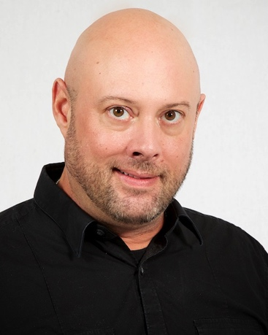
Meet Jason Helmick | @theJasonHelmick
Author/Evangelist, Pluralsight
CFO/COO – PowerShell.Org
Windows PowerShell MVP
Co-Author “Windows PowerShell 4 TFM”
Author “Learn Windows IIS in a Month of Lunches”
25 year IT veteran
Speaker at several industry conferences
Teaches PowerShell to the IT pro for automation of products such as MS Exchange, SharePoint and IIS.
Frequent contributor to magazines TechNet, Redmond and TechTarget

Slide 4
Course Modules
Getting started with PowerShell Desired State Config (DSC)
01 | Getting ready for DSC Architecture overview along with resources and requirements for DSC
02 | Performing a push deployment Perform a push deployment configuring the LCM and your first DSC configuration
03 | Configuring Pull servers for deployment Explore the Pull server options SMB and HTTP
04 | Deploying configurations using a Pull server Preparing your environment for pull configurations and querying diagnostic information
05 | Resource roundup Start working with the available resources in your configurations
06 | Writing better configurations Enhance your configurations with parameters, credentials and more
07 | DSC and Linux Start working cross platform with configuring Linux

Slide 5
Setting Expectations
Target Audience
Any IT pro or developer that is responsible for configuration management, automation, security and business agility
Suggested Prerequisites/Supporting Material
Getting started with Windows PowerShell Jump Start
http://www.microsoftvirtualacademy.com/training-courses/getting-started-with-powershell-3-0-jump-start
Advanced Tools & Scripting with PowerShell Jump Start
http://www.microsoftvirtualacademy.com/training-courses/advanced-tools-scripting-with-powershell-3-0-jump-start
Additional resources at PowerShell.Org (DSC Hub)
http://powershell.org/wp/dsc-hub/

Slide 6
Join the MVA Community!
Microsoft Virtual Academy
Free online learning tailored for IT Pros and Developers
Over 2M registered users
Up-to-date, relevant training on variety of Microsoft products
“Earn while you learn!”
Get 50 MVA Points for this event!
Visit http://aka.ms/MVA-Voucher
Enter this code: PShellDSCFound (Expires: 3/26/15)

