Slide 1
Getting Started with PowerShell Desired State Configuration (DSC)
Jeffrey Snover | Distinguished Engineer & Lead Architect
Jason Helmick | Author/Evangelist, Pluralsight

Slide 2
Course Modules
Getting started with PowerShell Desired State Config (DSC)
01 | Getting ready for DSC Architecture overview along with resources and requirements for DSC
02 | Performing a push deployment Perform a push deployment configuring the LCM and your first DSC configuration
03 | Configuring Pull servers for deployment Explore the Pull server options SMB and HTTP
04 | Deploying configurations using a Pull server Preparing your environment for pull configurations and querying diagnostic information
05 | Resource roundup Start working with the available resources in your configurations
06 | Writing better configurations Enhance your configurations with parameters, credentials and more
07 | DSC and Linux Start working cross platform with configuring Linux

Slide 3
01 | Getting ready for DSC
Jeffrey Snover | Distinguished Engineer & Lead Architect
Jason Helmick | Author/Evangelist, Pluralsight

Slide 4
Module Overview
The purpose for DSC
DSC architecture overview
Resources for DSC
Requirements for DSC

Slide 5
The purpose for DSC
Distributed Heterogeneous Configuration Management Platform
Why declarative configurations?
Managing drift
Cross platform importance
DevOps?

Slide 6
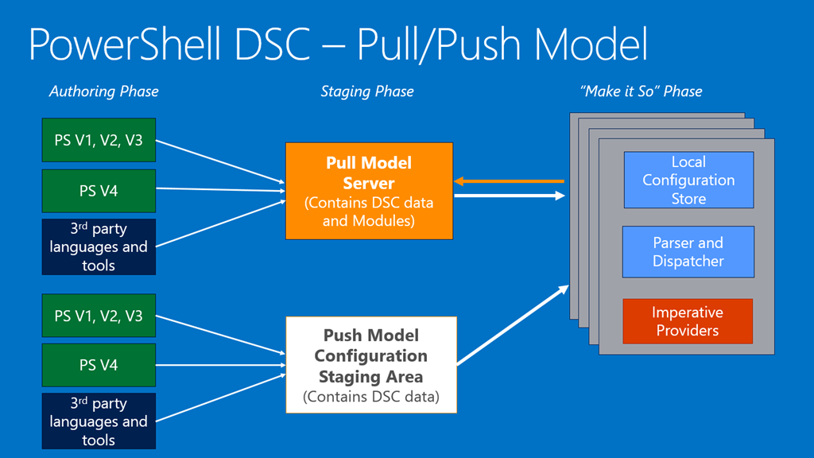
DSC architecture overview

Slide 7
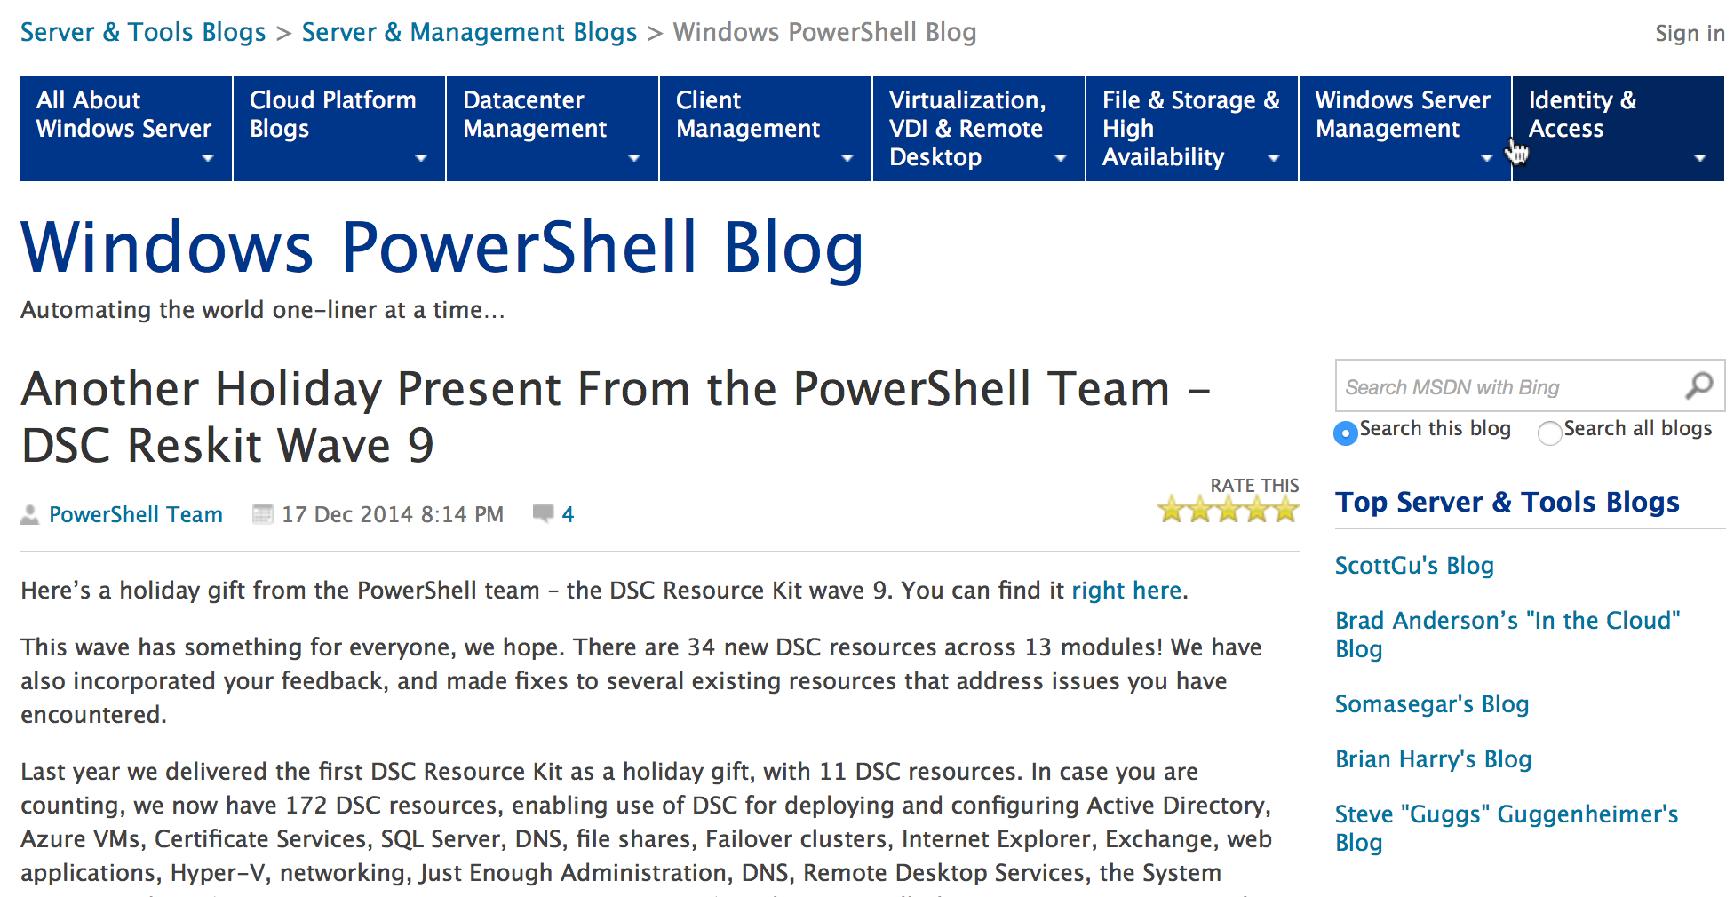
Resources for DSC
Resources to get the job done
In the box – out of the box
PSGet/OneGet

Slide 8
Requirements for DSC
Supported PowerShell versions and Operating Systems
Feb WMF 5 preview KB3037315
DSC is built on CIM and needs the WinRM service and listeners – Remoting
Configuring Remoting for DSC
Configure a script execution policy

