Slide 1
Getting Started with PowerShell Desired State Configuration (DSC)
Jeffrey Snover | Distinguished Engineer & Lead Architect
Jason Helmick | Author/Evangelist, Pluralsight

Slide 2
Course Modules
Getting started with PowerShell Desired State Config (DSC)
01 | Getting ready for DSC Architecture overview along with resources and requirements for DSC
02 | Performing a push deployment Perform a push deployment configuring the LCM and your first DSC configuration
03 | Configuring Pull servers for deployment Explore the Pull server options SMB and HTTP
04 | Deploying configurations using a Pull server Preparing your environment for pull configurations and querying diagnostic information
05 | Resource roundup Start working with the available resources in your configurations
06 | Writing better configurations Enhance your configurations with parameters, credentials and more
07 | DSC and Linux Start working cross platform with configuring Linux

Slide 3
02 | Performing a push deployment
Jeffrey Snover | Distinguished Engineer & Lead Architect
Jason Helmick | Author/Evangelist, Pluralsight

Slide 4
Module Overview
The purpose for a Push deployment
Writing a DSC configuration
Configuring the Local Configuration Manager (LCM)
Creating the Management Object File (MOF)
Performing the Push deployment

Slide 5
The Purpose for a Push deployment

Slide 6
Writing a DSC configuration
Define Configuration {}
Define Node {}
Define Resource

Slide 7
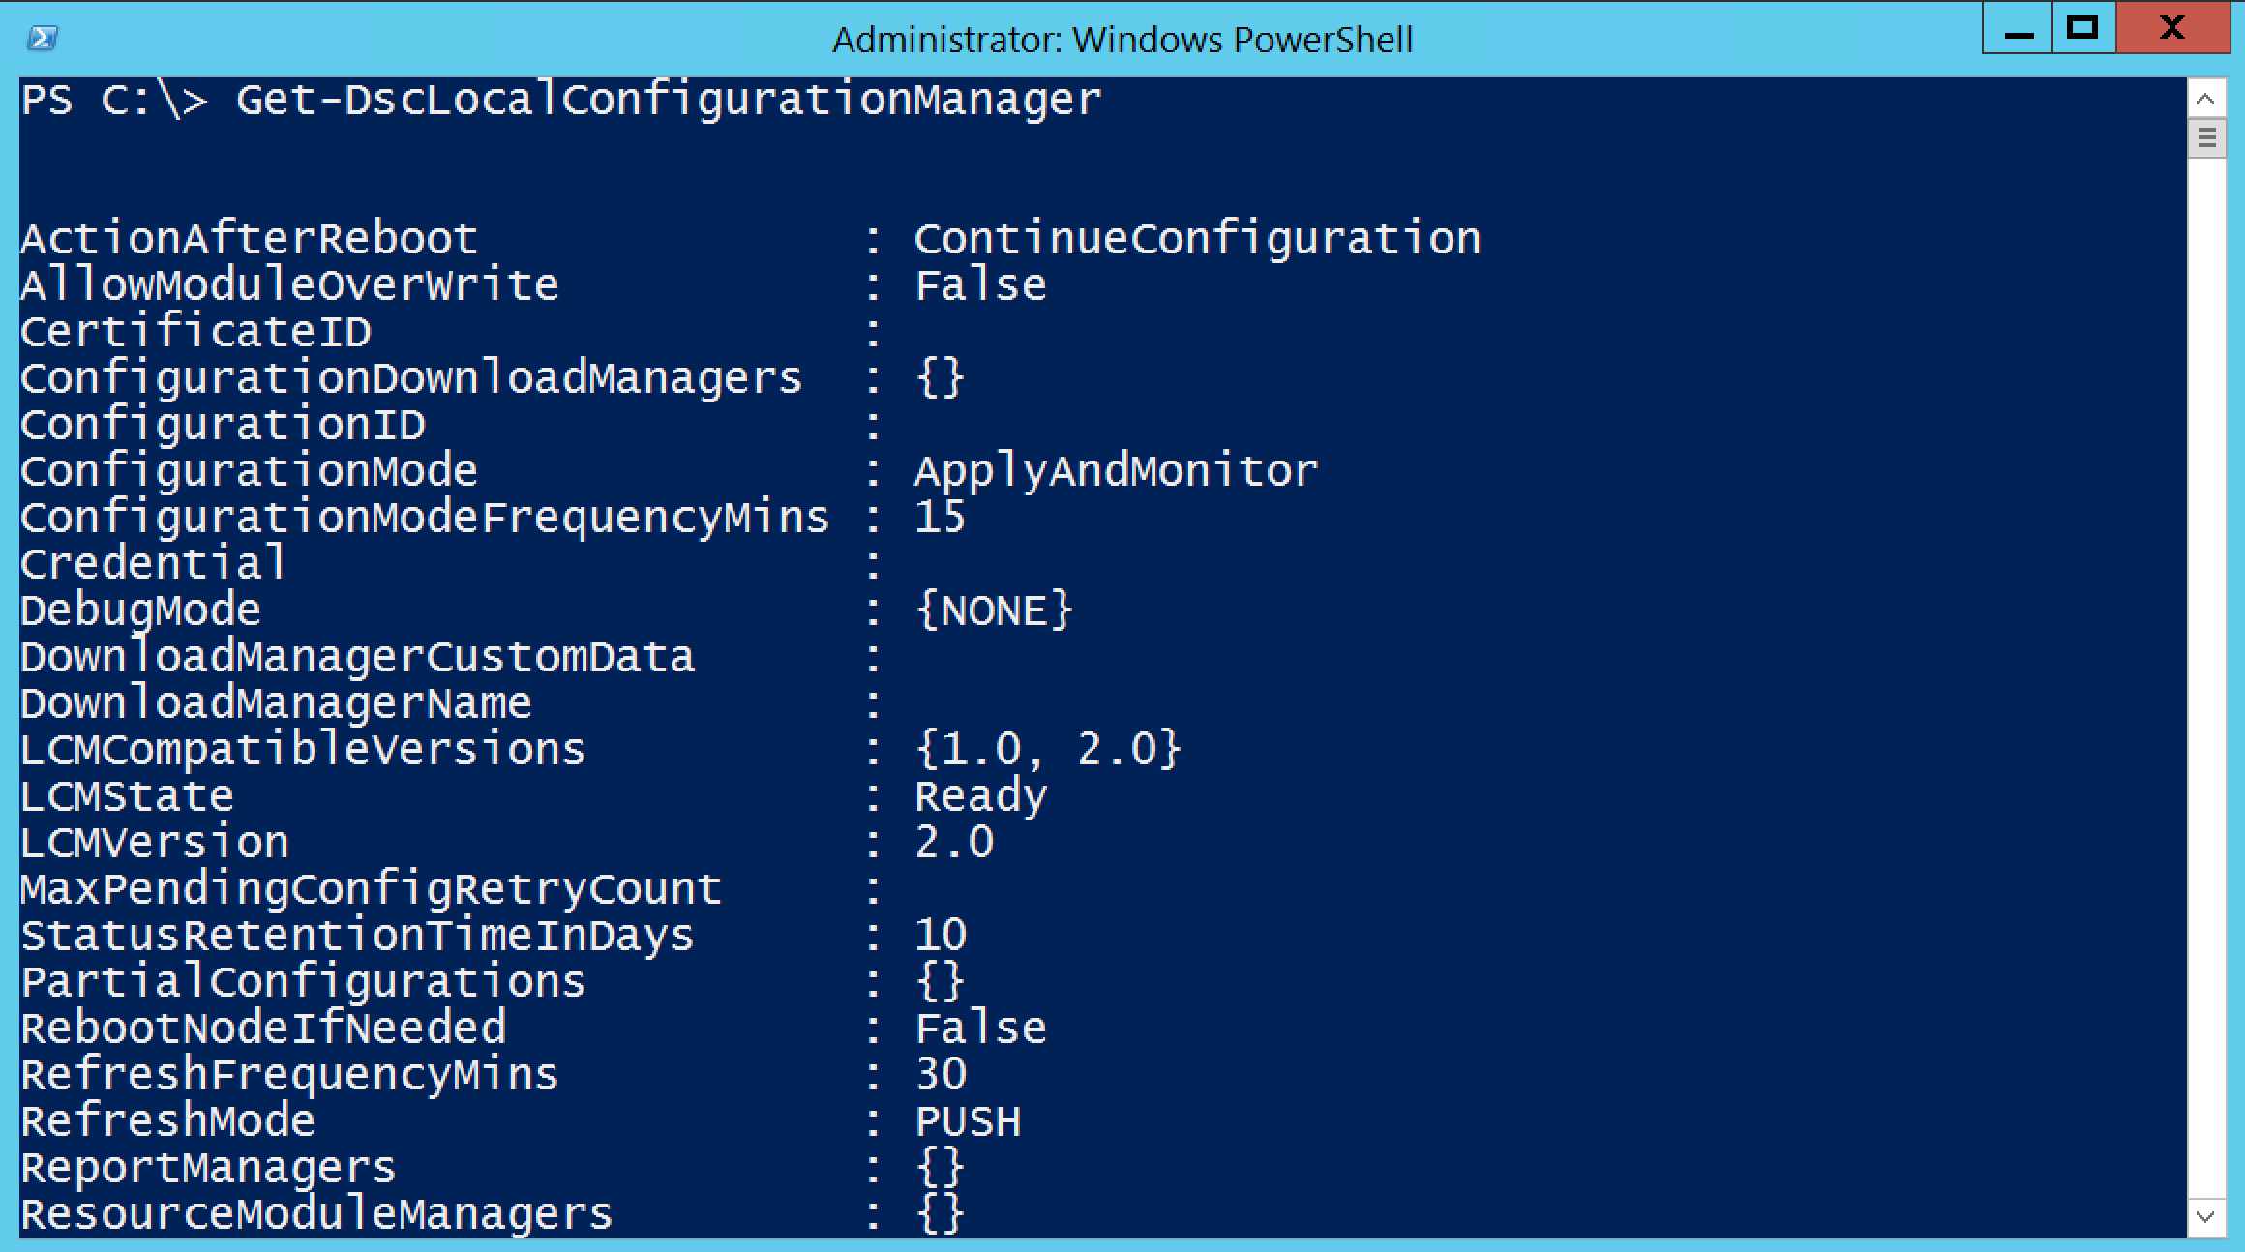
Configuring the LCM

Slide 8
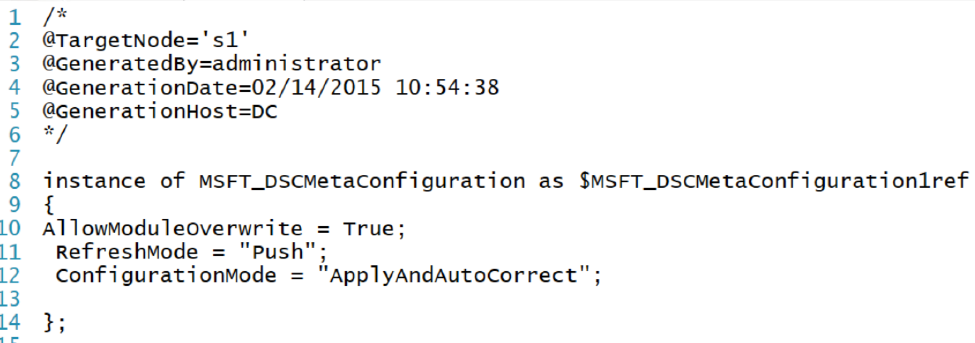
Creating the MOF
The purpose of MOF with DSC
Running the configuration creates the MOF

Slide 9
Performing the Push deployment
Creating a simple test deployment of IIS
Locate the resources needed
Create the configuration
Push the configuration

