Slide 1
Getting Started with PowerShell Desired State Configuration (DSC)
Jeffrey Snover | Distinguished Engineer & Lead Architect
Jason Helmick | Author/Evangelist, Pluralsight

Slide 2
Course Modules
Getting started with PowerShell Desired State Config (DSC)
01 | Getting ready for DSC Architecture overview along with resources and requirements for DSC
02 | Performing a push deployment Perform a push deployment configuring the LCM and your first DSC configuration
03 | Configuring Pull servers for deployment Explore the Pull server options SMB and HTTP
04 | Deploying configurations using a Pull server Preparing your environment for pull configurations and querying diagnostic information
05 | Resource roundup Start working with the available resources in your configurations
06 | Writing better configurations Enhance your configurations with parameters, credentials and more
07 | DSC and Linux Start working cross platform with configuring Linux

Slide 3
05 | Resource roundup
Jeffrey Snover | Distinguished Engineer & Lead Architect
Jason Helmick | Author/Evangelist, Pluralsight

Slide 4
Module Overview
Working with the built-in resources
Adding resources
Adding resources to a pull server

Slide 5
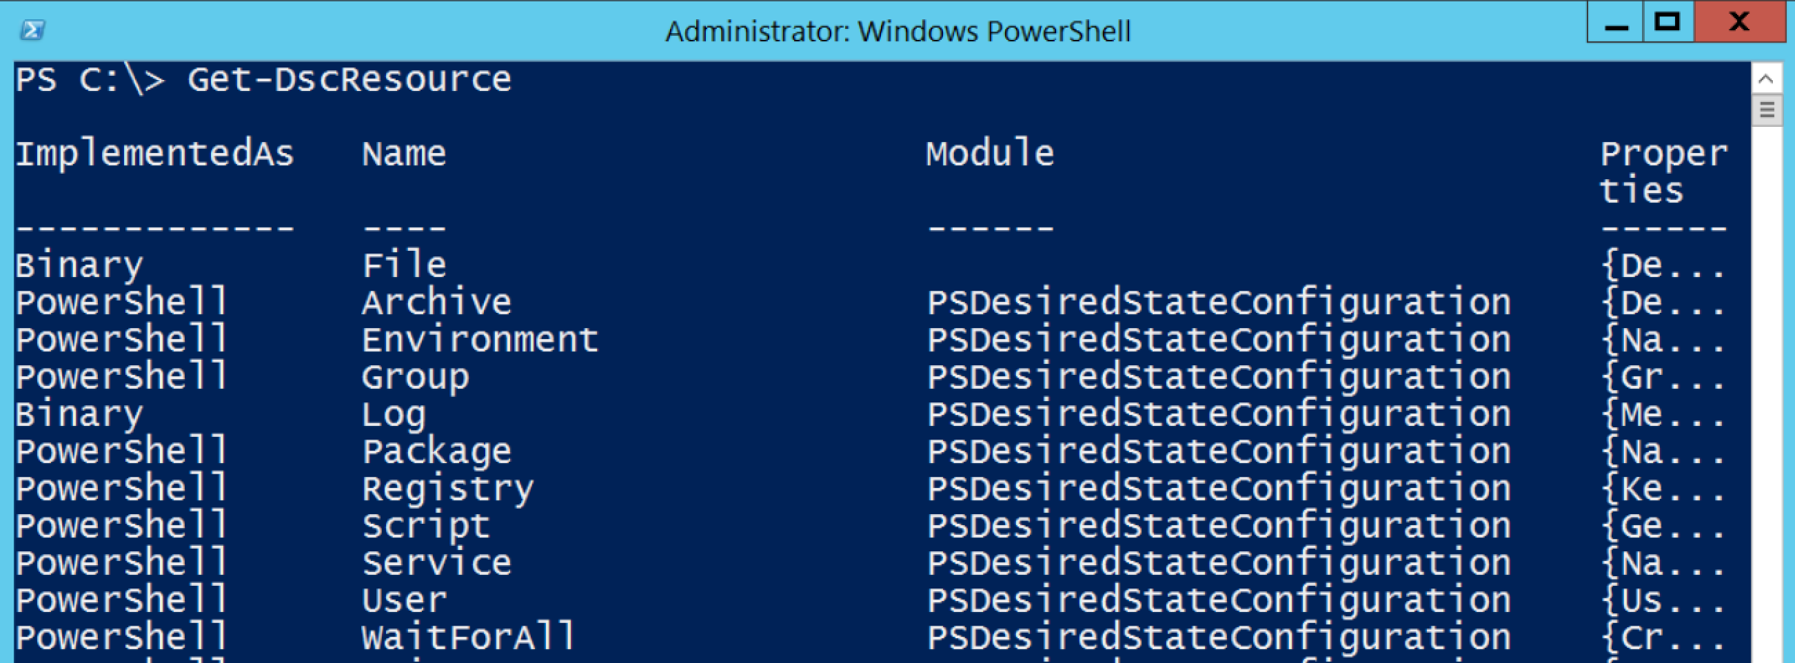
Working with the built-in resources
The current built-in resources

Slide 6
Adding Resources - Locally

Slide 7
Adding Resources – Pull server

