Slide 1
Getting Started with PowerShell Desired State Configuration (DSC)
Jeffrey Snover | Distinguished Engineer & Lead Architect
Jason Helmick | Author/Evangelist, Pluralsight

Slide 2

Meet Jeffrey Snover | ‏@jsnover
Distinguished Engineer & Lead Architect for Windows Server & System Center Division
Inventor of Windows PowerShell
Responsible for setting long term technical vision for these products and running the technology planning for the releases
Over 30 years of industry experience
Microsoft, Tivoli, NetView, DEC
Held 8 patents prior to joining Microsoft, and has registered 30 since.
Frequent speaker at industry and research conferences on a variety of management and language topics

Slide 3
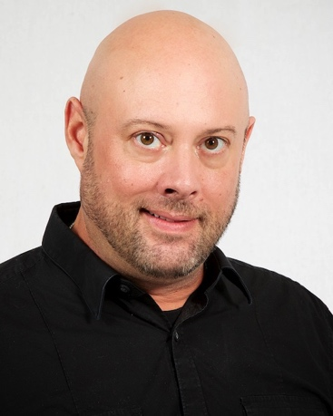
Meet Jason Helmick | @theJasonHelmick
Author/Evangelist, Pluralsight
CFO/COO – PowerShell.Org
Windows PowerShell MVP
Co-Author “Windows PowerShell 4 TFM”
Author “Learn Windows IIS in a Month of Lunches”
25 year IT veteran
Speaker at several industry conferences
Teaches PowerShell to the IT pro for automation of products such as MS Exchange, SharePoint and IIS.
Frequent contributor to magazines TechNet, Redmond and TechTarget

Slide 4
Course Modules
Getting started with PowerShell Desired State Config (DSC)
01 | Getting ready for DSC Architecture overview along with resources and requirements for DSC
02 | Performing a push deployment Perform a push deployment configuring the LCM and your first DSC configuration
03 | Configuring Pull servers for deployment Explore the Pull server options SMB and HTTP
04 | Deploying configurations using a Pull server Preparing your environment for pull configurations and querying diagnostic information
05 | Resource roundup Start working with the available resources in your configurations
06 | Writing better configurations Enhance your configurations with parameters, credentials and more
07 | DSC and Linux Start working cross platform with configuring Linux

Slide 5
Setting Expectations
Target Audience
Any IT pro or developer that is responsible for configuration management, automation, security and business agility
Suggested Prerequisites/Supporting Material
Getting started with Windows PowerShell Jump Start
http://www.microsoftvirtualacademy.com/training-courses/getting-started-with-powershell-3-0-jump-start
Advanced Tools & Scripting with PowerShell Jump Start
http://www.microsoftvirtualacademy.com/training-courses/advanced-tools-scripting-with-powershell-3-0-jump-start
Additional resources at PowerShell.Org (DSC Hub)
http://powershell.org/wp/dsc-hub/

Slide 6
Join the MVA Community!
Microsoft Virtual Academy
Free online learning tailored for IT Pros and Developers
Over 2M registered users
Up-to-date, relevant training on variety of Microsoft products
“Earn while you learn!”
Get 50 MVA Points for this event!
Visit http://aka.ms/MVA-Voucher
Enter this code: PShellDSCFound (Expires: 3/26/15)

Slide 7
01 | Getting ready for DSC
Jeffrey Snover | Distinguished Engineer & Lead Architect
Jason Helmick | Author/Evangelist, Pluralsight

Slide 8
Module Overview
The purpose for DSC
DSC architecture overview
Resources for DSC
Requirements for DSC

Slide 9
The purpose for DSC
Distributed Heterogeneous Configuration Management Platform
Why declarative configurations?
Managing drift
Cross platform importance
DevOps?

Slide 10
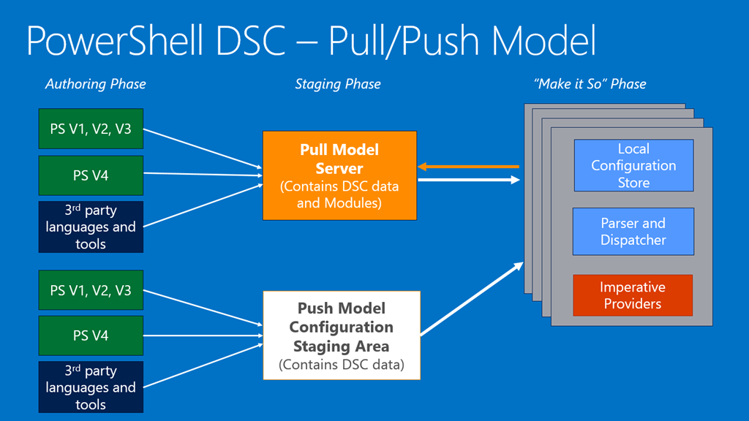
DSC architecture overview

Slide 11
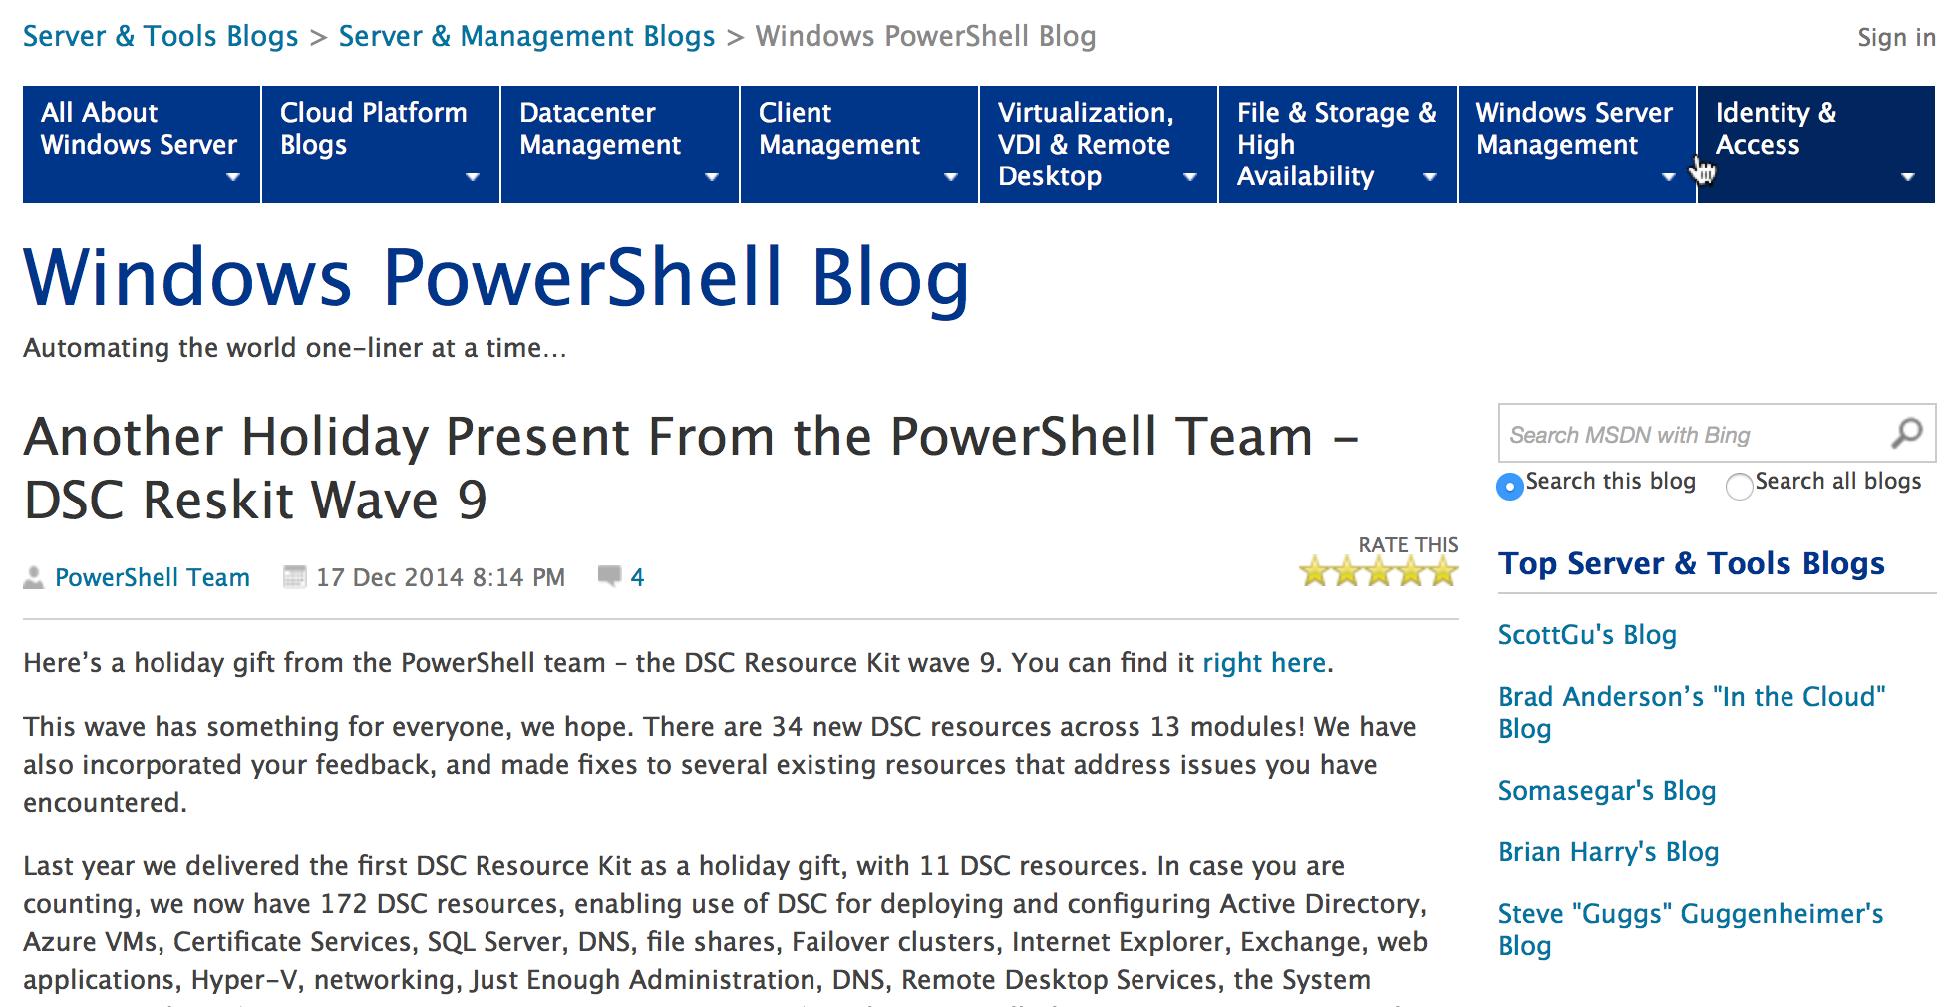
Resources for DSC
Resources to get the job done
In the box – out of the box
PSGet/OneGet

Slide 12
Requirements for DSC
Supported PowerShell versions and Operating Systems
Feb WMF 5 preview KB3037315
DSC is built on CIM and needs the WinRM service and listeners – Remoting
Configuring Remoting for DSC
Configure a script execution policy

Slide 13
02 | Performing a push deployment
Jeffrey Snover | Distinguished Engineer & Lead Architect
Jason Helmick | Author/Evangelist, Pluralsight

Slide 14
Module Overview
The purpose for a Push deployment
Writing a DSC configuration
Configuring the Local Configuration Manager (LCM)
Creating the Management Object File (MOF)
Performing the Push deployment

Slide 15
The Purpose for a Push deployment

Slide 16
Writing a DSC configuration
Define Configuration {}
Define Node {}
Define Resource

Slide 17
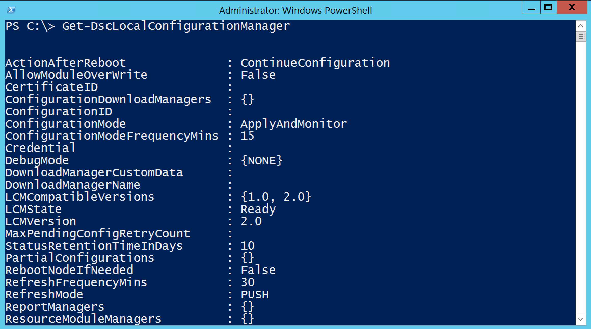
Configuring the LCM

Slide 18
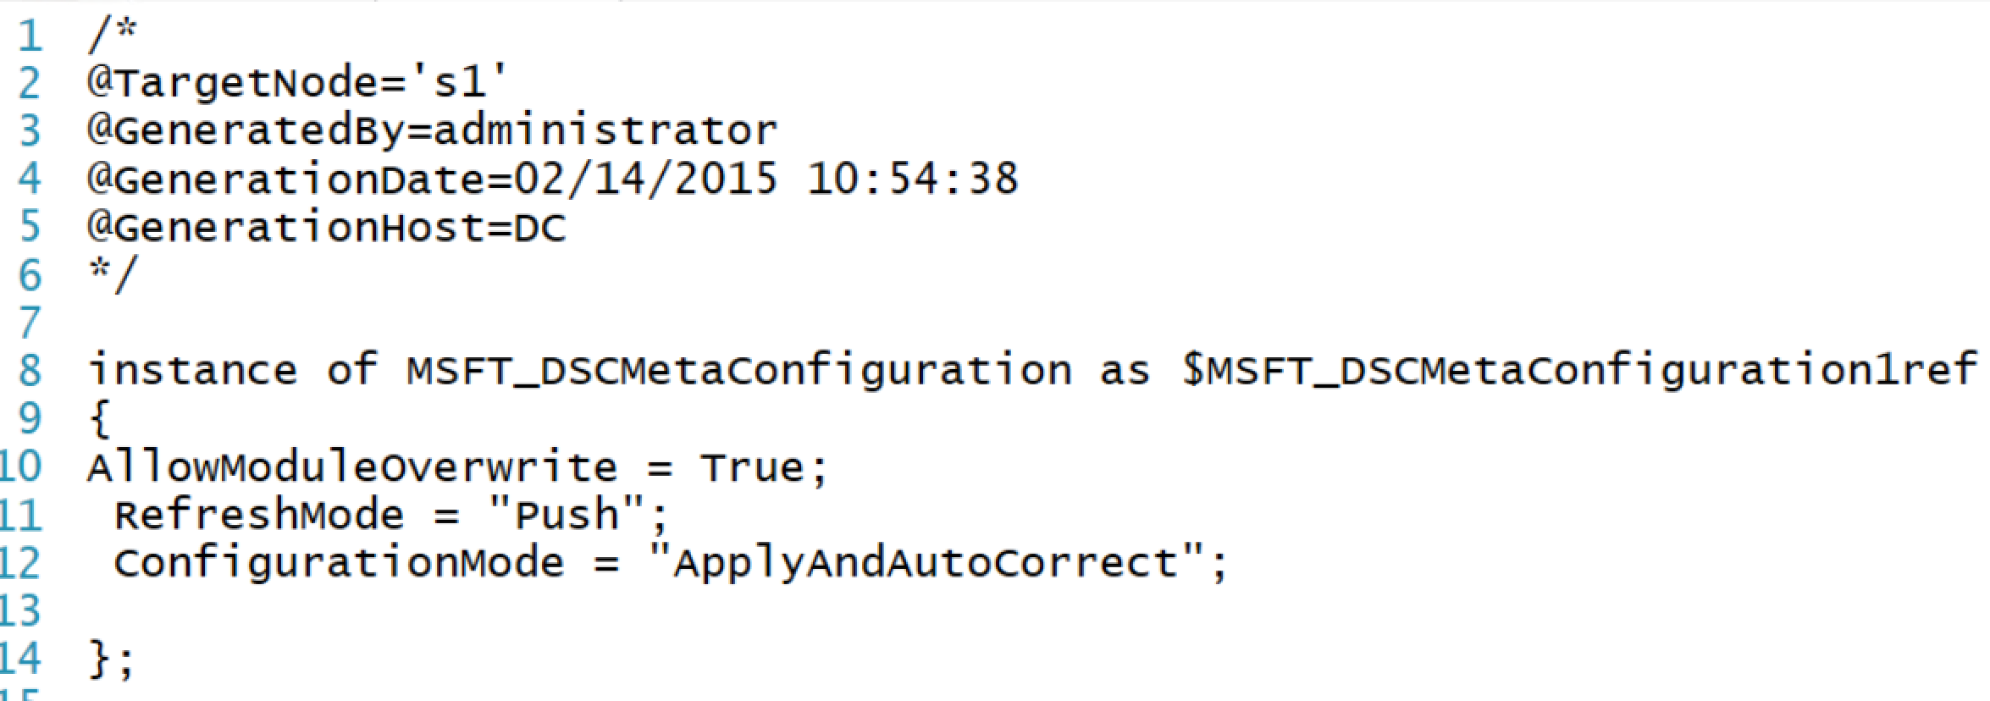
Creating the MOF
The purpose of MOF with DSC
Running the configuration creates the MOF

Slide 19
Performing the Push deployment
Creating a simple test deployment of IIS
Locate the resources needed
Create the configuration
Push the configuration

Slide 20
03 | Configuring Pull servers for deployment
Jeffrey Snover | Distinguished Engineer & Lead Architect
Jason Helmick | Author/Evangelist, Pluralsight

Slide 21
Module Overview
The Purpose of a Pull Server
Configuring SMB pull server
Configuring HTTP pull server
Configuring HTTPS pull server

Slide 22
The Purpose of a Pull Server

Slide 23
Configuring SMB pull server
SMB pull server is the simplest to configure
Create and configure an SMB Share
Store the MOF and Resource Modules in the share
Configure the clients LCM

Slide 24
Configuring HTTP pull server
Need resource module xPSDesiredStateConfiguration
How do you get it?
Where do you put it?
Use module to create an HTTP pull server configuration
Configure the clients for HTTP pull server

Slide 25
Configuring HTTPS pull server
Need resource module xPSDesiredStateConfiguration
Need a certificate and its thumbprint
Use module to create an HTTPS pull server configuration
Configure the clients for HTTPS pull server

Slide 26
04 | Deploying configurations using a Pull server
Jeffrey Snover | Distinguished Engineer & Lead Architect
Jason Helmick | Author/Evangelist, Pluralsight

Slide 27
Module Overview
How the deployment works
Configuring the LCM for Pull
Preparing the configuration
Query node status and other diagnostics

Slide 28
How the deployment works

Slide 29
Configuring the LCM for pull
Configure the clients LCM for pull
ConfigurationRepositoryWeb
ConfigurationRepositoryShare
Configure the ConfigurationID with a GUID
Set polling interval
Future configurations will be named with a matching GUID

Slide 30
Preparing the configuration
Configurations will be named with a matching GUID for the desired clients
Configurations are copied to the web server
C:\Program Files\WindowsPowerShell\DscService\Configuration
Create a checksum for the configurations
Additional modules are copied to the web server
C:\Program Files\WindowsPowerShell\DscService\Modules

Slide 31
Querying node status and other diagnostics
Query node information
http://blogs.msdn.com/b/powershell/archive/2014/05/29/how-to-retrieve-node-information-from-pull-server.aspx
Update-DscConfiguration – Check job for progress
Get-WinEvent -ProviderName Microsoft-Windows-DSC
Get-WinEvent -ProviderName Microsoft-Windows-PowerShell-DesiredStateConfiguration-FileDownloadManager
Get-WinEvent -ProviderName Microsoft-Windows-Powershell-DesiredStateConfiguration-PullServer
XDSCDiagnostics Module

Slide 32
05 | Resource roundup
Jeffrey Snover | Distinguished Engineer & Lead Architect
Jason Helmick | Author/Evangelist, Pluralsight

Slide 33
Module Overview
Working with the built-in resources
Adding resources
Adding resources to a pull server

Slide 34
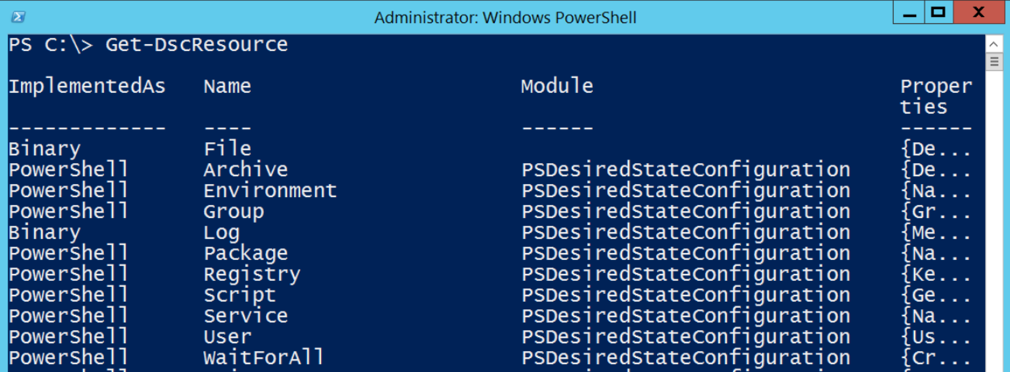
Working with the built-in resources
The current built-in resources

Slide 35
Adding Resources - Locally

Slide 36
Adding Resources – Pull server

Slide 37
06 | Writing better configurations
Jeffrey Snover | Distinguished Engineer & Lead Architect
Jason Helmick | Author/Evangelist, Pluralsight

Slide 38
Module Overview
Parameterized configurations
Using credentials in configurations
Getting the order straight with DependsOn
Building bigger configurations

Slide 39
Parameterized configurations

Slide 40
Using Credentials in configurations

Slide 41
Getting the order straight with DependsOn

Slide 42
Building bigger configurations
Discussed in the next video!
Nested
Composite Resource
Partial configurations

Slide 43
07 | DSC and Linux
Jeffrey Snover | Distinguished Engineer & Lead Architect
Jason Helmick | Author/Evangelist, Pluralsight

Slide 44
Module Overview
The importance of cross platform
Requirements for Linux
Building OMI Server and LCM
Writing a configuration for Linux

Slide 45
The importance of cross platform

Slide 46
Requirements for Linux
CentOS 6
Ubuntu
Oracle
Building Clouds – Michael Greene
http://blogs.technet.com/b/privatecloud/archive/2014/05/19/powershell-dsc-for-linux-step-by-step.aspx
PowerShell Magazine – Ravikanth C
http://www.powershellmagazine.com/2014/05/21/installing-and-configuring-dsc-for-linux/

Slide 47
Building OMI Server and LCM

Slide 48
Writing a configuration for Linux

