Slide 1
MadhuTwin
A digital twin for Type 2 Diabetes in India that warns the doctor about a glucose spike two hours before it happens, and shows what would prevent it.
Madhu (मधु) = honey; madhumeha is the Ayurvedic name for diabetes.
Team Vantage
Management Development Institute, Gurgaon
Happiest Health Digital Twin Challenge 2026 · Phase 1 submission
Notes:
Hello, we are presenting MadhuTwin: a digital twin for people with type 2 diabetes in India. It predicts a glucose spike two hours before it happens, explains why, and lets the doctor test what would prevent it, all on a virtual replica of the patient.

Slide 2
India has 101 million people with diabetes
and their glucose is managed in 3-monthly snapshots, not in the hours when it actually goes wrong
101 M
136 M
~70 g+
adults with diabetes (11.4%)
more with prediabetes
carbs in a typical Indian lunch; rice, roti and sweet chai drive steep post-meal spikes
What a doctor sees today
What MadhuTwin adds
An HbA1c every 3 months: an average that hides daily spikes
A CGM report after the fact, if the patient has a sensor
Generic diet advice that ignores how this person responds
No early warning and no way to test a change before prescribing it
A virtual replica of each patient, updated every 5 minutes
A 2-hour warning before glucose crosses 180 mg/dL
Plain-language reasons: meal habit, sleep, stress, activity
A what-if simulator: rice → millet, smaller portion, walk after eating
Source: ICMR-INDIAB-17, Lancet Diabetes & Endocrinology, 2023.
MadhuTwin · Team Vantage
2
Notes:
India has about one hundred and one million adults with diabetes, and another one hundred and thirty six million with prediabetes. Yet care is still driven by an HbA1c every three months, an average that hides the daily spikes after high carbohydrate meals. Doctors get no early warning, and no way to test a lifestyle change for a specific patient before recommending it.

Slide 3
Use case: predict post-meal spikes 2 hours ahead
Condition: Type 2 Diabetes · Adverse event: an excursion ≥180 mg/dL lasting ≥15 minutes (International Consensus on Time in Range)
Static EHR
Wearables
Layer 1 · Twin
Layer 2 · AI
Doctor console
Demographics, diagnoses, meds, labs (HbA1c, HOMA-IR, HOMA-B, eGFR), 12-month trends
CGM every 5 min, heart rate, HRV, steps, sleep stages, food log
Personal insulin sensitivity, beta-cell response, basal glucose; hidden state every 5 min; 2-h projection
LightGBM risk ± confidence, time to event, forecasts; reasons in plain words
Who → when → why → what to do → what if I intervene?
→
→
→
→
Why a hybrid twin, not just a predictor
A pure ML model can say what will probably happen. A mechanistic twin can also answer what would happen if the patient changed something, and it can be personalised from day 0 using the health record. MadhuTwin uses both: physiology for personalisation and counterfactuals, ML for accuracy on messy real-life data.
MadhuTwin · Team Vantage
3
Notes:
We picked type 2 diabetes and one precise adverse event: a glucose excursion above 180 milligrams per decilitre lasting at least fifteen minutes, predicted two hours ahead. The system fuses the static health record with wearable streams through a physiology twin and a machine learning layer, and presents everything in a doctor's console. We chose a hybrid design because a pure predictor can't answer what-if questions, and a pure physiology model struggles with messy real-life data.

Slide 4
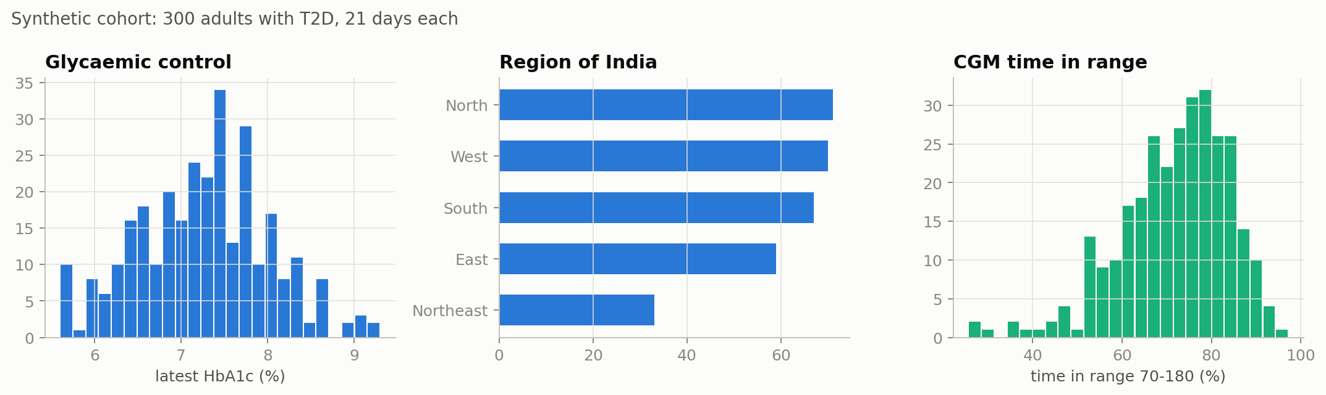
Data: 300 India-context synthetic patients
EHRs in the Synthea CSV schema; wearables from a physiology simulator of Indian days · plus a separate retrospective check on 265 adults from open cohorts (USA + Spain)
What makes it realistic
37 regional foods with carbs and GI: idli, poha, rajma chawal, fish-rice, millets
Late dinners, sugary chai (often unlogged), festival thalis, eating out
Sleep with 90-min cycles, stressful days, illness, missed doses
CGM lag, noise, drift and dropouts; watch off-wrist while charging
Food log completed only ~56% of the time, carbs under-estimated
Hidden 'true' physiology kept aside to validate the twin
Stream | Resolution | Size
CGM glucose | 5 min | 1.77 M readings
HR · HRV · steps · sleep | 5 min | 6,048 per patient per signal
Food log | event | 15,684 meals
EHR (Synthea schema) | static | labs, SNOMED CT, LOINC, RxNorm
MadhuTwin · Team Vantage
4
Notes:
Because real patient data is restricted under the DPDP Act and HIPAA, we built three hundred synthetic patients modelled on Indian diets and routines. Health records follow the Synthea schema with standard medical codes. The wearable streams come from a physiology simulator of Indian free-living days: regional meals, late dinners, sugary chai, festivals, stress, poor sleep, illness and missed medicine. Crucially, each virtual patient has a hidden true physiology, which lets us check whether our twin really learned the person.

Slide 5
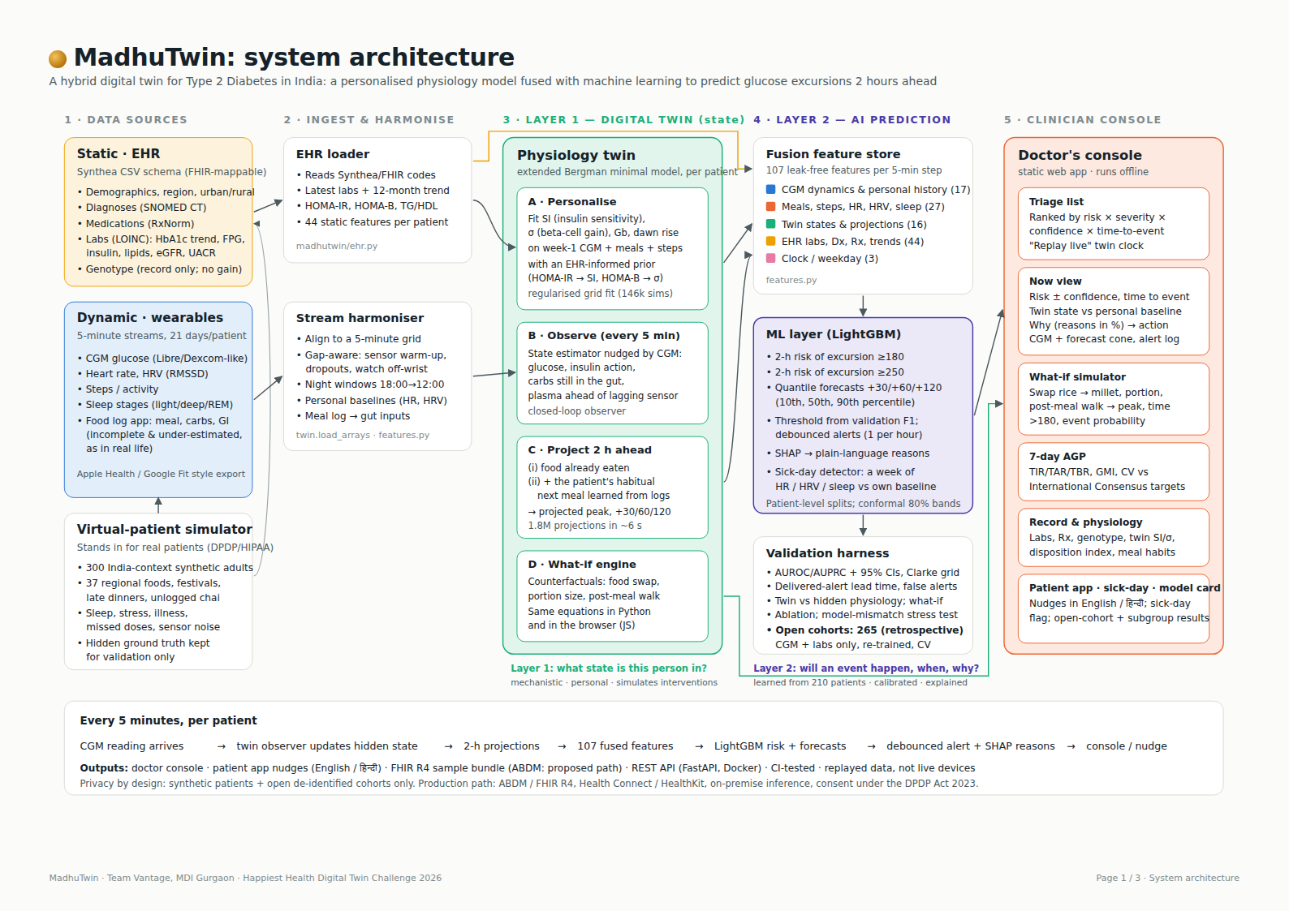
Architecture
Layer 1 keeps a live physiological state per patient; Layer 2 predicts from it. Every arrow runs every 5 minutes.
MadhuTwin · Team Vantage
5
Notes:
Here is the architecture. Data sources on the left are harmonised onto a five-minute grid. Layer one, the twin core, personalises a glucose-insulin model for each patient, keeps estimating hidden states like carbohydrate still in the gut, and projects two hours ahead. Layer two, the AI, fuses about a hundred features for a LightGBM risk model and glucose forecasts, with SHAP explanations. Everything feeds the doctor's console.

Slide 6
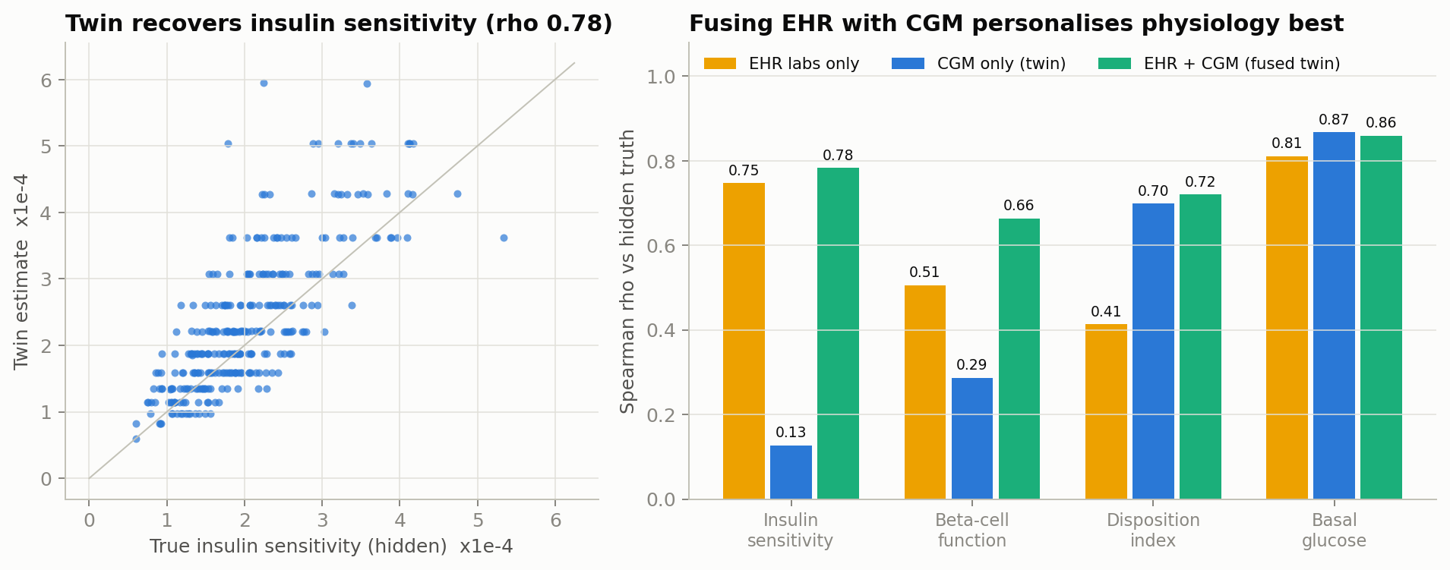
The twin learns each patient's physiology
Personalised from an EHR-informed prior + week-1 CGM (regularised fit), then checked against the simulator's hidden truth
Fusion matters here
CGM alone cannot separate insulin resistance from weak insulin secretion (rho 0.13). Labs alone are noisy. Together, the twin recovers insulin sensitivity at rho 0.78 and beta-cell function at 0.66.
A · Personalise
B · Observe
C · Project
D · What-if
Fit SI, β-cell gain, basal glucose, dawn rise
Track carbs in gut, insulin action, true plasma glucose
Simulate 2 h: food eaten + usual next meal
Re-simulate with a food swap, smaller portion or walk
MadhuTwin · Team Vantage
6
Notes:
The heart of the system is the physiology twin. From the lab report and the first week of CGM, it fits each patient's insulin sensitivity, beta-cell response, basal glucose and dawn rise. This is where fusing the two data streams clearly pays off: CGM alone cannot tell insulin resistance apart from weak insulin secretion, and labs alone are noisy, but together the twin recovers insulin sensitivity with a rank correlation of about zero point seven eight against the hidden truth.

Slide 7
A digital twin, not just another risk model
How the EHR and wearables are fused into one live patient state
 | Ordinary AI risk model | MadhuTwin
Answers | “Will glucose go high?” | “What state is this person in, what happens next, what if we act?”
Per-patient model | No; shared weights | Yes: SI, β-cell gain, basal glucose, dawn rise
New patient | Needs history | Starts from the EHR on day 0; matures over week 1
Interventions | Cannot simulate | Food swap, portion, walk: simulated estimates
Drift | Retrain | Nightly re-personalisation
Patient state vector | Updated
Glucose (plasma, ahead of sensor) | 5 min
Carbs still in the gut | 5 min
Insulin action | 5 min
Activity, HR vs own baseline | 5 min
Sleep debt, HRV vs baseline | nightly
Insulin sensitivity (× baseline) | nightly
Basal glucose | nightly
β-cell gain, dawn rise | weekly
HbA1c, eGFR, medicines | new result
Habitual next meal | weekly
How fusion works
EHR → informed prior for a regularised fit of the twin's physiology (HOMA-IR → insulin sensitivity, HOMA-B → β-cell gain)
Wearables → the twin's observer every 5 min (CGM), its inputs (meals, steps) and personal baselines (HR, HRV, sleep)
Twin state + raw streams + EHR → Layer 2 AI
MadhuTwin · Team Vantage
7
Notes:
What makes this a digital twin rather than another risk model? An ordinary model shares one set of weights across everyone and can only say whether glucose will go high. MadhuTwin keeps a personal physiology for each patient, starts from their health record on day one, keeps a live state vector updated every five minutes, re-personalises every night, and can simulate what would happen if they changed something. The health record enters as a prior on the twin's physiology, and the wearables drive its state.

Slide 8
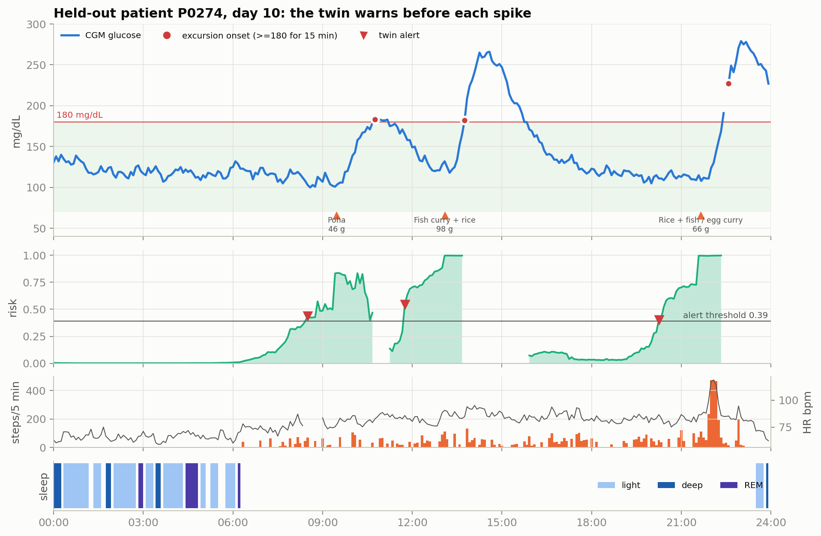
It warns before the spike
45 held-out patients the model never saw · days 8–21 · a decision every 5 minutes
0.912
75%
75 min
2.3
AUROC, ≥180 mg/dL within 2 h (95% CI 0.905–0.918)
of 2,001 spikes warned ≥30 min ahead by delivered alerts (CI 70%–79%)
median warning before onset
false alerts per patient-day (threshold 0.40)
Operating threshold 0.40: why
Chosen on validation patients (best F1), never on test
Debounced to ≤1 alert per hour. “We optimise for useful alerts, not maximum sensitivity.”
A busy clinic can pick 0.70: 0.8 false alerts/day, still 63% of spikes ≥30 min early
When: onset time error 17 min; 2-h peak error 18 mg/dL
Calibrated: ECE 0.009, Brier 0.105; confidence from a 5-model ensemble
MadhuTwin · Team Vantage
8
Notes:
On forty five patients the model never saw, the risk model reaches an AUROC of 0.91. At the default threshold it flags 75% of glucose spikes at least thirty minutes in advance, with a median warning of about 75 minutes, at around two to three false alerts per patient per day. The chart shows a synthetic held-out day: the risk rises before each meal-related spike. We chose the threshold on validation patients and debounce alerts, because we optimise for useful alerts, not maximum sensitivity. The model also estimates when the spike will start, to within about 17 minutes.

Slide 9
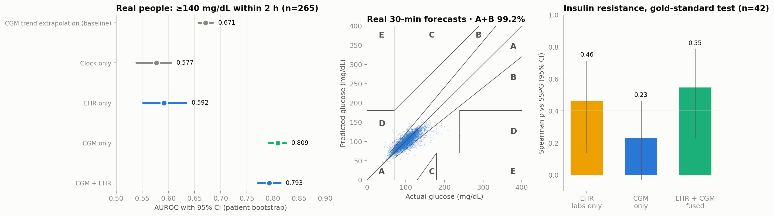
Retrospective check on open cohorts
265 adults (183 prediabetes, 72 normoglycaemic, 10 T2D) · CGM + labs only · re-trained, patient-level CV · target ≥140 mg/dL
AUROC 0.809 / 0.793
99.2% in Clarke zones A+B
Fusion wins on physiology
CGM-only / CGM + EHR, ≥140 mg/dL in 2 h (trend baseline 0.671); not the full system
30-min forecasts: 6.7 mg/dL error vs 7.9 for 'no change'
Insulin resistance (gold-standard SSPG): labs + CGM ρ 0.55 vs labs 0.46, CGM 0.23 (n=42); the alarm itself is CGM-driven
Not external validation of the synthetic-trained twin: the pipeline was re-trained and cross-validated within these cohorts (no person in both train and test). Only 10 people have T2D; meals, wearables, the full twin and Indian patients are untested on real data.
MadhuTwin · Team Vantage
9
Notes:
We also ran a retrospective check on 265 adults from two open cohorts, with CGM and lab records only. We re-trained the pipeline there with patient-level cross-validation. For a 140 milligram event, the CGM-only model reached an AUROC of 0.81 and the CGM plus EHR model 0.79. Only ten participants have type two diabetes, so this is a check of the method, not validation of the full twin.

Slide 10
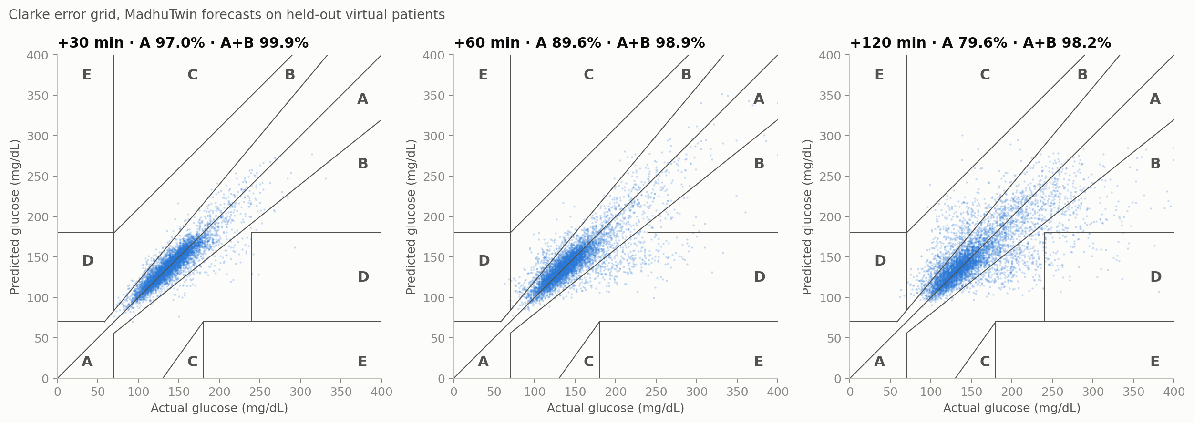
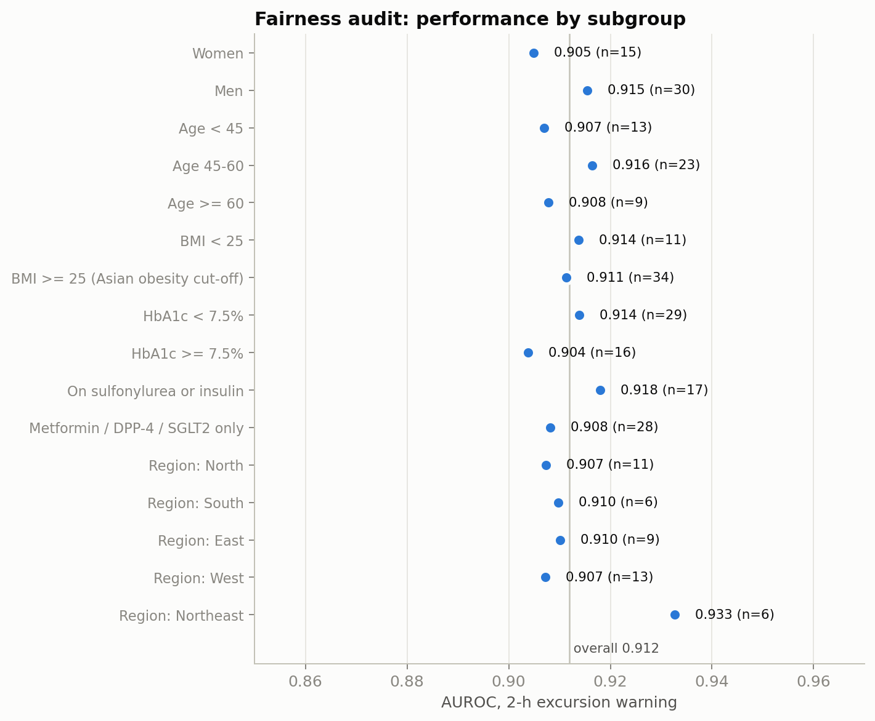
Evaluation details
Held-out synthetic evaluation · Clarke error grid · patient-level 95% CIs · empirical forecast bands · exploratory subgroups
How the numbers were checked
Forecasts: 99.9% / 98.9% / 98.1% in Clarke zones A+B at 30 / 60 / 120 min; zone D+E (dangerous) 0.13% at 30 min
Empirical coverage of split-conformal 80% bands: 79% at 60 min (raw quantiles 74%); observed on this test set, not guaranteed
Subgroups (exploratory, small): AUROC 0.903–0.932 across sex, age, BMI, HbA1c, medication and region
Every headline number carries a 95% CI from resampling patients
MadhuTwin · Team Vantage
10
Notes:
Forecasts are scored on the Clarke error grid, the standard for glucose prediction. Prediction bands are conformally calibrated, and we report the coverage we actually observed rather than a guarantee. Every headline number has a patient-level confidence interval, and an exploratory subgroup check shows similar performance across sex, age, weight, medication and region.

Slide 11
What each data stream contributes
AUROC on held-out patients; we report what we found, including where fusion did not help
What we learned
Once a patient has a week of CGM, their own glucose history carries most of the signal
EHR alone is informative (0.844) but adds little on top of wearables for the 2-h alarm
Where the EHR matters: personalising physiology (insulin sensitivity rho 0.13 → 0.78) and the what-if simulator
Genotype added nothing (AUROC 0.9123 with vs 0.9117 without), so the risk model leaves it out
The twin's value is in low data and counterfactuals: next slide
MadhuTwin · Team Vantage
11
Notes:
We ran an honest ablation. Time of day alone is surprisingly strong, because meals are habitual. Wearables lift AUROC to about zero point nine one. Adding the health record barely moves the two-hour alarm once a week of CGM exists: the patient's own glucose history already says it. The health record earns its place elsewhere: it is what lets the twin separate insulin resistance from secretion, and that is what the what-if simulator builds on.

Slide 12
What the twin measurably adds
Same LightGBM, same data, with vs without twin features · held-out patients
0.13→0.78
0.45→0.72
insulin-sensitivity ρ vs truth: CGM-only → fused twin
disposition index ρ: day 0 (EHR only) → day 7
0.93
×0.85
ρ predicted vs true rice→millet effect (ML alone: n/a)
insulin sensitivity tracked nightly during illness (×0.99 when well)
Twin maturity
Honest reading
Day 0: personalised from the EHR alone, no CGM history needed
Days 1–7: physiology sharpens (DI ρ 0.45 → 0.56 → 0.69 → 0.69 → 0.72 → 0.72)
After week 1: nightly re-fit tracks illness, stress and missed doses
With all 210 training patients the gain is within noise (+0.0007, 95% CI -0.0004 to +0.0020); false alerts at equal sensitivity 2.23 → 2.30/day. The twin helps most where data are scarce: a new clinic or a new patient.
MadhuTwin · Team Vantage
12
Notes:
Judges should ask what the twin really adds, so we measured it. With all two hundred and ten training patients, adding twin features to the same model changes AUROC by less than a thousandth, within noise, and we say so. But with only five or ten training patients, as in a new clinic, the twin adds clearly more. It also recovers each patient's physiology far better than CGM alone, gets sharper day by day, tracks illness night by night, and answers what-if questions that a pure prediction model cannot answer at all.

Slide 13
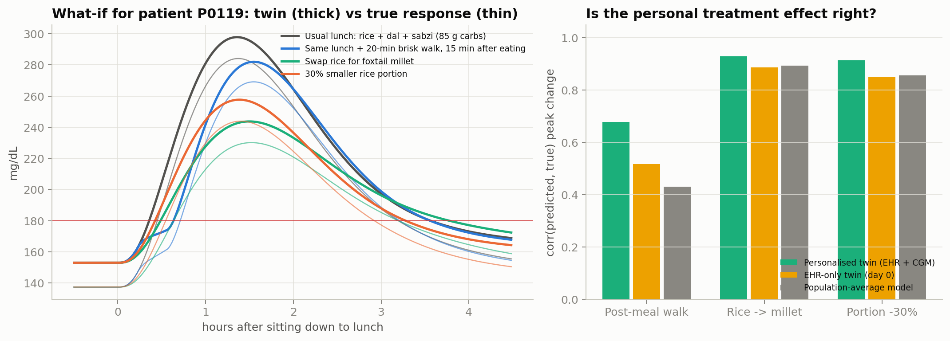
What-if simulator vs synthetic ground truth
Each intervention was re-run on the hidden 'true' virtual patient · real-patient effects remain unvalidated
Why it matters
Average peak drop: millet swap 53 mg/dL, smaller portion 40, walk 14
But responses differ person to person; the personalised twin ranks who benefits most
Stress test with different physics: rankings held, effect sizes biased
Shown as simulated estimates for discussion, not prescriptions
Correlation with true effect | Personalised twin | EHR-only twin | Population model
20-min walk after lunch | 0.68 | 0.52 | 0.43
Rice → foxtail millet | 0.93 | 0.89 | 0.89
30% smaller portion | 0.91 | 0.85 | 0.86
Ranking patients by usual post-lunch peak | 0.92 | 0.72 | 0.65
MadhuTwin · Team Vantage
13
Notes:
This is the part a pure predictor cannot do. We asked the twin what happens if a patient walks after lunch, swaps rice for foxtail millet, or eats a smaller portion, then re-ran the same change on the hidden true patient. The personalised twin predicts each person's benefit with a correlation of about zero point nine for the food changes, better than an EHR-only or population model. This is a synthetic benchmark: when we changed the simulator's physics, the twin still ranked who benefits but over-estimated some effect sizes, so we show these as estimates for discussion.

Slide 14
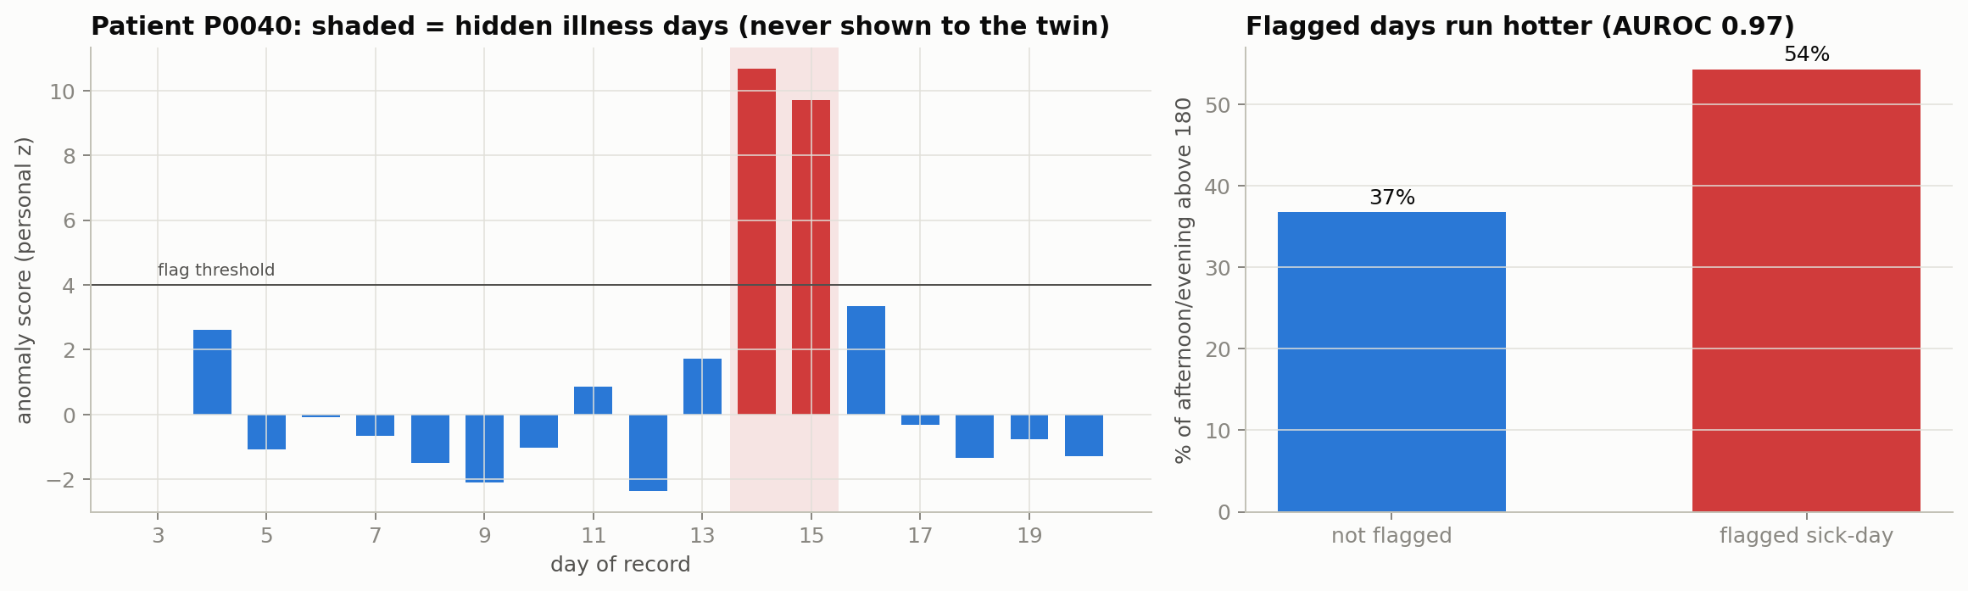
A second warning: sick days from heart and sleep data
The brief's example of a weekly anomaly, made specific to diabetes care
0.97
AUROC for illness days, with no labelled training data
78%
of illness days flagged; 0.12 false flags per patient-week
How it works and why it matters
Every morning, last night's sleeping heart rate, HRV, sleep and yesterday's activity are compared with the patient's own previous 7 nights (personal z-scores)
Flagged days ran hotter: 54% of the rest of the day above 180 mg/dL vs 37% otherwise
Triggers 'sick-day rules': check glucose more often, fluids, review SGLT2 inhibitor / metformin if dehydrated, call the doctor
Caveat: illness effects in the simulator are clear-cut; real-world infection detection from wearables is weaker but well documented
MadhuTwin · Team Vantage
14
Notes:
The brief also mentions flagging an anomaly from a week of sleep and heart rate data. For diabetes, the most useful one is a sick day. Each morning the twin compares last night's heart rate, HRV and sleep with the patient's own previous week. It flags hidden illness days well without any labelled training data, and flagged days really do run hotter, so the doctor can trigger sick-day rules early.

Slide 15
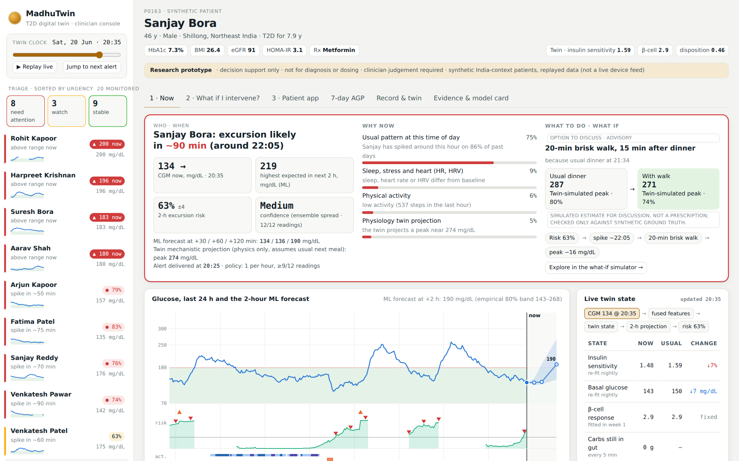
The doctor's console
Static web app: runs offline in any browser, no install
A doctor can
Who: triage by risk × severity × confidence × time to event
When: “spike likely in ~1 h 20 m, peak ~230 mg/dL”, with confidence
Why: reasons in plain words, with % share
What to do: one suggested action
What if: simulate it → peak, time >180, event probability
Twin state today vs the patient's own baseline
MadhuTwin · Team Vantage
15
Notes:
This is the doctor's console, built around five questions. Who needs attention: patients are ranked by risk, severity, confidence and time to event. When: the hero card says when the spike is likely and how high. Why: reasons in plain words with their share. What to do: one suggested action. And what if I intervene: the twin re-simulates the action and shows the new peak, time above range and event probability. Below, the twin state is compared with the patient's own baseline.

Slide 16
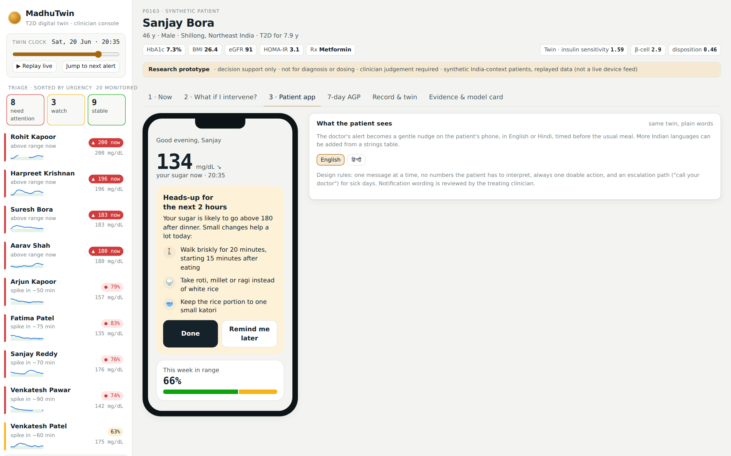
Designed with a clinic deployment pathway
Research prototype · interoperable outputs · offline-capable · patient-facing
Patient app nudges
FHIR R4 sample output
One message, one action, before the usual meal
English and हिन्दी today; strings table for more languages
Sick-day banner with 'call doctor'
Bundle: RiskAssessment + Observations
Pseudonymous Patient (DPDP data minimisation)
ABDM integration: proposed production path
Twin as a service
Engineering quality
REST API (FastAPI): risk, forecast, what-if, FHIR
Docker image serves API + console
Runs on a laptop CPU; no GPU or cloud needed
28 automated tests, none skipped: alert matching, API contract, leakage
GitHub Actions CI
One command: python run.py
MadhuTwin · Team Vantage
16
Notes:
MadhuTwin is a research prototype designed with a deployment pathway. Patients get one clear nudge before their usual meal, in English or Hindi. The twin produces sample FHIR R4 output, and integration with India's digital health mission is a proposed next step. A REST API and Docker image serve the model and the console, and automated tests run on every commit.

Slide 17
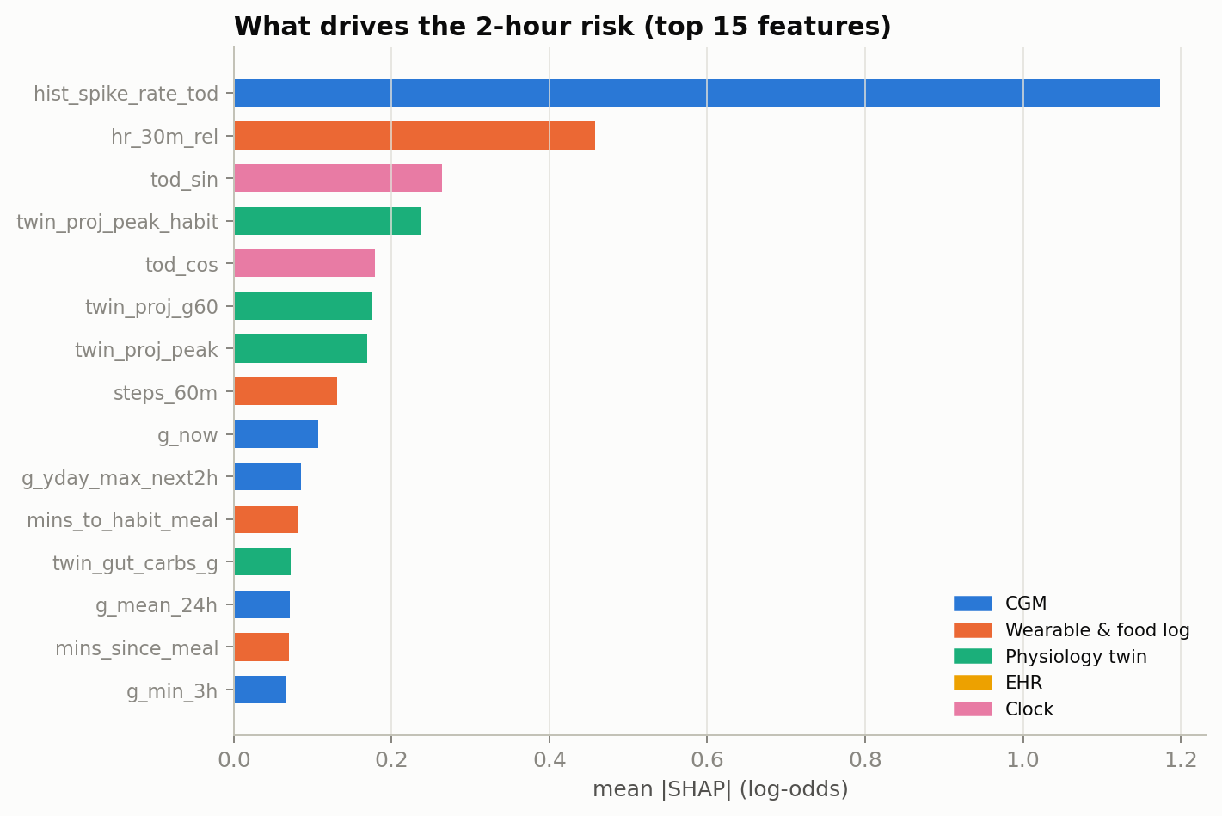
Explainable, private, honest about limits
Privacy & compliance
Limitations
Synthetic patients + open de-identified cohorts; no PHI anywhere
FHIR R4 sample output; ABDM integration is a proposed path
Designed for on-premise inference; consent-first under the DPDP Act 2023
Model card and decision-support labelling in the console
Main results are synthetic; open-cohort check: CGM + labs only, 10 with T2D; replayed data, no live devices
Twin and simulator share equations: fidelity is an upper bound; what-if sizes biased under mismatch
Twin adds little AUROC once 200+ patients exist
Not a medical device; decision support only
Top drivers of risk (SHAP attributions, not causes): the patient's own time-of-day spike history, heart rate relative to baseline, time of day, and the twin's projected peak including the usual next meal.
MadhuTwin · Team Vantage
17
Notes:
Every alert comes with its reasons. The strongest drivers are the patient's own history at that time of day, heart rate relative to baseline, the time of day, and the twin's projected peak including their usual next meal. We used only synthetic and open de-identified data, the outputs are sample FHIR resources, and we are explicit about limits: the open-cohort check covers CGM and labs only, and twin fidelity on simulated patients is an upper bound.

Slide 18
From prototype to clinic
What we would build next
Now
Next 3 months
6 months
12 months
300 synthetic patients; 265-person open-cohort check; nightly twin; console, patient app, FHIR sample, API, CI
Validate on an Indian CGM cohort with meals and wearables; hypoglycaemia risk; shadow-mode run in one clinic
Live ABDM / Health Connect connectors; more Indian languages; clinician usability study
Prospective pilot with a diabetes clinic; weekly cardiovascular-risk twin from sleep and HRV; CDSCO SaMD pathway
Impact
The aim, still to be tested in a clinic: turn CGM from a retrospective report into a proactive, personalised coach, with advice tailored to how each patient responds and a screen doctors can act on in a two-minute consult.
MadhuTwin · Team Vantage
18
Notes:
Next we would validate on an Indian cohort that also has meals and wearables, re-personalise the twin nightly, and add hypoglycaemia risk. Then connect to ABDM health records and phone health platforms, with nudges in Indian languages, and run a prospective clinic pilot. The goal is to turn CGM from a retrospective report into a proactive, personalised coach.

Slide 19
Thank you
Team Vantage
Team Leader
Silla Puja
Team Members
Shourya Singh
Ridhima Goyal
Management Development Institute, Gurgaon
Notes:
Thank you. All code, data generation, models, the console and documentation are in our public GitHub repository, and everything rebuilds with one command: python run.py.

