Slide 1
Centrality
Zhu Na 1706409

Slide 2
Agenda
Degree centrality
Closeness centrality
Betweenness centrality

Slide 3
Social circles: Twitter
Dataset statistics
Nodes | 81306
Edges | 1768149
Nodes in largest WCC | 81306 (1.000)
Edges in largest WCC | 1768149 (1.000)
Nodes in largest SCC | 68413 (0.841)
Edges in largest SCC | 1685163 (0.953)
Average clustering coefficient | 0.5653
Number of triangles | 13082506
Fraction of closed triangles | 0.06415
Diameter (longest shortest path) | 7
90-percentile effective diameter | 4.5
Notes:
snap.stanford.edu/data/egonets-Twitter.html

Slide 4
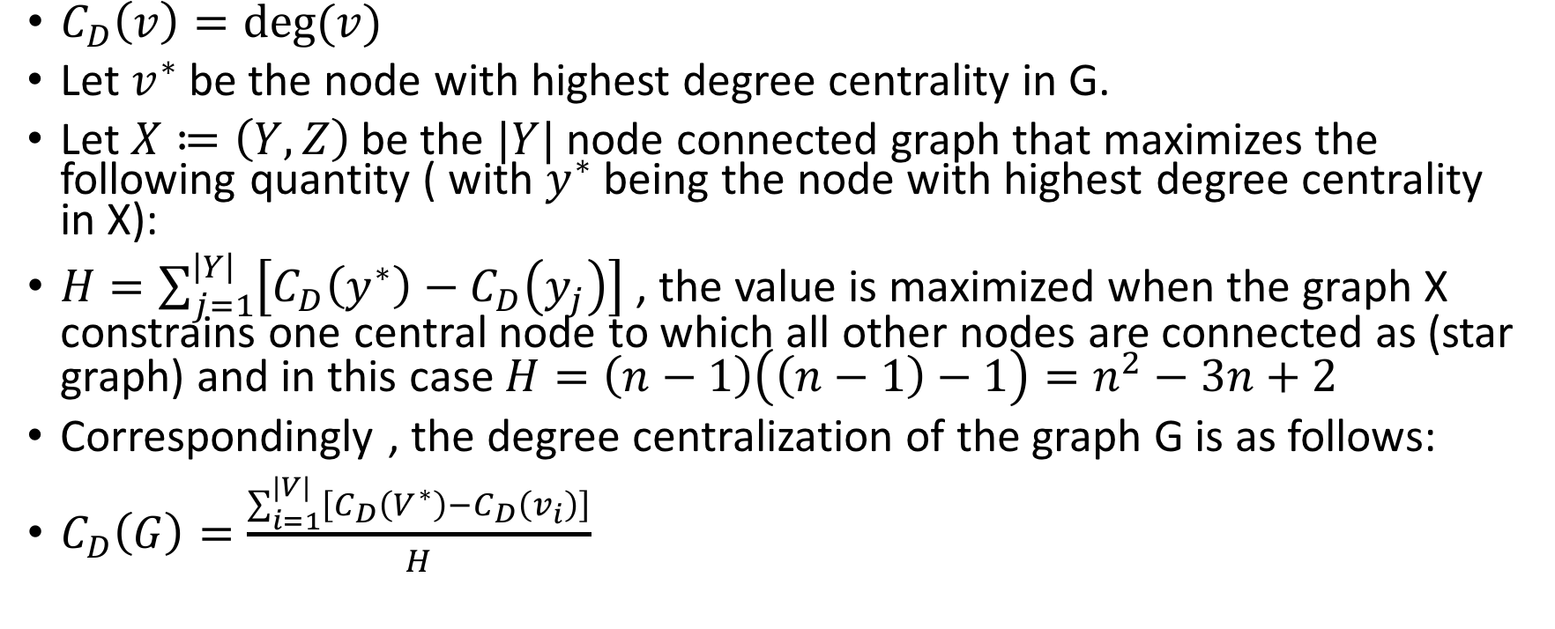
Degree Centrality^{[1][2]}
$C_{D}\left(v\right)=deg⁡(v)$
Let $v^{∗}$ be the node with highest degree centrality in G.
Let $X≔\left(Y,Z\right)$ be the $|Y|$ node connected graph that maximizes the following quantity ( with $y^{∗}$ being the node with highest degree centrality in X):
$H=\sum_{j=1}^{\left|Y\right|}{\left[C_{D}\left(y^{∗}\right)−C_{D}\left(y_{j}\right)\right]}$ , the value is maximized when the graph X constrains one central node to which all other nodes are connected as (star graph) and in this case $H=\left(n−1\right)\left(\left(n−1\right)−1\right)=n^{2}−3n+2$
Correspondingly , the degree centralization of the graph G is as follows:
$C_{D}\left(G\right)=\frac{\sum_{i=1}^{|V|}{\left[C_{D}\left(V^{∗}\right)−C_{D}\left(v_{i}\right)\right]}}{H}$
Notes:
Historically first and conceptually simplest is degree centrality, which is defined as the number of links incident upon a node (i.e., the number of ties that a node has). The degree can be interpreted in terms of the immediate risk of a node for catching whatever is flowing through the network (such as a virus, or some information). In the case of a directed network (where ties have direction), we usually define two separate measures of degree centrality, namely indegree and outdegree.

Slide 5
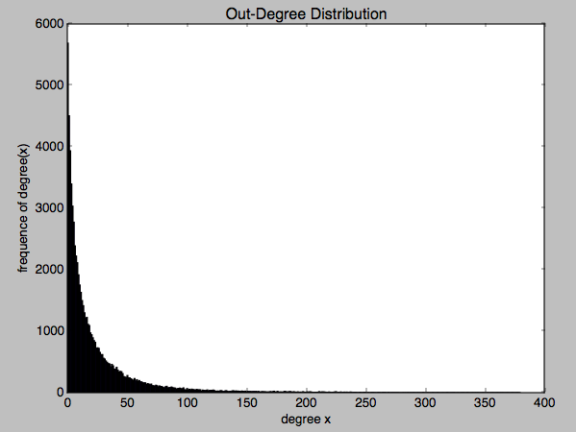
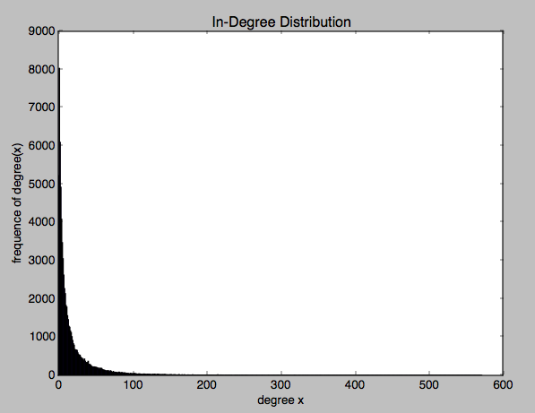
Distribution for out-degree and in-degree
Notes:
Key = degree i / value = frequency of degree i
dict_items([(1, 5689), (2, 4507), (3, 3937), (4, 3397), (5, 3036), (6, 2775), (7, 2389), (8, 2224), (9, 2115), (10, 1918), (11, 1752), (12, 1632), (13, 1499), (14, 1416), (15, 1300), (16, 1213), (17, 1225), (18, 1112), (19, 1093), (20, 973), (21, 943), (22, 893), (23, 847), (24, 819), (25, 724), (26, 730), (27, 721), (28, 656), (29, 619), (30, 620), (31, 561), (32, 547), (33, 516), (34, 494), (35, 474), (36, 468), (37, 420), (38, 460), (39, 437), (40, 384), (41, 379), (42, 412), (43, 365), (44, 337), (45, 345), (46, 341), (47, 311), (48, 262), (49, 252), (50, 248), (51, 279), (52, 242), (53, 240), (54, 226), (55, 214), (56, 201), (57, 230), (58, 190), (59, 211), (60, 187), (61, 197), (62, 176), (63, 175), (64, 162), (65, 158), (66, 160), (67, 133), (68, 148), (69, 140), (70, 128), (71, 140), (72, 114), (73, 112), (74, 104), (75, 121), (76, 112), (77, 95), (78, 109), (79, 101), (80, 99), (81, 86), (82, 76), (83, 96), (84, 103), (85, 80), (86, 81), (87, 83), (88, 92), (89, 82), (90, 74), (91, 75), (92, 58), (93, 66), (94, 69), (95, 74), (96, 64), (97, 65), (98, 78), (99, 47), (100, 43), (101, 65), (102, 43), (103, 55), (104, 46), (105, 57), (106, 51), (107, 47), (108, 40), (109, 53), (110, 49), (111, 43), (112, 47), (113, 25), (114, 42), (115, 38), (116, 34), (117, 37), (118, 44), (119, 30), (120, 36), (121, 38), (122, 37), (123, 42), (124, 34), (125, 23), (126, 25), (127, 26), (128, 23), (129, 32), (130, 32), (131, 21), (132, 19), (133, 28), (134, 32), (135, 22), (136, 17), (137, 21), (138, 20), (139, 29), (140, 30), (141, 22), (142, 28), (143, 24), (144, 25), (145, 22), (146, 19), (147, 26), (148, 23), (149, 20), (150, 25), (151, 14), (152, 21), (153, 18), (154, 20), (155, 18), (156, 19), (157, 19), (158, 18), (159, 21), (160, 15), (161, 20), (162, 11), (163, 13), (164, 18), (165, 15), (166, 14), (167, 14), (168, 10), (169, 12), (170, 11), (171, 18), (172, 12), (173, 18), (174, 23), (175, 10), (176, 13), (177, 21), (178, 9), (179, 11), (180, 12), (181, 9), (182, 14), (183, 21), (184, 16), (185, 11), (186, 13), (187, 17), (188, 18), (189, 8), (190, 13), (191, 13), (192, 9), (193, 8), (194, 13), (195, 7), (196, 10), (197, 3), (198, 15), (199, 11), (200, 7), (201, 8), (202, 13), (203, 8), (204, 14), (205, 12), (206, 5), (207, 4), (208, 5), (209, 7), (210, 6), (211, 9), (212, 16), (213, 5), (214, 13), (215, 11), (216, 11), (217, 9), (218, 5), (219, 5), (220, 10), (221, 8), (222, 4), (223, 6), (224, 8), (225, 11), (226, 15), (227, 3), (228, 7), (229, 4), (230, 11), (231, 3), (232, 6), (233, 9), (234, 4), (235, 9), (236, 4), (237, 4), (238, 10), (239, 8), (240, 3), (241, 5), (242, 5), (243, 5), (244, 2), (245, 1), (246, 7), (247, 3), (248, 2), (249, 4), (250, 6), (251, 4), (252, 1), (253, 3), (256, 1), (258, 2), (259, 4), (260, 3), (261, 2), (262, 2), (263, 1), (264, 3), (265, 3), (266, 3), (267, 1), (269, 4), (271, 3), (272, 4), (273, 2), (275, 1), (276, 4), (277, 1), (278, 2), (279, 2), (281, 1), (282, 2), (286, 2), (289, 2), (290, 1), (291, 1), (292, 1), (293, 1), (294, 1), (297, 1), (298, 2), (299, 1), (300, 2), (302, 1), (303, 2), (306, 2), (307, 1), (309, 2), (310, 2), (312, 1), (313, 2), (316, 1), (317, 2), (318, 1), (319, 1), (320, 3), (322, 1), (327, 1), (329, 2), (330, 1), (331, 1), (332, 1), (333, 1), (334, 2), (335, 1), (336, 1), (337, 1), (339, 2), (342, 1), (345, 1), (346, 1), (350, 1), (351, 1), (352, 1), (1205, 1), (354, 3), (356, 1), (357, 1), (359, 2), (361, 2), (363, 1), (364, 3), (1069, 1), (366, 1), (353, 1), (370, 1), (372, 1), (373, 2), (382, 1), (391, 2), (395, 1), (396, 1), (397, 2), (402, 1), (405, 1), (407, 1), (414, 1), (419, 1), (427, 1), (431, 2), (434, 1), (435, 1), (436, 1), (437, 1), (438, 1), (455, 1), (457, 1), (460, 1), (465, 1), (477, 1), (491, 1), (492, 1), (493, 1), (503, 1), (508, 1), (513, 1), (519, 1), (521, 1), (1111, 1), (526, 1), (530, 2), (544, 1), (546, 1), (575, 1), (581, 1), (603, 1), (630, 1), (631, 1), (659, 1), (687, 1), (705, 1), (713, 1), (719, 1), (724, 1), (365, 1), (1158, 1), (930, 1)])

Slide 6

Statistic of Degree Centrality
max out-degree is 1205
$C_{out−Degree}\left(G\right)$= 82703363.788500095
max in-degree is 3383
$C_{in−Degree}\left(G\right)$= 256171180.21799397

Slide 7
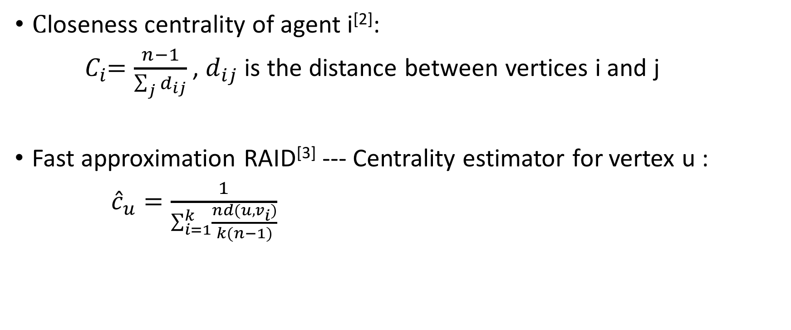
Closeness centrality
$\text{C}\text{loseness} \text{centrality} \text{of} \text{agent} \text{i}$^{[2]}:
${ C}_{i}=\frac{n−1}{\sum_{j}{d_{ij}}}$ , $d_{ij}$ is the distance between vertices i and j
Fast approximation RAID^{[3]} --- Centrality estimator for vertex u :
${\hat{c}}_{u}=\frac{1}{\sum_{i=1}^{k}{\frac{nd(u,v_{i})}{k(n−1)}}}$
Notes:
In a connected graph, the closeness centrality (or closeness) of a node is a measure of centrality in a network, calculated as the sum of the length of the shortest paths between the node and all other nodes in the graph. Thus the more central a node is, the closer it is to all other nodes.
Algorithm RAND:
Let k be the number of iterations needed to obtain the desired error bound.
In iteration i , pick vertex vi uniformly at random from G and solve the SSSP problem with vi as the source.
Let C^u be the centrality estimator for vertex u.

Slide 8
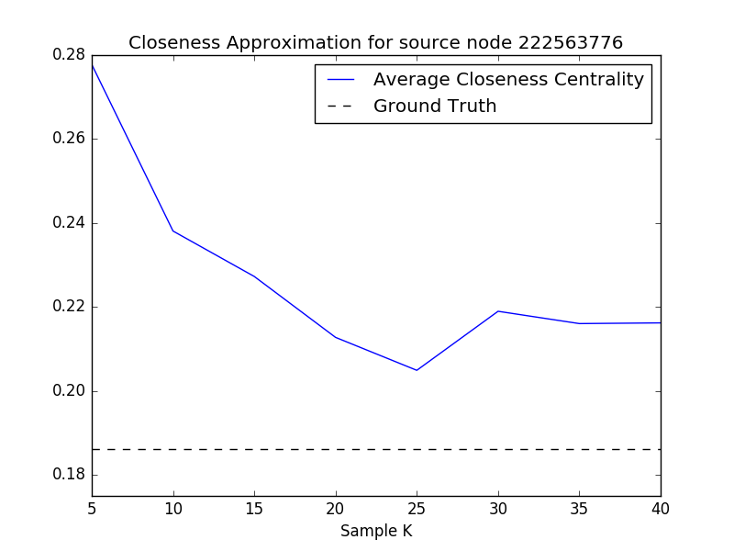
Notes:
Test :
Pick random 5 targets
from source : 119235800
RAND Error 33.3%
average distance 0.16666428900903985
time cost : 753.4092590808868
Running time from 2017-06-26 21:35:28.779091 to 2017-06-26 21:48:02.188811
SSSP Ground truth
closeness centrality 0.12952556936296022
time cost : 3082.8511850833893
Running time from 2017-06-26 21:48:02.189050 to 2017-06-26 22:39:25.040632
15
from source : 15947380
RAND-SSSP
average distance 0.15624777094597486
time cost : 1376.8762879371643
Running time from 2017-06-27 00:07:04.575226 to 2017-06-27 00:30:01.454099SSSP
from source : 2562661RAND-SSSPaverage distance 0.204078721235559 time cost : 1759.8332030773163Running time from 2017-06-27 00:51:12.140409 to 2017-06-27 01:20:31.973744SSSPcloseness centrality 0.17535661214707782 time cost : 29895.2809510231Running time from 2017-06-27 01:20:31.973924 to 2017-06-27 09:38:47.255262
/Applications/anaconda/envs/Python3.5/bin/python /Users/nanazhu/Documents/LosAlamos/demo_closeness.pyfrom source : 20583452RAND-SSSPaverage distance 0.27272338201479246 time cost : 1255.4970571994781Running time from 2017-06-27 00:50:17.598740 to 2017-06-27 01:11:13.096019SSSPcloseness centrality 0.23128115957330975 time cost : 30161.431552886963Running time from 2017-06-27 01:11:13.096310 to 2017-06-27 09:33:54.527927
from source : 135385447
RAND-SSSP
average distance 0.2049151094373441
time cost : 1073.5181941986084
Running time from 2017-06-26 23:00:26.299118 to 2017-06-26 23:18:19.817383SSSP
closeness centrality 0.18268581719429655
time cost : 2476.0539569854736
Running time from 2017-06-26 23:18:19.817434 to 2017-06-26 23:59:35.871740
/Applications/anaconda/envs/Python3.5/bin/python /Users/nanazhu/Documents/LosAlamos/demo_closeness.pyfrom source : 222563776RAND-SSSPaverage distance 0.2380918414414855 time cost : 115.63086080551147Running time from 2017-06-27 00:50:10.568065 to 2017-06-27 00:52:06.199228SSSPcloseness centrality 0.18625166400514415 time cost : 8149.327466964722Running time from 2017-06-27 00:52:06.199389 to 2017-06-27 03:07:55.527067
/Applications/anaconda/envs/Python3.5/bin/python /Users/nanazhu/Documents/LosAlamos/demo_closeness.pyfrom source : 222563776RAND-SSSPsample_k 35average distance 0.2160463005672739 time cost : 662.5095179080963Running time from 2017-06-27 10:45:17.129137 to 2017-06-27 10:56:19.639102Process finished with exit code 0
from source : 222563776RAND-SSSPsample_k 30average distance 0.21897497826005236 time cost : 2753.6742689609528Running time from 2017-06-27 09:47:19.581561 to 2017-06-27 10:33:13.256558Process finished with exit code 0

Slide 9

Betweenness centrality^{[2]}
$σ_{st}$:number of the shortest paths between pairs of vertices (s, t)
$σ_{st}\left(v\right)$:number of shortest paths that pass through the vertex v between pair of vertices(s, t)
$C_{B}\left(v\right)=\sum_{s≠v≠t⊆V}{\frac{σ_{st}\left(v\right)}{σ_{st}}}$
Notes:
In graph theory, betweenness centrality is a measure of centrality in a graph based on shortest paths. For every pair of vertices in a connected graph, there exists at least one shortest path between the vertices such that either the number of edges that the path passes through (for unweighted graphs) or the sum of the weights of the edges (for weighted graphs) is minimized. The betweenness centrality for each vertex is the number of these shortest paths that pass through the vertex.
Betweenness centrality finds wide application in network theory: it represents the degree of which nodes stand between each other.
For example, in a telecommunications network, a node with higher betweenness centrality would have more control over the network, because more information will pass through that node. Betweenness centrality was devised as a general measure of centrality:^{[1]}

Slide 10
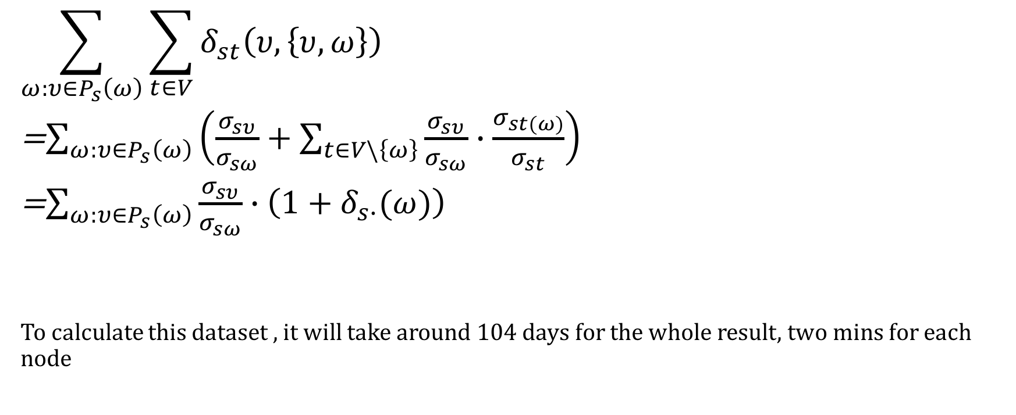
Fast Algorithm^{[4]}
$$\sum_{ω:υ∈P_{s}\left(ω\right)}{\sum_{t∈V}{δ_{st}\left(υ,\left\{υ,ω\right\}\right)}}$$
=$\sum_{ω:υ∈P_{s}\left(ω\right)}{\left(\frac{σ_{sυ}}{σ_{sω}}+\sum_{t∈V\backslash \left\{ω\right\}}{\frac{σ_{sυ}}{σ_{sω}}∙\frac{σ_{st(ω)}}{σ_{st}}}\right)}$
=$\sum_{ω:υ∈P_{s}\left(ω\right)}{\frac{σ_{sυ}}{σ_{sω}}∙\left(1+δ_{s∙}(ω)\right)}$
To calculate this dataset , it will take around 104 days for the whole result, two mins for each node
Notes:
for one SSSP calculation from the Algorithm^{[4]} , take time :
start from node : 53870594 start: 2017-06-29 23:49:10.150589 end: 2017-06-29 23:51:13.000150
And for all the 7K+ nodes it will take longer day than we wish to see and also this algorithm is used in Gephi

Slide 11
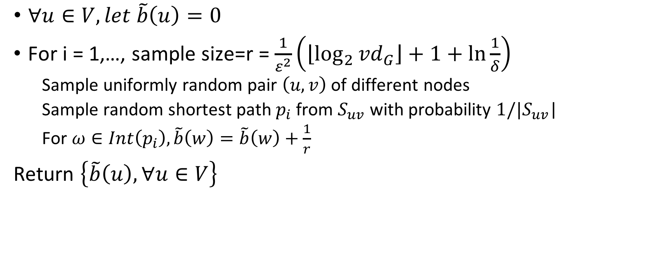
Faster Algorithm^{[5]}
$∀u∈V,let \tilde{b}\left(u\right)=0$
For i = 1,…, sample size=r = $\frac{1}{ε^{2}}\left(\left\lfloor \log_{2}{{vd}_{G}}\right\rfloor +1+\ln{\frac{1}{δ}}\right)$
Sample uniformly random pair $\left(u,v\right)$ of different nodes
Sample random shortest path $p_{i}$ from $S_{uv}$ with probability $1/|S_{uv}$|
For $ω∈Int\left(p_{i}\right),\tilde{b}\left(w\right)=\tilde{b}\left(w\right)+\frac{1}{r}$
Return $\left\{\tilde{b}\left(u\right),∀u∈V\right\}$
Notes:
One iteration :
VD_G is 5717
r is 2861
start node is: 536799668 stop node is 33612973
start time : 2017-06-29 23:53:06.804896 end time: 2017-06-29 23:53:22.720621

Slide 12
Top 10 Approximate Betweenness centrality
start time : 2017-06-28 15:37:28.572997
end time : 2017-06-29 23:43:32.462948
The top 10 nodes with their betweenness centrality:
(813286, 0.16068690585709944)
(17093617, 0.07053051211284847)
(15846407, 0.05305121128488176)
(3359851, 0.04998466727997532)
(59804598, 0.036185219257896334)
(12611642, 0.03434529285495247)
(15439395, 0.03127874885004603)
(2367911, 0.027292241643667614)
(22679419, 0.023305734437289196)
(14230524, 0.02023919043238272)

Slide 13
Reference
[1] https://en.wikipedia.org/wiki/Centrality
[2]Centrality measures
[3] David Eppstein, Joseph Wang. Fast Approximation of Centrality
[4]Ulrik Brandes. A Faster Algorithm for Betweenness Centrality
[5]Matteo Riondato, Evgenios M. Kornaropoulos. Fast Approximation of Betweenness Centrality through Sampling

