Slide 1
Pseudo-Label
The Simple and Efficient Semi-Supervised Learning Method
for
Deep Neural Networks
José Vicente Jaramillo 1735915
Na Zhu 1706409
Arikhan Arik 1629435

Slide 2
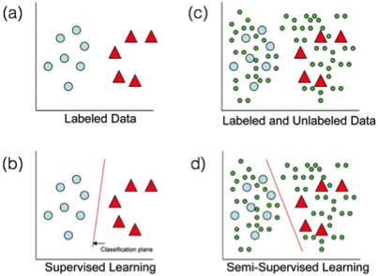
Semi-supervised learning

Slide 3
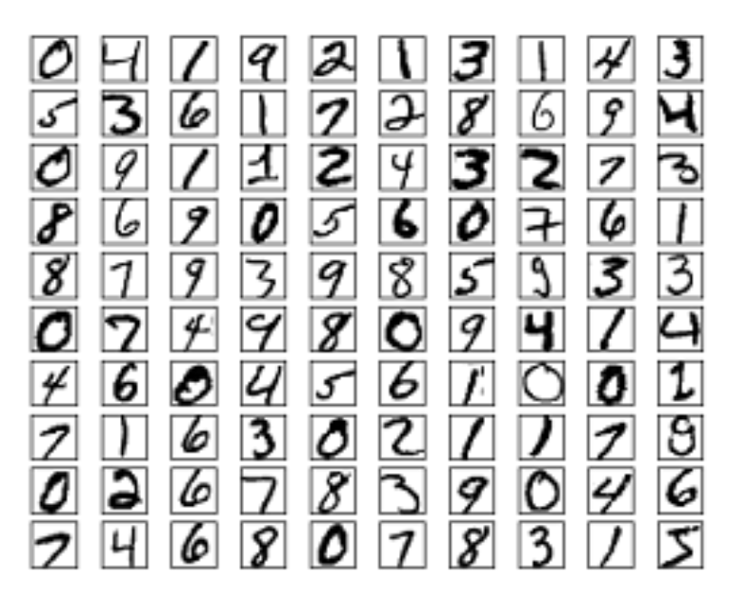
Data Set Demo
As data set, the known and popular MNIST has been used.
Four files are available on this site:
training set images (9912422 bytes)
training set labels (28881 bytes)
test set images (1648877 bytes)
test set labels (4542 bytes)
Notes:
The MNIST database was constructed from NIST's Special Database 3 and Special Database 1 which contain binary images of handwritten digits. NIST originally designated SD-3 as their training set and SD-1 as their test set. However, SD-3 is much cleaner and easier to recognize than SD-1. The reason for this can be found on the fact that SD-3 was collected among Census Bureau employees, while SD-1 was collected among high-school students. Drawing sensible conclusions from learning experiments requires that the result be independent of the choice of training set and test among the complete set of samples. Therefore it was necessary to build a new database by mixing NIST's datasets.
The MNIST training set is composed of 30,000 patterns from SD-3 and 30,000 patterns from SD-1. Our test set was composed of 5,000 patterns from SD-3 and 5,000 patterns from SD-1. The 60,000 pattern training set contained examples from approximately 250 writers. We made sure that the sets of writers of the training set and test set were disjoint.

Slide 4
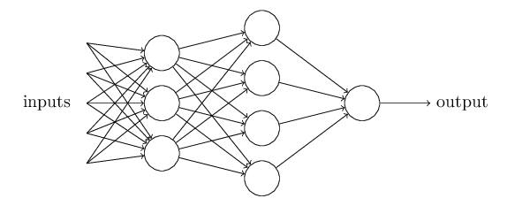
Neural network
The example of the general representation of the Neural Network has been shown in the below figure.
In our case:
Input Layer Nodes: 784
First Hidden Layer Nodes:392
Second hidden Layer Nodes:89
Output Layer Nodes: 10

Slide 5
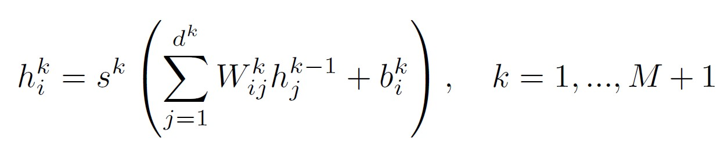
Deep Neural Networks
Where s is the nonlinear activation function such as sigmoid, W is the weight, h is the j-th hidden layer and b is the corresponding bias and M is the total number of the hidden layers.
Notes:
weight : Each input has an associated weight (w), which is assigned on the basis of its relative importance to other inputs.
bias : you want to be able to shift the entire curve to the right.which may be critical for successful learning.

Slide 6
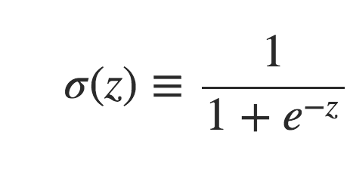
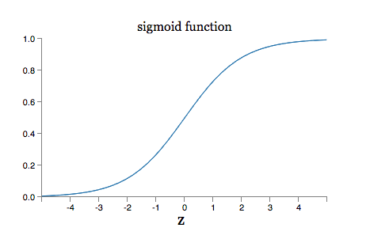
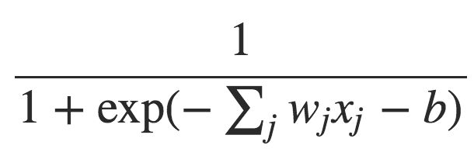

Sigmoid function
Notes:
when z=w⋅x+b is large and positive, the output from the sigmoid neuron is approximately 1, just as it would have been for a perceptron. Suppose on the other hand that z=w⋅x+bz=w⋅x+b is very negative. Then e−z→∞, and σ(z)≈0. So when z=w⋅x+b is very negative, the behaviour of a sigmoid neuron also closely approximates a perceptron.

Slide 7
Training
•Send the training set images into the network
•Propagate forward through the network to generate the labels
•Calculate the loss function between target labels with the output ones
•Using stochastic gradient descent to back propagate the update of weights and biases on all output and hidden neurons
Notes:
WHY need cost function :
The problem with that is that the number of images correctly classified is not a smooth function of the weights and biases in the network.
For the most part, making small changes to the weights and biases won't cause any change at all in the number of training images classified correctly, to get improved performance.
So the aim of our training algorithm will be to minimize the cost C(w,b) as a function of the weights and biases. we want to find a set of weights and biases which make the cost as small as possible.
We'll do that using an algorithm known as gradient descent

Slide 8
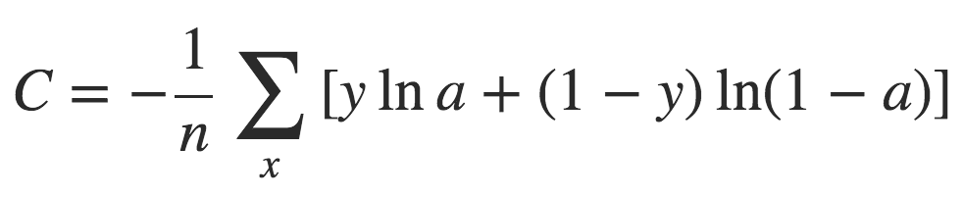
Loss function Cross-Entropy
Notes:
--------------------------------------
why cross-entropy
1 it's non-negative
2 tends toward zero as the neuron gets better at computing the desired output, y, for all training inputs, x.
3 ∂C/∂wj=1/n* ∑xj*(σ(z)−y) make the error bigger ---> the cost function are bigger
---------------------------------------
how to update the weight and bias
The weight's output delta and input activation are multiplied to find the gradient of the weight. ----> ∂C/∂wj=1/n* ∑xj*(σ(z)−y)
The sign of the gradient of a weight indicates whether the error varies directly with, or inversely to, the weight.
Therefore, the weight must be updated in the opposite direction, "descending" the gradient.
A ratio (percentage) of the weight's gradient is subtracted from the weight -----> . w = w - learning rate * ∂C/∂wj
This ratio (percentage) influences the speed and quality of learning; it is called the learning rate.
The greater the ratio, the faster the neuron trains, but the lower the ratio, the more accurate the training is.
Learning is repeated (on new batches) until the network performs adequately.

Slide 9
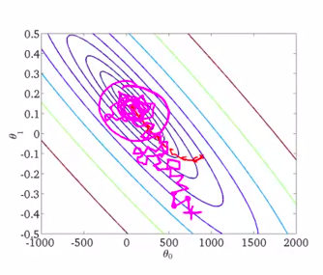
Stochastic Gradient Descent
Gradient descent algorithm
Stochastic approximation
Iterative method
Notes:
Gradient descent is a iterative optimization algorithm for finding the minimum of a function.
To find a local minimum of a function using gradient descent, one takes steps proportional to the negative of the gradient (or of the approximate gradient) of the function at the current point.
Iterative : Gradient descent algorithm works is to repeatedly compute the gradient ∇C, and then to move in the opposite direction, "falling down" the slope of the valley
https://www.coursera.org/learn/machine-learning/lecture/DoRHJ/stochastic-gradient-descent

Slide 10
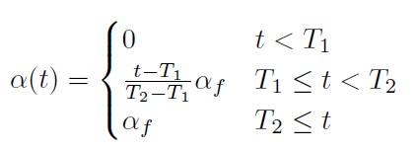
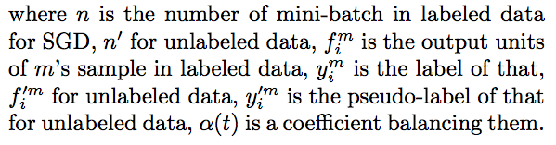
Pseudo-Label
Network is trained in a supervised fashion.
Pre-trained network is trained in with a group of labeled data and unlabeled data simultaneously.
For unlabeled data, the Pseudo-labels are computed with the trained network.
Pseudo-labels are computed (updated) each interaction.
Notes:
The proper scheduling of a(t) is very important for the network performance. If a(t) is too high, it disturbs training even for labeled data. Whereas if a(t) is too small, we cannot use benefit from unlabeled data.

Slide 11

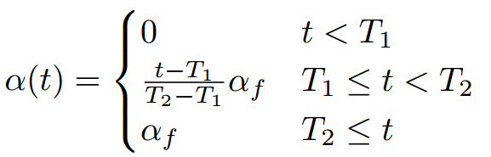
Overall loss function
Alpha

Slide 12
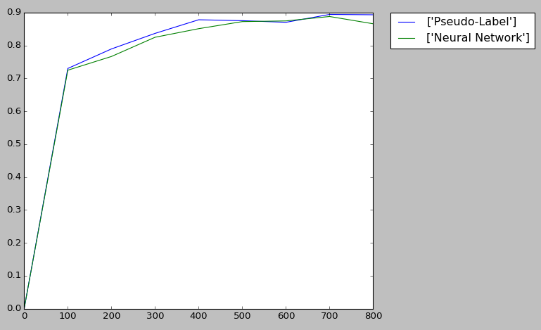
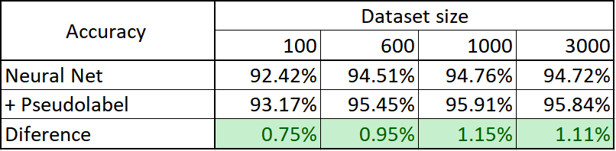
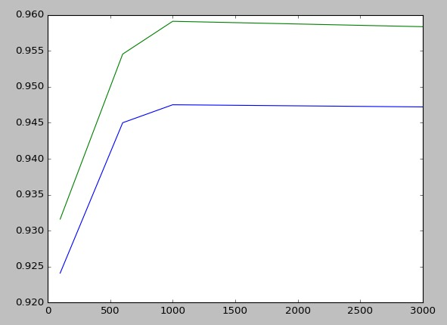
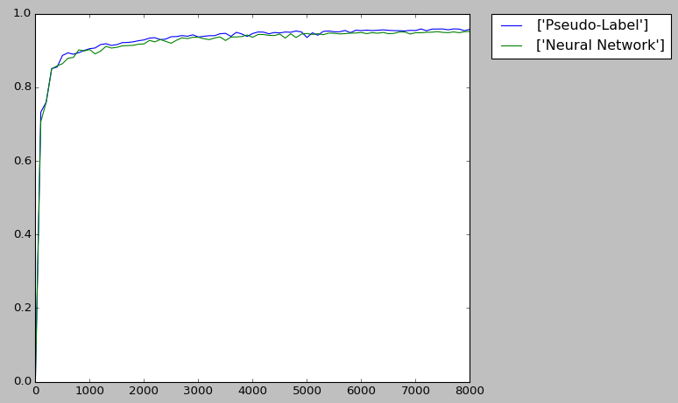
Results obtained
100 training data
1000 training data

