Slide 1

Step-By-Step Introduction to Apache Flink
[Setup, Configure, Run, Tools]
Slim Baltagi @SlimBaltagi
Washington DC Area Apache Flink Meetup
November 19th, 2015

Slide 2
For an overview of Apache Flink, see slides at http://www.slideshare.net/sbaltagi_x000b_
Google Dataflow
Cascading
Zeppelin
Table
Hadoop M/R
Dataflow (WiP)
Table
ML
Gelly
MRQL
SAMOA
APIs & LIBRARIES
DataSet (Java/Scala/Python)
Batch Processing
DataStream (Java/Scala)
Stream Processing
Batch Optimizer
Stream Builder
SYSTEM
Runtime
Distributed Streaming Dataflow
Local
Single JVM
Embedded
Docker
Cluster
Standalone
YARN, Tez, Mesos (WIP)
Cloud
Google’s GCE
Amazon’s EC2
IBM Docker Cloud, …
DEPLOY
Files
Local
HDFS
S3
Tachyon
Databases
MongoDB
HBase
SQL
…
Streams
Flume
Kafka
RabbitMQ
…
STORAGE

Slide 3
Agenda
How to setup and configure your Apache Flink environment?
How to use Apache Flink tools?
3. How to run the examples in the Apache Flink bundle?
4. How to set up your IDE (IntelliJ IDEA or Eclipse) for Apache Flink?
5. How to write your Apache Flink program in an IDE?

Slide 4
1. How to setup and configure your Apache Flink environment?
1.1 Local (on a single machine)
1.2 Flink in a VM image (on a single machine)
1.3 Flink on Docker
1.4 Standalone Cluster
1.5 Flink on a YARN Cluster
1.6 Flink on the Cloud

Slide 5
1.1 Local (on a single machine)
  Flink runs on Linux, OS X and Windows. In order to execute a program on a running Flink instance (and not from within your IDE) you need to install Flink on your machine.
  The following steps will be detailed for both Unix-Like (Linux, Mac OS X) as well as Windows environments:
    1.1.1 Verify requirements
    1.1.2 Download the Flink binary package
    1.1.3 Unpack the downloaded archive
    1.1.4 Configure
    1.1.5 Start a local Flink instance
    1.1.6 Validate Flink is running
    1.1.7 Run a Flink example
    1.1.8 Stop the local Flink instance
Notes:
The following steps assume a UNIX-like environment. For Windows, see Flink on Windows: https://ci.apache.org/projects/flink/flink-docs-master/setup/local_setup.html#flink-on-windows

Slide 6
1.1 Local (on a single machine)
  1.1.1 Verify requirements
  The machine that Flink will run on, must have Java 1.7.x or higher installed. To check the Java version installed issue the command: java –version. The out of the box configuration will use your default Java installation.
  Optional: If you want to manually override the Java runtime to use, set the JAVA_HOME environment variable in Unix-like environment. To check if JAVA_HOME is set, issue the command: echo $JAVA_HOME.
  If needed, follow the instructions for installing Java and setting JAVA_HOME on a Unix system here: https://docs.oracle.com/cd/E19182-01/820-7851/inst_set_jdk_korn_bash_t/index.html
Notes:
The following steps assume a UNIX-like environment. For Windows, see Flink on Windows: https://ci.apache.org/projects/flink/flink-docs-master/setup/local_setup.html#flink-on-windows

Slide 7
1.1 Local (on a single machine)
  In Windows environment, check the correct installation of Java by issuing the following command: java –version.
  The bin folder of your Java Runtime Environment must be included in Window’s %PATH% variable. If needed, follow this guide to add Java to the path variable. http://www.java.com/en/download/help/path.xml
  If needed, follow the instructions for installing Java and setting JAVA_HOME on a Windows system here: https://docs.oracle.com/cd/E19182-01/820-7851/inst_set_jdk_windows_t/index.html
Notes:
For Windows, see Flink on Windows: https://ci.apache.org/projects/flink/flink-docs-master/setup/local_setup.html#flink-on-windows

Slide 8
1.1 Local (on a single machine)
  1.1.2 Download the Flink binary package
  The latest stable release of Apache Flink can be downloaded from http://flink.apache.org/downloads.html
  For example: In Linux-Like environment, run the following command:
  wget https://www.apache.org/dist/flink/flink-0.10.0/flink-0.10.0-bin-hadoop1-scala_2.10.tgz
  Which version to pick?
    You don’t have to install Hadoop to use Flink.
    But if you plan to use Flink with data stored in Hadoop, pick the version matching your installed Hadoop version.
    If you don’t want to do this, pick the Hadoop 1 version.
Notes:
For Windows, see Flink on Windows: https://ci.apache.org/projects/flink/flink-docs-master/setup/local_setup.html#flink-on-windows

Slide 9
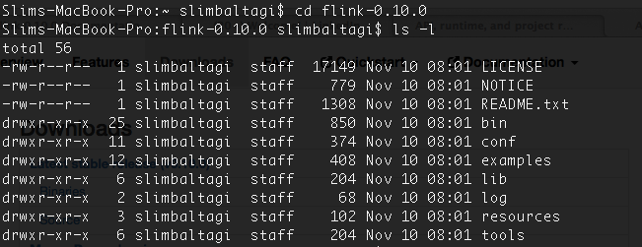
1.1 Local (on a single machine)
1.1.3 Unpack the downloaded .tgz archive
  Example:
$ cd ~/Downloads # Go to download directory
$ tar -xvzf flink-*.tgz # Unpack the downloaded archive
$ cd flink-0.10.0
$ ls –l

Slide 10
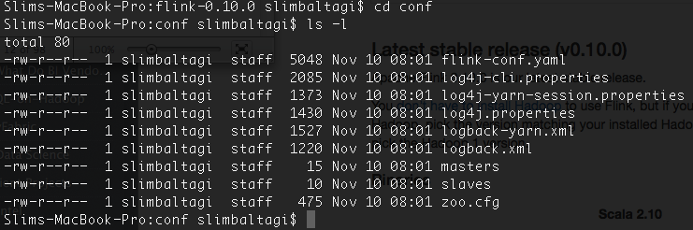
1.1 Local (on a single machine)
1.1.4. Configure
  The resulting folder contains a Flink setup that can be locally executed without any further configuration.
  flink-conf.yaml under flink-0.10.0/conf contains the default configuration parameters that allow Flink to run out-of-the-box in single node setups.

Slide 11
1.1 Local (on a single machine)
1.1.5. Start a local Flink instance:
  Given that you have a local Flink installation, you can start a Flink instance that runs a master and a worker process on your local machine in a single JVM.
  This execution mode is useful for local testing.
  On UNIX-Like system you can start a Flink instance as follows:
    cd /to/your/flink/installation
    ./bin/start-local.sh

Slide 12
1.1 Local (on a single machine)
1.1.5. Start a local Flink instance:
  On Windows you can either start with:
    Windows Batch Files by running the following commands
      cd C:\to\your\flink\installation
      .\bin\start-local.bat
    or with Cygwin and Unix Scripts: start the Cygwin terminal, navigate to your Flink directory and run the start-local.sh script
      $ cd /cydrive/c
      cd flink
      $ bin/start-local.sh

Slide 13
1.1 Local (on a single machine)
The JobManager (the master of the distributed system) automatically starts a web interface to observe program execution. It runs on port 8081 by default (configured in conf/flink-config.yml). http://localhost:8081/
1.1.6 Validate that Flink is running
You can validate that a local Flink instance is running by:
    Issuing the following command: $ jps
    jps: java virtual machine process status tool
    Looking at the log files in ./log/
    $ tail log/flink-*-jobmanager-*.log
    Opening the JobManager’s web interface at
    $ open http://localhost:8081

Slide 14
1.1 Local (on a single machine)
1.1.7 Run a Flink example
  On UNIX-Like system you can run a Flink example as follows:
    cd /to/your/flink/installation
    ./bin/flink run ./examples/WordCount.jar
  On Windows Batch Files, open a second terminal and run the following commands”
    cd C:\to\your\flink\installation
    .\bin\flink.bat run .\examples\WordCount.jar
1.1.8 Stop local Flink instance
On UNIX you call ./bin/stop-local.sh
On Windows you quit the running process with Ctrl+C

Slide 15
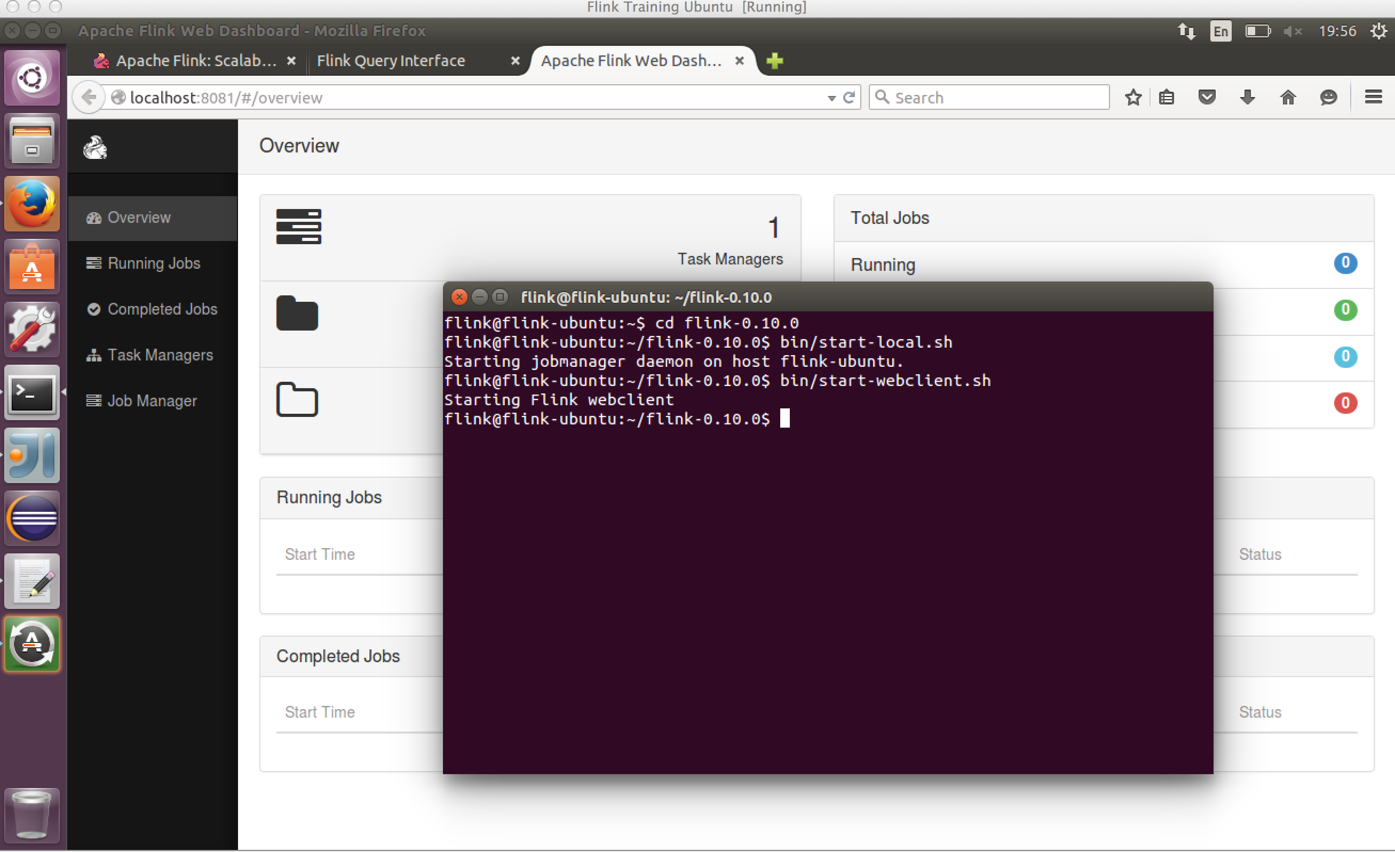
1.2 VM image (on a single machine)

Slide 16
1.2 VM image (on a single machine)
Please send me an email to sbaltagi@gmail.com for a link from which you can download a Flink Virtual Machine.
The Flink VM, which is approximately 4 GB, is from data Artisans http://data-artisans.com/
It currently has Flink 0.10.0, Kafka, IDEs (IntelliJ, Eclipse), Firefox, …
It will contain soon the FREE training from data Artisans for Flink 0.10.0
Meanwhile, an older version, based on 0.9.1, of this FREE training is is available from http://dataartisans.github.io/flink-training/

Slide 17
1.3 Docker
Docker can be used for local development.
Container based virtualization advantages:
  lightweight and portable;
  build once
  run anywhere
  ease of packaging applications
  automated and scripted
  isolated
Often resource requirements on data processing clusters exhibit high variation.
Elastic deployments reduce TCO (Total Cost of Ownership).

Slide 18
1.3 Flink on Docker
Apache Flink cluster deployment on Docker using Docker-Compose by Simons Laws from IBM. Talk at the Flink Forward in Berlin on October 12, 2015.
  Slides: http://www.slideshare.net/FlinkForward/simon-laws-apache-flink-cluster-deployment-on-docker-and-dockercompose
  Video recording (40’:49): https://www.youtube.com/watch?v=CaObaAv9tLE
The talk:
  Introduces the basic concepts of container isolation exemplified on Docker
  Explain how Apache Flink is made elastic using Docker-Compose.
  Show how to push the cluster to the cloud exemplified on the IBM Docker Cloud.

Slide 19
1.3 Flink on Docker
Apache Flink dockerized: This is a set of scripts to create a local multi-node Flink cluster, each node inside a docker container. https://hub.docker.com/r/gustavonalle/flink/
Using docker to setup a development environment that is reproducible. Apache Flink cluster deployment on Docker using Docker-Compose https://github.com/apache/flink/tree/master/flink-contrib/docker-flink
Web resources to learn more about Docker http://www.flinkbigdata.com/component/tags/tag/47-docker

Slide 20
1.4 Standalone Cluster
See quick start - Cluster https://ci.apache.org/projects/flink/flink-docs-release-0.10/quickstart/setup_quickstart.html#cluster-setup
See instructions on how to run Flink in a fully distributed fashion on a static (possibly heterogeneous) cluster. This involves two steps:
  Installing and configuring Flink
  Installing and configuring the Hadoop Distributed File System (HDFS)
  https://ci.apache.org/projects/flink/flink-docs-master/setup/cluster_setup.html

Slide 21
1.5 Flink on a YARN Cluster
You can easily deploy Flink on your existing YARN cluster:
  Download the Flink Hadoop2 package: Flink with Hadoop 2
  Make sure your HADOOP_HOME (or YARN_CONF_DIR or
    HADOOP_CONF_DIR) environment variable is set to read your YARN and HDFS configuration.
  Run the YARN client with: ./bin/yarn-session.sh You can run the client with options -n 10 -tm 8192 to allocate 10 TaskManagers with 8GB of memory each.
For more detailed instructions, please check out the documentation: https://ci.apache.org/projects/flink/flink-docs-master/setup/yarn_setup.html

Slide 22


1.6 Flink on the Cloud
1.6.1 Google Compute Engine (GCE)
1.6.2 Amazon EMR

Slide 23
1.6 Cloud
1.6.1 Google Compute Engine
Free trial for Google Cloud Engine:
https://cloud.google.com/free-trial/
Enjoy your $300 in GCE for 60 days!
Now, how to setup Flink with Hadoop 1 or Hadoop 2 on top of a Google Compute Engine cluster?
Google’s bdutil starts a cluster and deploys Flink with Hadoop. To get started, just follow the steps here: https://ci.apache.org/projects/flink/flink-docs-master/setup/gce_setup.html
https://ci.apache.org/projects/flink/flink-docs-master/setup/gce_setup.html

Slide 24
1.6 Cloud
1.6.2 Amazon EMR
Amazon Elastic MapReduce (Amazon EMR) is a web service providing a managed Hadoop framework.
  http://aws.amazon.com/elasticmapreduce/
  http://docs.aws.amazon.com/ElasticMapReduce/latest/DeveloperGuide/emr-what-is-emr.html
Example: Use Stratosphere with Amazon Elastic MapReduce, February 18, 2014 by Robert Metzger
https://flink.apache.org/news/2014/02/18/amazon-elastic-mapreduce-cloud-yarn.html
Use pre-defined cluster definition to deploy Apache Flink using Karamel web app http://www.karamel.io/
Getting Started – Installing Apache Flink on Amazon EC2 by Kamel Hakimzadeh. Published on October 12, 2015 https://www.youtube.com/watch?v=tCIA8_2dR14

Slide 25
Agenda
How to setup and configure your Apache Flink environment?
How to use Apache Flink tools?
3. How to run the examples in the Apache Flink bundle?
4. How to set up your IDE (IntelliJ IDEA or Eclipse) for Apache Flink?
5. How to write your Apache Flink program in an IDE?

Slide 26
2. How to use Apache Flink tools?
  2.1 Command-Line Interface (CLI)
  2.2 Web Submission Client
  2.3 Job Manager Web Interface
  2.4 Interactive Scala Shell
  2.5 Apache Zeppelin Notebook

Slide 27
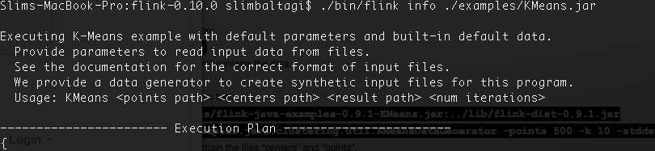
2.1 Command-Line Interface (CLI)
  Flink provides a CLI to run programs that are packaged as JAR files, and control their execution.
  bin/flink has 4 major actions
      run #runs a program.
      info #displays information about a program.
      list #lists scheduled and running jobs
      cancel #cancels a running job.
  Example: ./bin/flink info ./examples/KMeans.jar
  See CLI usage and related examples: https://ci.apache.org/projects/flink/flink-docs-master/apis/cli.html

Slide 28
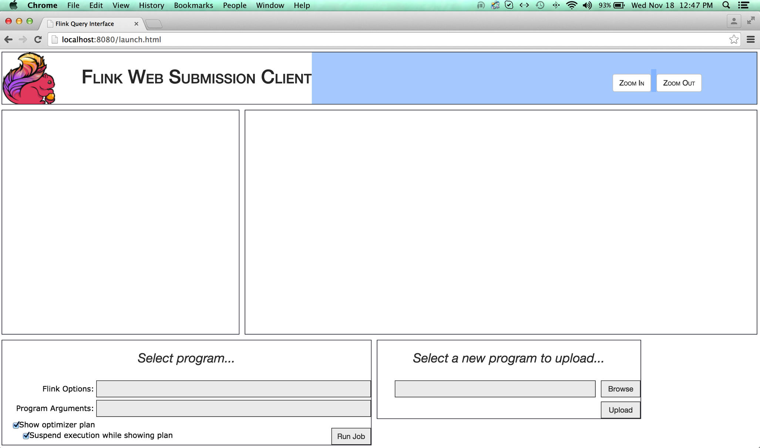
2.2 Web Submission Client

Slide 29
2.2 Web Submission Client
Flink provides a web interface to:
  Upload programs
  Execute programs
  Inspect their execution plans
  Showcase programs
  Debug execution plans
  Demonstrate the system as a whole
The web interface runs on port 8080 by default.
To specify a custom port set the webclient.port
property in the ./conf/flink.yaml configuration file.

Slide 30
2.2 Web Submission Client
Start the web interface by executing:
./bin/start-webclient.sh
Stop the web interface by executing:
./bin/stop-webclient.sh
Jobs are submitted to the JobManager specified by jobmanager.rpc.address and jobmanager.rpc.port
For more details and further configuration options, please consult this webpage:
https://ci.apache.org/projects/flink/flink-docs-release-0.10/setup/config.html#webclient

Slide 31
2.3 Web Submission Client
  The JobManager (the master of the distributed system) starts a web interface to observe program execution.
  It runs on port 8081 by default (configured in conf/flink-config.yml).
  Open the JobManager’s web interface at
  http://localhost:8081
    jobmanager.rpc.port 6123
    jobmanager.web.port 8081

Slide 32
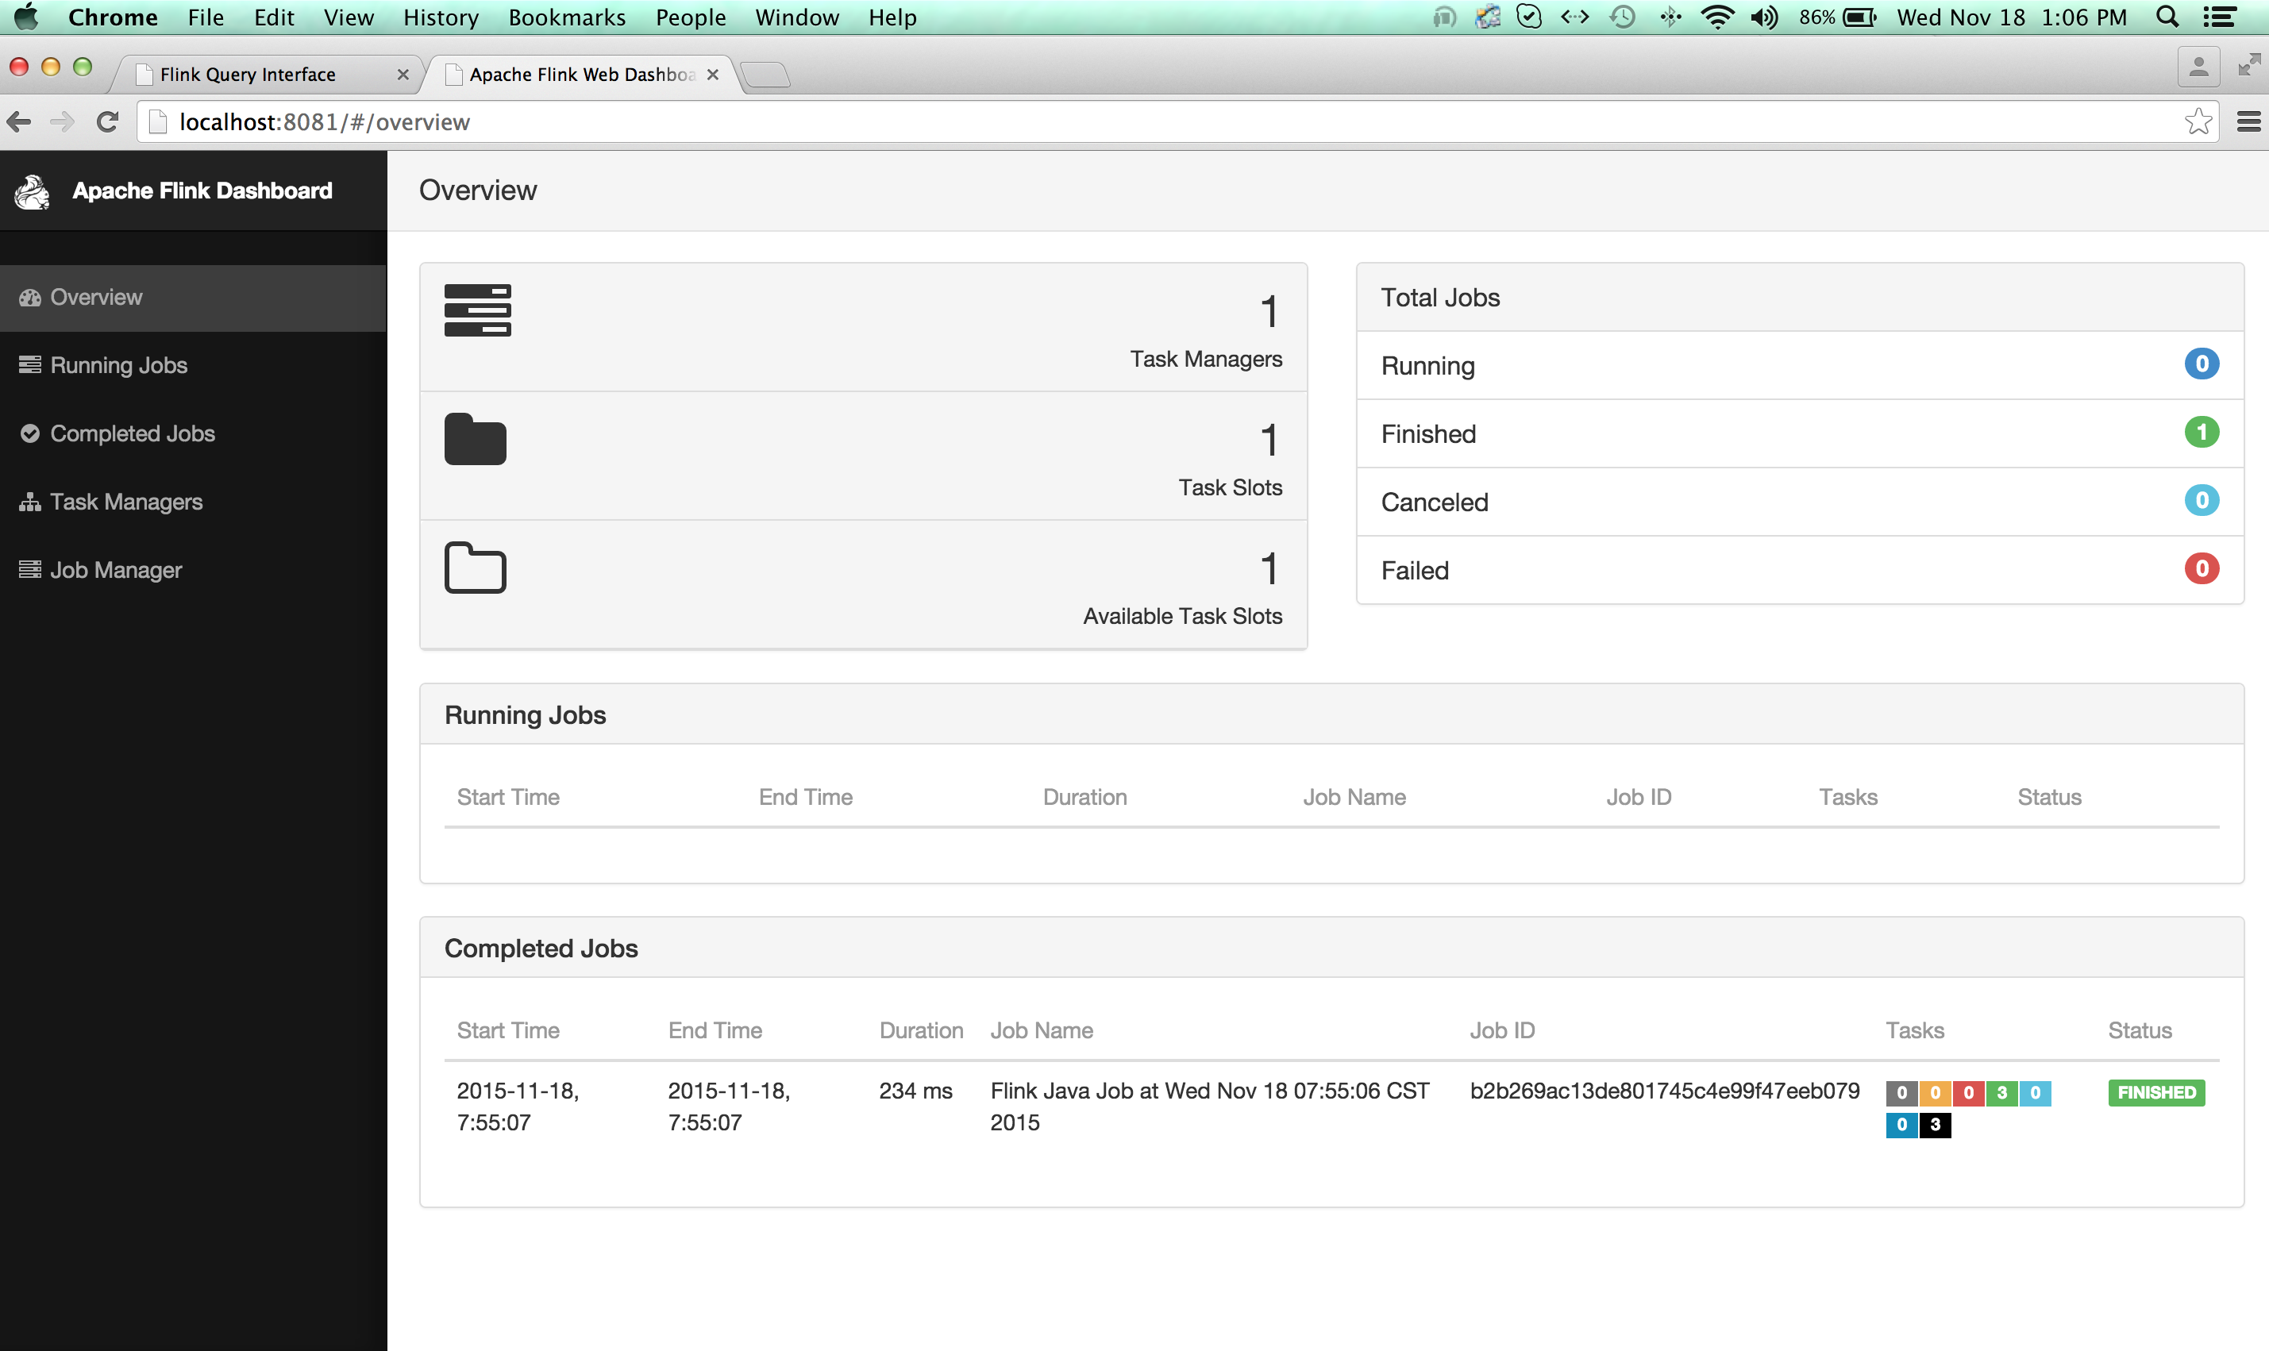
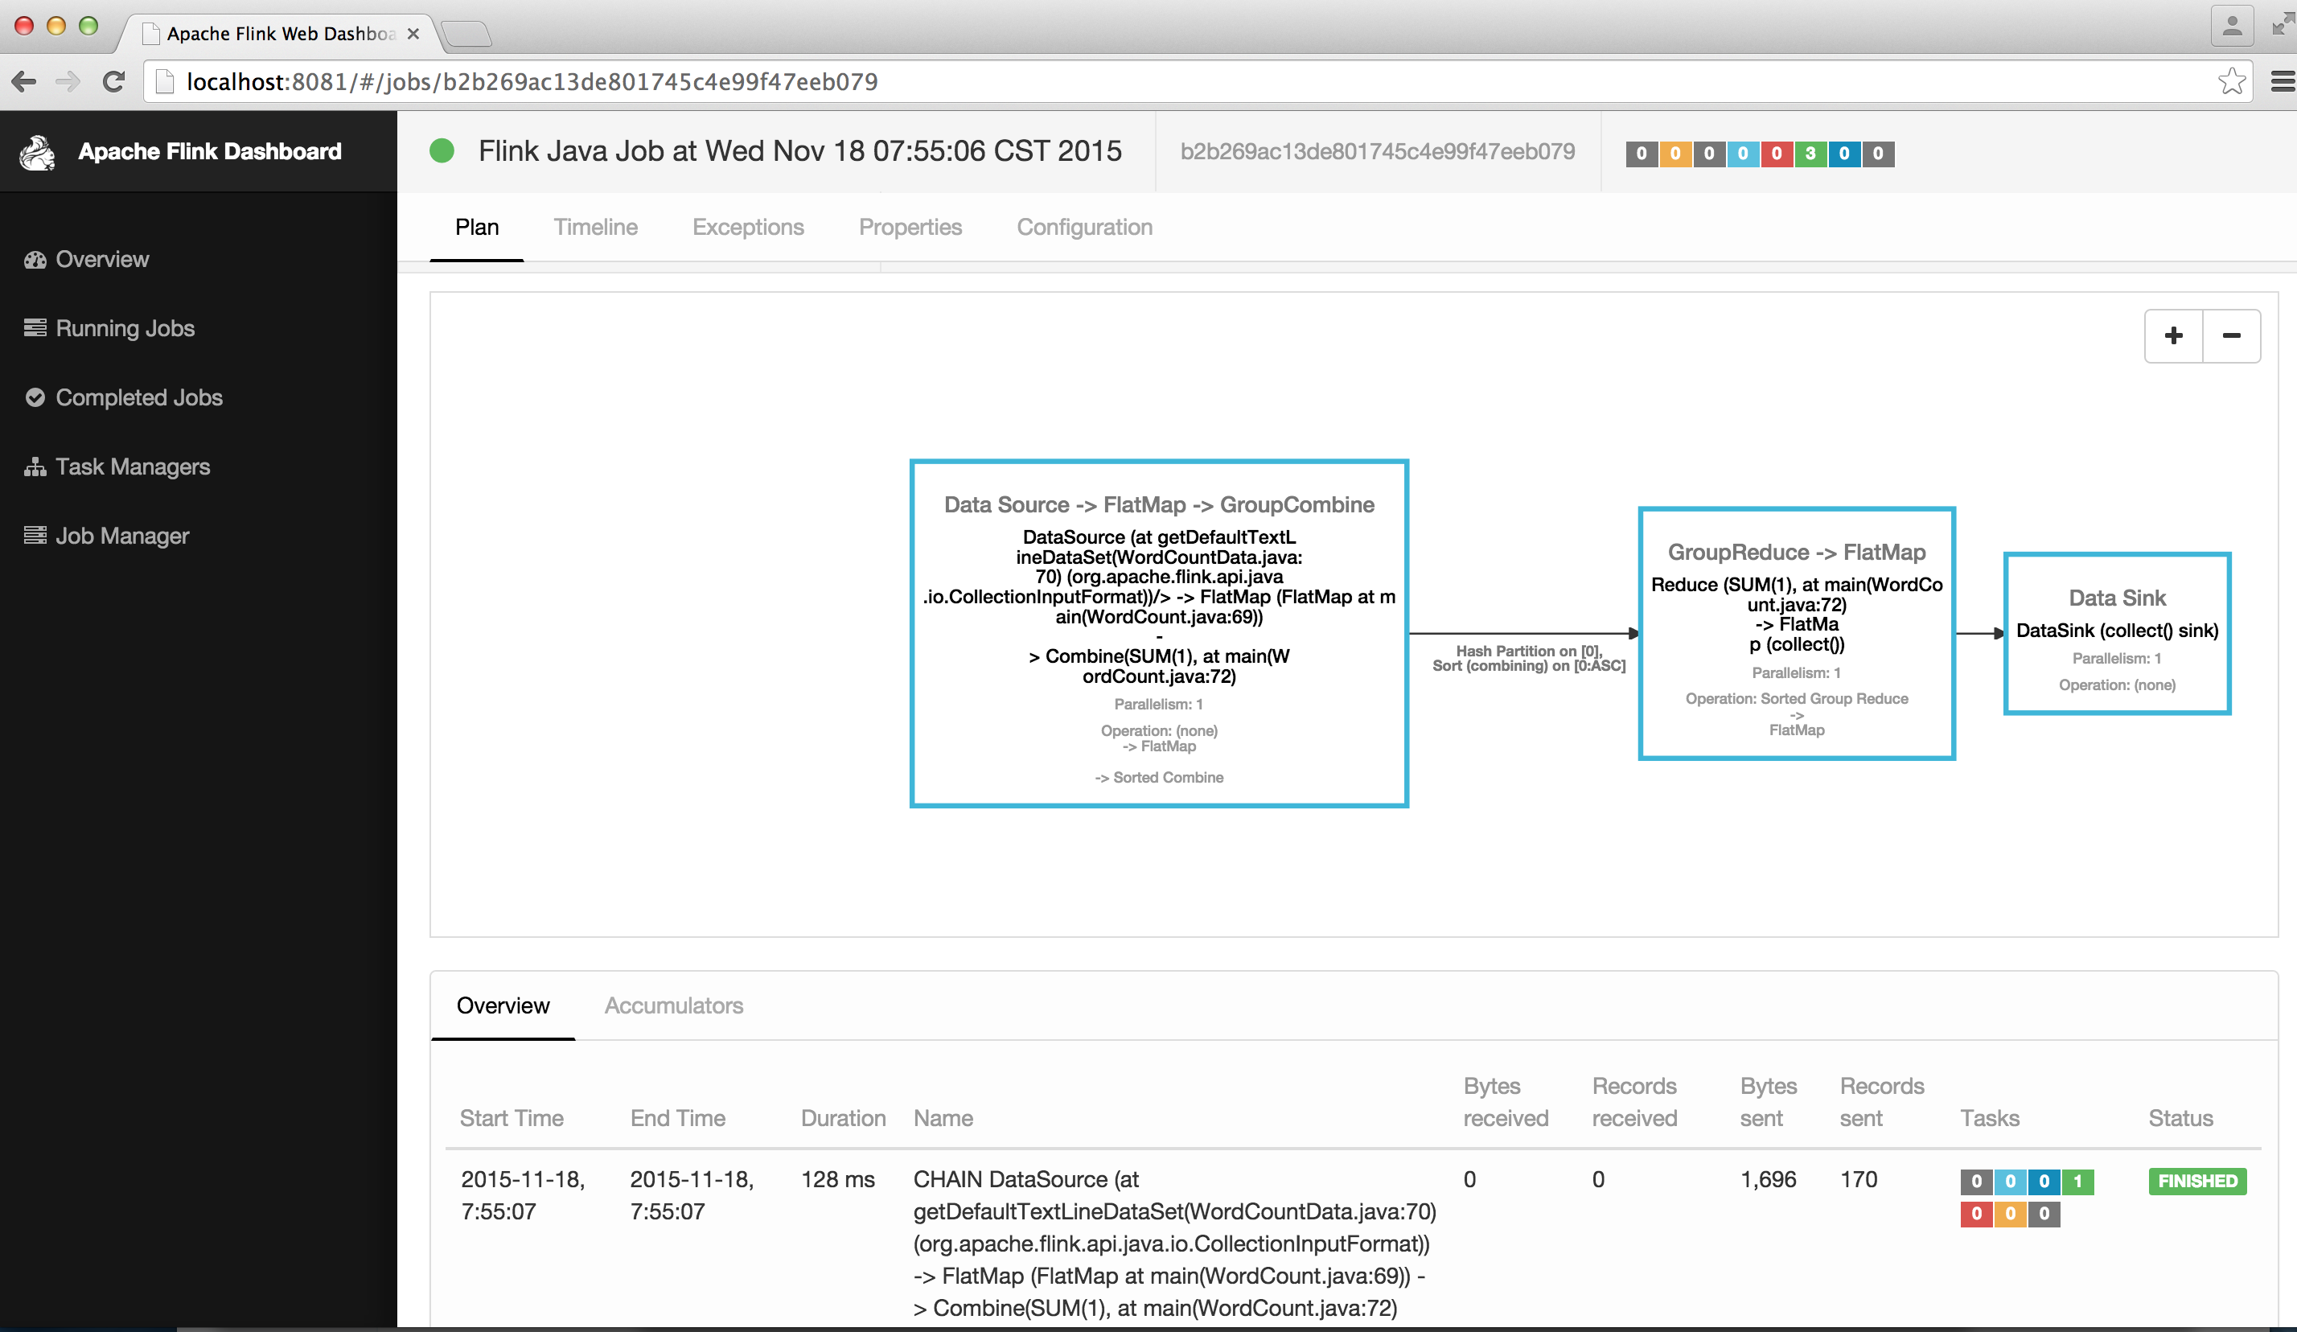
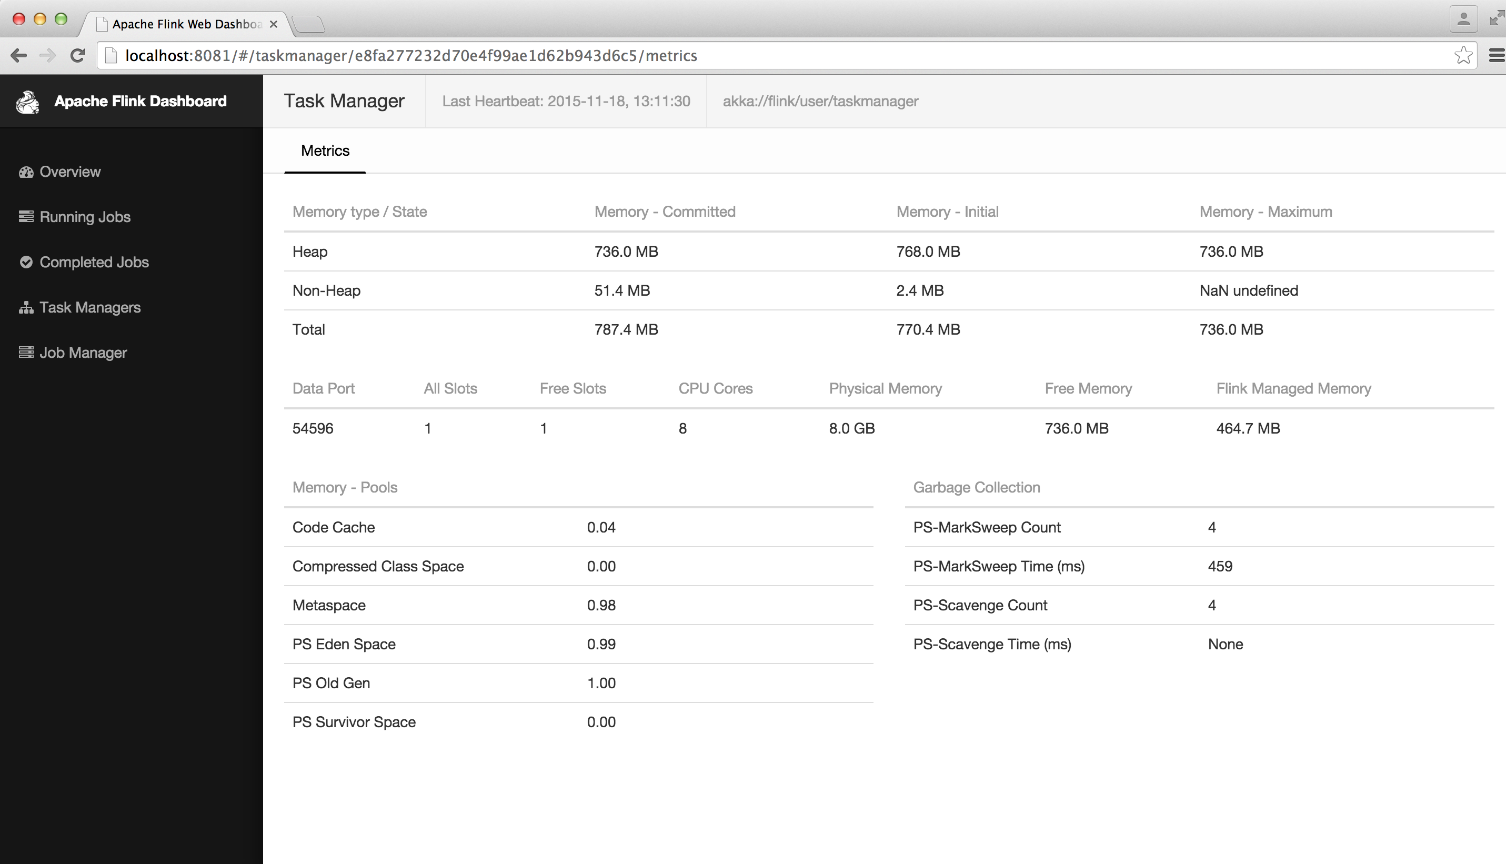
2.3 Job Manager Web Interface
Overall system status
Job execution details
Task Manager resource
utilization

Slide 33
2.3 Job Manager Web Interface
  The JobManager web frontend allows to :
      Track the progress of a Flink program as all status changes are also logged to the JobManager’s log file.
      Figure out why a program failed as it displays the exceptions of failed tasks and allows to figure out which parallel task first failed and caused the other tasks to cancel the execution.

Slide 34
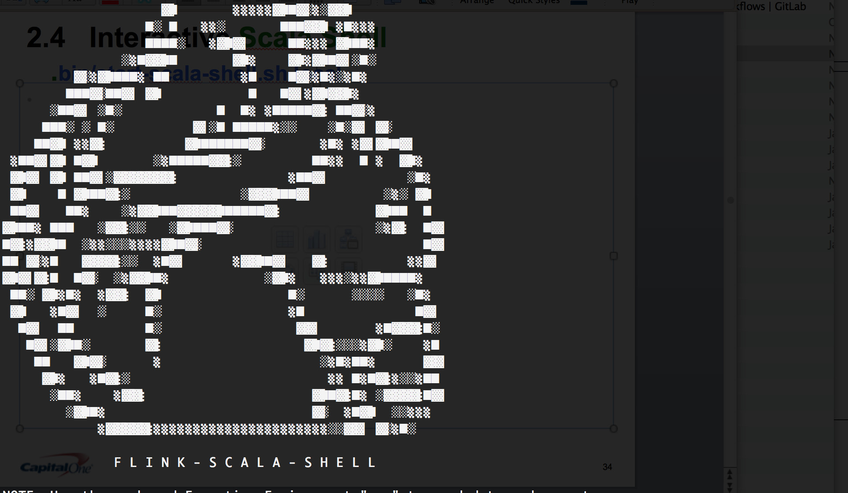
2.4 Interactive Scala Shell
.bin/start-scala-shell.sh local

Slide 35
2.4 Interactive Scala Shell
  Flink comes with an Interactive Scala Shell - REPL ( Read Evaluate Print Loop ).
  It can be used in a local setup as well as in a cluster setup.
    ./bin/start-scala-shell.sh local
    bin/start-scala-shell.sh remote <hostname> <portnumber>
    Interactive queries
    Let’s you explore data quickly
    Complete Scala API available
    The Flink Shell comes with command history and auto completion.
    So far only batch mode is supported. There is plan to add streaming in the future.
    https://ci.apache.org/projects/flink/flink-docs-release-0.10/apis/scala_shell.html

Slide 36
2.4 Interactive Scala Shell
Usage:
  Example 1:
  Scala-Flink> val input = env.fromElements(1,2,3,4)
  Scala-Flink> val doubleInput = input.map(_ *2)
  Scala-Flink> doubleInput.print()
  Example 2:
  Scala-Flink> val text = env.fromElements("To be, or not to be")
  Scala-Flink> val counts = text.flatMap { _.toLowerCase.split("\\W+") }.
  map { (_, 1) }.
  groupBy(0).
  sum(1)
  Scala-Flink> counts.print()

Slide 37
2.4 Interactive Scala Shell
Problems with the Interactive Scala Shell:
  No visualization
  No saving
  No replaying of written code
  No assistance as in an IDE

Slide 38
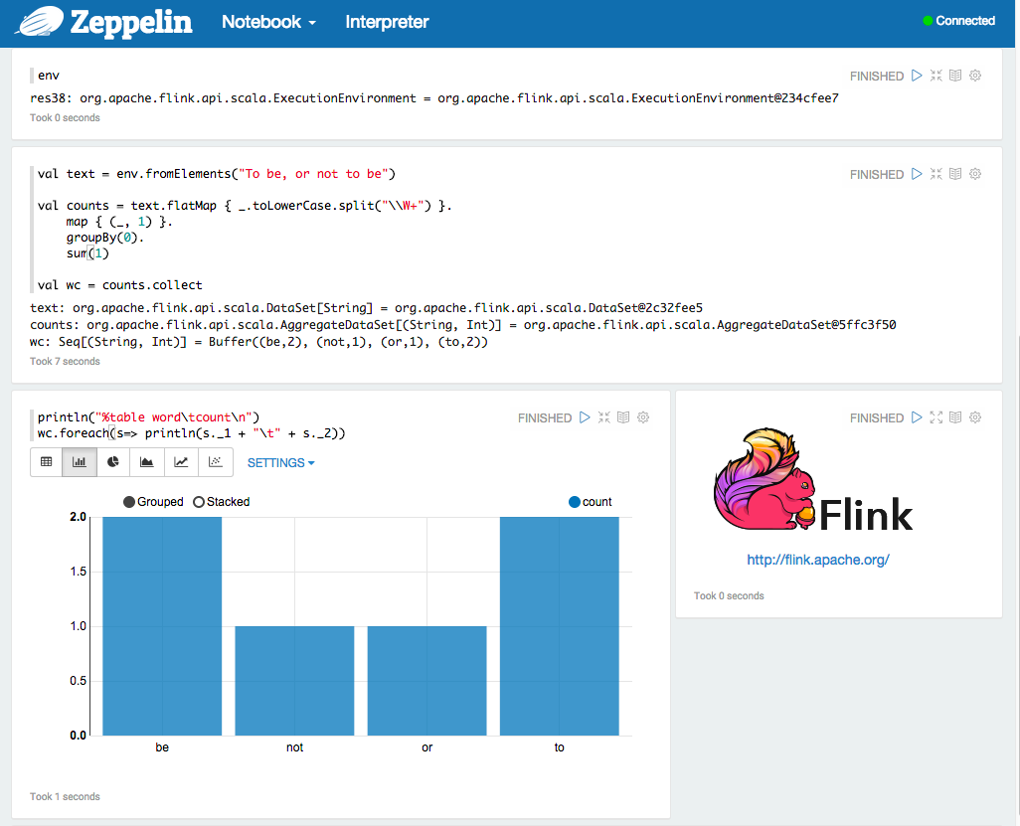
2.5 Apache Zeppelin Notebook

Slide 39
2.5 Apache Zeppelin Notebook
Web-based interactive computation environment
Combines rich text, execution code, plots and rich media
Exploratory data science
Storytelling

Slide 40
2.5 Apache Zeppelin Notebook
Resources:
  Step by Step tutorial for setting up Apache Zeppelin while pointing to a full blown cluster. Trevor Grant, November 3, 2015
  http://trevorgrant.org/2015/11/03/apache-casserole-a-delicious-big-data-recipe-for-the-whole-family/
  ‘Data Science Lifecycle with Apache Flink and Apache Zeppelin’. Moon Soo Lee, Flink Forward 2015, Berlin, Germany. October 12, 2015
  Slides: http://www.slideshare.net/FlinkForward/moon-soo-lee-data-science-lifecycle-with-apache-flink-and-apache-zeppelin
  Video recording: https://www.youtube.com/watch?v=icyOTyteMqs
Interactive Data Analysis with Apache Flink. Till Rohrmann, June 24, 2015
  http://www.slideshare.net/tillrohrmann/data-analysis-49806564

Slide 41
Agenda
How to setup and configure your Apache Flink environment?
How to use Apache Flink tools?
3. How to run the examples in the Apache Flink bundle?
4. How to set up your IDE (IntelliJ IDEA or Eclipse) for Apache Flink?
5. How to write your Apache Flink program in an IDE?

Slide 42
3. How to run the examples in the Apache Flink bundle?
    3.1.1 Where are the examples?
    3.1.2 Where are the related source codes?
    3.1.3 How to re-build these examples?
    3.1.4 How to run these examples?

Slide 43
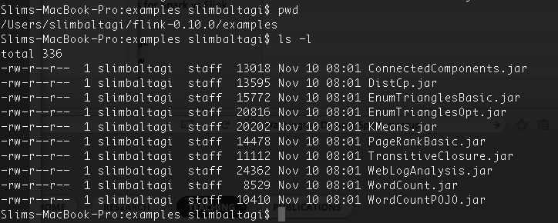
3.1 How to run the examples in the Apache Flink bundle?
    3.1.1 Where are the examples?

Slide 44
3.1 How to run the examples in the Apache Flink bundle?
The examples provided in the Flink bundle showcase different applications of Flink from simple word counting to graph algorithms.
They illustrate the use of Flink’s API.
They are a very good way to learn how to write Flink jobs.
A good starting point would be to modify them!
Now, where are the related source codes!?

Slide 45
3.1 How to run the examples in the Apache Flink bundle?
    3.1.2 Where are the related source codes?
    You can find the source code of these Flink examples in the flink-examples and the flink-streaming-examples modules of the source release of Flink. Example: https://www.apache.org/dist/flink/flink-0.10.0-src.tgz
    You can also access the source (and hence the examples) through GitHub:
    https://github.com/apache/flink/tree/master/flink-examples

Slide 46
3.1 How to run the examples in the Apache Flink bundle?
    3.1.2 Where are the related source codes?
    If you don't want to import the whole Flink project just for playing around with the examples, you can:
      Create an empty maven project. This script will automatically set everything up for you: $ curl http://flink.apache.org/q/quickstart.sh | bash
      Import the "quickstart" project into Eclipse or IntelliJ. It will download all dependencies and package everything correctly.
      If you want to use an example there, just copy the Java file into the "quickstart" project.

Slide 47
3.1 How to run the examples in the Apache Flink bundle?
3.1.3 How to re-build these examples?
To build the examples, you can run:
"mvn clean package -DskipTests”
in the "flink-examples/flink-java-examples" directory.
This will re-build them.

Slide 48
3.1 How to run the examples in the Apache Flink bundle?
    3.1.4 How to run these examples?
    How to display the command line arguments?
    ./bin/flink info ./examples/WordCount.jar
    Example of running an example: ./bin/flink run ./examples/KMeans.jar
    Source code: https://github.com/apache/flink/blob/master/flink-examples/flink-java-examples/src/main/java/org/apache/flink/examples/java/clustering/KMeans.java
    More on the bundled examples:
    https://ci.apache.org/projects/flink/flink-docs-master/apis/examples.html#running-an-example

Slide 49
Run K-Means example
1. Generate Input Data
Flink contains a data generator for K-Means that has the following arguments (arguments in [] are optional):
-points <num> -k <num clusters> [-output <output-path>] [-stddev <relative stddev>] [-range <centroid range>] [-seed <seed>]
Go to the Flink root installation:
$ cd flink-0.10.0
Create a new directory that will contains the data:
$ mkdir kmeans
$ cd kmeans

Slide 50
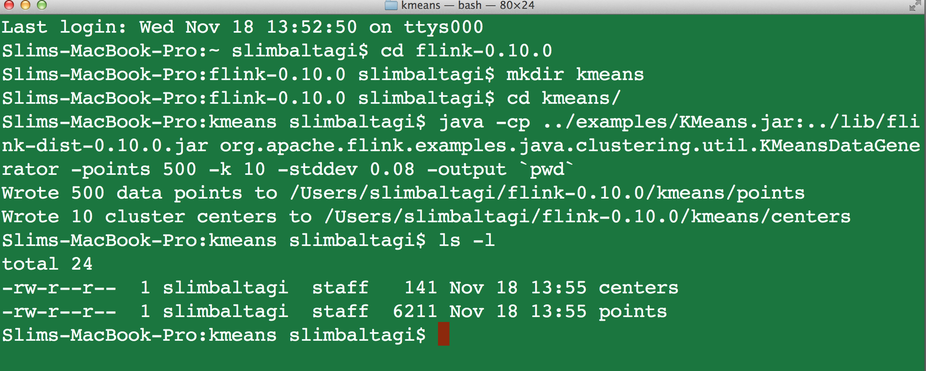
Run K-Means example
Create some data using Flink's tool:
java -cp ../examples/KMeans.jar:../lib/flink-dist-0.10.0.jar org.apache.flink.examples.java.clustering.util.KMeansDataGenerator -points 500 -k 10 -stddev 0.08 -output `pwd`
The directory should now contain the files "centers" and "points".

Slide 51
Run K-Means example
Continue following the instructions on Quick Start: Run K-Means Example as outlined here: https://ci.apache.org/projects/flink/flink-docs-release-0.10/quickstart/run_example_quickstart.html
Happy Flinking!

Slide 52
Agenda
How to setup and configure your Apache Flink environment?
How to use Apache Flink tools?
3. How to run the examples in the Apache Flink bundle?
4. How to set up your IDE (IntelliJ IDEA or Eclipse) for Apache Flink?
5. How to write your Apache Flink program in an IDE?

Slide 53
4. How to set up your IDE (IntelliJ IDEA or Eclipse) for Apache Flink?
  4.1 How to set up your IDE (IntelliJ IDEA)?
  4.2 How to setup your IDE (Eclipse)?
  Flink uses mixed Scala/Java projects, which pose a challenge to some IDEs
  Minimal requirements for an IDE are:
      Support for Java and Scala (also mixed projects)
      Support for Maven with Java and Scala

Slide 54
4.1 How to set up your IDE (IntelliJ IDEA)?
IntelliJ IDEA supports Maven out of the box and offers a plugin for Scala development.
IntelliJ IDEA Download https://www.jetbrains.com/idea/download/
IntelliJ Scala Plugin
  http://plugins.jetbrains.com/plugin/?id=1347
Check out Setting up IntelliJ IDEA guide for details
https://github.com/apache/flink/blob/master/docs/internals/ide_setup.md#intellij-idea
Screencast: Run Apache Flink WordCount from IntelliJ https://www.youtube.com/watch?v=JIV_rX-OIQM

Slide 55
4.2 How to setup your IDE (Eclipse)?
For Eclipse users, Apache Flink committers recommend using Scala IDE 3.0.3, based on Eclipse Kepler.
While this is a slightly older version, they found it to be the version that works most robustly for a complex project like Flink. One restriction is, though, that it works only with Java 7, not with Java 8.
Check out how to setup Eclipse docs: https://github.com/apache/flink/blob/master/docs/internals/ide_setup.md#eclipse

Slide 56
Agenda
How to setup and configure your Apache Flink environment?
How to use Apache Flink tools?
3. How to run the examples in the Apache Flink bundle?
4. How to set up your IDE (IntelliJ IDEA or Eclipse) for Apache Flink?
5. How to write your Apache Flink program in an IDE?

Slide 57
5. How to write your Apache Flink program in an IDE?
  5.1 How to write a Flink program in an IDE?
  5.2 How to generate a Flink project with Maven?
  5.3 How to import the Flink Maven project into IDE
  5.4 How to use logging?
  5.5 FAQs and best practices related to coding

Slide 58
5.1 How to write a Flink program in an IDE?
The easiest way to get a working setup to develop (and locally execute) Flink programs is to follow the Quick Start guide:
  https://ci.apache.org/projects/flink/flink-docs-master/quickstart/java_api_quickstart.html
  https://ci.apache.org/projects/flink/flink-docs-master/quickstart/scala_api_quickstart.html
It uses Maven archetype to configure and generate a Flink Maven project.
This will save you time dealing with transitive dependencies!
This Maven project can be imported into your IDE.

Slide 59
5.2. How to generate a skeleton Flink project with Maven?
Generate a skeleton flink-quickstart-java Maven project to get started with no need to manually download any .tgz or .jar files
      Option 1: $ curl http://flink.apache.org/q/quickstart.sh | bash
A sample quickstart Flink Job will be created:
    Switch into the directory using: cd quickstart
    Import the project there using your favorite IDE (Import it as a maven project)
    Build a jar inside the directory using: mvn clean package
    You will find the runnable jar in quickstart/target
Notes:
This is Slide 5 of http://www.slideshare.net/robertmetzger1/apache-flink-hands-on

Slide 60
5.2. How to generate a skeleton Flink project with Maven?
Option 2: Type the command below to create a flink-quickstart-java or flink-quickstart-scala project and specify Flink version
you can also put “quickstart-scala” here
mvn archetype:generate /
-DarchetypeGroupId=org.apache.flink /
-DarchetypeArtifactId=flink-quickstart-java /
-DarchetypeVersion=0.10.0
or “0.1.0-SNAPSHOT”
Notes:
This is Slide 5 of http://www.slideshare.net/robertmetzger1/apache-flink-hands-on

Slide 61
5.2. How to generate a skeleton Flink project with Maven?
The generated projects are located in a folder called flink-java-project or flink-scala-project.
In order to test the generated projects and to download all required dependencies run the following commands (change flink-java-project to flink-scala-project for Scala projects)
  cd flink-java-project
  mvn clean package
Maven will now start to download all required dependencies and build the Flink quickstart project.

Slide 62
5.3 How to import the Flink Maven project into IDE
The generated Maven project needs to be imported into your IDE:
IntelliJ:
    Select “File” -> “Import Project”
    Select root folder of your project
    Select “Import project from external model”, select “Maven”
    Leave default options and finish the import
Eclipse:
    Select “File” -> “Import” -> “Maven” -> “Existing Maven Project”
    Follow the import instructions
Notes:
We pass the filename and location of this file using the -Dlog4j.configuration= parameter to the JVM.

Slide 63
5.4 How to use logging?
The logging in Flink is implemented using the slf4j logging interface. log4j is used as underlying logging framework.
Log4j is controlled using property file usually called log4j.properties. You can pass to the JVM the filename and location of this file using the Dlog4j.configuration= parameter.
The loggers using slf4j are created by calling
  import org.slf4j.LoggerFactory
  import org.slf4j.Logger
  Logger LOG = LoggerFactory.getLogger(Foobar.class)
You can also use logback instead of log4j. https://ci.apache.org/projects/flink/flink-docs-release-0.9/internals/logging.html
Notes:
We pass the filename and location of this file using the -Dlog4j.configuration= parameter to the JVM.

Slide 64
5.5 FAQs & best practices related to coding
Errors http://flink.apache.org/faq.html#errors
Usage http://flink.apache.org/faq.html#usage
Flink APIs Best Practices
  https://ci.apache.org/projects/flink/flink-docs-master/apis/best_practices.html
Thanks!

