Slide 1
Mining Sensor Data to Evaluate Indoor Environmental Quality of Public Educational Buildings
Supervisor: Professor Ioannis Chatzigiannakis , Aris Anagnostopoulos
Zhu Na Zhu.1706409@studenti.uniroma1.it

Slide 2
Agenda
IoT platform in schools
Data availability
Thermal comfort
Conclusion

Slide 3
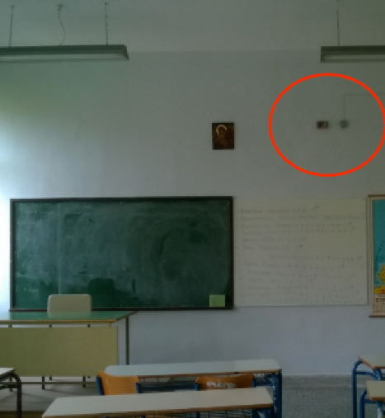
Internet of Things in Schools
The network of
Vehicles, Home appliances, smart devices…
To exchange data through Internet
Collect
Real-World Measurement
Deploy
IoT Infrastructure
Analysis
and
Evaluate
Propose Evidence-based Suggestions
Optimize Environment Quality

Slide 4
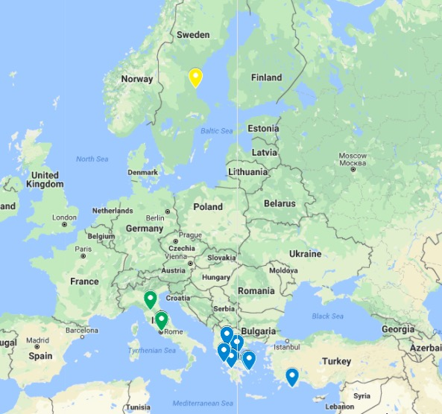
Platform Overview
12 schools in Greece
2 schools in Italy
1 school in Sweden
Over 900 teachers
Over 5500 students
From primary school to university

Slide 5
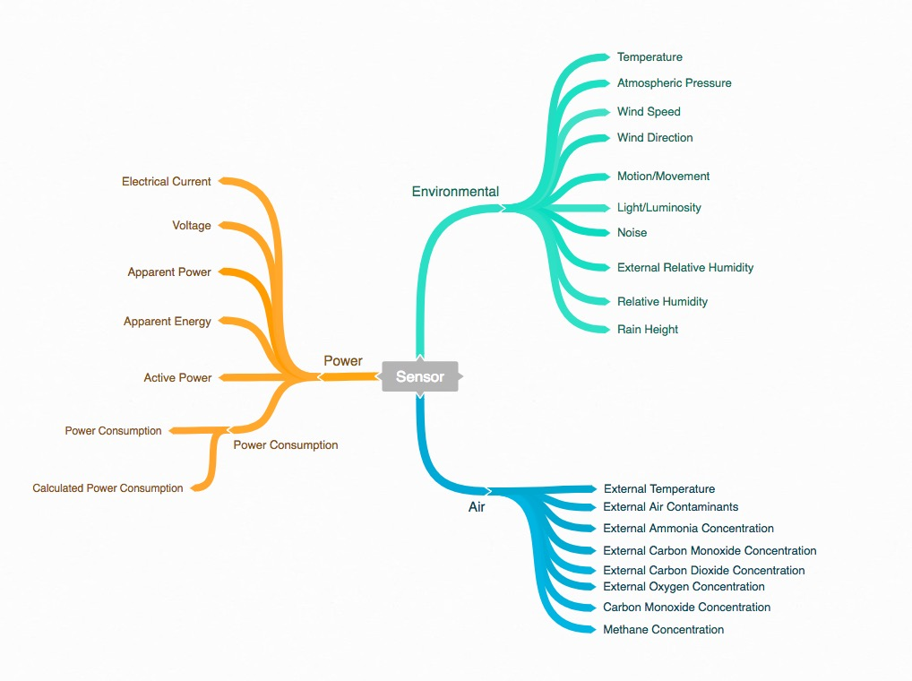
Sensor Deployment
Sensing Points: 725
Power consumption devices
Indoor environmental comfort devices
Outdoor weather stations devices
Atmosphere stations
Time coverage : over 2 years
Total Data Size: 14-15 Gigabytes

Slide 6
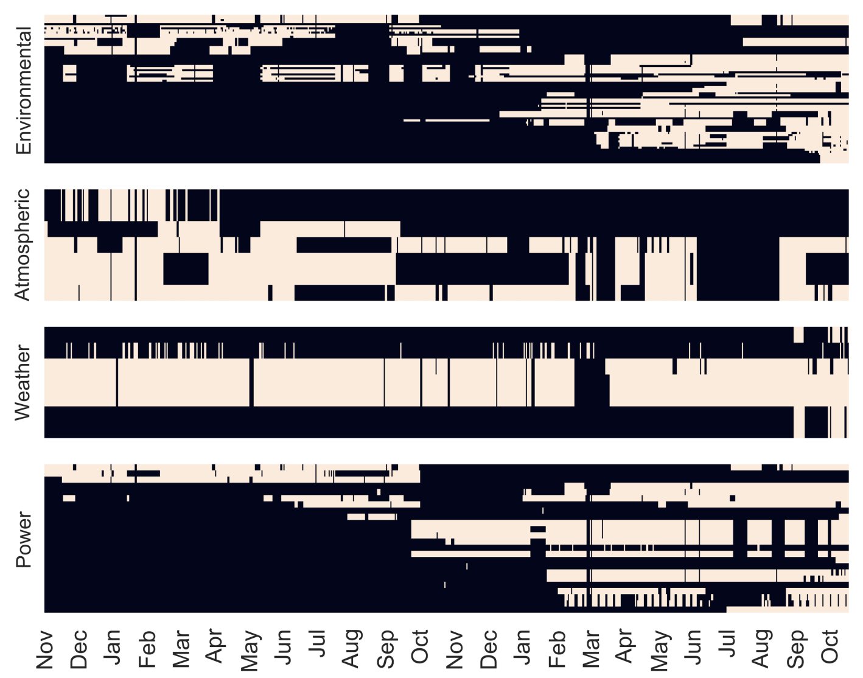
Availability - Missing Data
When processing data from the low-cost IoT devices, first problem is missing data
Check the data by categorizing types for the devices, we can see: different types show different stability for uploading the data into the platform
Missing data is caused by :
Power-off
Devices are broken
Connections are broken
Installed in the wrong place

Slide 7
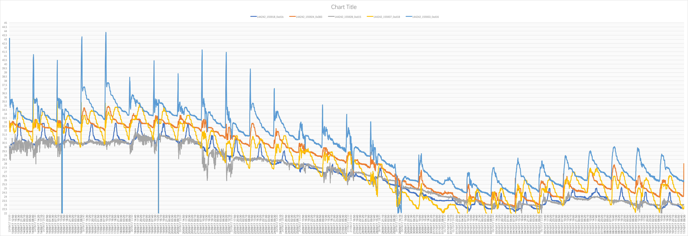
Availability - Outliers
The identification of outliers is based on the interquartile range (IQR)
Using the upper and lower quartiles Q3 (75th percentile) and Q1 (25th percentile).
The lower boundary = Q1-3×IQR The upper boundary = Q3+3×IQR Where IQR=Q3-Q1
If a value is outside the boundaries [Q1-3×IQR, Q3+3×IQR] it is flagged as an outlier.
Notes:
Second thing we notice is sensor keep producing crazy data which doesn't make sense

Slide 8
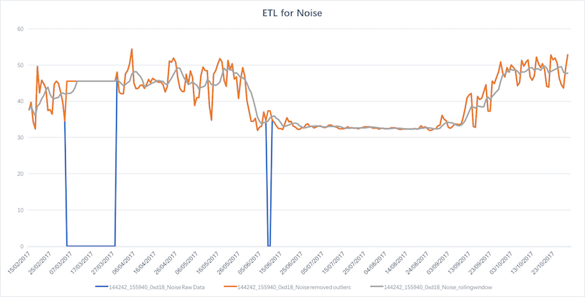
Availability - Moving Windows Average
Fill-in those values using a simple local algorithm that introduces historic values for the specific time period.
Smooth out short-term fluctuations
Notes:
-> Remove Outliers or missing data
-> Fill back the recent historic values

Slide 9
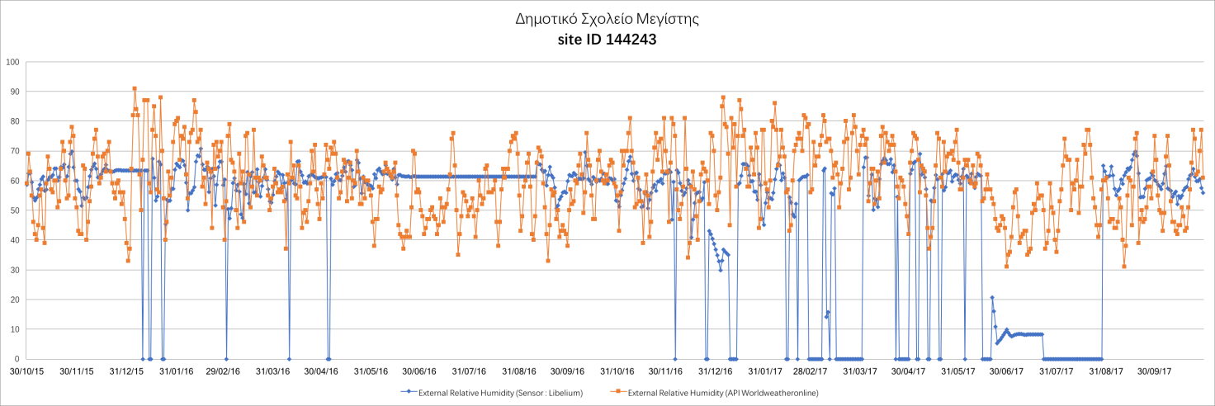
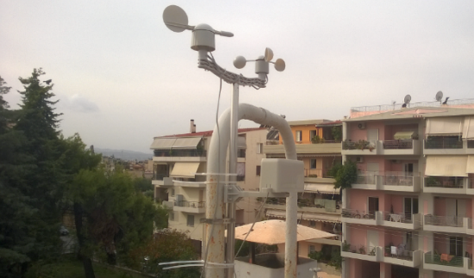
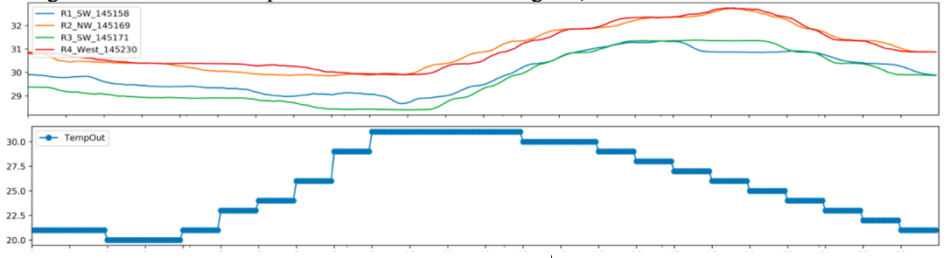
Data Retrieved From Internet
• For historical weather data: worldweatheronline.com
• For real-time weather data: openweathermap.org
Notes:
11. External data sources
-> Weather map
-> Discussion on sampling rate

Slide 10
Thermal Comfort
Comfortable environment improves academic result
Balance of heat exchange
Condition of mindset is not easy to evaluate

Slide 11
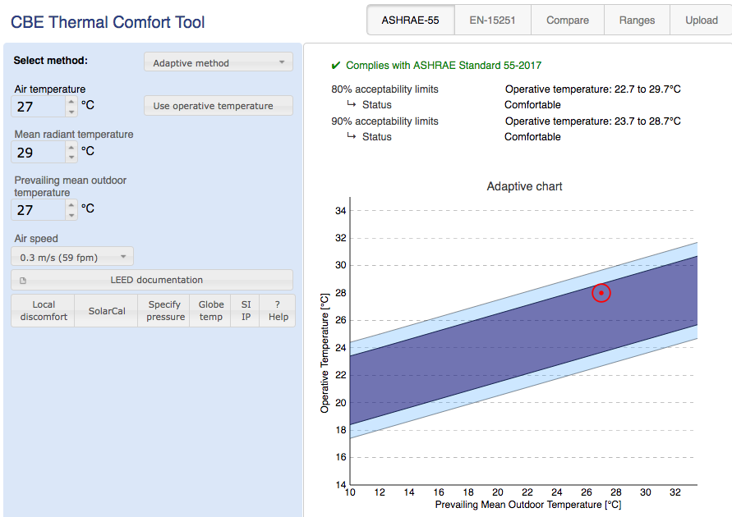
Comfort Tool From Berkeley
ANSI/ASHRAE Standard 55: a standard to evaluate the thermal indoor environments comfort
Air speed
Metabolic rate of a human
Clothing level to protect the human body from heat or cold
Humidity of the air
Means radiant temperature (a radiant transfer between human body and the environment)
Air temperature
Notes:
Short the comfort part

Slide 12
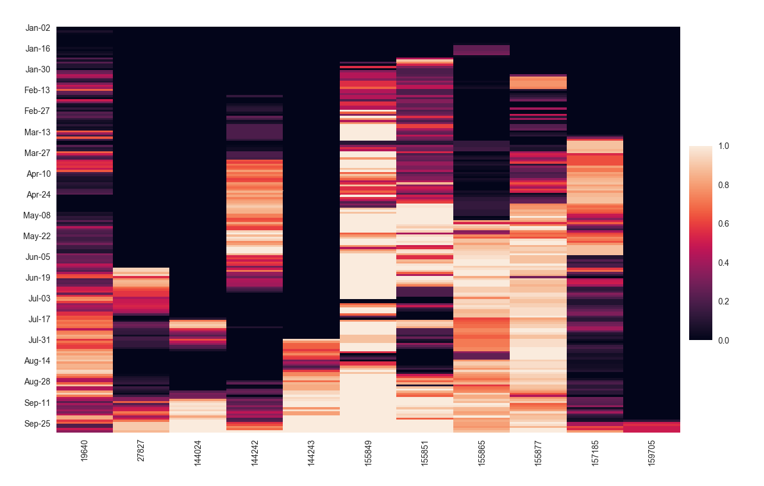
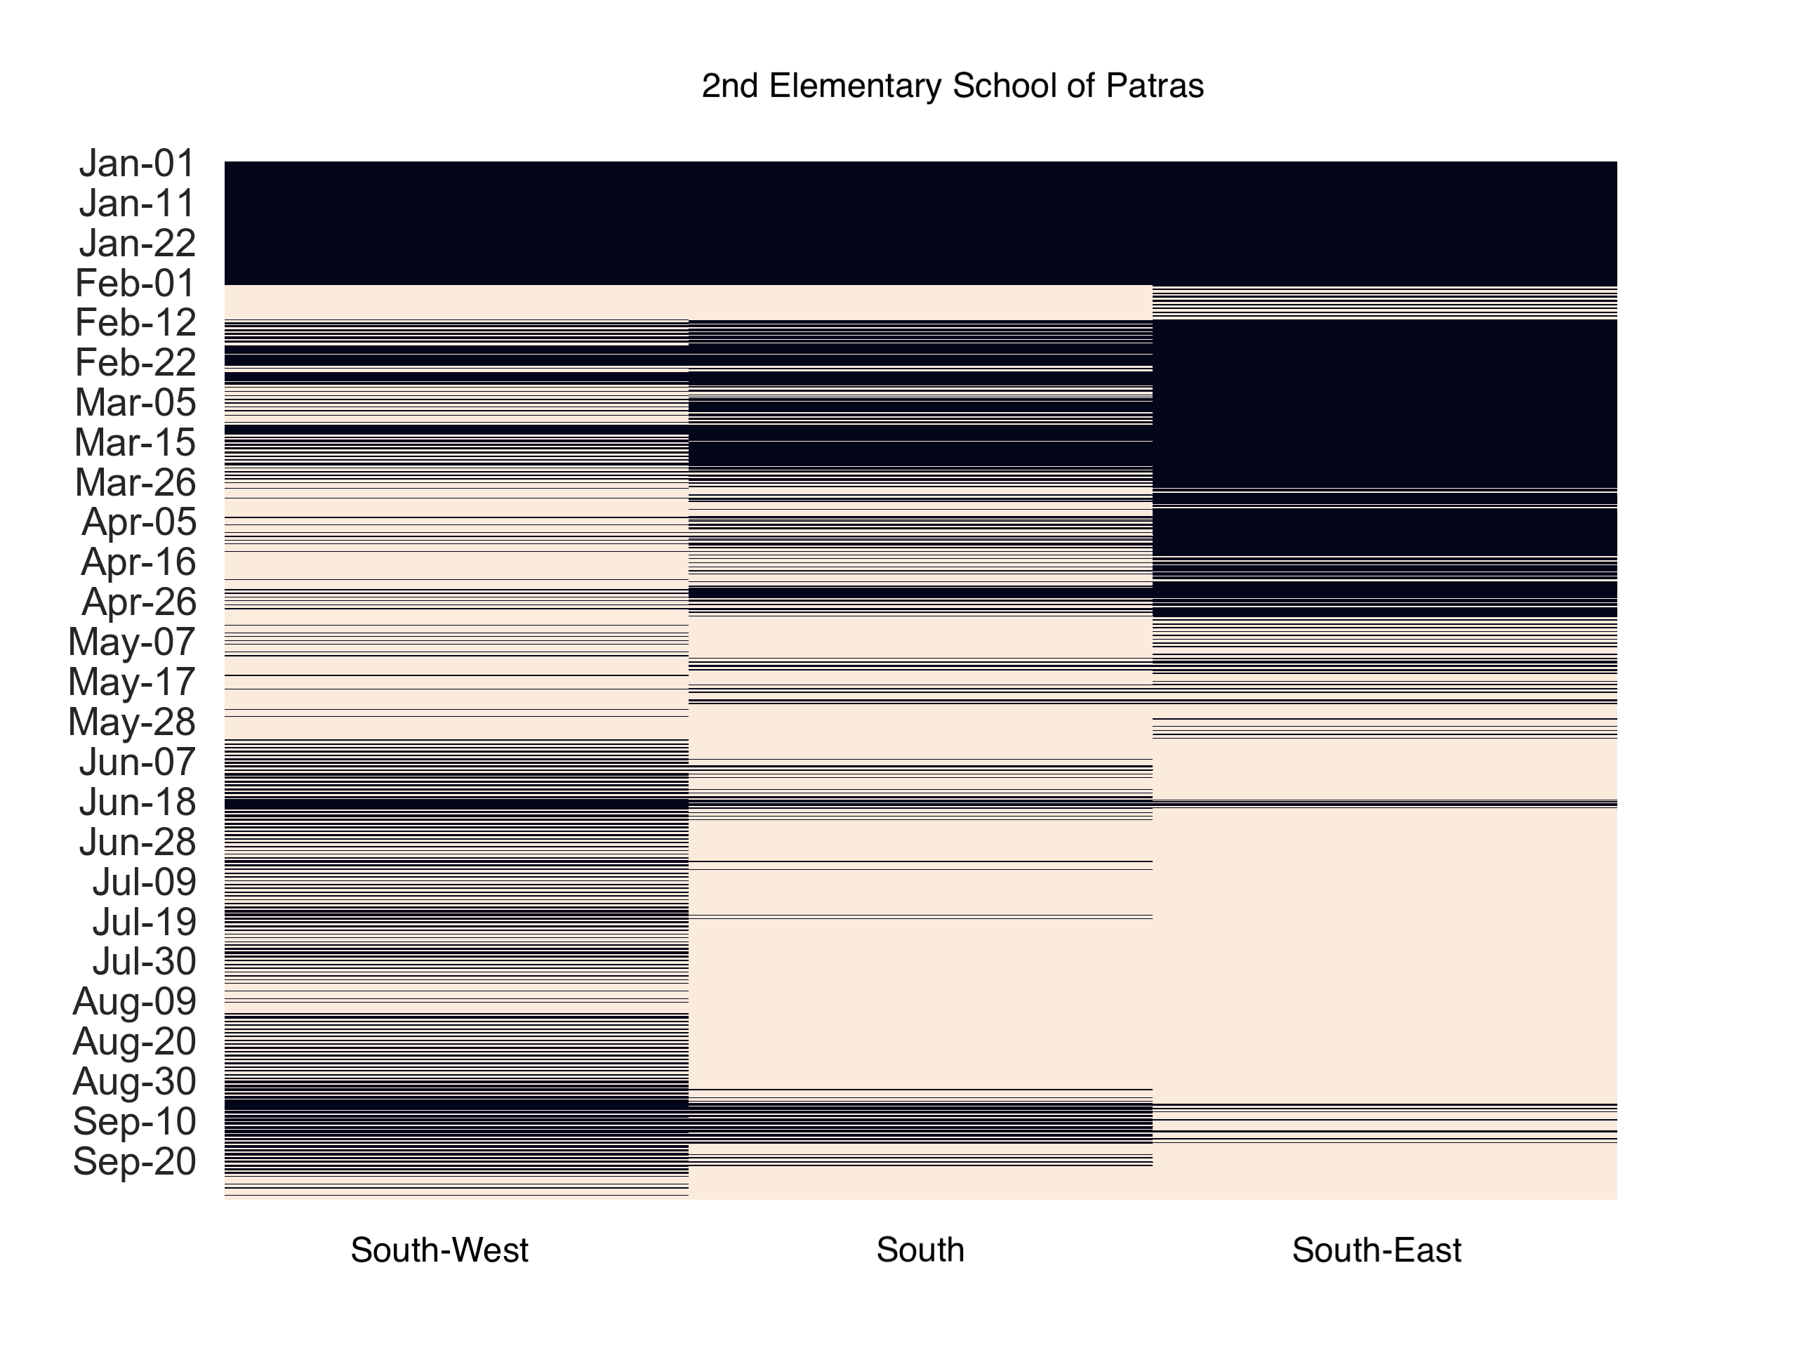
Thermal Comfort Evaluation
Average comfort on all the rooms for each school
Jan 1st – Sep 30th 2017
Monday-Friday
8:00-16:00
Notes:
Overview for average of comfort in twelve schools
155877 direct sunlight exposed time

Slide 13
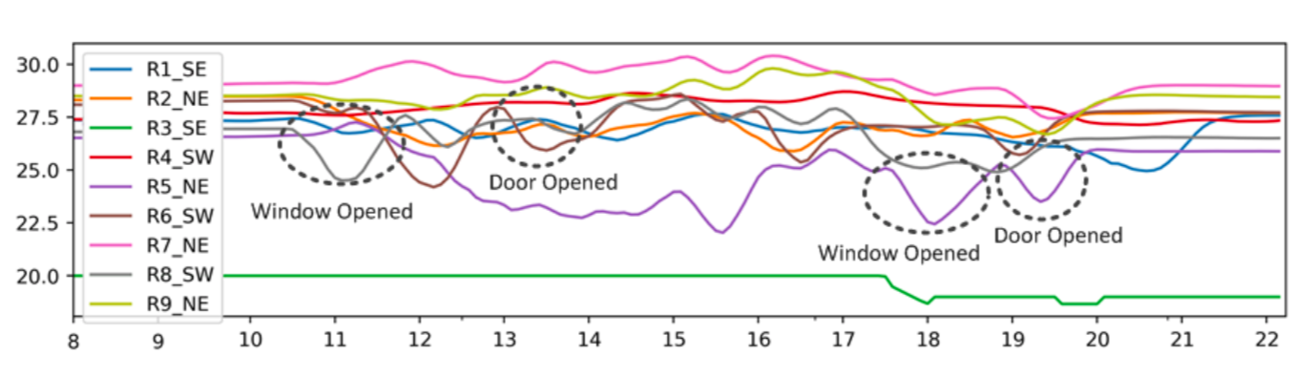
Comfort With Human Intervention
When there is a window open or a door opened the temperature decrease immediately
With fresh air circulating , the room could easily be adjusted into comfort condition
Notes:
we could use this simple activity to bring the room back to the comfort zone

Slide 14
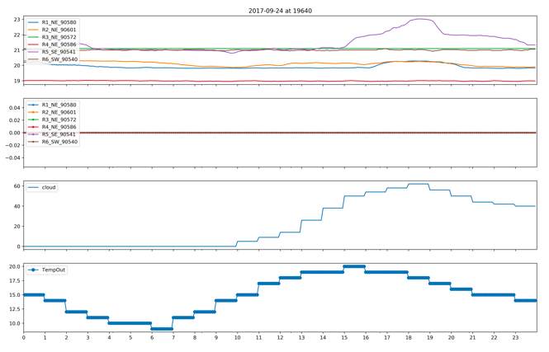
Comfort Without Human Intervention
Indoor temperature change (pic 1)
No human activity(pic 2)
Sunny during the day and cloudy at night(pic 3)
Little bit cold in the early morning but comfort temperature in the afternoon(pic 4)
Notes:
purple room increase two degrees while the rest are barely change during the whole day

Slide 15
Conclusion
Collected data for evidence-based insights
Implemented the binary classifier to evaluate the comfort
Identified similarities among the best performance classrooms
Identified the impact on the comfort of the classrooms
Revealed how to adjust the conditions within poorly performance classrooms
Possible future steps are to focus on the indoor air quality, visual comfort, acoustic comfort to provide a better environment status in school buildings.

Slide 16
Publications
IEEE International Conference on Communications (ICC) 2018 Symposium on Communications QoS, Reliability, and Modeling
"A Fog Computing-oriented, highly scalable IoT framework for Monitoring Public Educational Buildings”
IEEE International Conference on Pervasive Computing and Communications (PERCOM) 2018
Workshop on Pervasive Sensing for Sustainable Smart Cities and Smart Buildings
"On Mining IoT Data for Evaluating the Operation of Public Educational Buildings"

Slide 17
Thank you

