Slide 1

Fairweather pedestrians of the Big Apple.
Is there a link between weather for hire car usage in New York
Group 5: Pablo Crespo, Victoria Wise, Trushil Patel, Steve Moss

Slide 2
Raw Data Source: Uber and non-Uber vehicle rides in New York City •Dataset from Uber Pickups in New York City by FiveThirtyEight (https://www.kaggle.com/fivethirtyeight/uber-pickups-in-new-york-city) •Uber rides: 4 files of raw data on pickups from Uber, separated by month, with detailed location information. •Non-Uber vehicle rides: 8 files of raw data on pickups from non-Uber for-hire vehicle (FHV) companies. The trip information varies by company, but can include day of trip, time of trip, pickup location, driver's for-hire license number, and vehicle's for-hire license number.Historical Weather API •Dataset from Weather API and Data for Businesses and Developers (https://www.worldweatheronline.com/developer/) •Time frame requested from the Historical Weather API is between 1st July 2014 – 30th Sep 2014 •We have kept below data from the Historical Weather API for our project:
Date
Average, Max, and Min temperature in Celsius
UV index
Precipitation by millimetre
Weather description
Cloud cover
Humidity

Slide 3
Key stats
Max, min, median of
Daily max temp
Daily Rainfall
Daily humidity
Daily cloud cover
Daily UV Index
Number of non-Uber FHV rides in time period
Number of Uber rides in time period

Slide 4
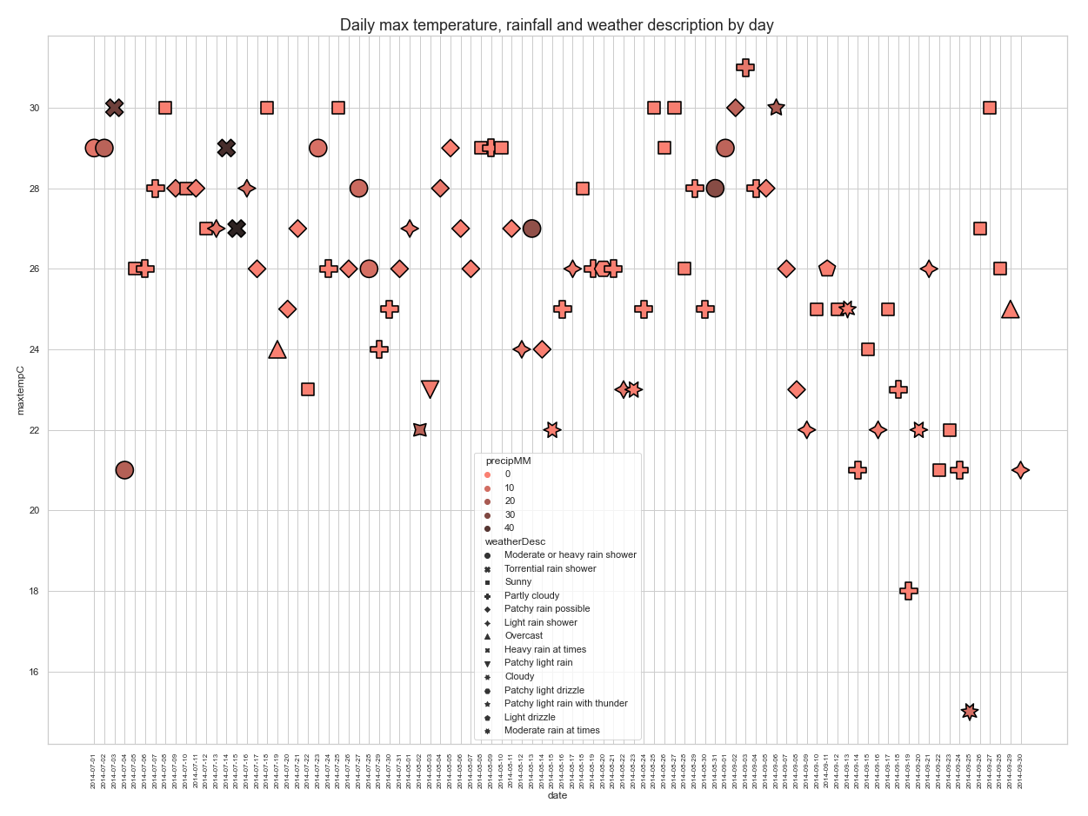
Plot of the weather data for New York between 1 July 2014 and 30 September 2014
Max temperature is shown on the y-axis
The symbols are colour coded by maximum rainfall in mm (precipMM) and the symbolised using the weather description for that day

Slide 5
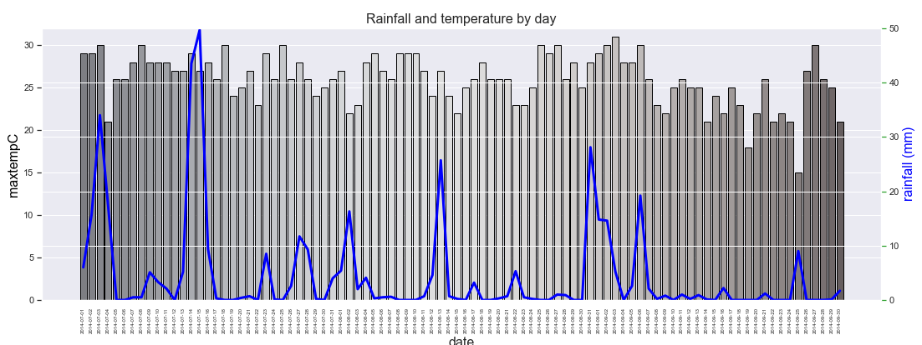
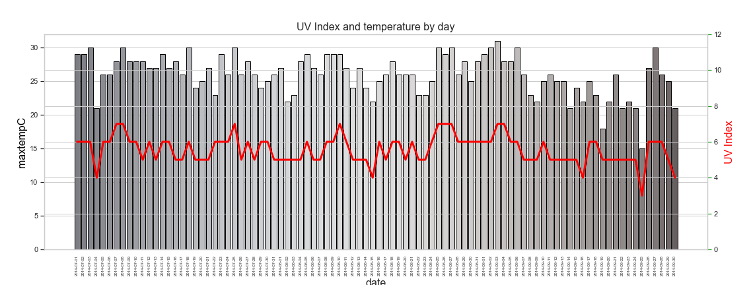
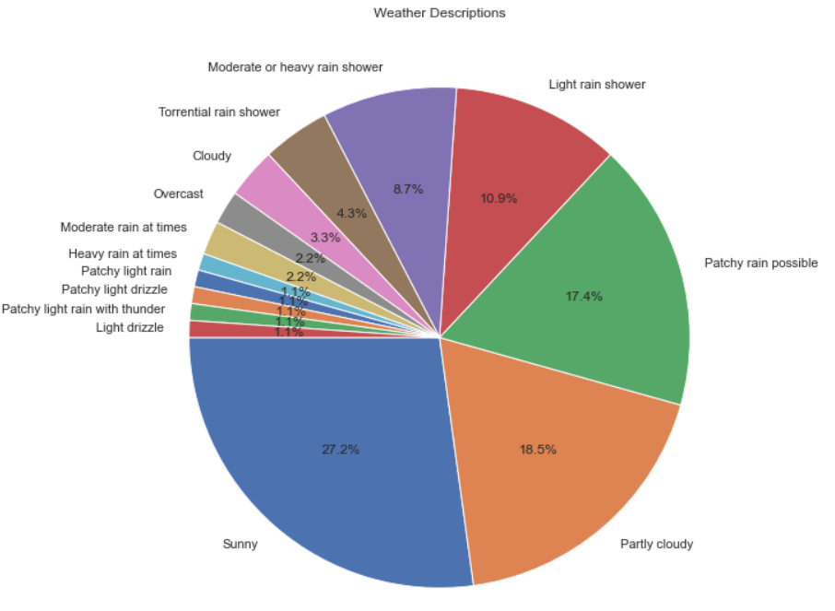
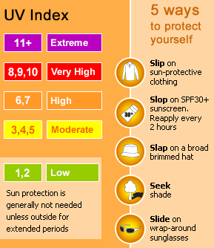
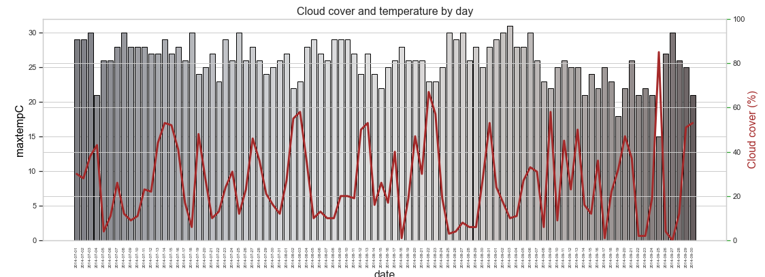
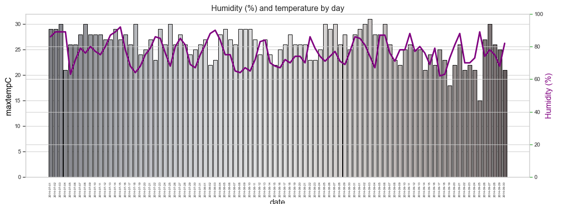
Details of the weather in New York between 1 July and 30 September 2014
Plot of max temperature vs rainfall
Shows ….
Plot of…..
Shows ….
Plot of…..
Shows ….
Plot of…..
Shows 53.2% of days had no rain
Plot of…..
Shows ….
Plot of…..
Shows ….
Notes:
This slide is to discuss the weather in new York over the period of interest

Slide 6
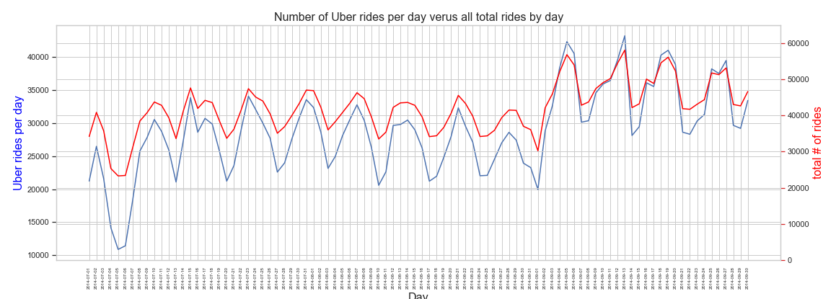

Slide 7
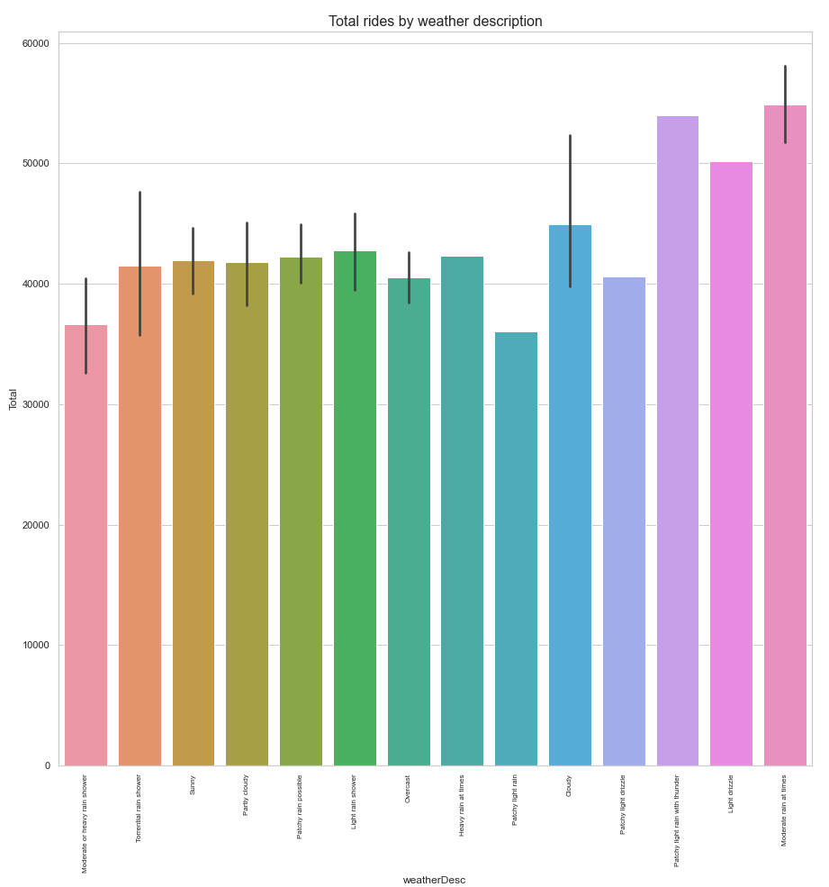
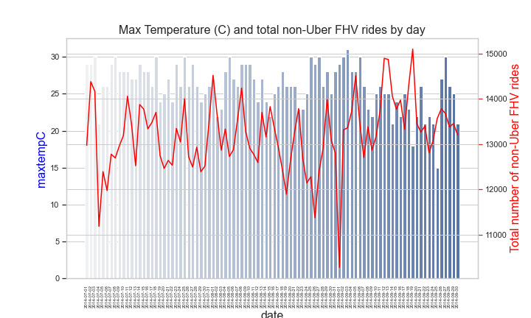
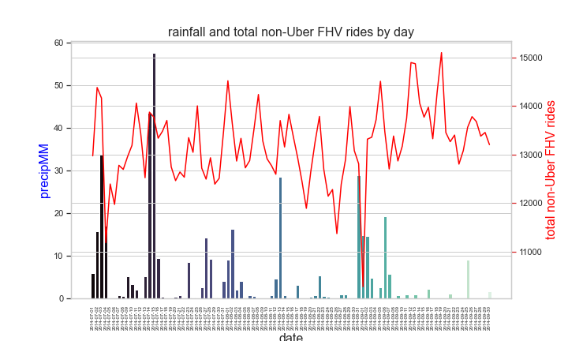
Plot of…..
Shows ….
Plot of…..
Shows ….
Plot of…..
Shows ….
Plot of…..
Shows ….
Plot of…..
Shows ….

Slide 8
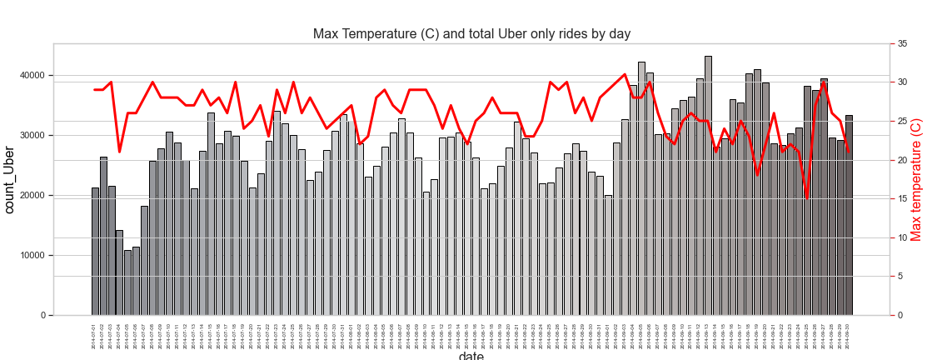
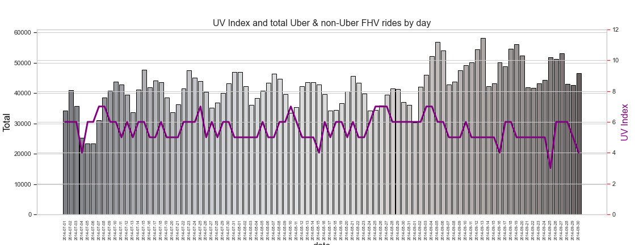
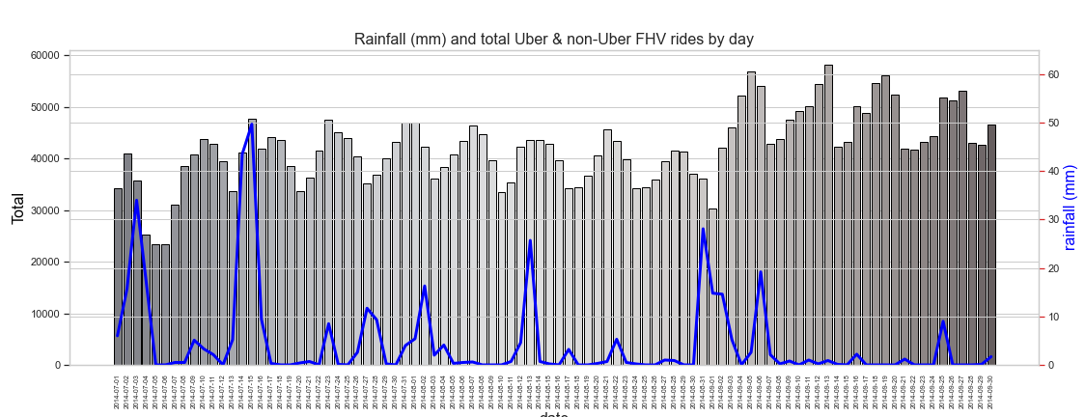
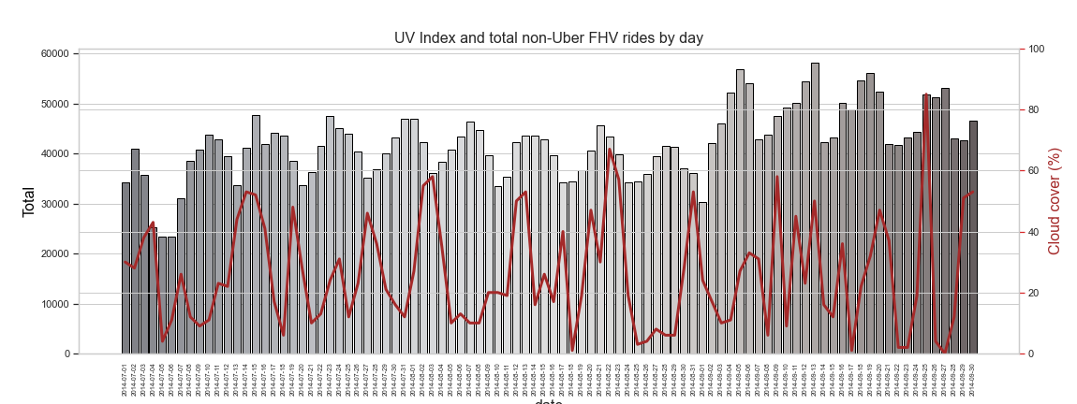
Details of the Uber and non-Uber FHV rides per day and weather in New York between 1 July and 30 September 2014
Plot of…..
Shows ….
Plot of…..
Shows ….
Plot of…..
Shows ….
Plot of…..
Shows ….
Plot of…..
Shows ….

Slide 9
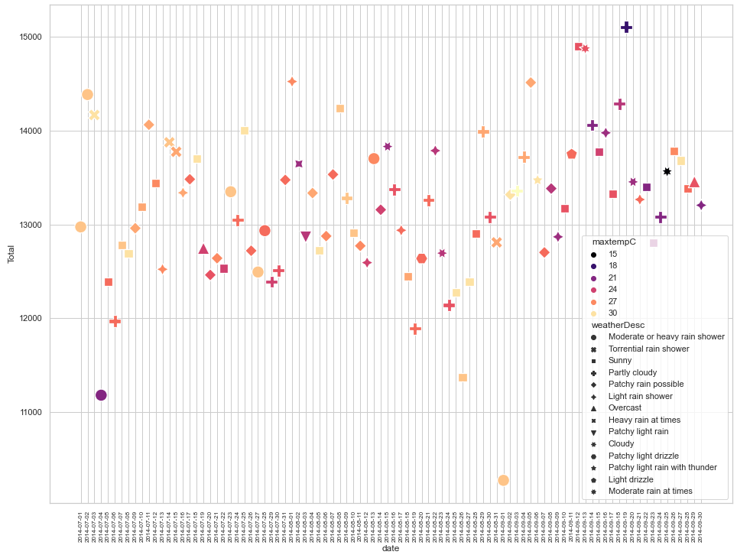
Total non-Uber FHV rides per day and weather in New York between 1 July and 30 September 2014
Plot of total rides by non-Uber FHV services between 1 July 2014 and 30 September 2014
The symbols are colour coded by maximum temperature (C) and the symbolised using the weather description for that day

Slide 10
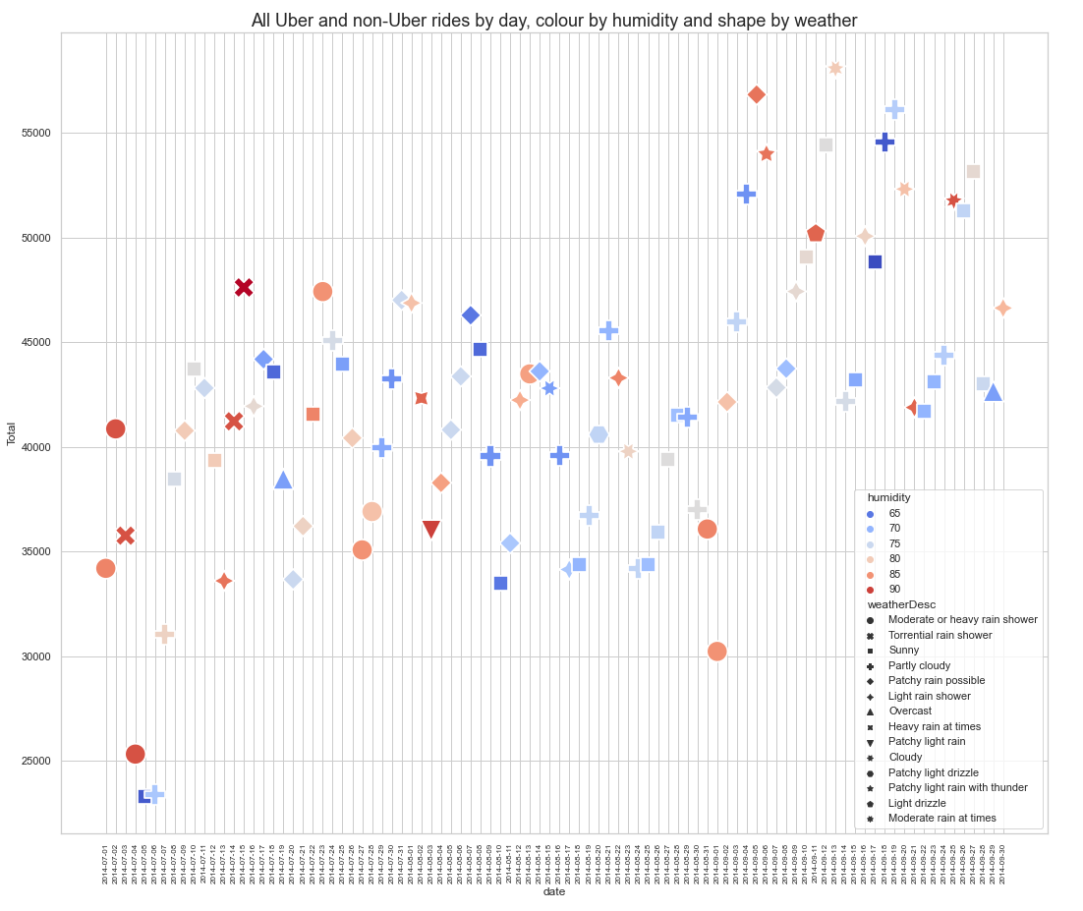
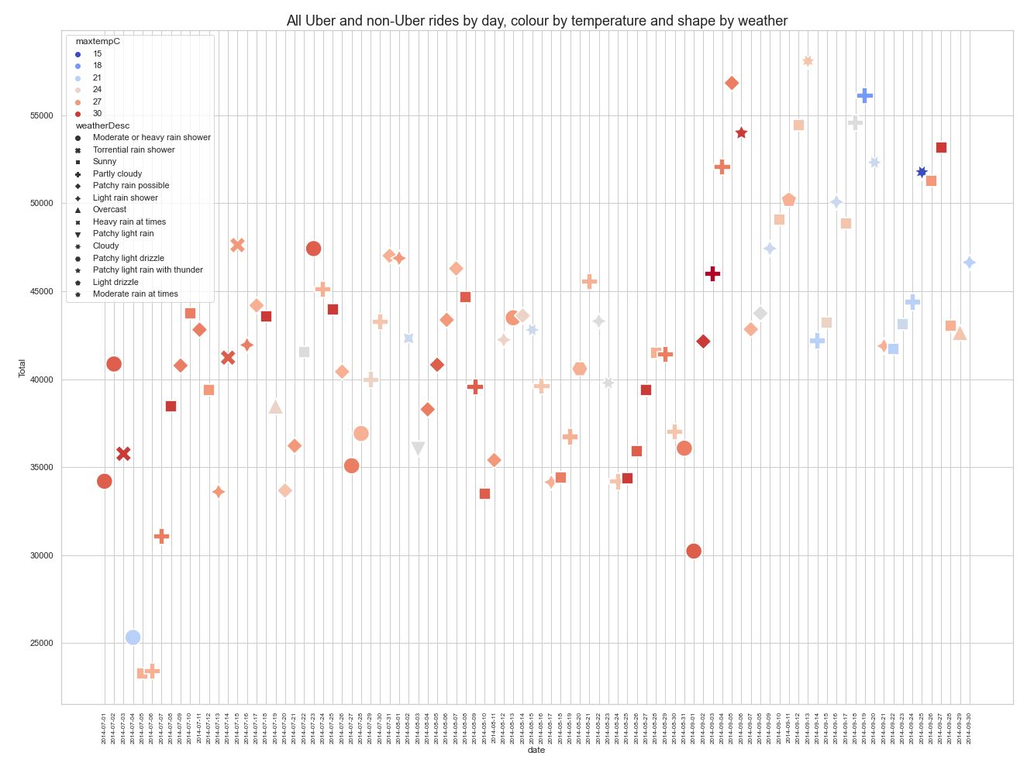
What happens after the 4th September 2014?
What happens after the 4th September 2014?

Slide 11
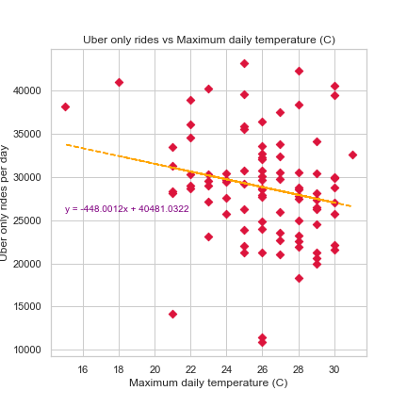
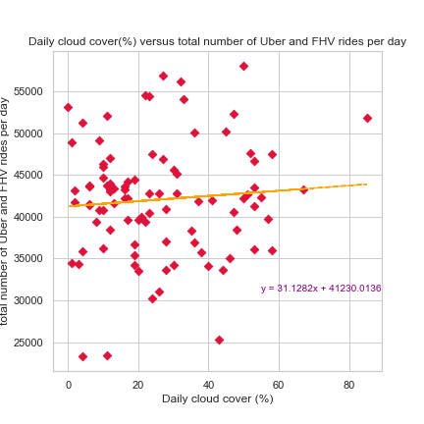
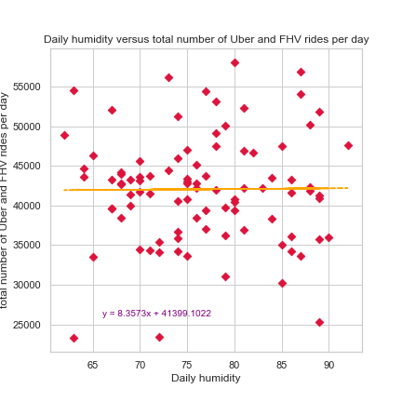
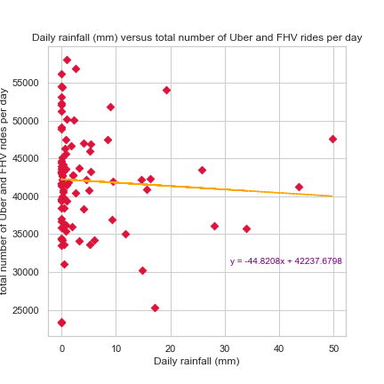

Slide 12
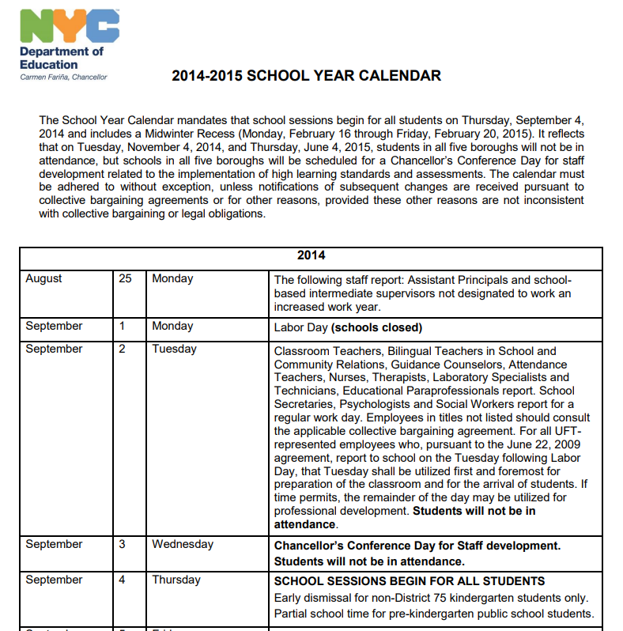
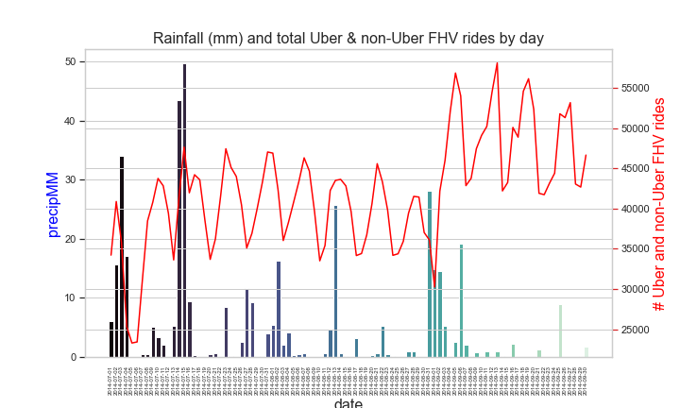
School’s out……no more
Just maybe not the weather but school’s back
xxxxx

Slide 13
Conclusions (just suggestions what do you think?)
No correlation between Uber/non-UberFHV rides and weather in time period
Long enough time period
Increase in Uber rides in early September, roughly around 4 September 2014, start of 2014-2015 school term in NY

