Slide 1

Quick tour on the P2Pvalue website
Deliverable 5.1 (section 1)
www.p2pvalue.eu

Slide 2
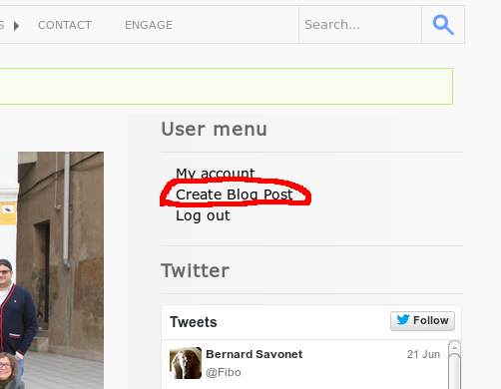
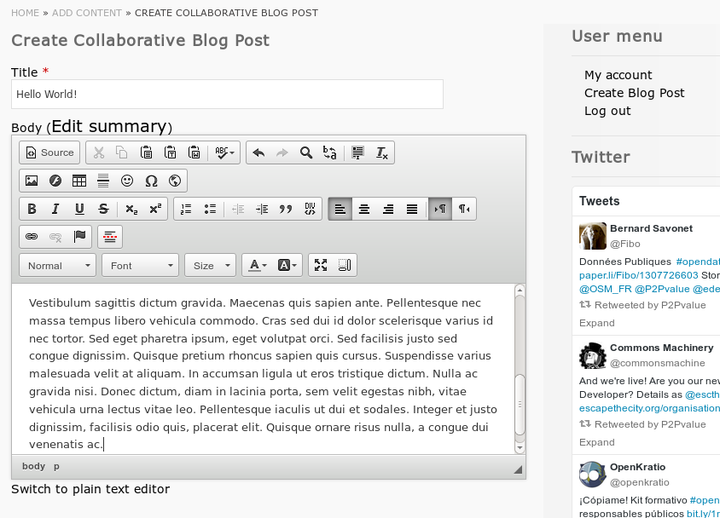
Sections (by entity type)
Blog Posts
They can be created by any “consortium member”
They appear automatically in the Blog section
“Wiki-like”: anybody can edit any blog post and
a new revision is automatically created
To edit an existent blog post, visit it and click “edit”
Login at http://www.p2pvalue.eu/user
www.p2pvalue.eu

Slide 3
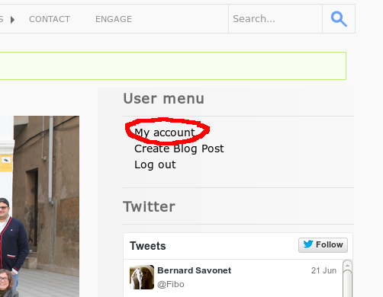
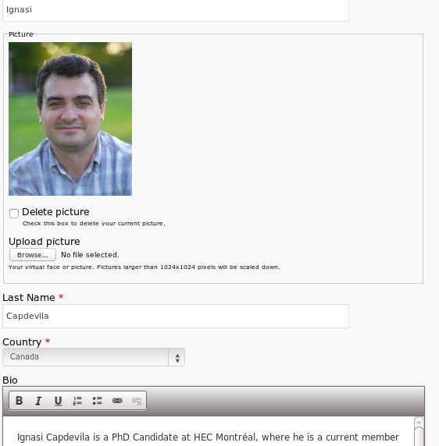
Sections (by content type)
User Profiles
They can be updated directly by the
“consortium members”
They appear automatically
in the People section
www.p2pvalue.eu

Slide 4
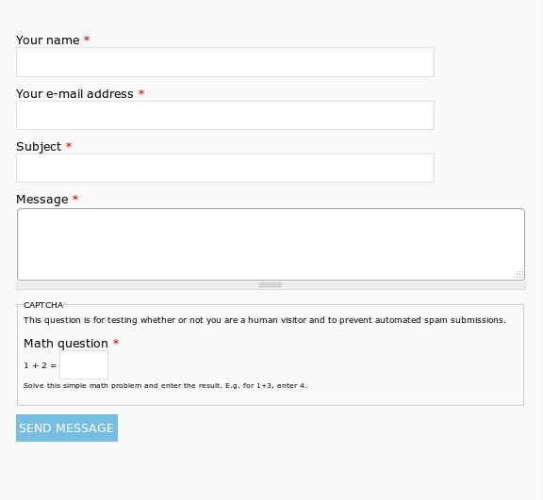
Sections (by entity type)
Rest of sections
Most of them implemented as static pages
(Project, Workplan, Consortium, ...)
Some other functionalities implemented with
specific modules (e.g.: Search, Contact Form, etc.)
Editable/configurable only by administrators
Let me (or any other admin) know if you want to get
administration permissions: drozas@surrey.ac.uk
www.p2pvalue.eu

Slide 5
Accounts and permissions (Drupal roles)
Rest of sections
A total of 35 user accounts
The following users have administration permissions:
    UAB: jsalcedo, mfuster, rmartinez
    P2PF: chris, kflanagan
    UCM: jarroyo
    UniS: ngilbert, lyang, drozas
www.p2pvalue.eu

Slide 6
Some useful links
  Deliverable 5.1:
  http://www.p2pvalue.eu/sites/default/files/u3/P2Pvalue_D5.1_Project_Platform_Node.pdf
  Dissemination and communication resources:
  https://docs.google.com/document/d/1E9lyl2XUiCVkd-X_Q-rcuferLgxWJuqPcdRoIODttlY/edit
  How-to update your profile:
  https://docs.google.com/document/d/1PoDio-fO2zN0x8CbjP5hg1HHtnJf_KJDpSd7v47W8sE/edit
  Code:
    Github: https://github.com/P2Pvalue/p2pvalue-website-code
    Gitorius: https://gitorious.org/test_drozas/
    (@to-do: bug rel. “transfer ownership” reported)
www.p2pvalue.eu

