Slide 1


Token
Kidnapping's
Revenge
Cesar Cerrudo
Argeniss

Slide 2
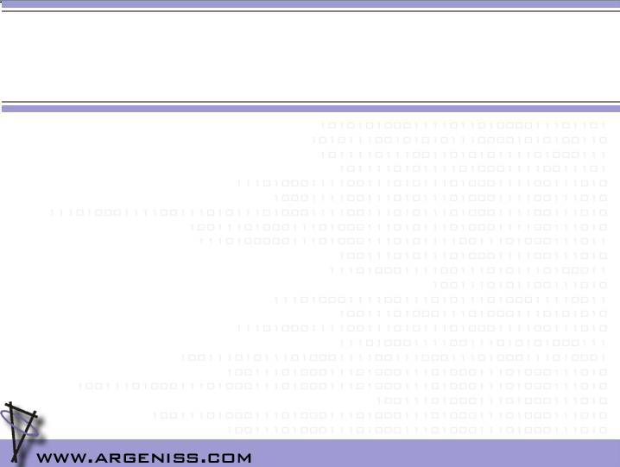
Who am I?
Argeniss Founder and CEO
I have been working on security for 8 years
I have found and helped to fix hundreds of vulnerabilities in software such as MS Windows, MS SQL Server, Oracle Database Server, IBM DB2, and many more...
+50 vulnerabilities found on MS products (+20 on Windows operating systems)
I have researched and created novel attacks and exploitation techniques

Slide 3
Agenda
Introduction
What is impersonation and what are tokens?
Windows XP and 2003 services security
Windows 7, Vista and 2008 services security
Token Kidnapping's revenge time
Conclusions

Slide 4
Introduction
In the past all Windows services ran as Local SYSTEM account
  Compromise of a service==full system compromise
Then MS introduced NETWORK SERVICE and LOCAL SERVICE accounts
  Compromise of a service!=full system compromise
Windows Vista, Windows 2008 and Windows 7 introduced new protections
First Token Kidnapping issues were fixed, but as we are going to see Windows is still not perfect...

Slide 5
What is impersonation and what are tokens?
Impersonation is the ability of a thread to execute using different security information than the process that owns the thread
  ACL checks are done against the impersonated users
  Impersonation APIs: ImpersonateNamedPipeClient(), ImpersonateLoggedOnUser(), RpcImpersonateClient()
  Impersonation can only be done by processes with “Impersonate a client after authentication” (SeImpersonatePrivilege)
  When a thread impersonates it has an associated impersonation token
Notes:
Impersonate a client after authentication user right was first introduced in Windows 2000 SP4, Windows XP SP2 and Windows 2003

Slide 6
What is impersonation and what are tokens?
Access token is a Windows object that describes the security context of a process or thread
  It includes the identity and privileges of the user account associated with the process or thread
  They can be Primary or Impersonation tokens
    Primary are those that are assigned to processes
    Impersonation are those that can be get when impersonation occurs
      Four impersonation levels: SecurityAnonymous, SecurityIdentity, SecurityImpersonation, SecurityDelegation
Notes:
Impersonate a client after authentication user right was first introduced in Windows 2000 SP4, Windows XP SP2 and Windows 2003

Slide 7
Windows XP and 2003 services security
Services run under Network Service, Local Service, Local System and user accounts
  All services can impersonate
Fixed weaknesses
  A process running under X account could access processes running under the same account
After fixes
  RPCSS and a few services that impersonate SYSTEM account are now properly protected
  WMI processes are protected now

Slide 8
Windows Vista, 2008 and 7 services security
Per service SID (new protection)
  Nice feature, now service processes are really protected and its resources can be armoured
Fixed weaknesses in Windows Vista and 2008
  While regular threads were properly protected, threads from thread pools were not
  WMI processes running under LOCAL SERVICE and NETWORK SERVICE were not protected
After fixes
  Threads from thread pools are properly protected
  WMI processes are protected now

Slide 9
Token Kidnapping's revenge time
First I found that Tapi service had process handles with duplicate handle permissions
Then I started to examine the Tapi service
  Found weak registry permissions
    HKLM\SOFTWARE\Microsoft\Tracing
    HKLM\SOFTWARE\Microsoft\Windows\CurrentVersion\Telephony
  Found lineAddProvider() API, Network Service and Local Service accounts can load arbitrary dlls
    Tapi service runs as System in Windows 2003
  Found that Tracing functionality is used by most services, including services running as System

Slide 10
Token Kidnapping's revenge time
Previous findings lead to other interesting findings in Windows 2003
  When WMI is invoked, DCOMLaunch service reads Network and Local Service users registry keys
    If values are found then HKCR keys are not used
    Allows WMI process protection bypass
Finally I could elevate privileges in all Windows versions and bypass protections

Slide 11
Token Kidnapping's revenge time
Windows 2003 IIS 6 exploits
  Bypass WMI protection
  Load arbitrary Dll
Windows 2008 and Windows 7 IIS 7 exploits
  Exploit weak registry permissions

Slide 12
Recomendations
Windows XP and Windows 2003
  On IIS 6 don't run ASP .NET in full trust and don't run web apps under Network or Local Service accounts.
On Windows 7, Vista and 2008
  On IIS 7 don't run ASP .NET in full trust and don't run web sites under Network Service or Local Service accounts
  Don't run services under Network Service or Local Service accounts
    Use regular user accounts to run services

Slide 13
Conclusions
On Windows XP and Windows 2003
  If a user can execute code under Network Service or Local Service account
    User can execute code as SYSTEM
On Windows 7, Vista and 2008
  If a user can impersonate
    User can execute code as SYSTEM
  New services protections are almost useless

Slide 14
References
Token Kidnapping
http://www.argeniss.com/research/TokenKidnapping.pdf
Impersonate a client after authentication
http://support.microsoft.com/kb/821546
Access tokens
http://msdn2.microsoft.com/en-us/library/aa374909.aspx
Process Explorer and Process Monitor
http://www.sysinternals.com
Api Impersonation Functions
http://msdn.microsoft.com/en-us/library/cc246062(PROT.10).aspx

Slide 15
Fin
Questions?
Thanks
Contact: cesar>at<argeniss>dot<com
Argeniss – Information Security
WE BREAK ANYTHING
www.argeniss.com

