Slide 1
Pumping below K-edge with radiation resonant to K-α transition:
Saturable absorption – measurements done by Ichiro
  26.01.2024-29.01.2024
  07.2024
Modeling the RSA
  XLO code for absorption
  XATOM for occupations

Slide 2
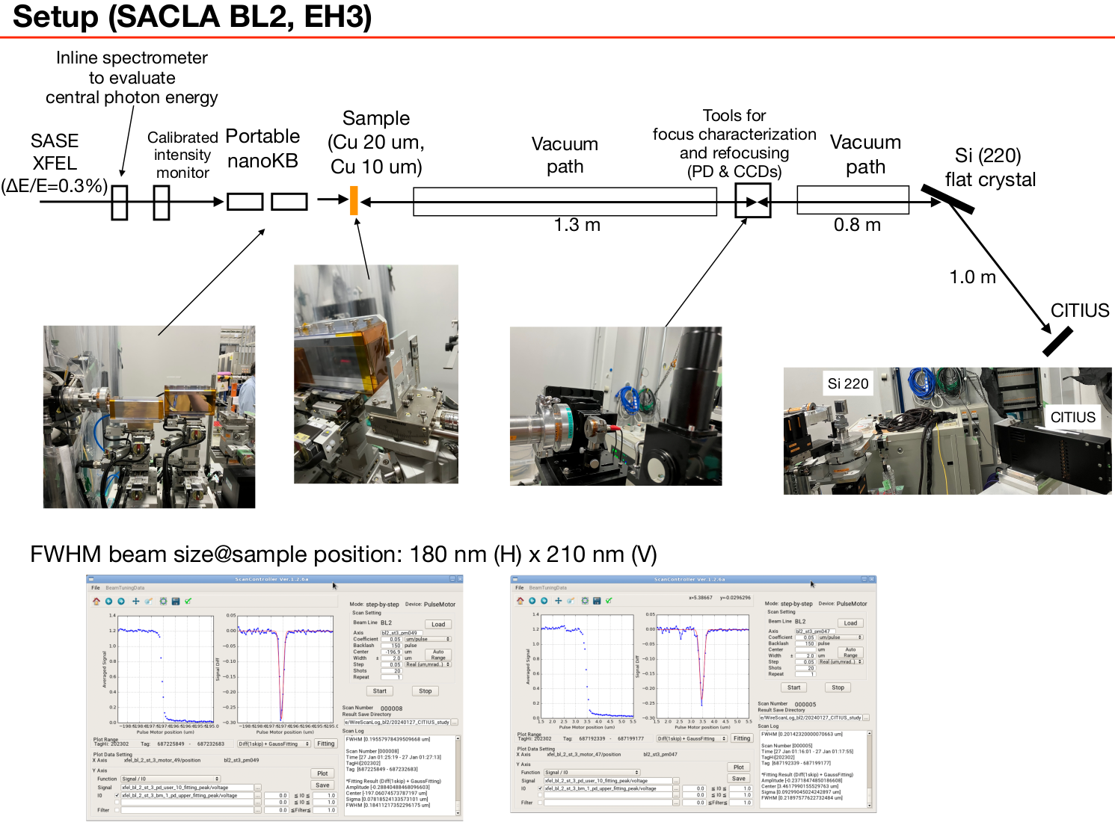
Experimental data from Ichiro

Slide 3
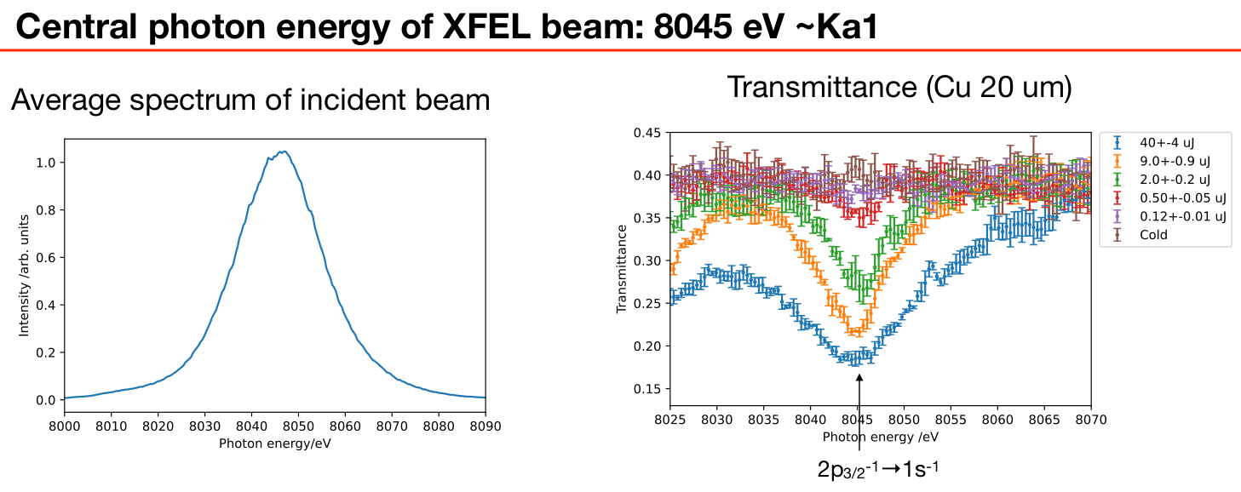
Experimental data from Ichiro

Slide 4
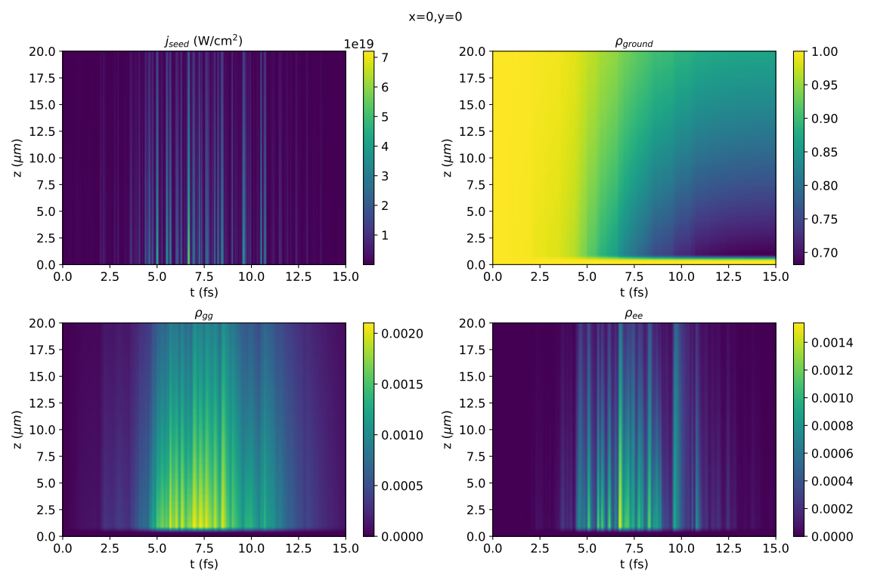
Behavior for a single run
40 uJ, FWHM: 180 nm x 220 nm, 6 fs

Slide 5
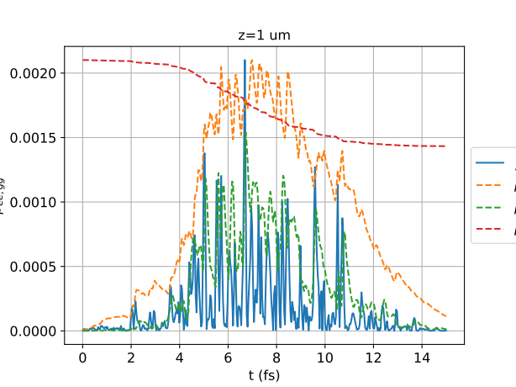
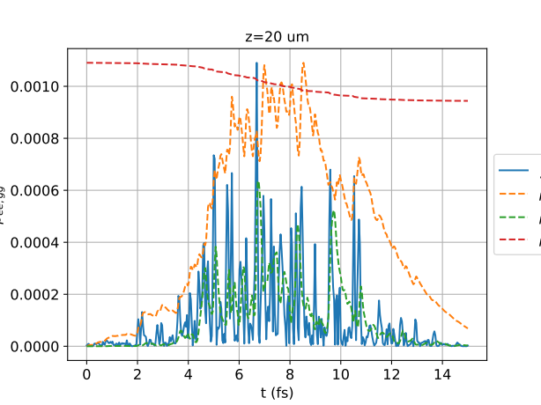
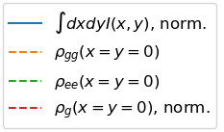
Behavior for a single run
40 uJ, FWHM: 180 nm x 220 nm, 6 fs

Slide 6
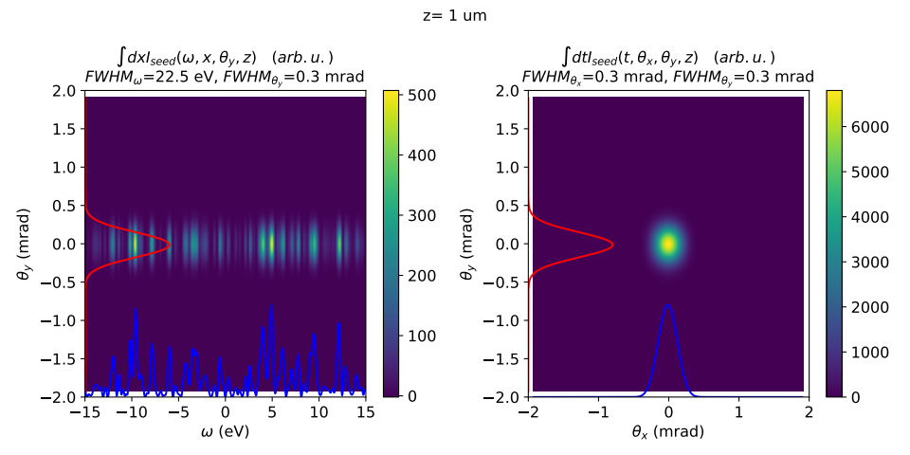
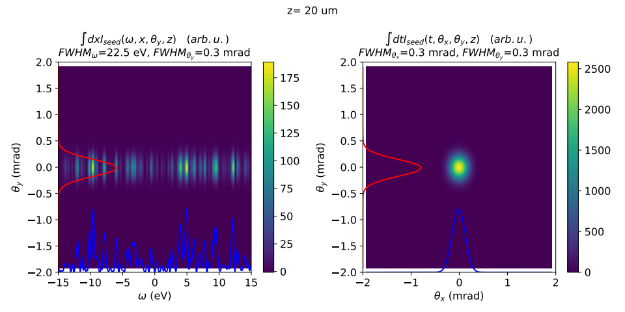
Behavior for a single run
40 uJ,
FWHM: 180 nm x 220 nm, 6 fs

Slide 7
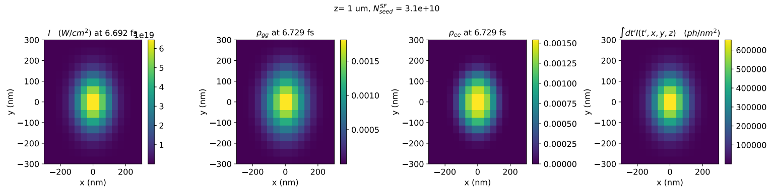
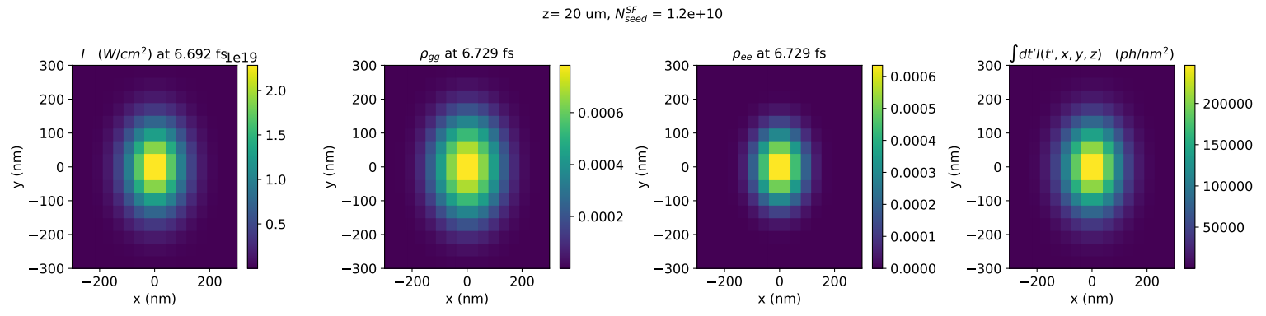
Behavior for a single run
40 uJ, FWHM: 180 nm x 220 nm, 6 fs

Slide 8
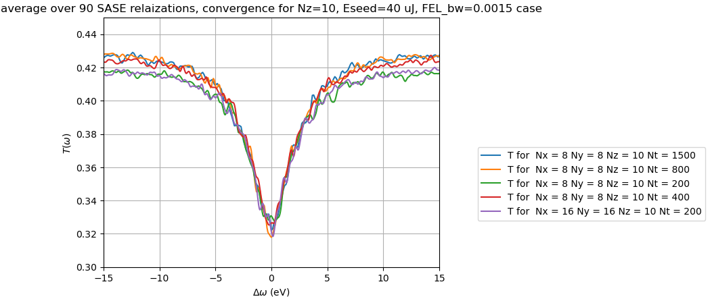
Sensitivity to grid (convergence)

Slide 9
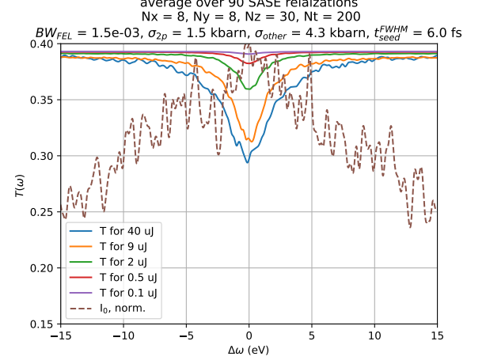
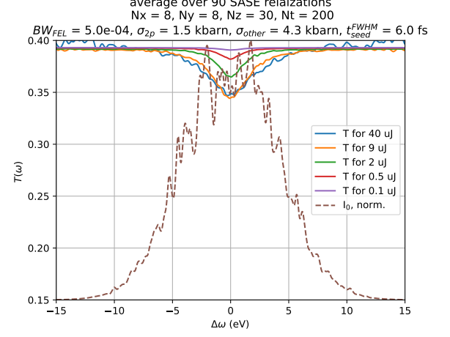
Sensitivity to FEL bandwidth

Slide 10
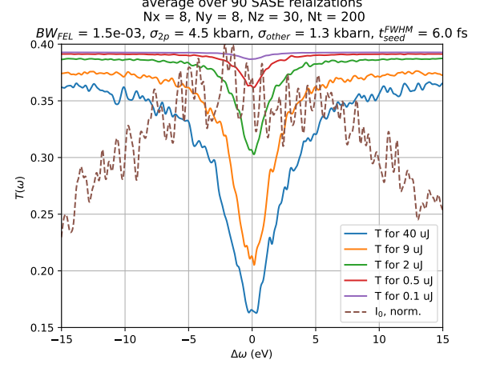
Sensitivity to absorption cross-section

Slide 11
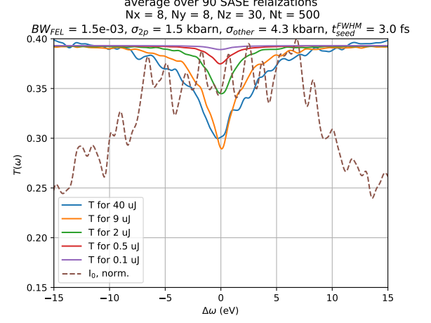
Sensitivity to pulse duration

Slide 12
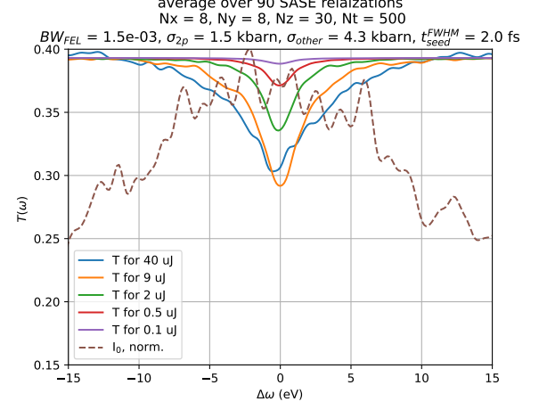
Sensitivity to pulse duration

Slide 13
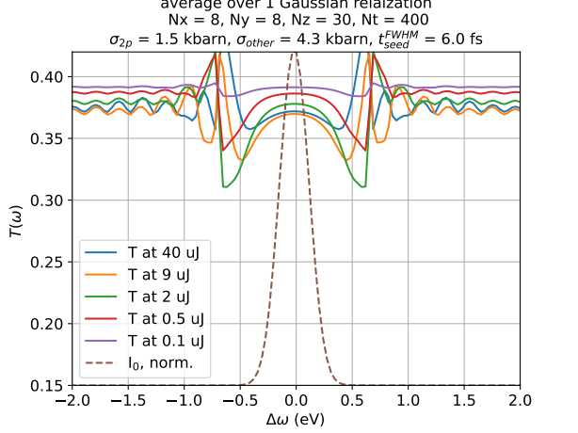
Sensitivity to pulse shape

Slide 14
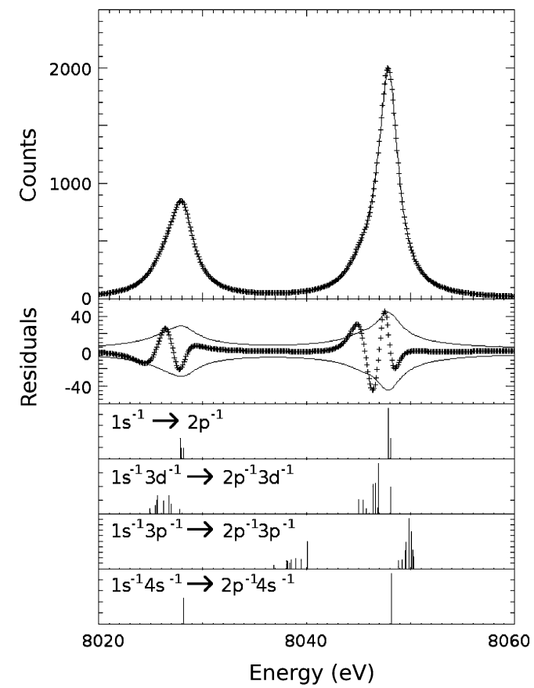
Possible sources of discrepancy
K-alpha 2 line is not accounted for
Electron-impact ionization – most likely, negligible
States after L₃M₄₅M₄₅ Auger decay: these states are available for further ionization and may show subsequent satellite lines in absorption. Such states may be longer-lived and thus pronounced.
C. T. Chantler, J. A. Lowe, I. P. Grant,
10.1103/PhysRevA.82.052505

Slide 15
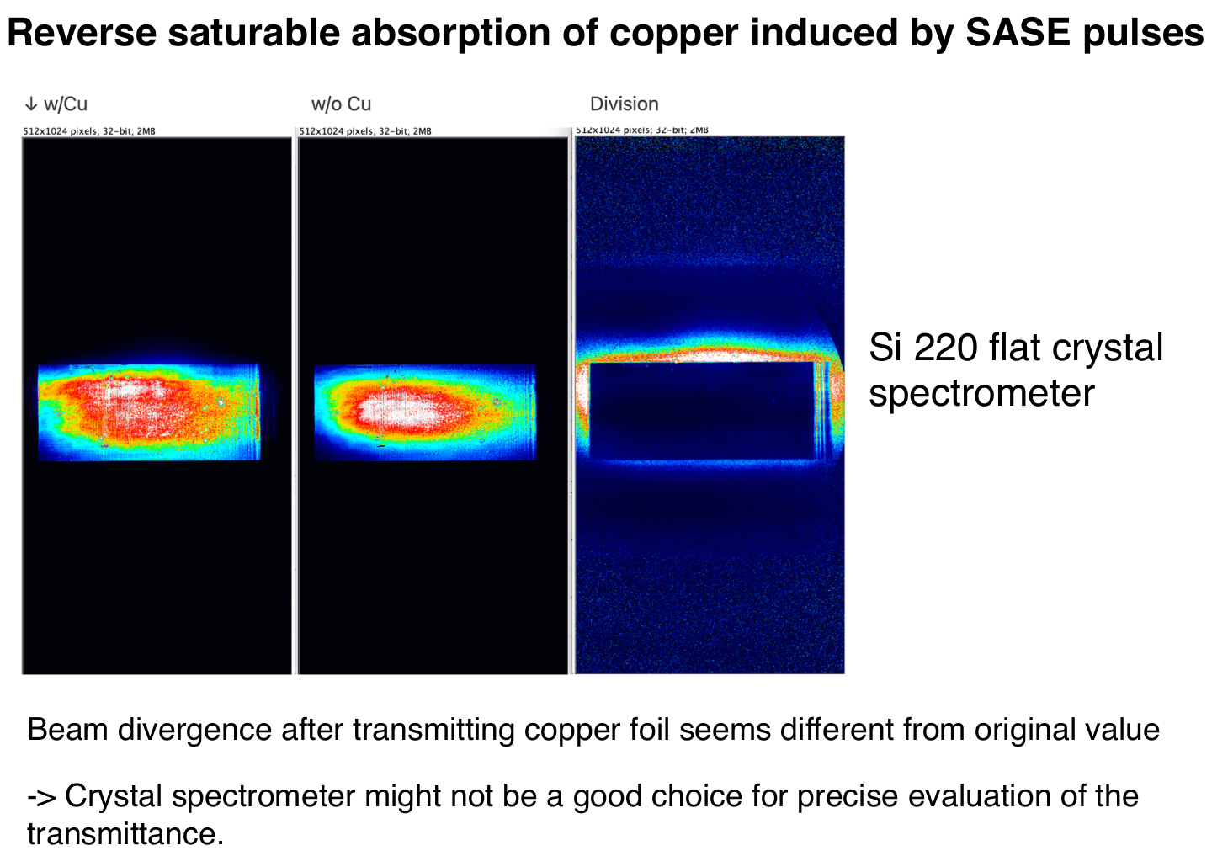
Data from Ichiro, beamtime at July 2024

Slide 16
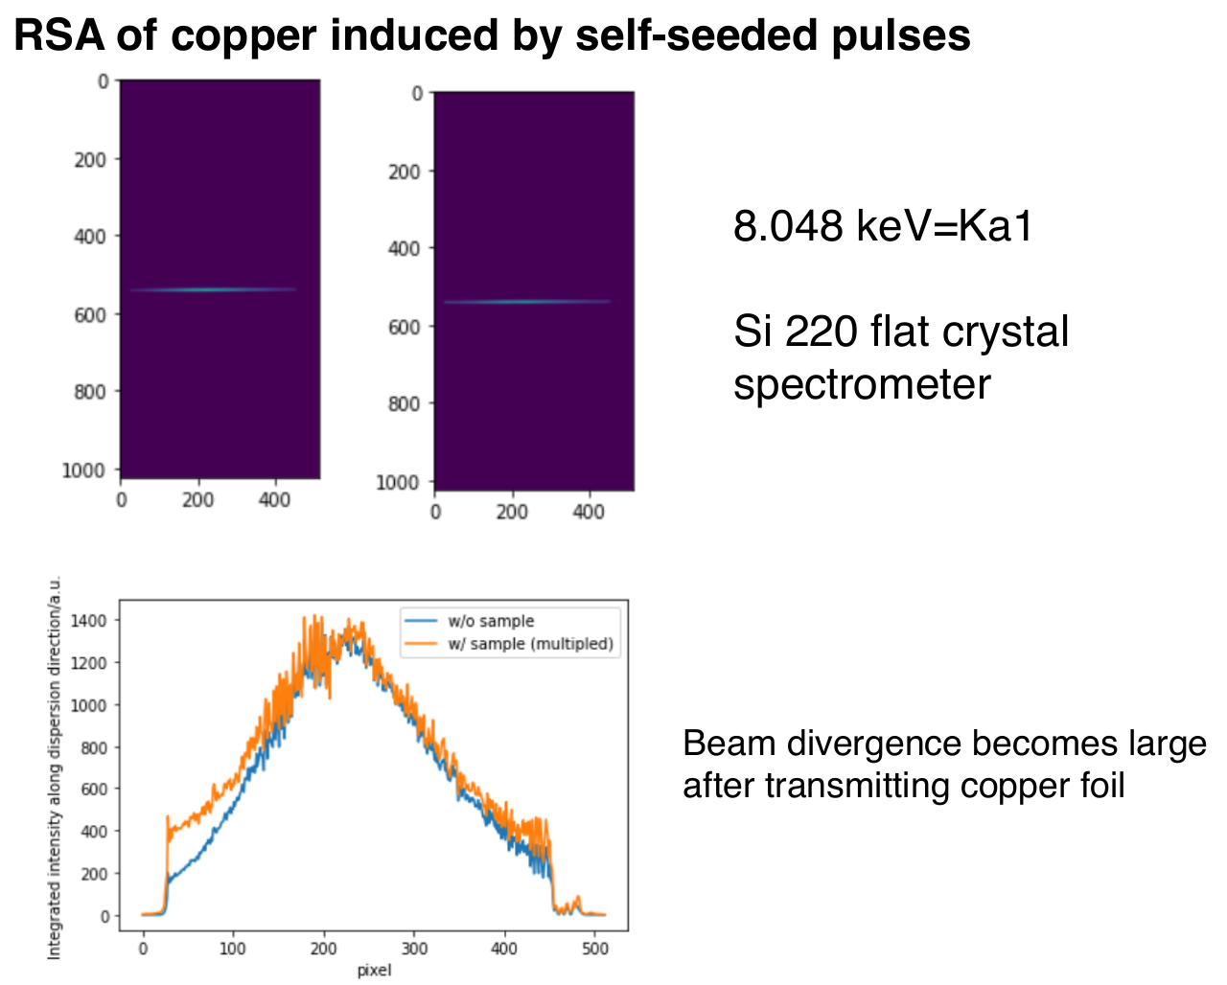
Data from Ichiro, beamtime at July 2024

Slide 17
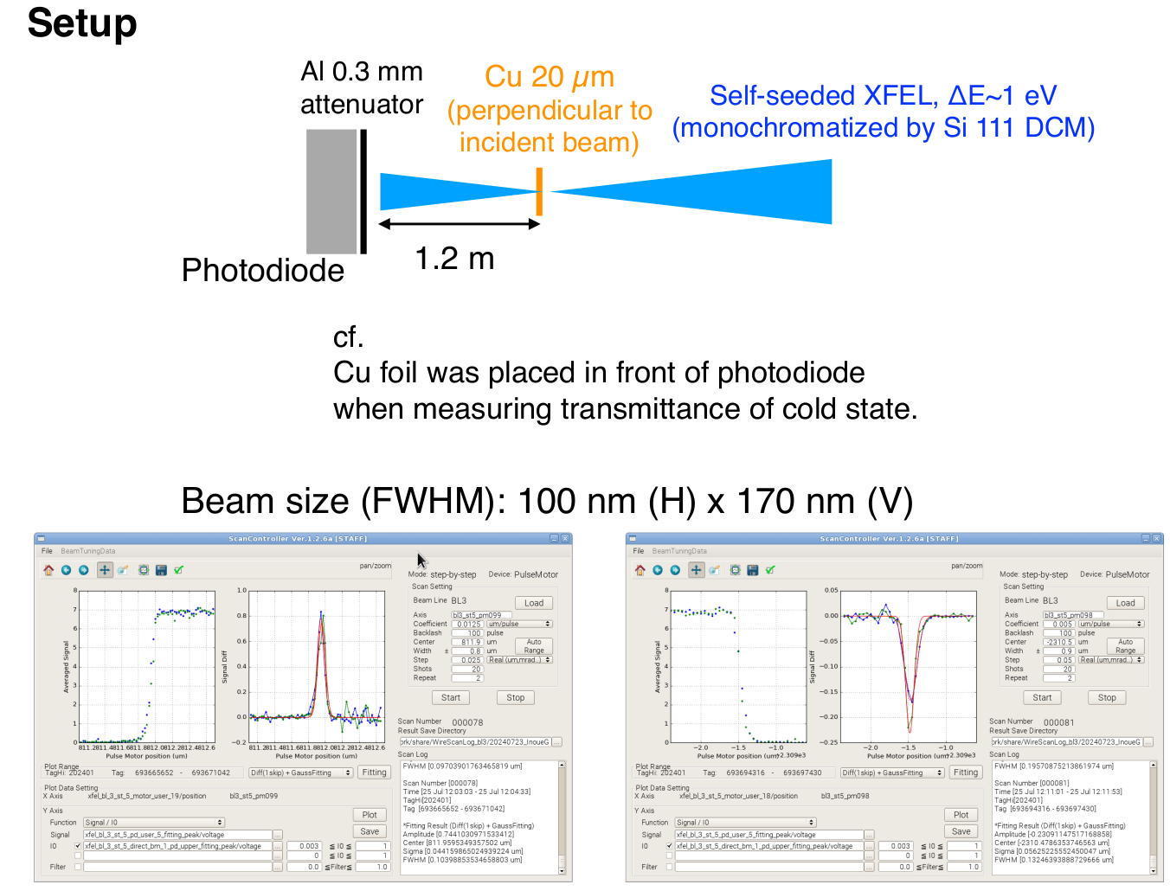
Data from Ichiro, beamtime at July 2024

Slide 18
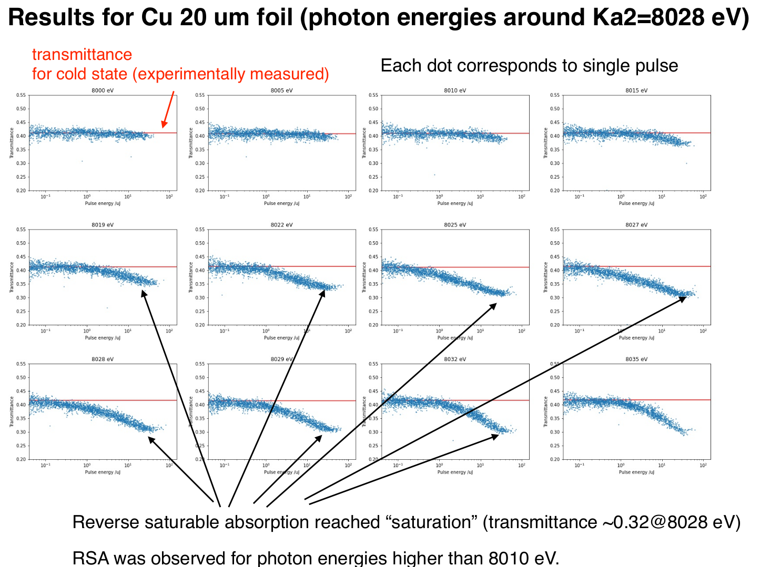
Data from Ichiro, beamtime at July 2024

Slide 19
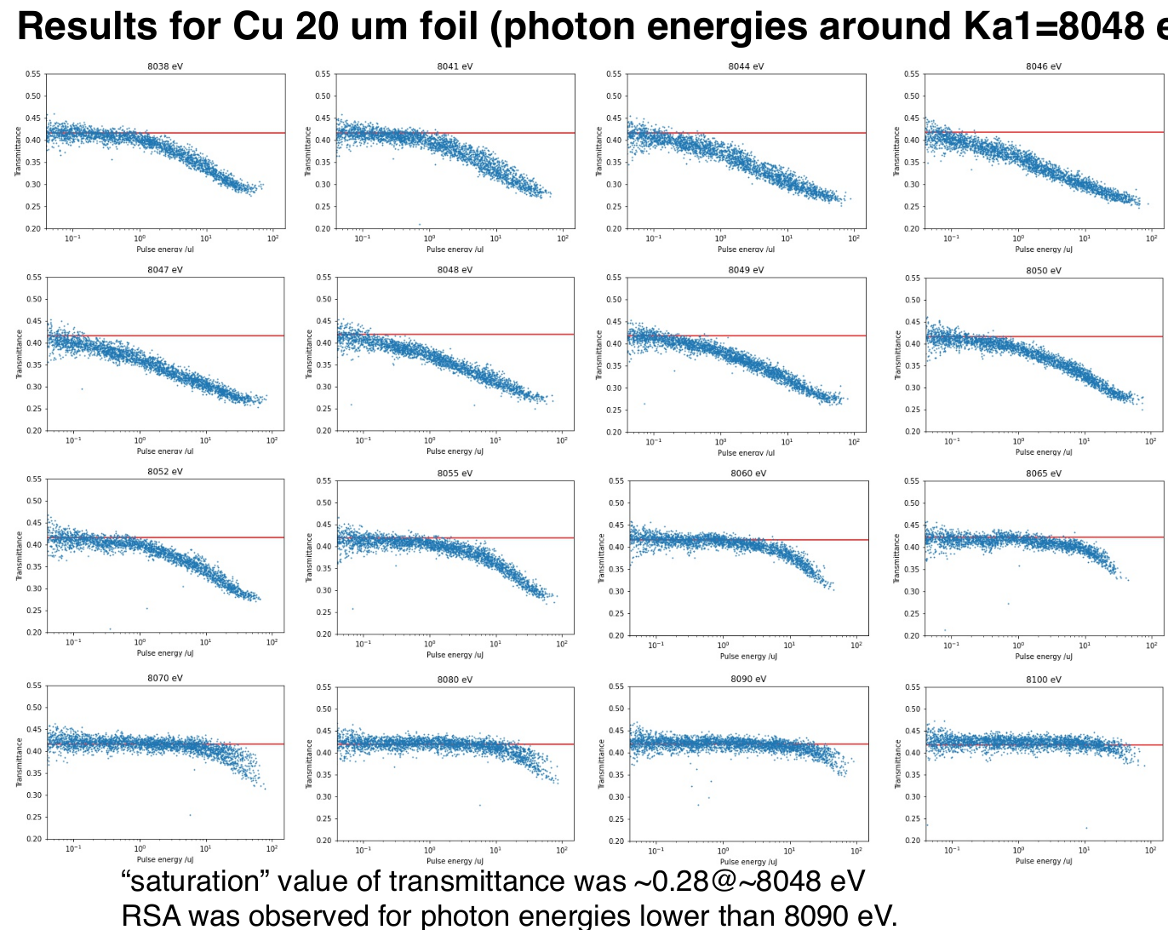
Data from Ichiro, beamtime at July 2024

Slide 20
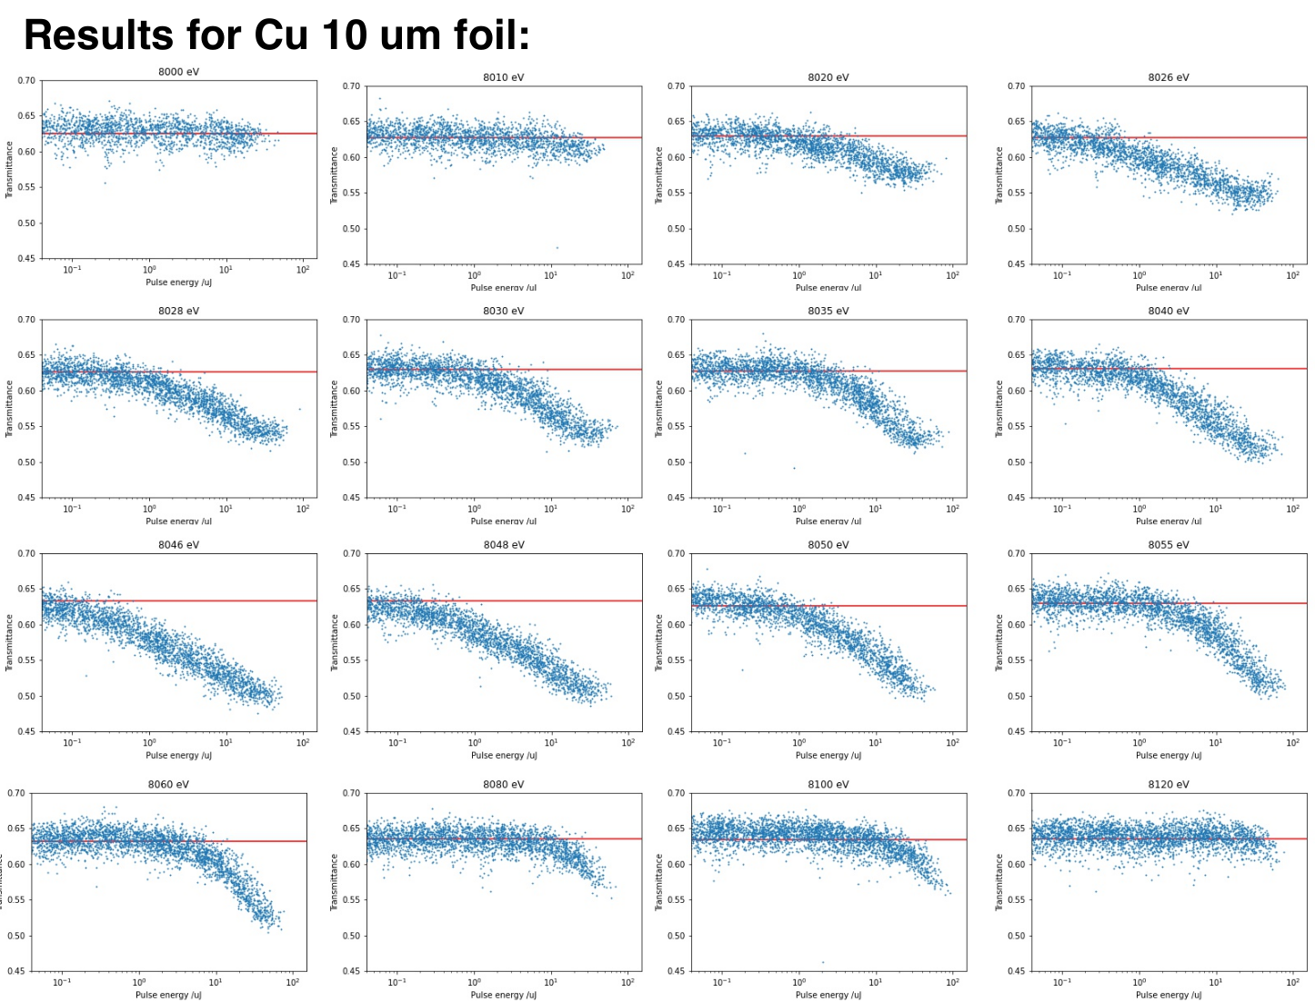
Data from Ichiro, beamtime at July 2024

Slide 21
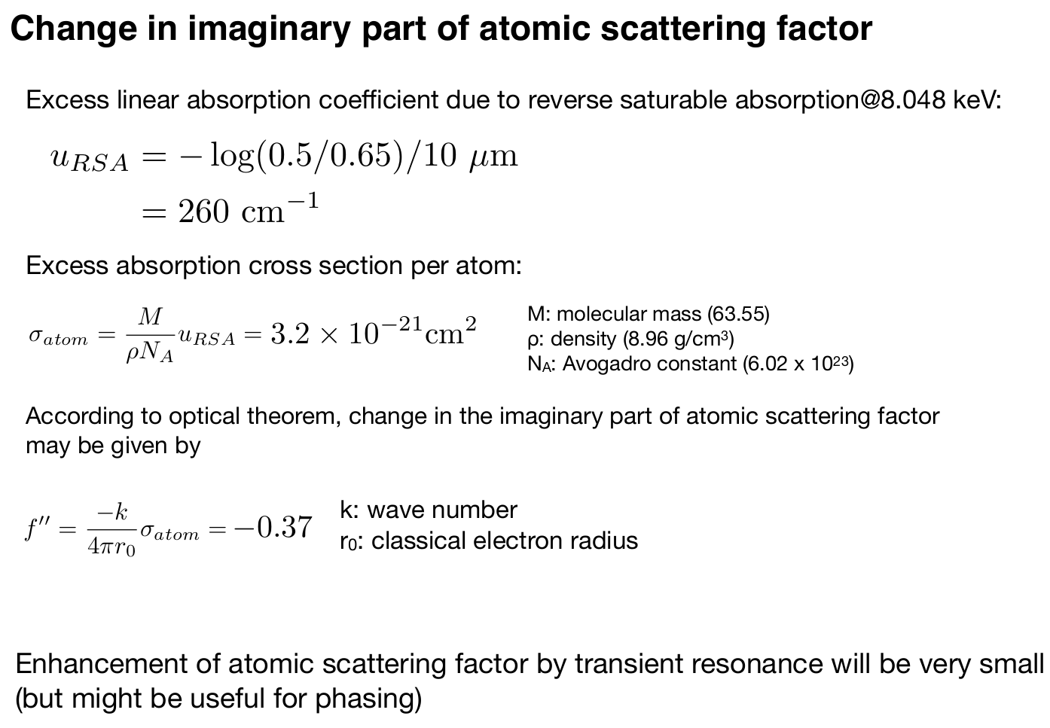
Data from Ichiro, beamtime at July 2024

Slide 22
Data from kinetic Boltzmann code

Slide 23
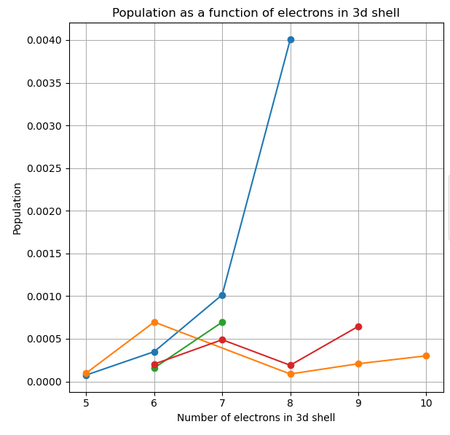
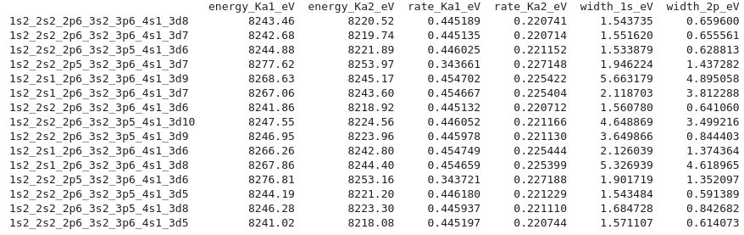
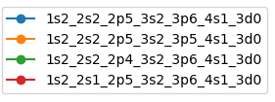
States with hole in 2p, data from Boltzmann code for 40 uJ

Slide 24
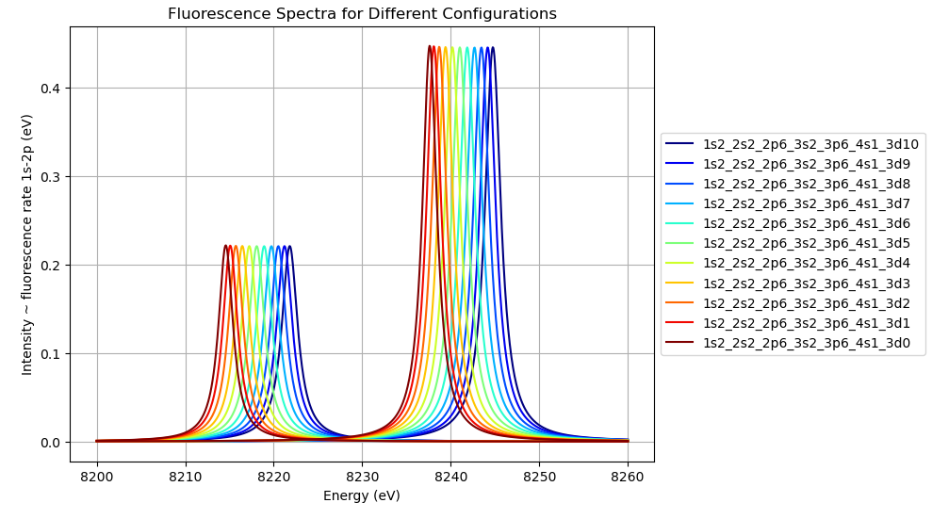
XATOM positions of fluorescence lines for 3d states

Slide 25
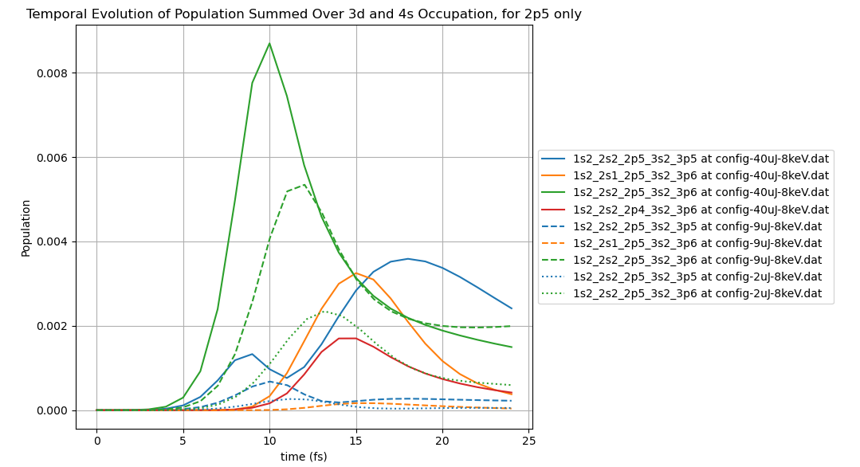
Role of other states (hole in 2s1, 2p4, 3p5), data from Boltzmann code

Slide 26
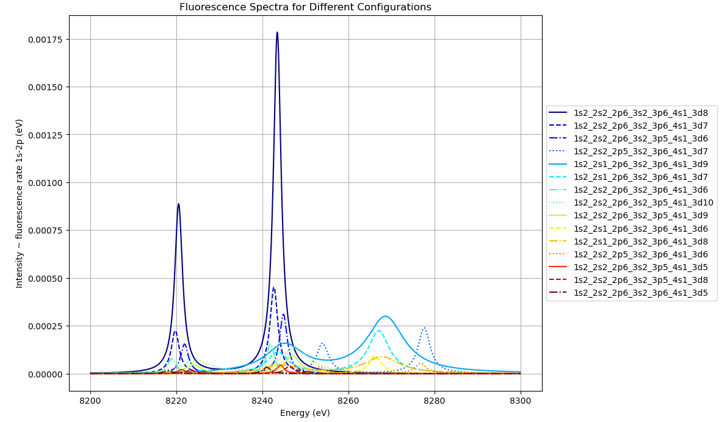
Role of other states, data from Boltzmann code

Slide 27
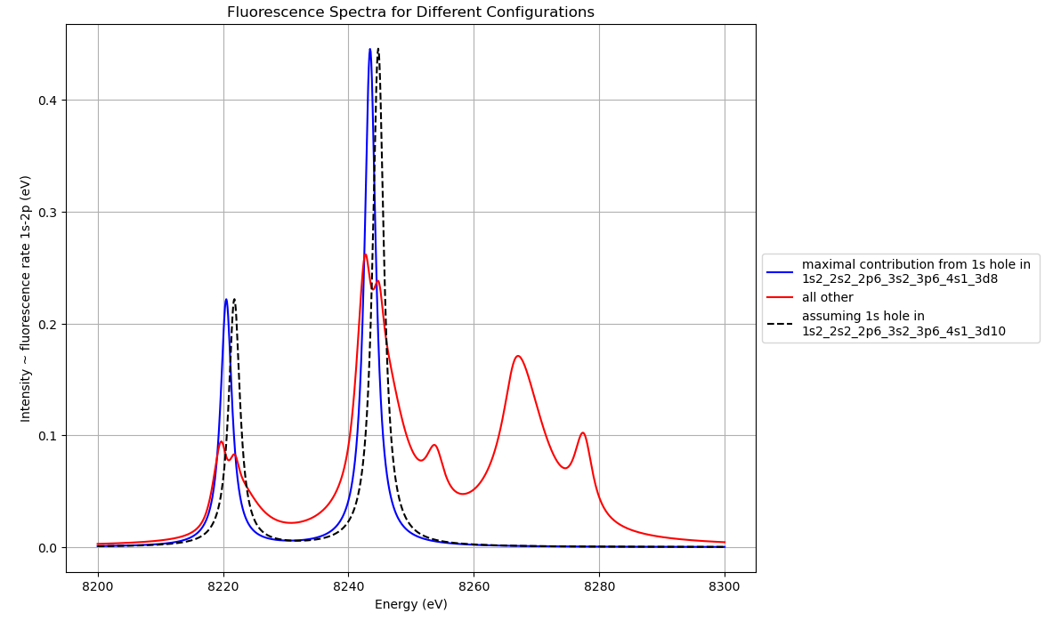
Role of other states, data from Boltzmann code

Slide 28
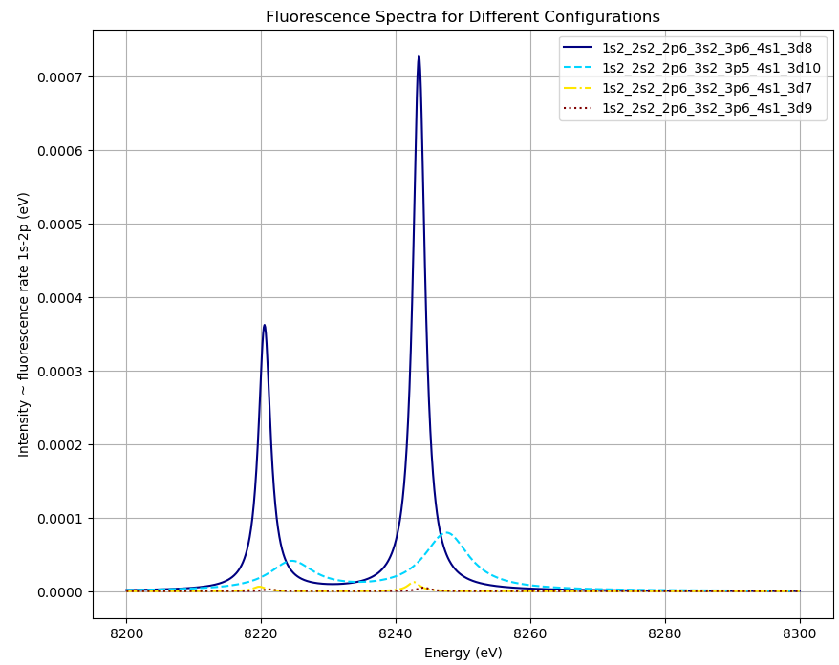
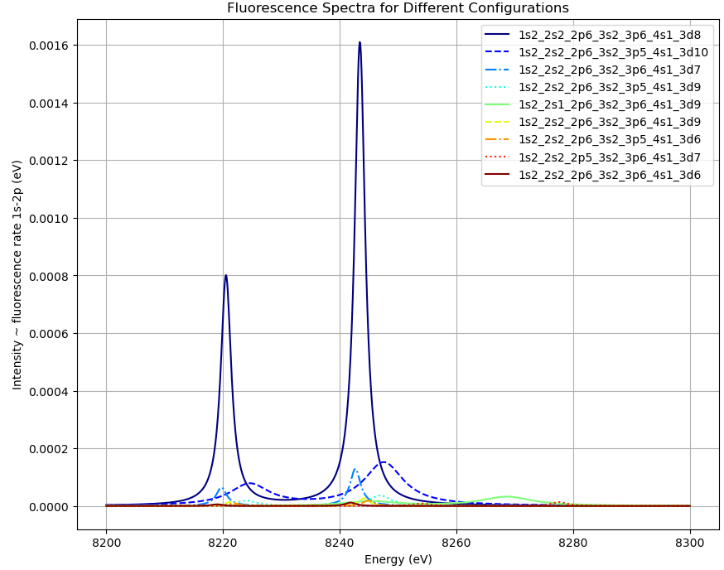
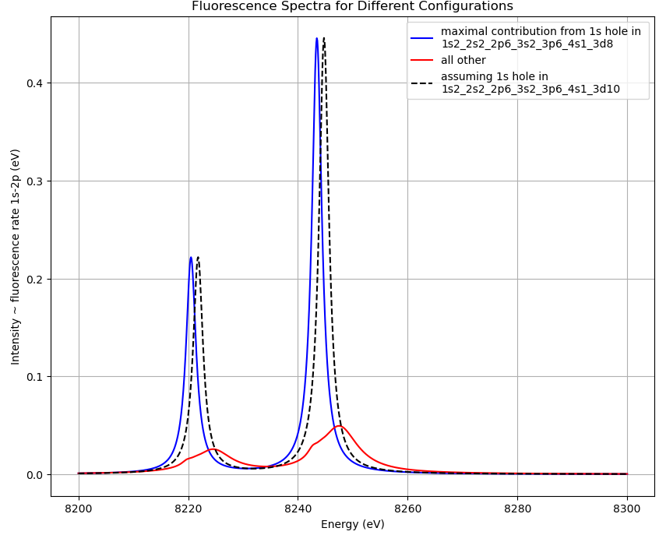
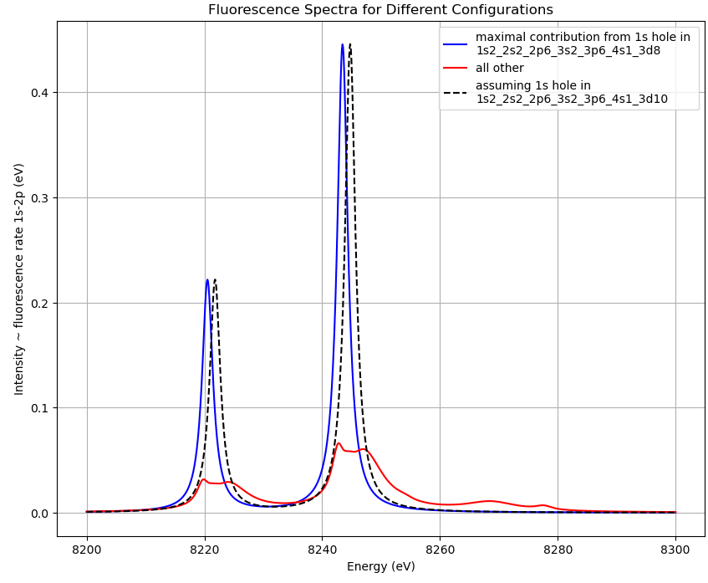
2 uJ
9 uJ

Slide 29
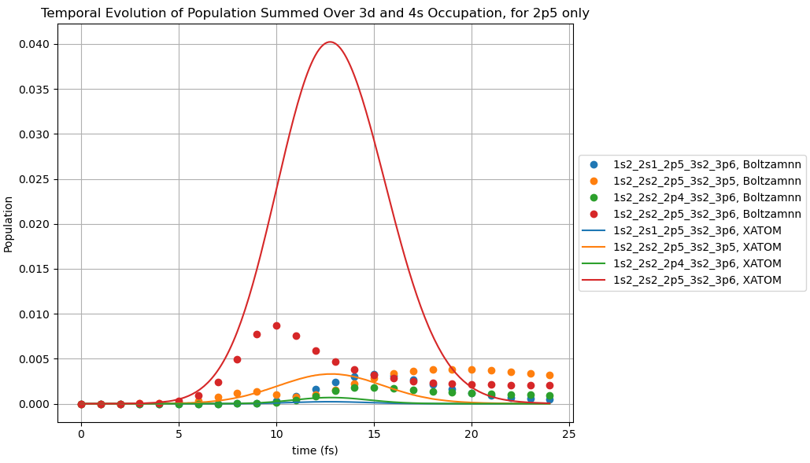
Boltzmann and XATOM code are quite different for the states with 2p holes

Slide 30
Non-relativistic (no spin-orbit) calculations with XATOM

Slide 31
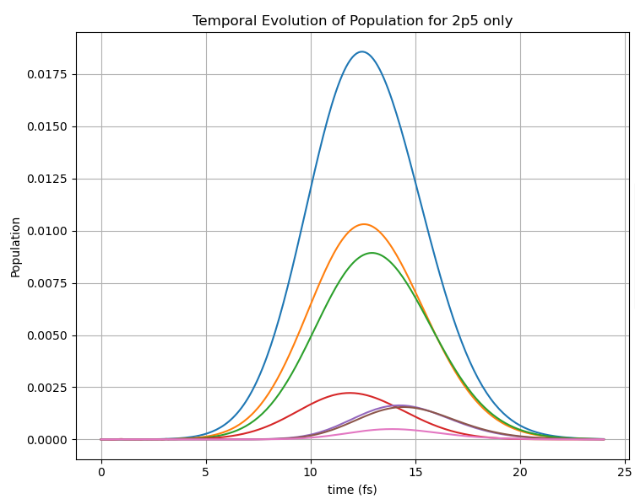
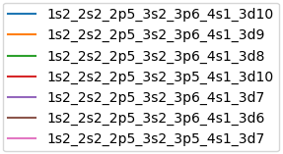
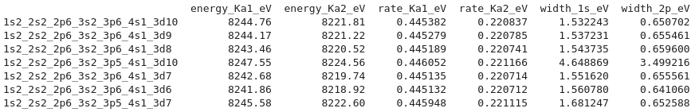

Slide 32
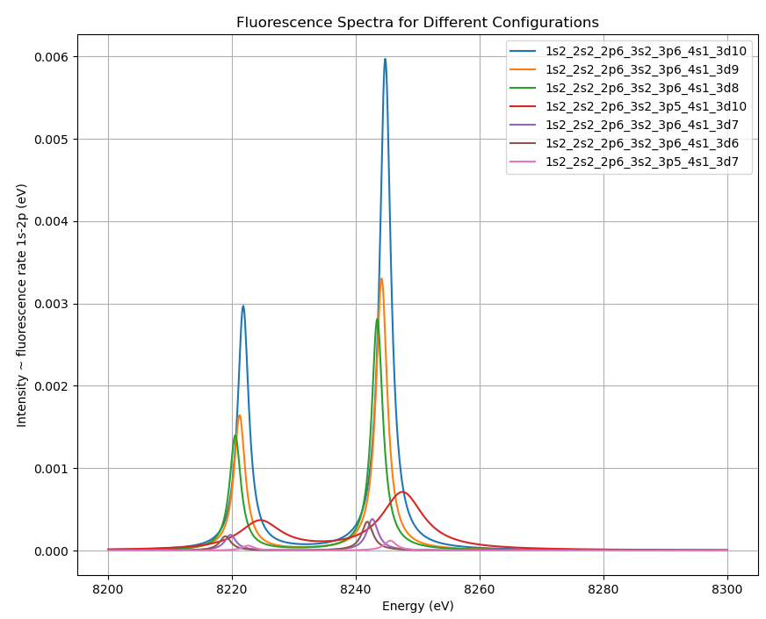
with hole in 1s

Slide 33
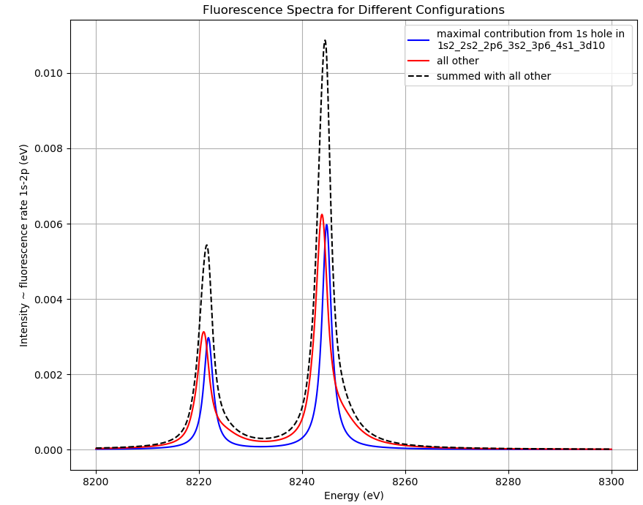

Slide 34
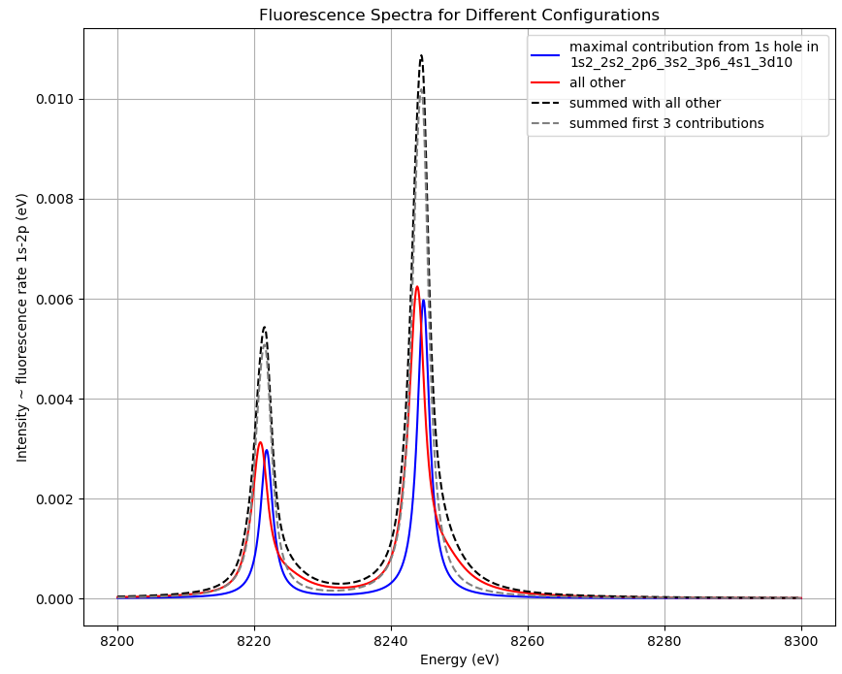

Slide 35
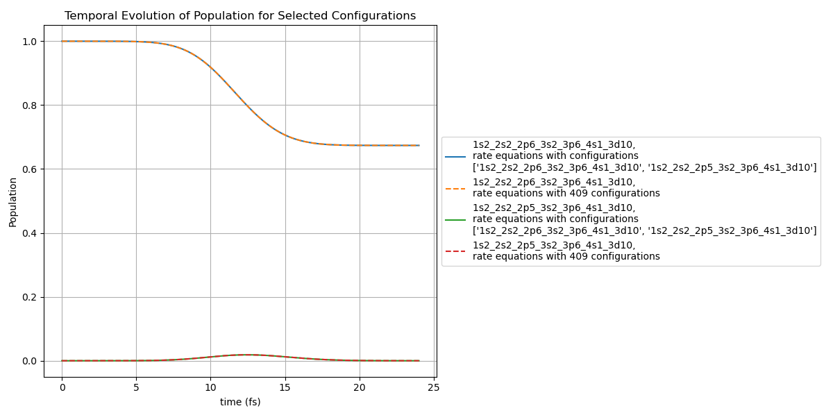

Slide 36
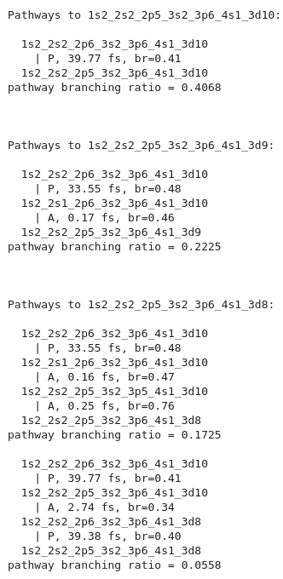
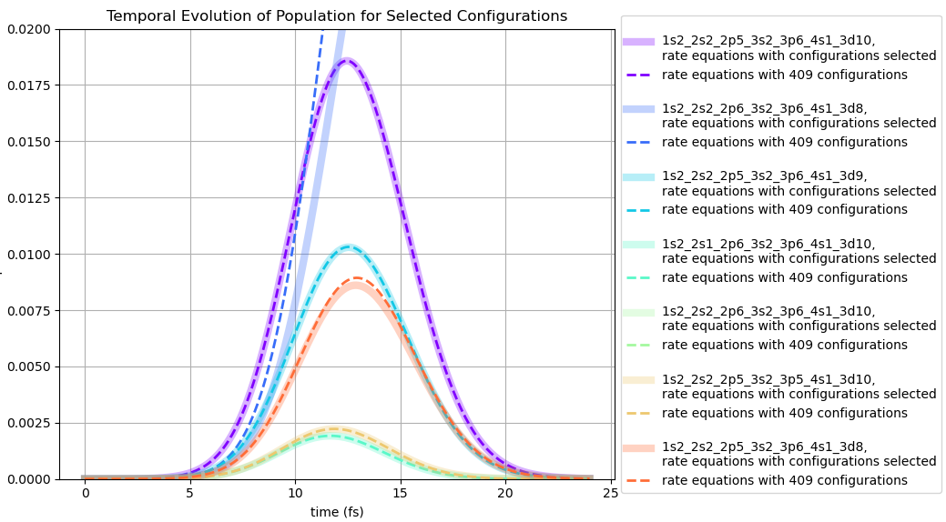

Slide 37
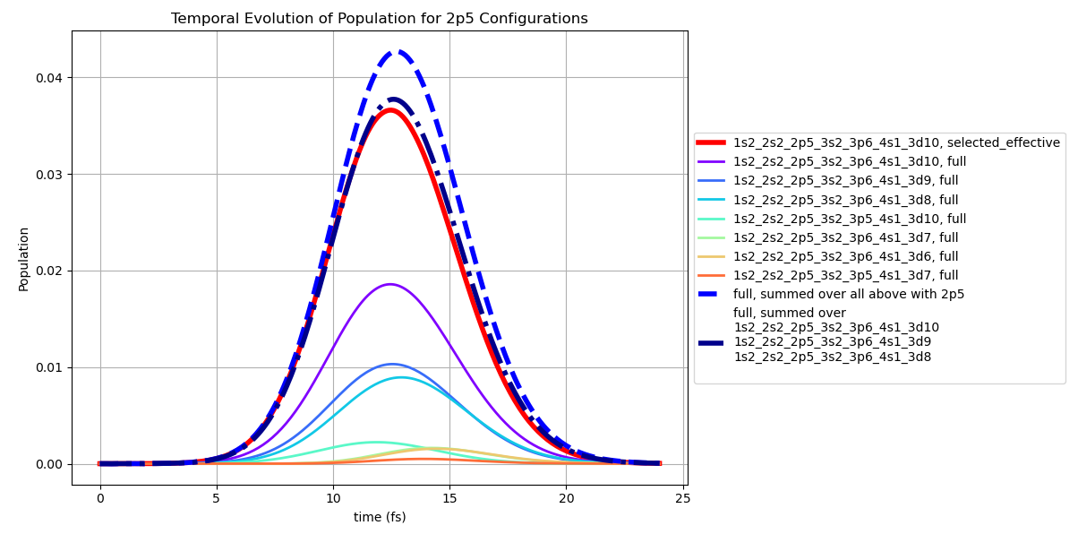
Effective enhancement due PAA cascades = 1.97

Slide 38
Relativistic (spin-orbit) calculations with XATOM

Slide 39
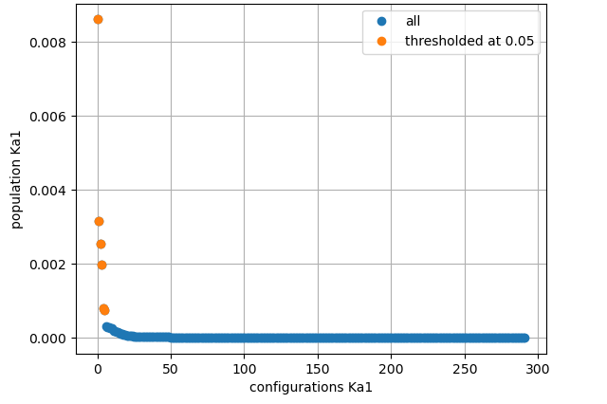
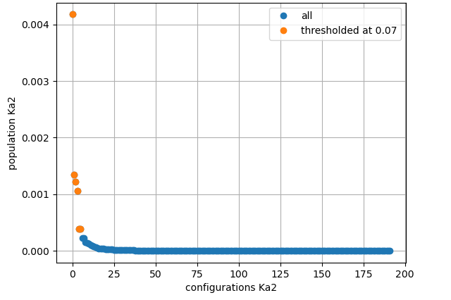
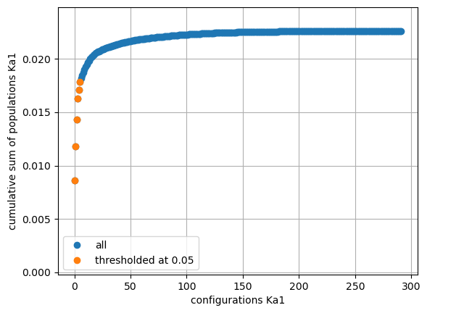

Relativistic (spin-orbit) calculation,
1340 configurations in total,
267 configurations that result in K-a1 fluorescence,
167 configurations that result in K-a2
25 configurations that result in both K-a1 and 2

Slide 40

Relativistic (spin-orbit) calculation

Slide 41

Relativistic (spin-orbit) calculation

Slide 42

Relativistic (spin-orbit) calculation

Slide 43




Relativistic (spin-orbit) calculation, effective pathways

Slide 44

Relativistic (spin-orbit) calculation, effective enhancement due PAA cascades = 2.26

