Slide 1

GridPulse
Urban Smart Electricity Consumer Assistance
and Energy Monitoring System
Pawan Suryakant Tiwari
Guide: Dr. Uma Goradiya
IDEA LAB-V • Course Code 12212506
TE CMPN/C
Roll No. 53
Theme: Urban System
Academic Year 2026-2027
1 / 7
Notes:
Good morning. I am Pawan Suryakant Tiwari from TE Computer Engineering, division C, roll number 53. My IDEA LAB-V project is GridPulse, developed under the guidance of Dr. Uma Goradiya. The idea combines electricity consumption awareness with a clear support workflow for consumers and utility staff.
Source: C:/Pawan/College/IdeaLab/output/GridPulse_Idea_Lab_Report_Pawan_Tiwari.docx. Screenshots: local GridPulse prototype, captured 12 October 2026.

Slide 2
The electricity consumer problem
A monthly bill arrives.
The consumer has questions.
Household experience
Utility support workload
Limited visibility during the month
An unexpected billed amount
Time spent arranging support
Repeated billing queries
Pending cases to track
Appointments and staff to coordinate
Project focus: clearer consumption information and scheduled assistance
2 / 7
Notes:
The problem begins before a complaint. Consumers make electricity-use decisions throughout the month but may only examine expenditure when the bill arrives. An unusual bill creates questions, and obtaining support takes coordination. Staff also need to follow pending cases and upcoming appointments. GridPulse addresses this complete journey under the Urban System theme.
Source: C:/Pawan/College/IdeaLab/output/GridPulse_Idea_Lab_Report_Pawan_Tiwari.docx. Screenshots: local GridPulse prototype, captured 12 October 2026.

Slide 3
The gap found
Existing approaches
The integration gap
Consumer portals handle bills
and service requests.
Meter dashboards show usage.
Research models forecast demand.
Consumption insight and a
billing query need one
connected support workflow.
An estimate, a review alert, a ticket
and a scheduled consultation
Opportunity identified for this prototype: connect monitoring with consumer assistance
3 / 7
Notes:
Digital complaint portals already exist. MSEDCL, for example, provides billing history and service requests. Smart-meter research also covers forecasting and load analytics. The opportunity in my project is to connect these activities in one demonstrable journey: understand usage, compare a bill, raise a ticket and attend scheduled support. I am not claiming that existing utilities have no digital complaint services.
Source: C:/Pawan/College/IdeaLab/output/GridPulse_Idea_Lab_Report_Pawan_Tiwari.docx. Screenshots: local GridPulse prototype, captured 12 October 2026.
Existing-system reference: https://wssebill.mahadiscom.in/wss/images/WssHelp/Web_Self_Service_%28WSS%29.htm
Literature: https://arxiv.org/abs/1802.04117

Slide 4
The gap GridPulse solves
01
Monitor
₹150
Live usage and a monthly estimate
02
Plan
or more in absolute variance
flags the bill for review
Spending target and energy suggestions
03
Review
4 hours
Compare the entered bill with the estimate
before the appointment,
consultation mode locks
04
Get support
Ticket token, appointment and status tracking
Online or offline support
Offline is the default
4 / 7
Notes:
GridPulse links four activities. First, the consumer sees live simulated readings and a tariff-based monthly estimate. Second, the consumer sets a budget and receives rule-based suggestions. Third, the system compares an entered bill with the estimate and flags an absolute variance of at least 150 rupees. Finally, the consumer gets a complaint token and appointment. The mode locks four hours before the slot, with offline as the default. The intended two-hour reminder call remains a future integration.
Source: C:/Pawan/College/IdeaLab/output/GridPulse_Idea_Lab_Report_Pawan_Tiwari.docx. Screenshots: local GridPulse prototype, captured 12 October 2026.

Slide 5
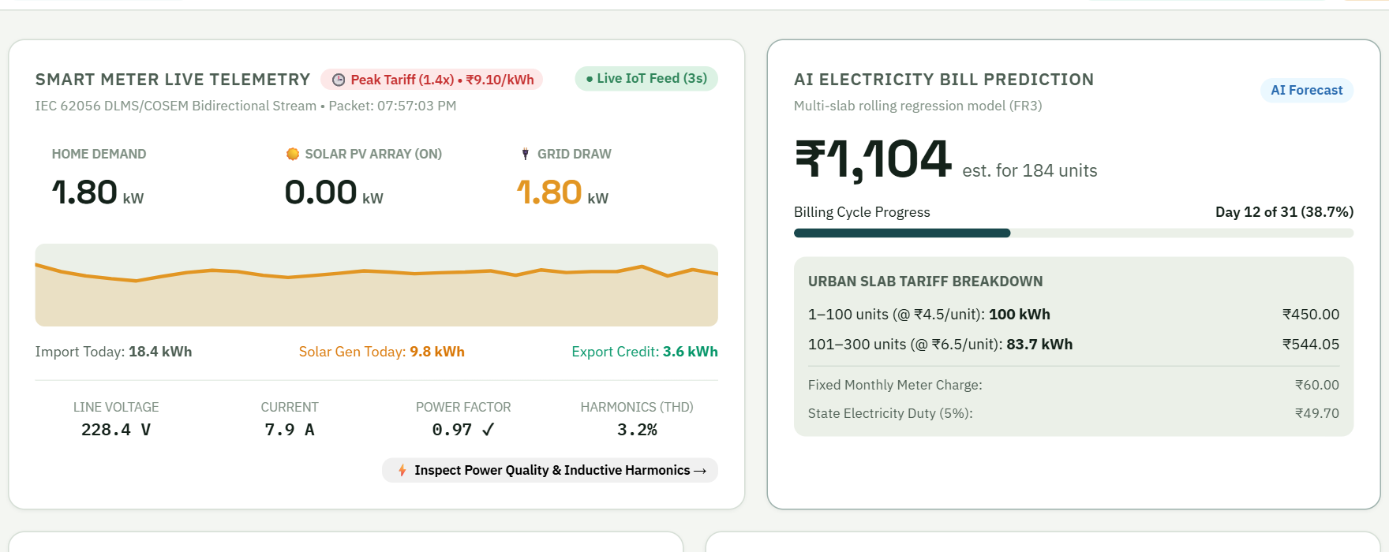
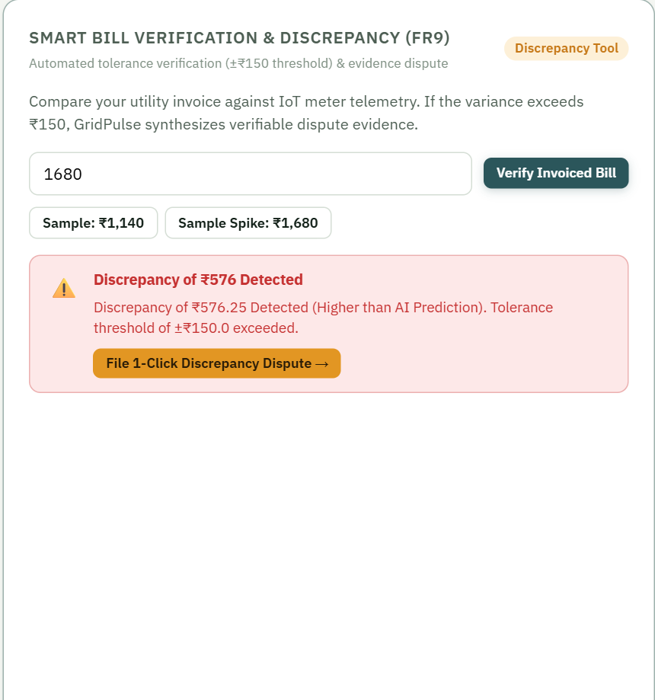
Prototype output: the citizen view
Live telemetry and monthly estimate
Bill discrepancy alert
₹1,104
₹1,680
₹576.25
displayed monthly estimate
sample invoice entered
variance flagged for review
5 / 7
Notes:
These are screenshots from the working local prototype. The citizen view shows the live meter simulation alongside the cost estimate. In the captured example, the monthly estimate rounds to 1,104 rupees while the entered sample invoice is 1,680 rupees. The unrounded estimate is 1,103.75, so the variance is 576.25 rupees and the interface offers a dispute shortcut. The readings are simulated. The current forecast uses a seven-day average and illustrative tariff slabs, rather than a trained AI model.
Source: C:/Pawan/College/IdeaLab/output/GridPulse_Idea_Lab_Report_Pawan_Tiwari.docx. Screenshots: local GridPulse prototype, captured 12 October 2026.

Slide 6
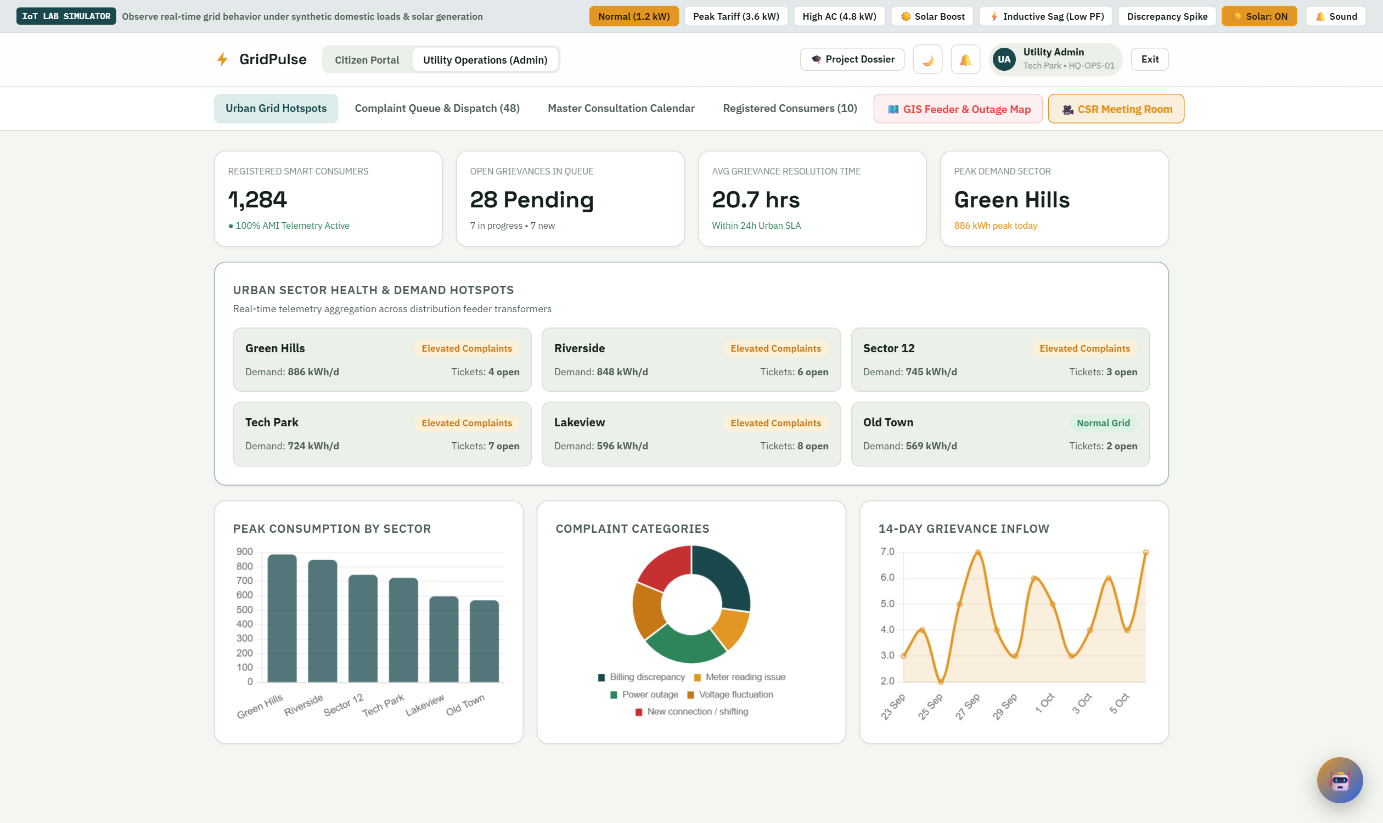
Prototype output: the utility view
Locality demand
Complaint patterns
Staff and schedules
22 / 22
targeted checks passed
Next: physical sensing,
secure access and
reliable reminders
Dashboard uses sample operational data
6 / 7
Notes:
The utility dashboard brings complaint categories, locality demand and support workload into one view. Staff can open the case queue, assign support and inspect consultation schedules. These charts use sample operational data. All 22 targeted checks passed, covering tariff points, bill-variance boundaries, login behaviour, complaints and appointment locking. This supports the basic software demonstration. The next steps are measured sensor integration, secure authentication, durable data storage and reliable reminder delivery.
Source: C:/Pawan/College/IdeaLab/output/GridPulse_Idea_Lab_Report_Pawan_Tiwari.docx. Screenshots: local GridPulse prototype, captured 12 October 2026.

Slide 7
Thank You
Questions and feedback
Pawan Suryakant Tiwari
GridPulse • IDEA LAB-V
7 / 7
Notes:
Thank you. I welcome your questions and feedback on the idea, the demonstrated workflow and the next development steps.
Source: C:/Pawan/College/IdeaLab/output/GridPulse_Idea_Lab_Report_Pawan_Tiwari.docx. Screenshots: local GridPulse prototype, captured 12 October 2026.

