Slide 1
Fibonacci heap
Cuntan Paul

Slide 2
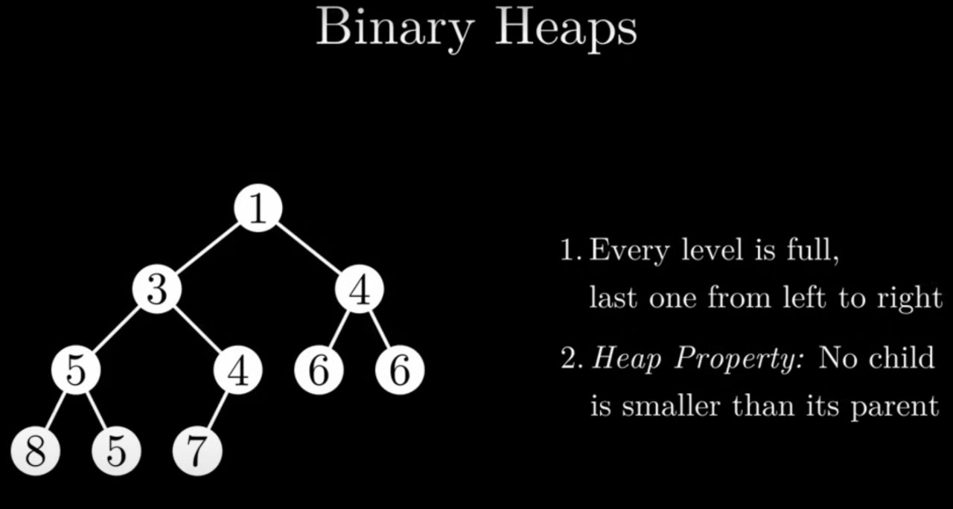
FIBONACCI HEAP
The Fibonacci is a type of Priority Heap.
It is based on a binary heap.

Slide 3
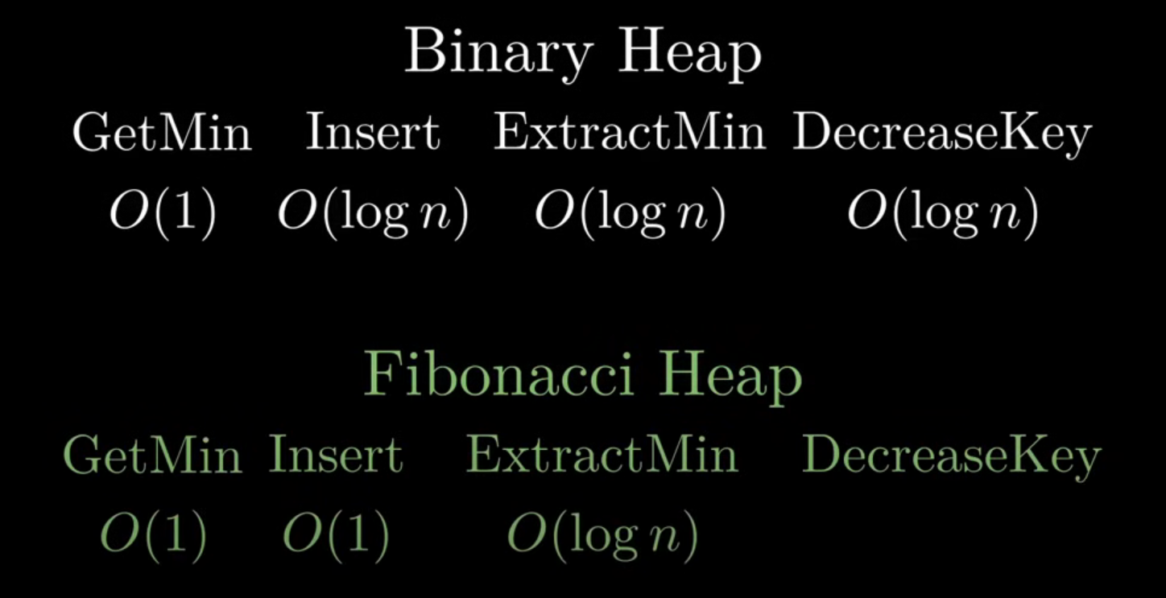

And is trying to better the efficiency of the operations by simplifing the Insert and DecreaseKey operations and having ExtractMin do the clean up, when it is called.

Slide 4
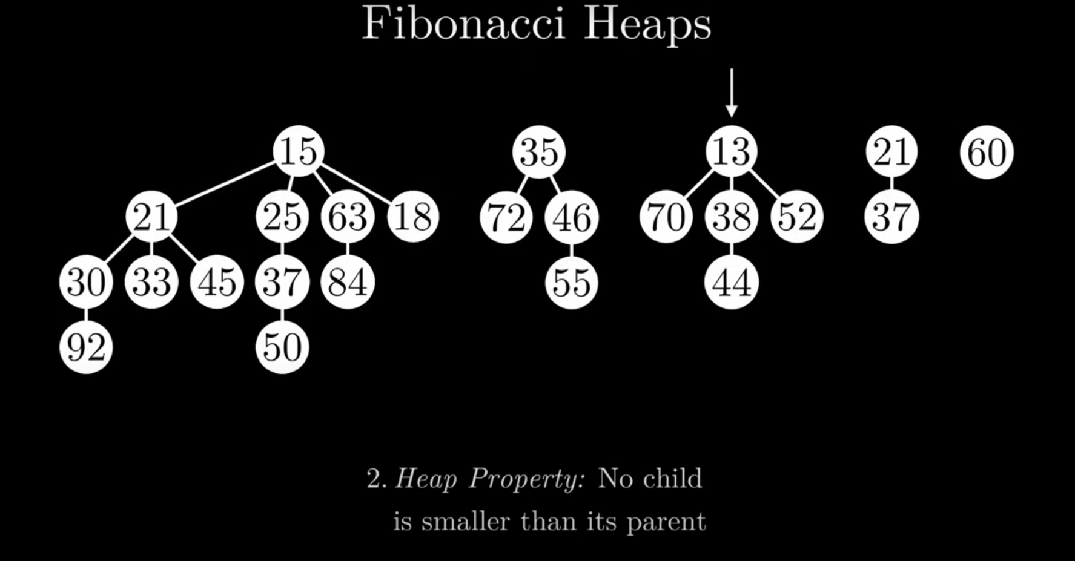

A heap can have multiple trees.
A node can have as many children as it wants.
No parent is larger than its children.
The nodes on the same level are connected with a doubly linked list.
Each node has a pointer to a child and parent.

Slide 5
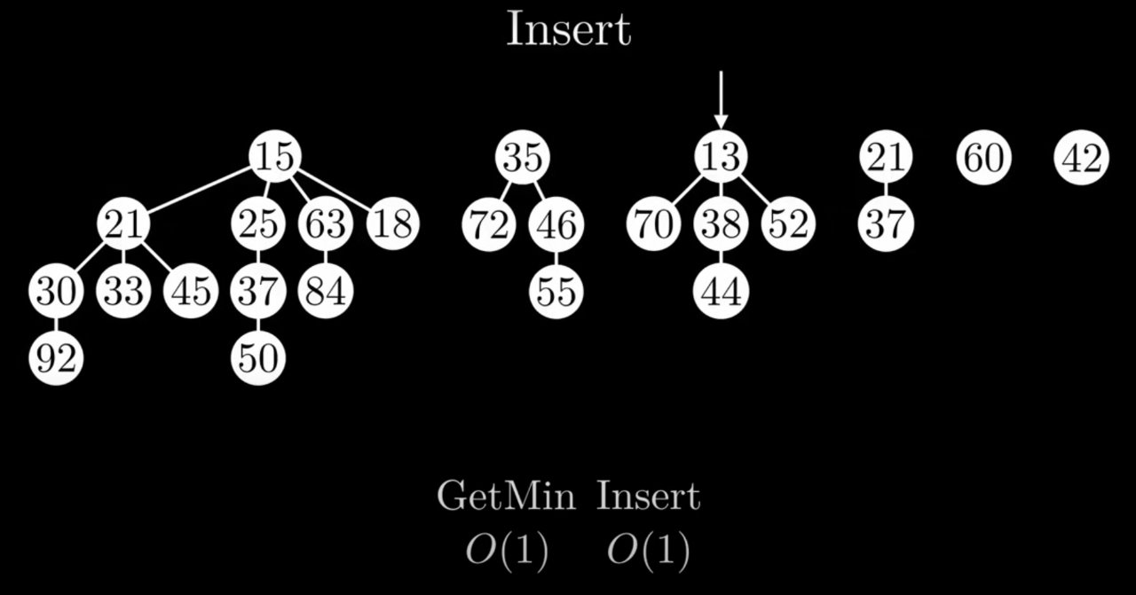
INSERT AND GET MIN
GetMin:
We store the pointer to the minimum element at all times.
2. Insert:
Simply merge a tree (in this case a single node) to the heap.

Slide 6
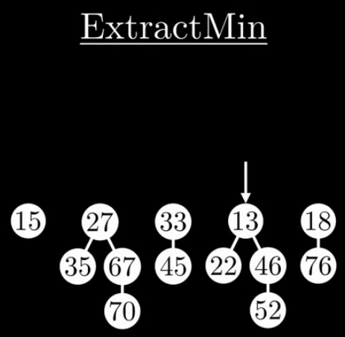
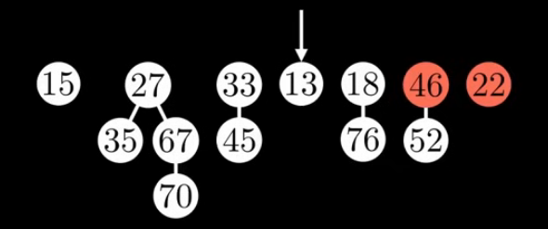
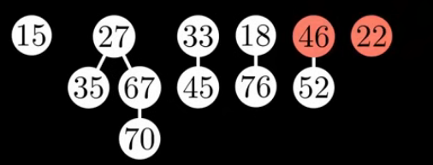

EXTRACT MIN
Step 1: Remove minimum and merge its children to the heap

Slide 7
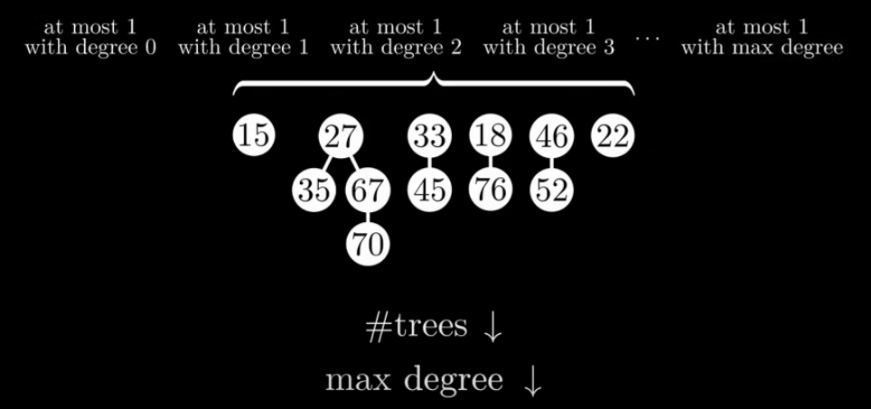
Step 2: Clean up
Merge trees that have the same degree until there is only 1 tree with a certain degree.

Slide 8
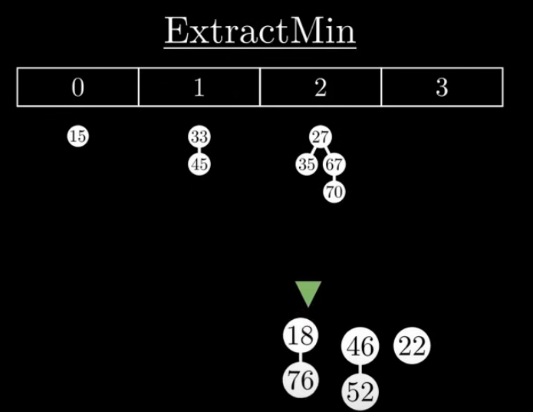
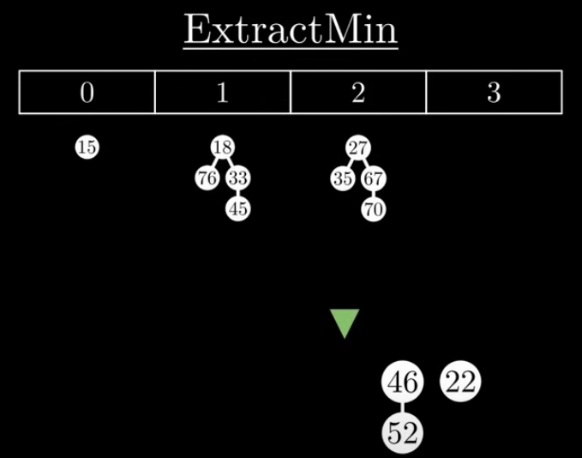
degree

Slide 9
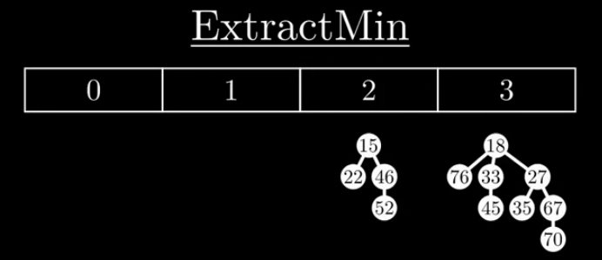

Slide 10
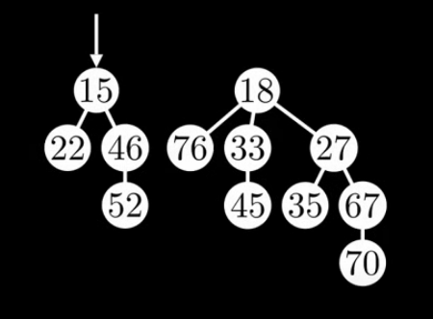
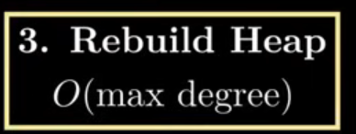
Step 3: merge the heaps together, and fing new minimum

Slide 11
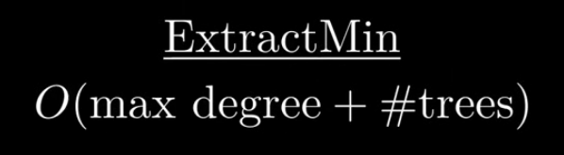
So...
But...

Slide 12
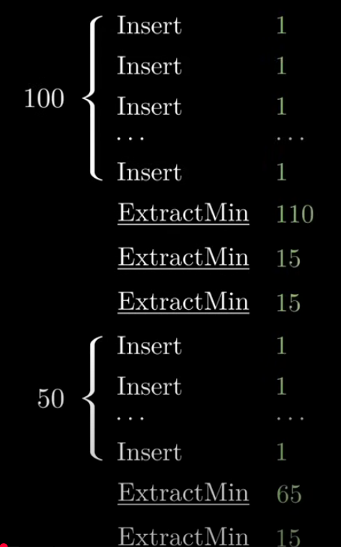
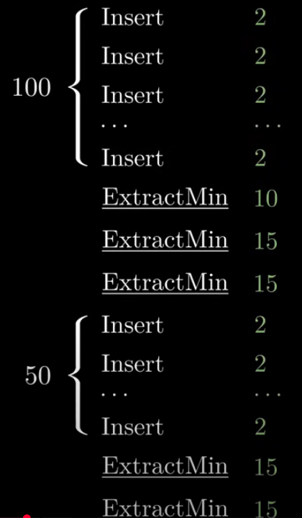
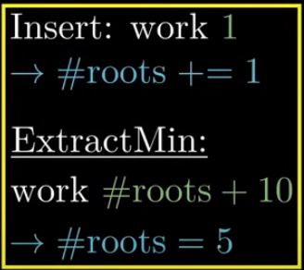
AMORTIZED ANALYSIS
If we do a lot of inserts, ExtractMin wil have a lot of work to do when it is first called.
But what if we distribute the added "work" back to the Inserts.
Then we'll see that the time for Insert remains O(1), but the time for ExtractMin can never be higher than the number of roots in the heap.

Slide 13
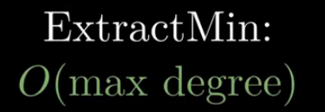
Inserts
We showed previously that the number of Inserts doesn't matter in an amortized analysis, so the complexity of ExtractMin is O(max degree).

Slide 14
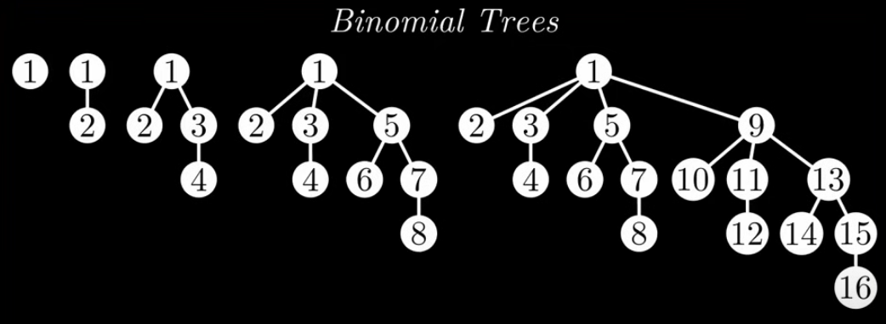

Also, the Clean up phase of ExtractMin and the merging of the trees by degree, generated a Binomial Tree:
A propriety of Binomial Trees is that

Slide 15
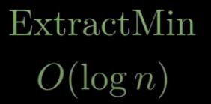
So, finally, we conclude that ExtractMin has a complexity of O(log n).

Slide 16
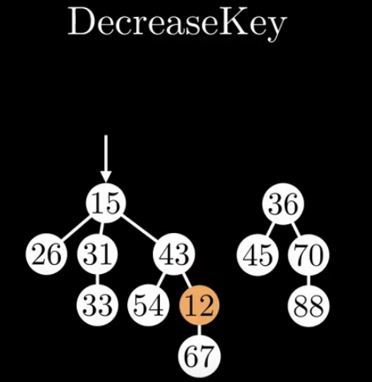
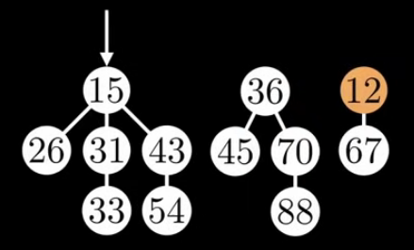
DECREASE KEY
For DecreaseKey we could just cut out the desired node and merge it to the heap, but doing this repeatedly will lead to the trees in the heap no longer being Binomial Trees, therefore losing the O(log n) complexity.

Slide 17
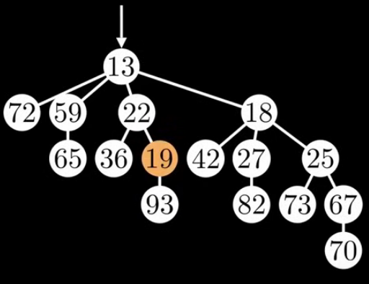
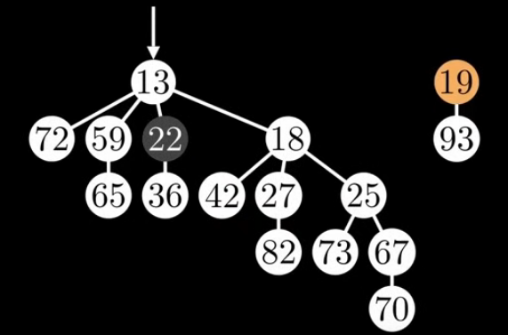
That's why we will introduce a new strategy: marking the parents of cut nodes, in order to keep degree low.

Slide 18
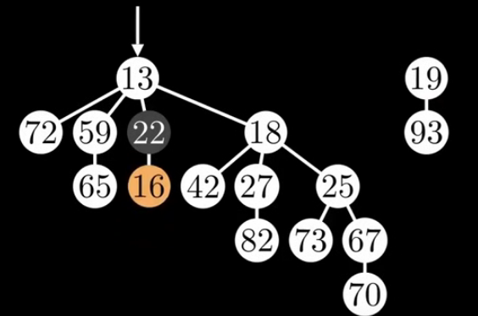
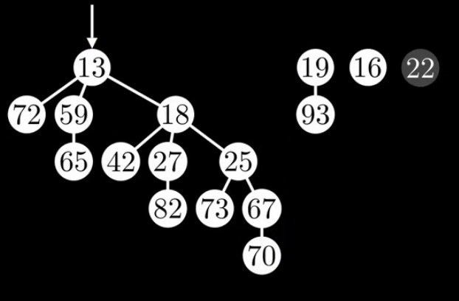

Slide 19
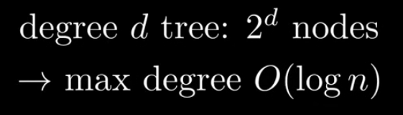
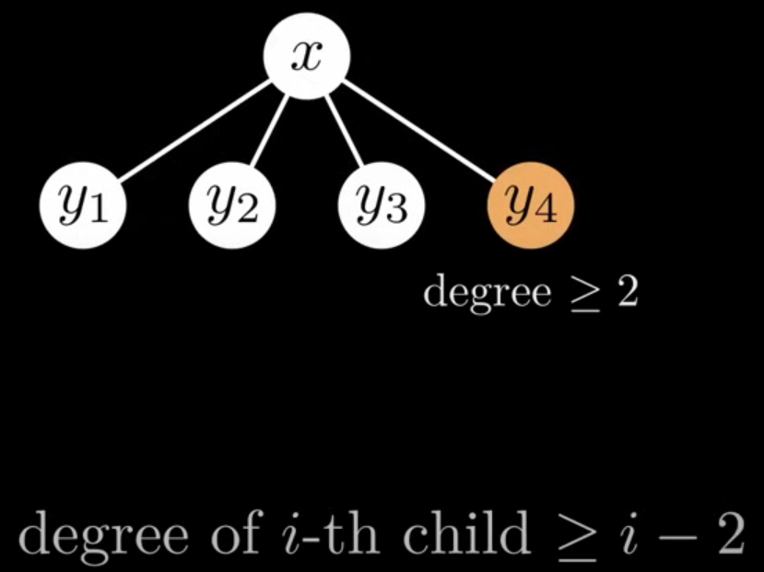
WHY FIBONACCI?
Now, the final questions is: Is ExtractMin still O(log n) after DecreseKey?
We showed that the trees produced by ExtractMin are Binomial Trees. They have
So, do the new trees, after DecreaseKey, grow exponentially?

Slide 20
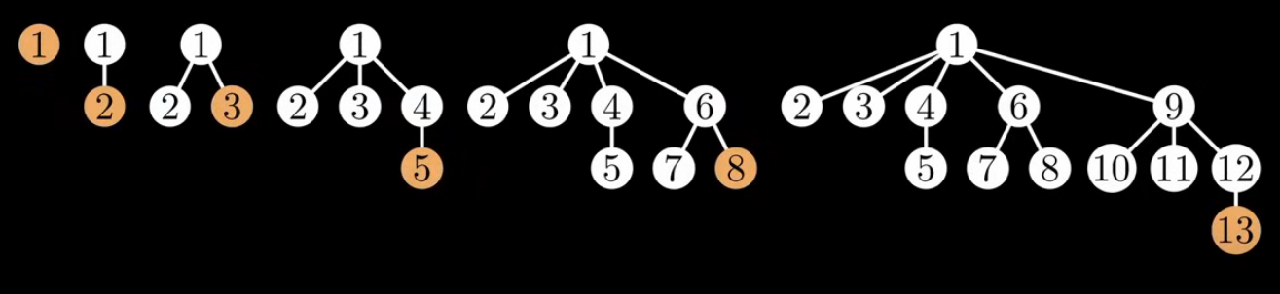

Now, when we construct the smaller posible tree for a certain degree with: degree of i-th child >= i - 2
degree of 4-th child >= 4 - 2 = 2
In conclusion, the trees in a Fibonacci Heap grow exponentially folowing the Fibonacci sequence and the golden ratio ⁠φ⁠. This gives ExtractMin O(log n) complexity.

Slide 21
Bibliography
https://www.youtube.com/watch?v=6JxvKfSV9Ns&t=1381s, SithDev

