Slide 1
PYTORCH
General Overview
Q4 2019

Slide 2

Agenda
What is PYTORCH
High Level Technical Overview
Potential User Cases

Slide 3
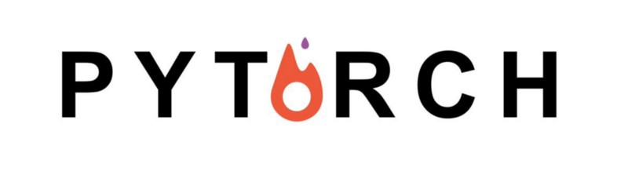
What Is PYTORCH

Slide 4
Overview
PyTorch is a Python based scientific computing package
It has a deep learning framework that provides maximum flexibility and speed during implementing and building deep neural network architectures.
PyTorch addresses 4 major challenge:
Extensive reworking
Time-consuming training
Python programming language inflexibility
Slow scale-up
https://docs.microsoft.com/en-us/azure/search/

Slide 5
2 Main Characteristics
Imperative Programming: a programming paradigm that uses statements that change a program's state.
Dynamic Computation Graphing: is a mutable system represented as a directed graph of data flow between operations.
Notes:
The demo we have is built using Basic tier

Slide 6
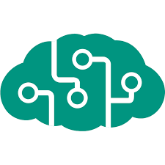
High Level Technical Overview

Slide 7
Main API
Torch
Torch.nn
Torch.cuda
Torch.tensor
Torchvision
Torchvision.dataset
Torchvision.io
Torchvision.models
Torchvision.transform
Torchaudio
Torchtext

Slide 8
Key Features
TorchScript
Distributed Training
Tools & Libraries
Cloud Partners
Native ONNX Support

Slide 9
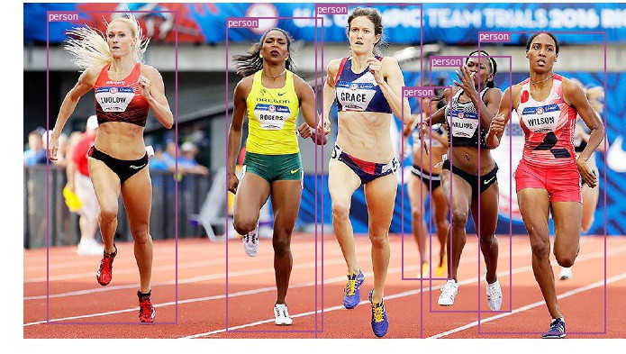
USE CASES

Slide 10
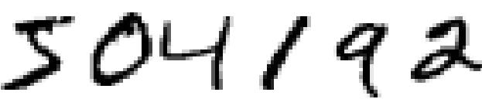
Use Case: Handwritten Digits Classification

Slide 11
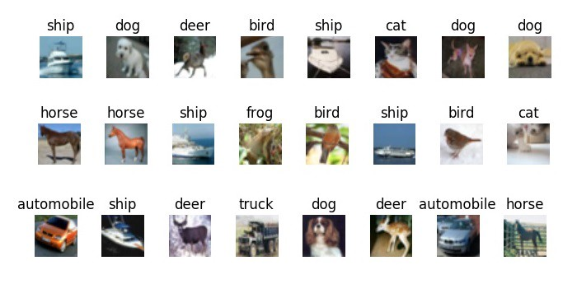
Use Case: Objects Image Classification

Slide 12
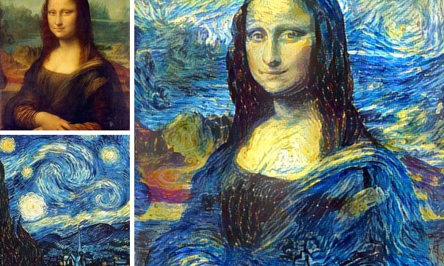
Use Case: Image Style Transfer

Slide 13
THANK YOU

