Slide 1
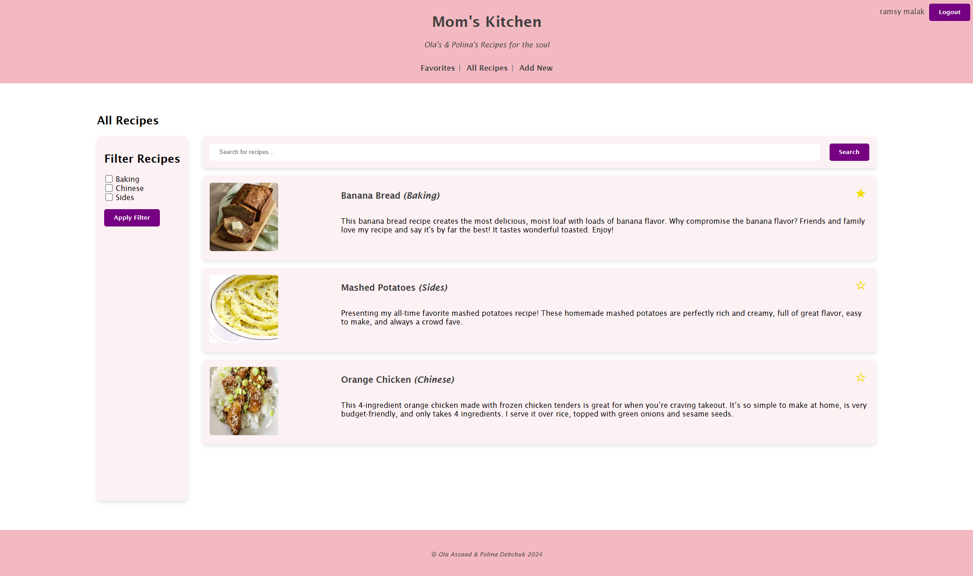
Notes:
Hello everyone!
The Mom’s Kitchen is created to add, edit, delete and show details of recipes.
There are implemented search and filtering features.

Slide 2
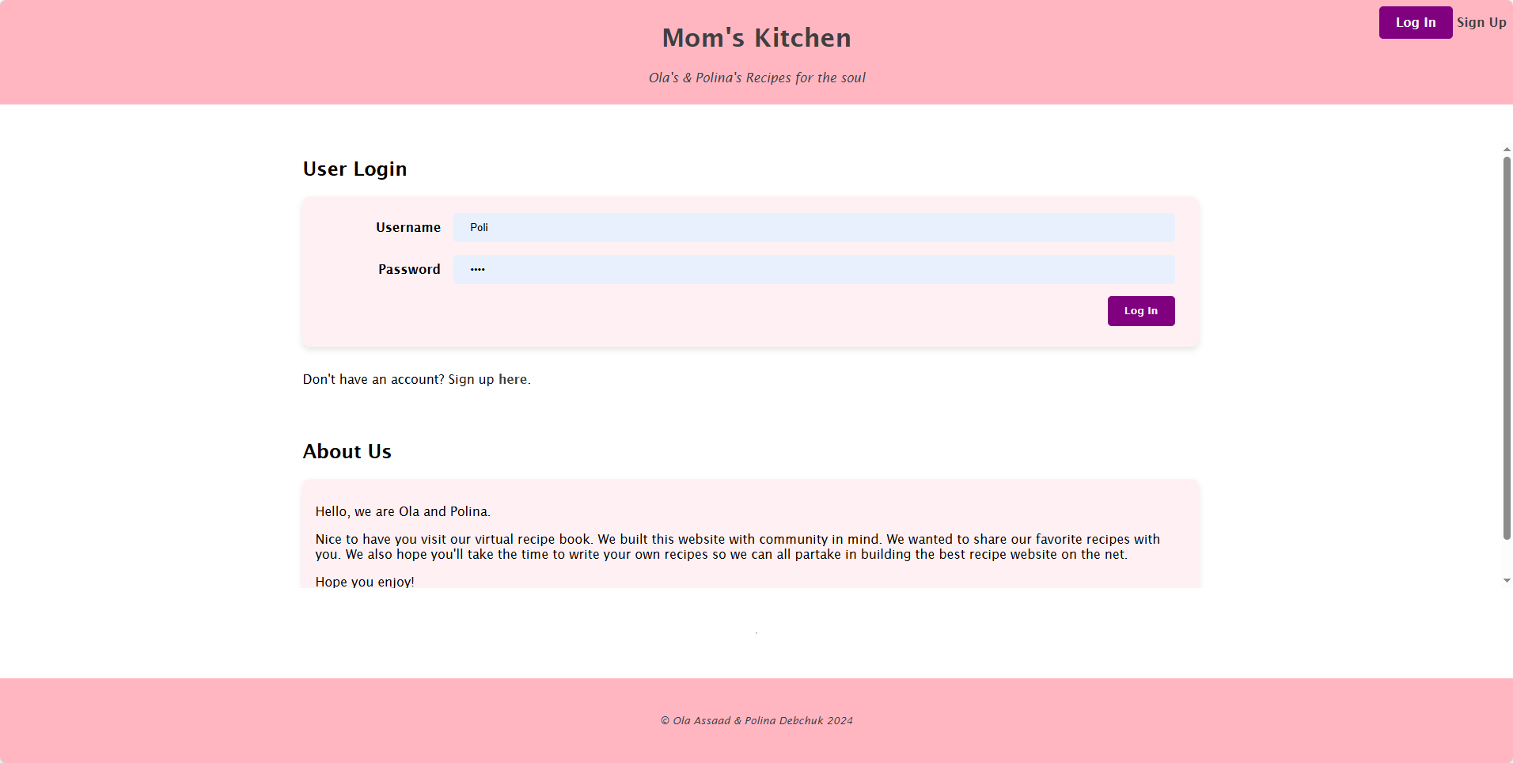
Notes:
This is the landing page, where the user can log in or create a new account.
User’s data is store in “users” table inside momskitchen database.
The momskitchen database is designed to manage a collection of recipes and user interactions within a web-based cooking or food-sharing application.

Slide 3
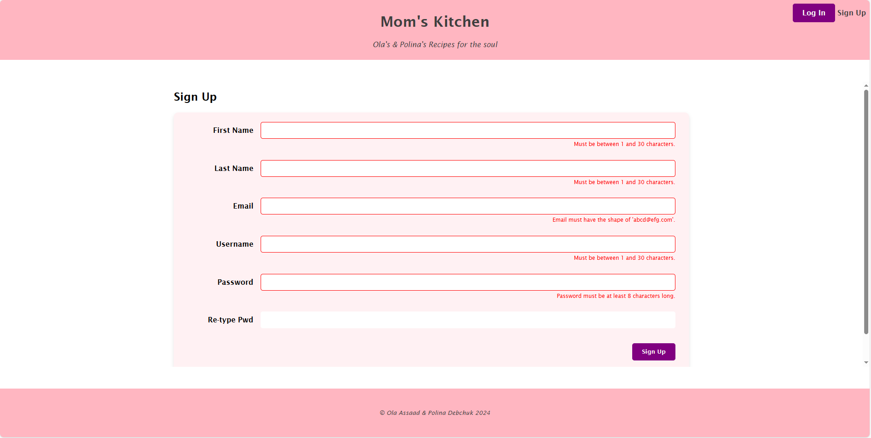
Notes:
This slide shows how is implemented a validation of user’s data input with a JavaScript so that user will submit form with correct/valid data.

Slide 4
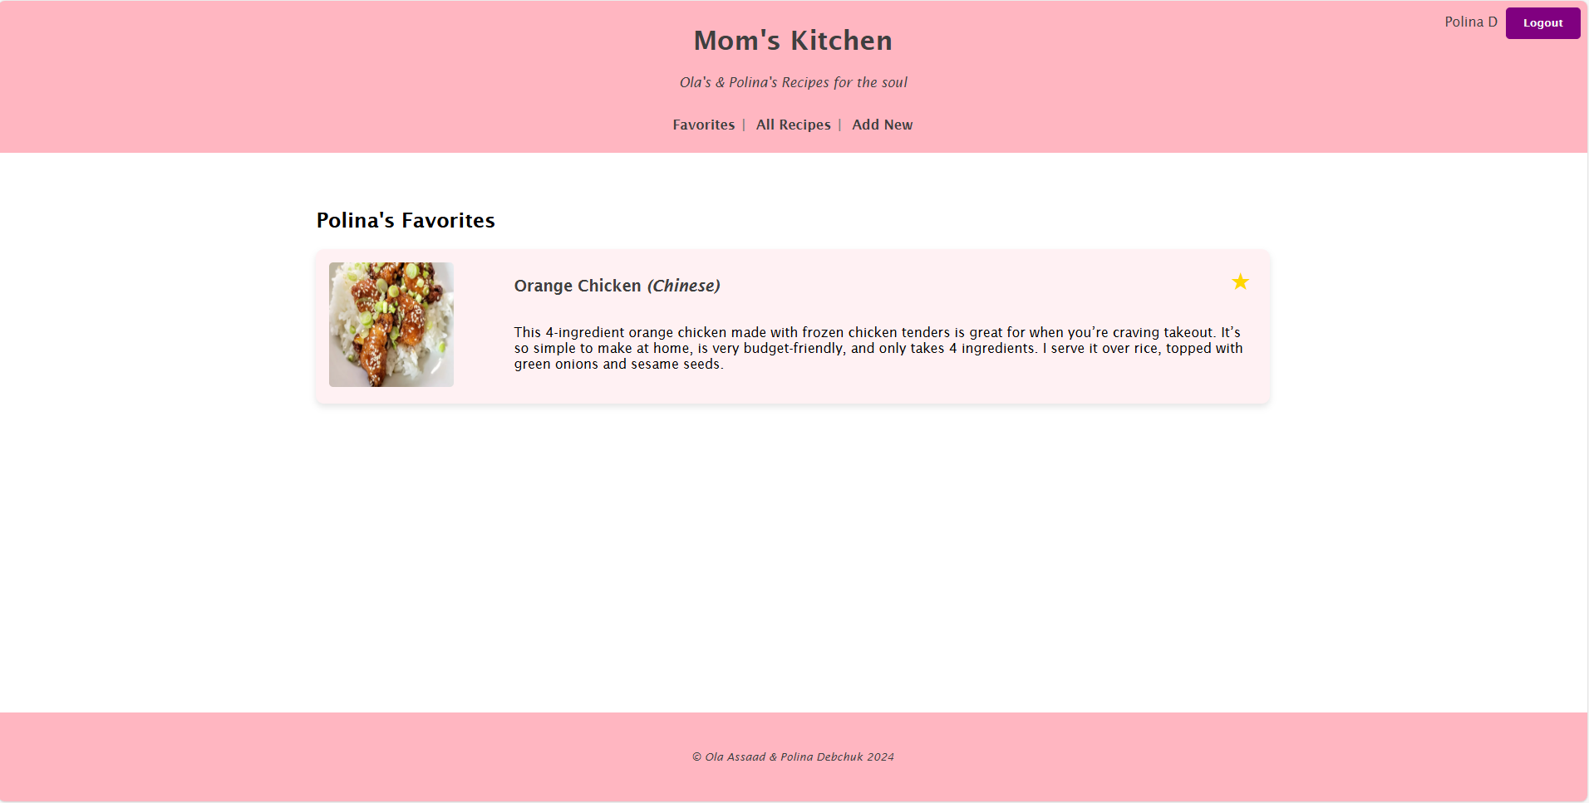
Notes:
User can add recipes to favorites (click on “star”). On this page will be list of all user’s favorits

Slide 5
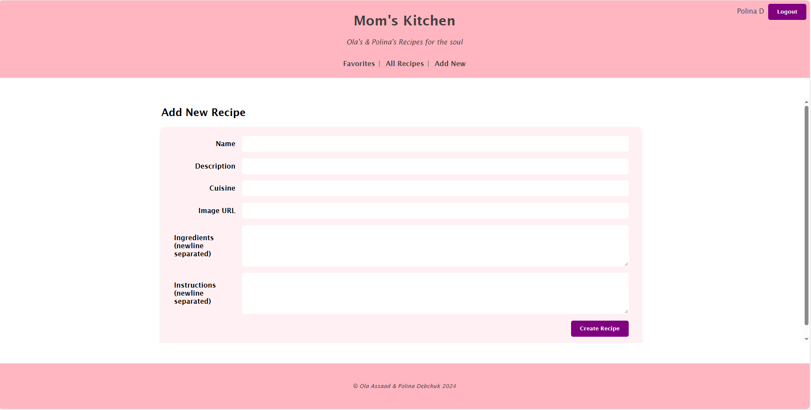
Notes:
User can create a new recipe and add it to list of all recipes, and lately choose it as a favorite

Slide 6
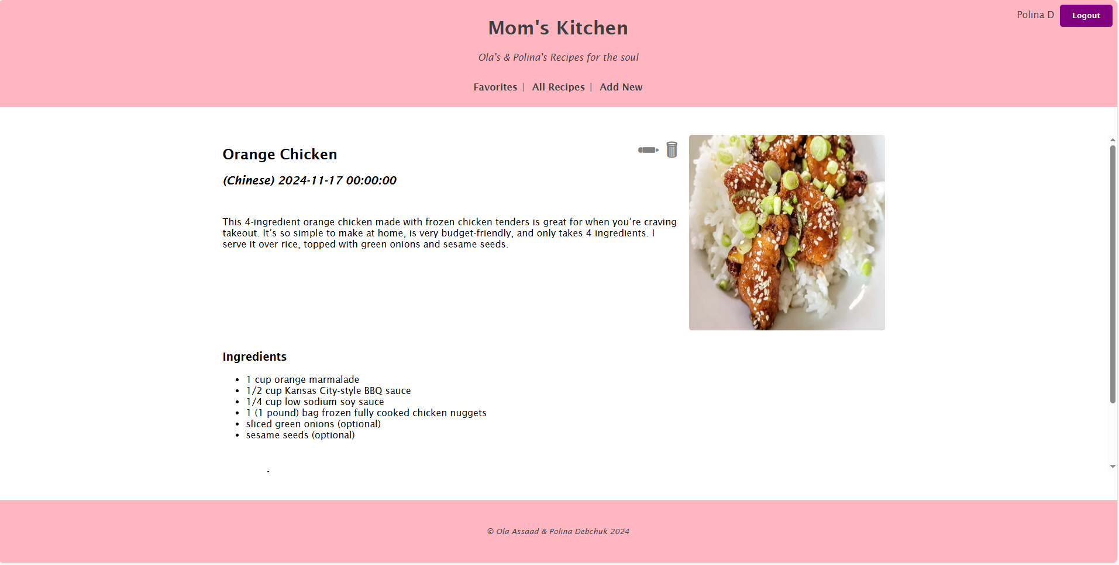
Notes:
Here you can see all recipe’s details.
Also, from here user can edit recipe (click on “pencil”) or delete (click on “recycle bin”)

Slide 7
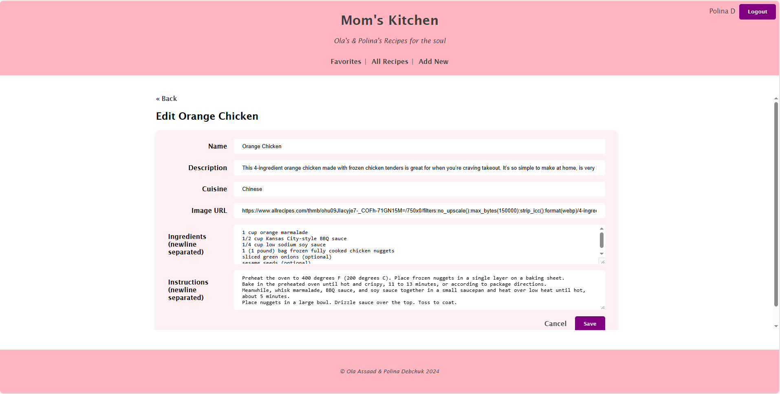
Notes:
edit

Slide 8
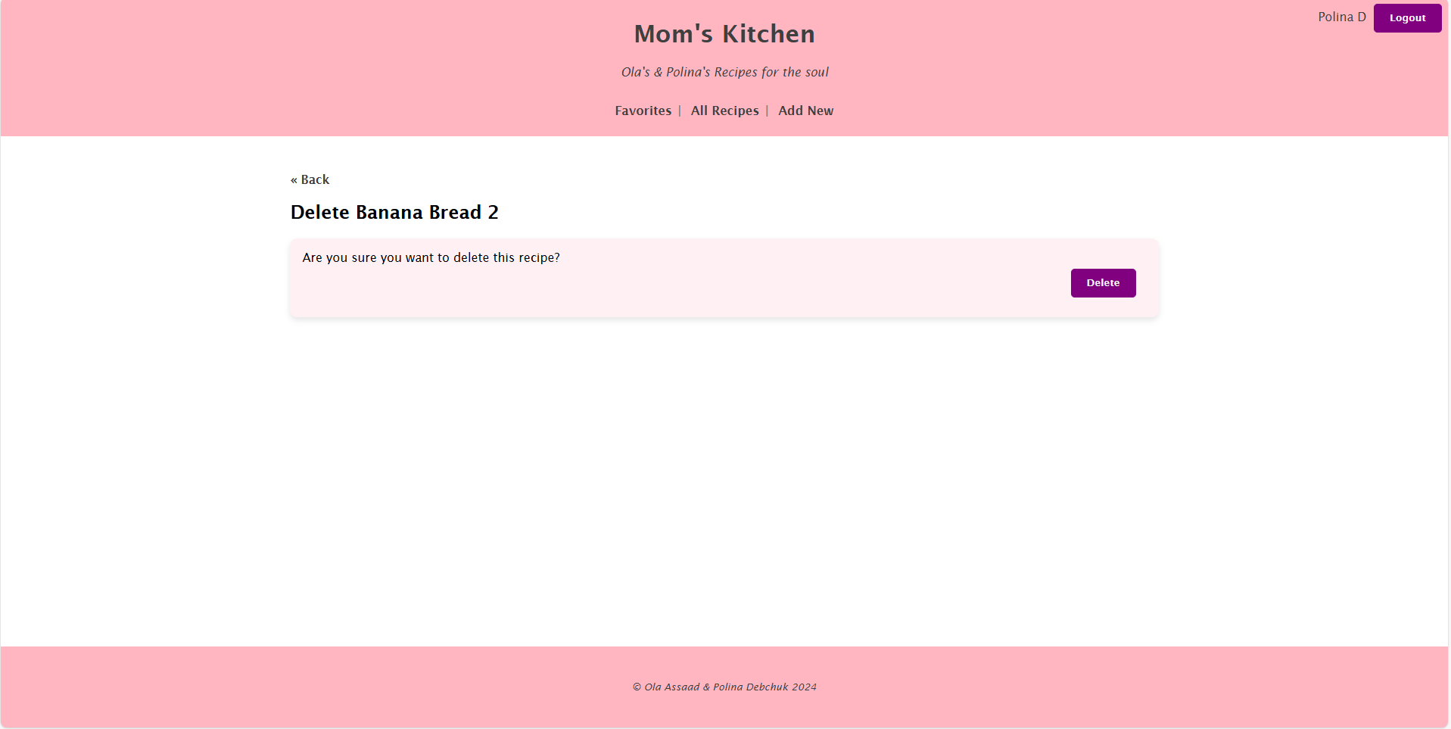
Notes:
When user wants to delete there is a confirmation message before deleting forever.

