Slide 1
Analysis of Clustered News
Daming Lu

Slide 2
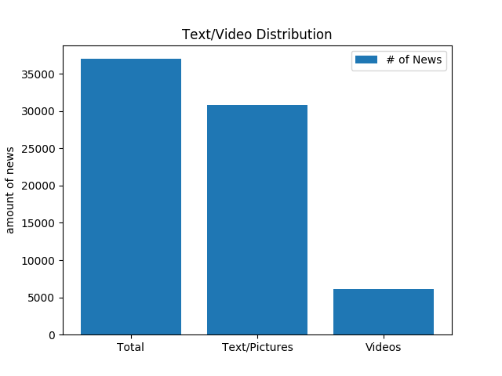
News Generation Amount
16538 topics in 1 hr
Each topic has an average of
1.86 text/image news
0.37 video news

Slide 3
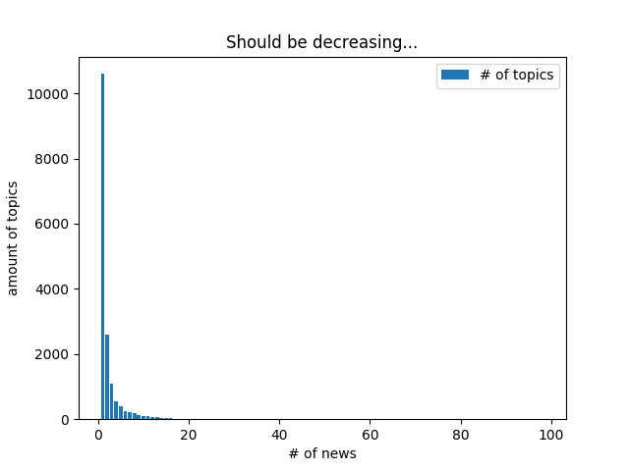
Long Tail
Max: 1 topic 98 news/videos
Min and Majority: 1 topic 1 news

Slide 4
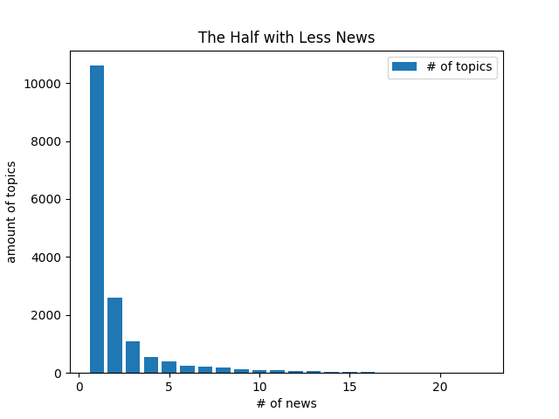
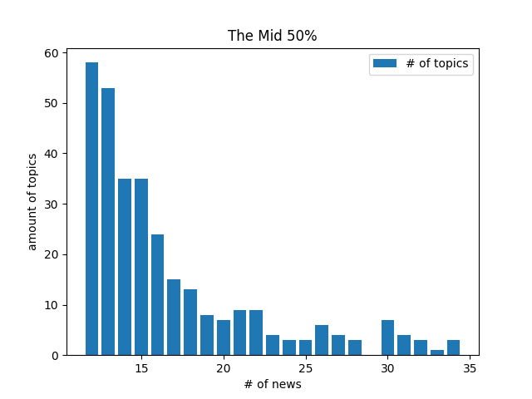
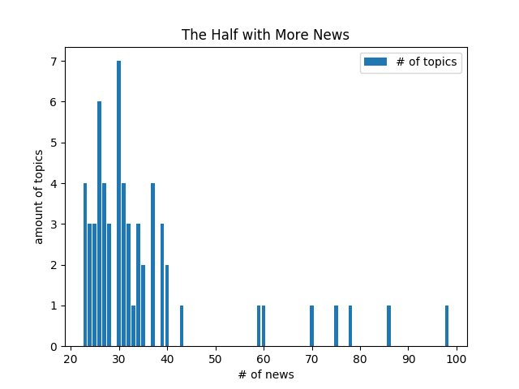
Closer Look

