Slide 1
One-Click ETL Generator
Team Members:
- Prajwal Goswami
- Swarali
- Saloni
- Nirupama
- Divya
AI-powered tool to simplify ETL pipeline creation via natural language and auto-generated code.

Slide 2
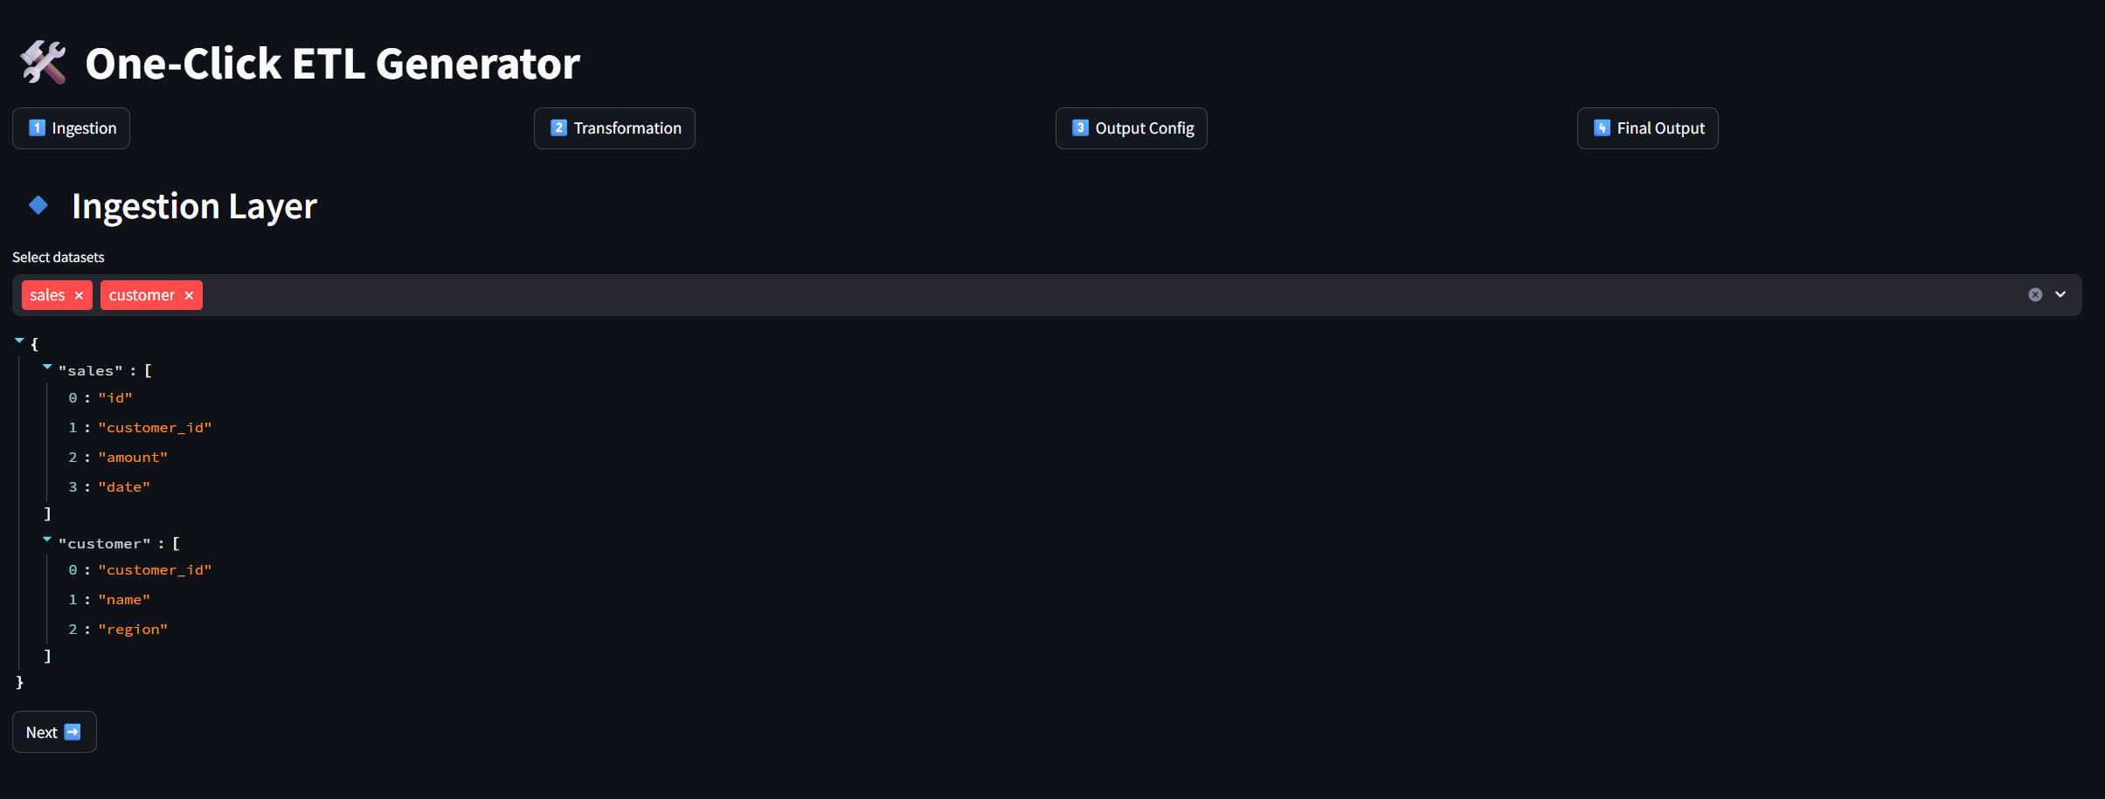
Problem Statement & Objectives
Traditional ETL is complex, time-consuming, and requires expert coding.
Objective: Simplify ETL development, enable users to create pipelines quickly using natural language.

Slide 3
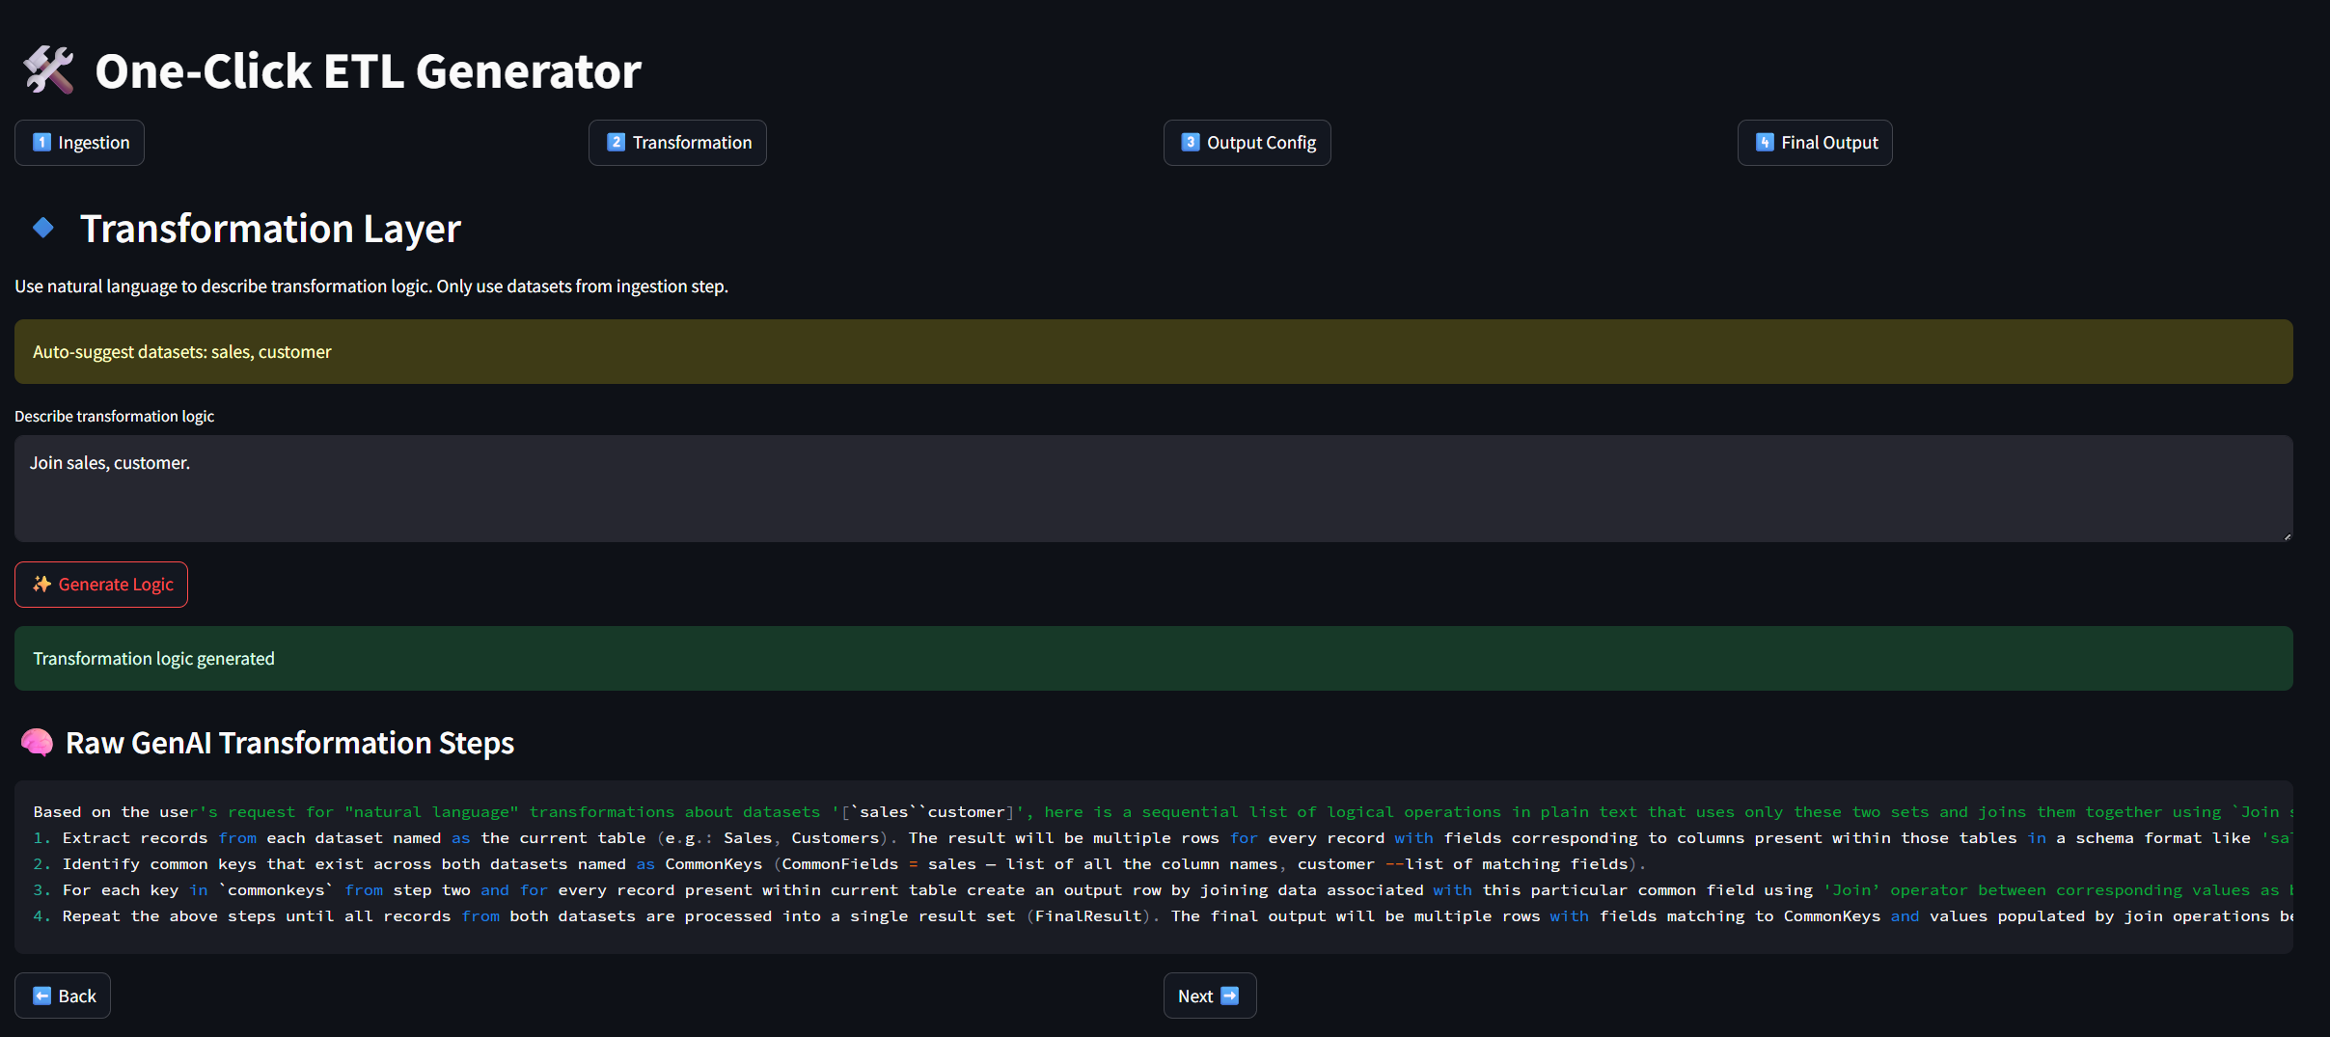
Solution Architecture
Frontend: Streamlit-based UI for dataset selection, transformation input, output config.
Backend: Python functions for SQL & PySpark code generation.
AI integration: Ollama model for generating transformation logic from natural language.
Session management for multi-step wizard-like experience.

Slide 4
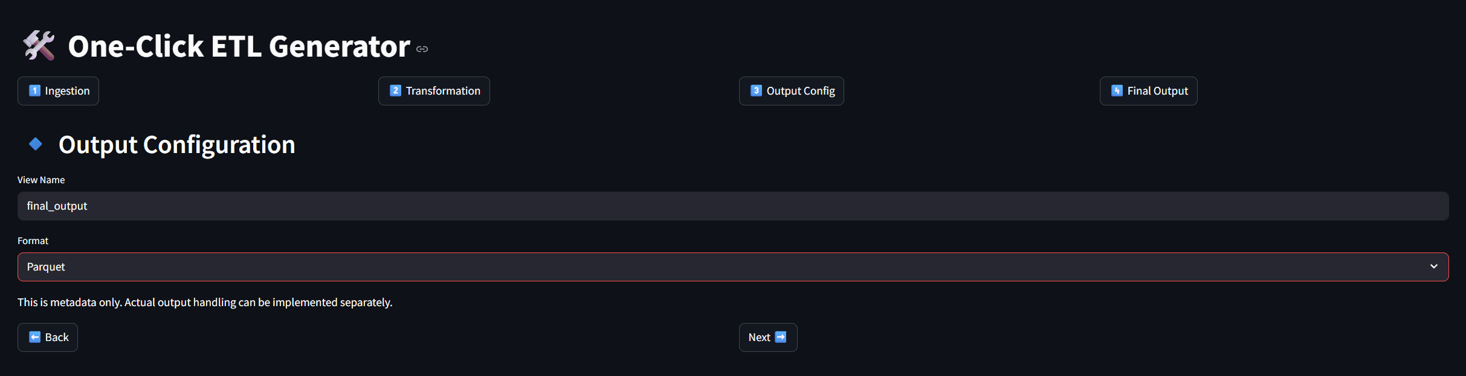
Functional Workflow
Dataset ingestion selection.
Describe transformation in natural language.
Output configuration (format, naming).
Final generated transformation steps, SQL, and PySpark code.

Slide 5
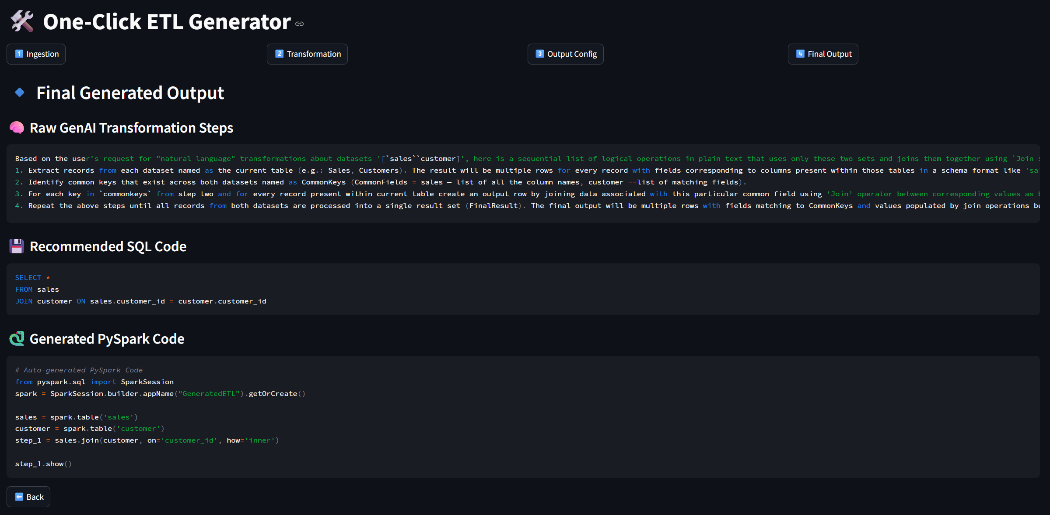
Future Work & Conclusion
Extend AI capabilities to handle complex transformations.
Integrate output with real ETL platforms for deployment.
Add collaboration features and version control in UI.
Summary and invite questions.

