Slide 1
ChronusMatch: A Low-Latency Order Matching and Trade Management System
Group -28

Slide 2
PROBLEM STATEMENT
In trading systems, multiple BUY and SELL orders are placed simultaneously and need to be processed efficiently to identify compatible orders and execute trades. Managing these orders requires proper prioritization based on price-time priority, accurate handling of complete and partial order execution, and effective order book management. Without an organized order matching mechanism, the system may face processing delays, difficulties in tracking orders, and inconsistencies in order and trade records. Therefore, ChronusMatch aims to develop an efficient order matching system that processes BUY and SELL orders, executes trades based on matching conditions, supports order cancellation, and maintains persistent order and trade information for reliable and consistent operations.

Slide 3
OBJECTIVES
Develop REST APIs for BUY and SELL order management.
Implement price-time priority-based order matching.
Maintain an organized order book.
Support complete and partial order execution.
Implement order cancellation.
Store orders and trades using SQLite.
Provide trade history, statistics, and order book information.
Support data recovery after backend restart.

Slide 4
PROPOSED SYSTEM
ChronusMatch is an order matching application that processes BUY and SELL orders and executes trades when matching conditions are satisfied.
Key Features:
Order submission and validation.
Automated order matching.
Price-time priority.
Partial order execution.
Order book management.
Trade history and persistence.
Dashboard-based monitoring.

Slide 5
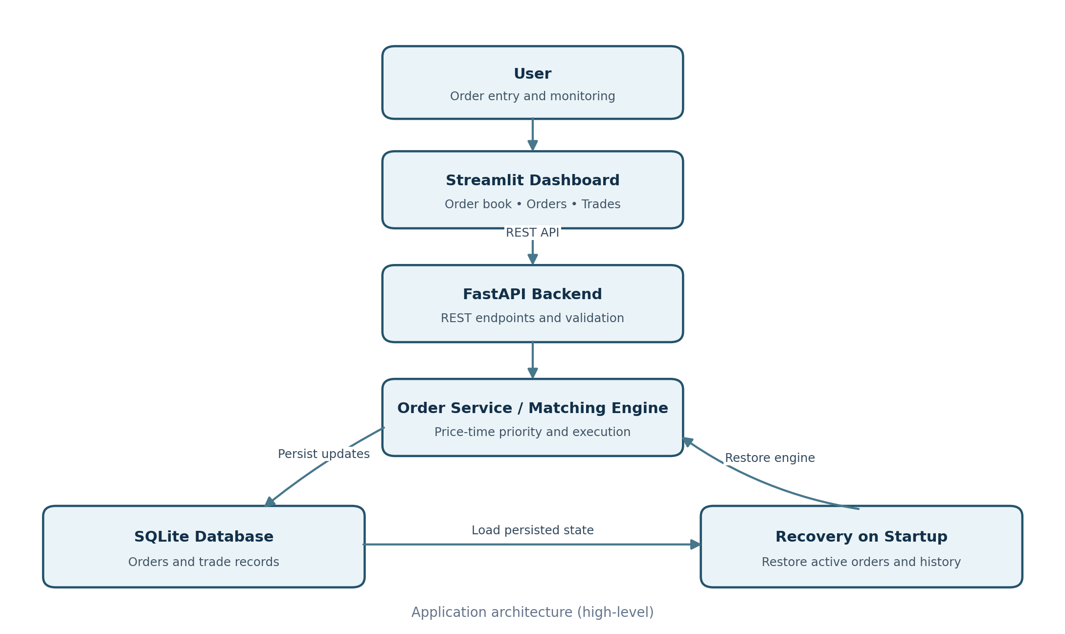
SYSTEM ARCHITECTURE

Slide 6
IMPLEMENTAION
1. Backend Development: Developed the backend using Python and FastAPI to handle incoming requests and provide REST APIs.
2. Order Management: Implemented BUY and SELL order creation, retrieval, and cancellation functionalities.
3. Matching Engine Integration: Integrated the matching engine to process orders based on price-time priority.
4. Order Book Management: Maintained active BUY and SELL orders with their prices, quantities, and statuses.
5. Trade Execution: Implemented complete and partial order execution when compatible orders are matched.
6. Database Integration: Used SQLite to store order details and executed trade records.
7. Database Repository: Implemented database operations for creating, retrieving, and updating orders and trades.
8. Persistence and Recovery: Implemented recovery functionality to restore active orders and trade history after backend restart.
9. API Development: Developed REST endpoints for orders, trades, statistics, and order book information.
10. Testing: Used Postman and Pytest to verify API functionality, order processing, validation, cancellation, and database recovery.
11. Dashboard Integration: Integrated the Streamlit dashboard with the FastAPI backend to interact with and monitor trading activities.

Slide 7
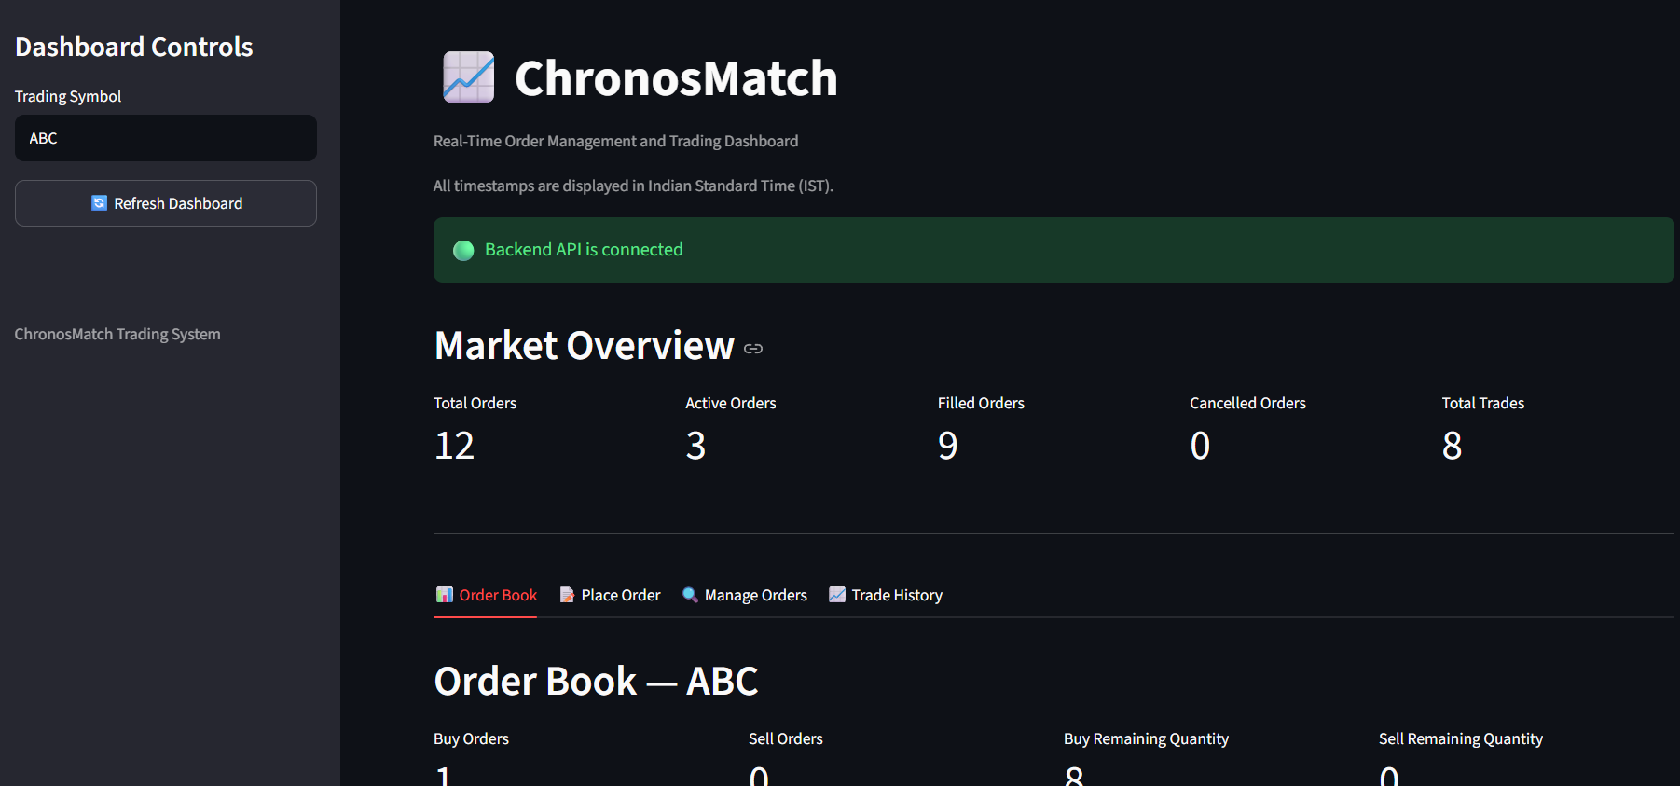
DASHBOARD

Slide 8
FUTURE SCOPE
Improve order matching performance.
Reduce order processing latency.
Support higher order volumes.
Introduce real-time dashboard updates.
Improve database transaction handling.
Add authentication and authorization.
Perform latency and throughput benchmarking.
Enhance system monitoring and scalability.

Slide 9
CONCLUSION
ChronusMatch provides an integrated order matching system.
Supports BUY and SELL order processing using price-time priority.
Handles complete and partial trade execution.
Maintains an organized order book.
Provides persistent order and trade storage.
Integrates FastAPI backend with a Streamlit dashboard.
Establishes a foundation for future performance and scalability improvements.

Slide 10
THANK YOU

