Slide 2
Scope of a modernization / migration is restricted to Application Code

Slide 3
APPROACH
Key good practices
Information sharing based on a central collaborative platform
● Simplified knowledge transfer, with least effort approach: no issue solved twice.
● Wipro Consulting, Customer Portal, Knowledgebase, Support, Documentation, Trainings.
Reuse, automate, standardize as much as possible
● Infrastructure, deployments, tests, dependencies, stages, processes, management
● Transform: Red Hat Application Migration Toolkit, Spring Migration Analyzer
Efficient, proven, pragmatic methodology
● As few changes as possible to get a running functionally identical application
● Holistic portfolio approach for green and brown fields
● Scaling through a factory delivery model

Slide 4

METHODOLOGY
Iterative, managed service, factory scale up

Slide 5
Tools Used to Analyze
Red Hat Application Migration Toolkit
Red Hat Application Migration Toolkit is an assembly of open source tools that enables large-scale application migrations and modernizations. The tooling consists of multiple individual components that provide support for each phase of a migration process. The migrations supported include application platform upgrades, migrations to a cloud-native deployment environment, and also migrations from several commercial products to the Red Hat JBoss Enterprise Application Platform
Spring Migration Analyzer
Spring Migration Analyzer is a command-line tool that can be used to analyze Java EE applications and produce a report that describes the application and how it can be migrated to Spring.

Slide 6
High-level Steps for Migration
Identify the Sample EAR project and ensure the code is in github and all developers have access to this repository
Create a separate branch “migration” & Checkout code on local working directory
Run Red hat Application Migration Toolkit and Spring Analyzer tool. (subsequent slides has the details on how to use and Analysis report)
Identify the “entity” or database-table specific resource for migration
Create a new folder with the entity name; example if its items then create folder called as “items-service”
Create the spring boot specific files in the new project
Create RESTful endpoint to access this database
Check the business logic used for working with items
Call the restful service instead of session bean in the UI/client code
Run both spring boot and the ear
UI should work as expected

Slide 7
AMT Tool
https://developers.redhat.com/products/rhamt/download/
./rhamt-cli --input /path/to/simple-sample-app.ear --output /path/to/output/ --source weblogic --target eap:7 --packages com.acme
This command uses the following options:
--input: Path to the application to analyze.
--output: Output directory for the generated reports.
--source: Source technology of the application.
--target: Target technology for the application migration.
--packages: List of packages to evaluate.

Slide 8
List of Target Technologies
Available target technologies:
camel
cloud-readiness
drools
eap
eap6
eap7
fsw
fuse
hibernate
hibernate-search
java-ee
jbpm
linux
openjdk
resteasy

Slide 9
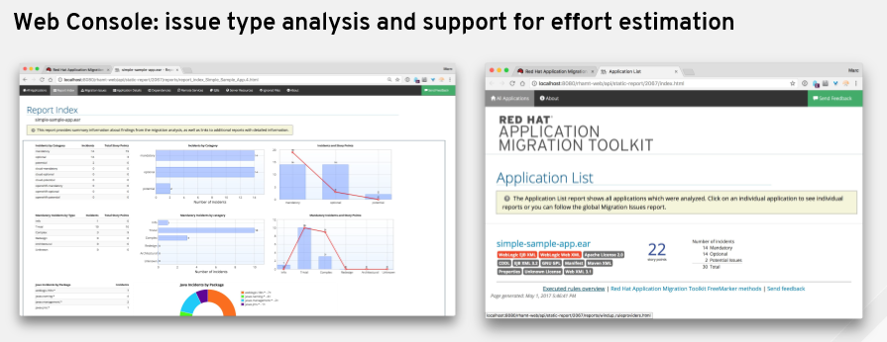
Report for analysis

Slide 10
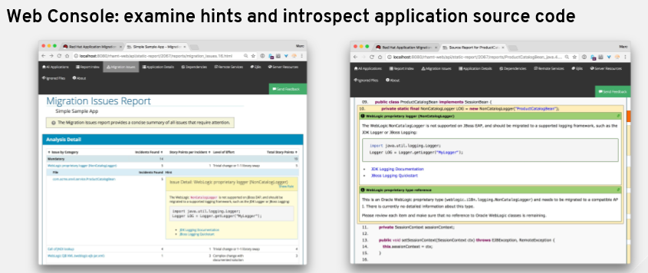
Report for analysis (contd…)

Slide 11
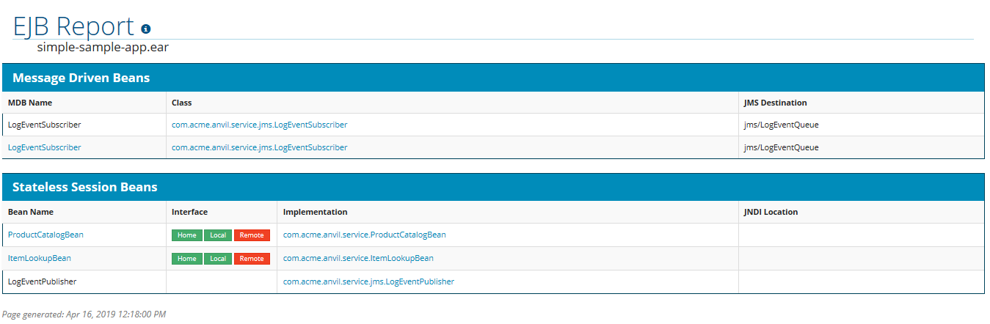
Report for analysis (contd…)

Slide 12
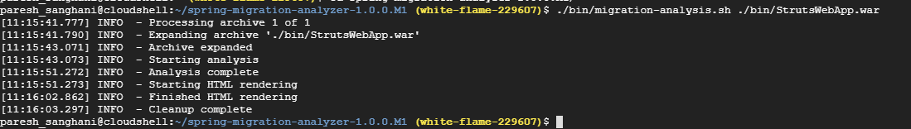
Spring Migration Analyzer
https://docs.spring.io/spring-migration-analyzer/docs/1.0.0.M1/user-guide/htmlsingle/

Slide 13
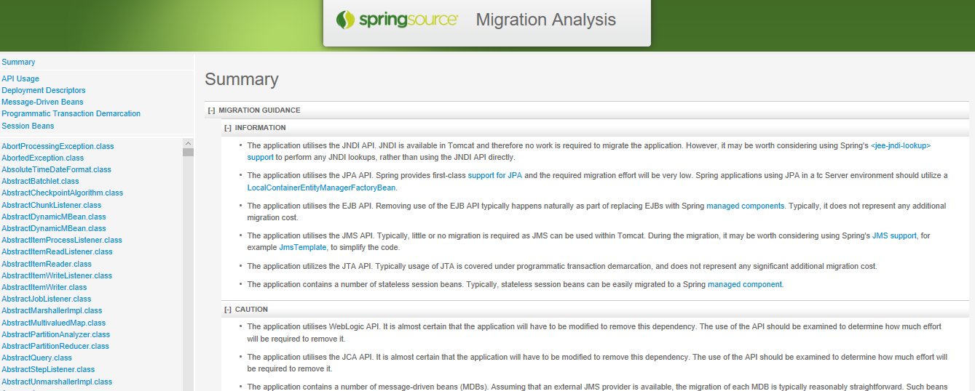
Spring Migration Analysis Summary

Slide 14
Github URL
https://github.com/PA20063329/monolithic-web

